Slide 1
APPOINTMENT
FHIR

Slide 2
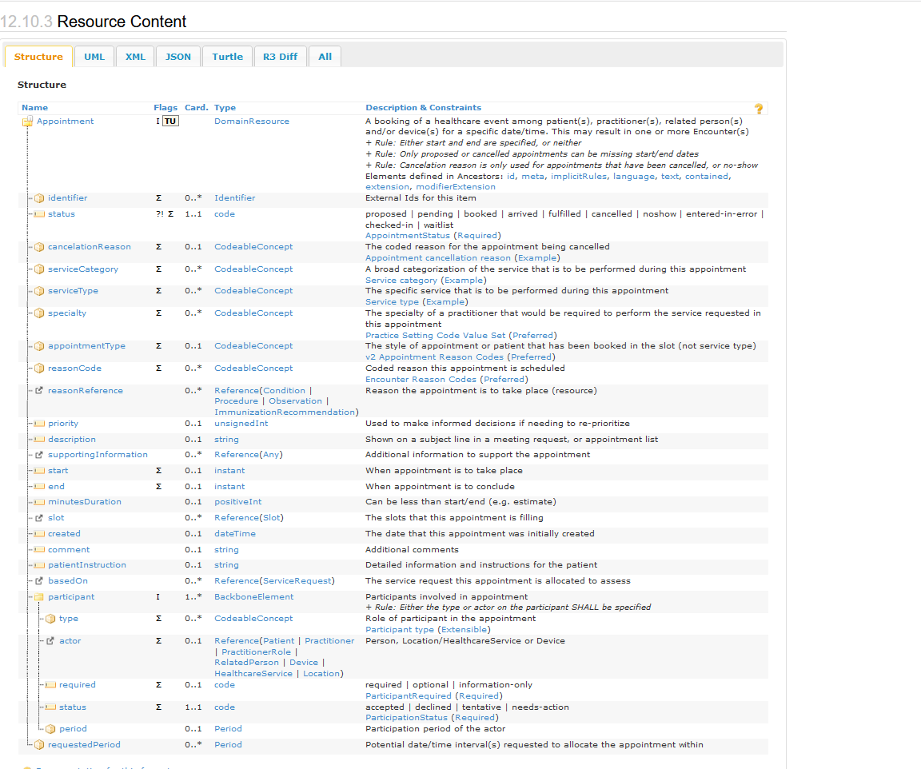
Notes:
url : https://www.hl7.org/fhir/slot.html

Slide 3
service-category
Code | Display | Definition
2 | Aged Care | Aged Care
17 | General Practice | General Practice/GP (doctor)
26 | Specialist Clinical Pathology | Specialist Clinical Pathology – requires referral
27 | Specialist Medical | Specialist Medical – requires referral
30 | Specialist Radiology/Imaging | Specialist Radiology/Imaging – requires referral
https://www.hl7.org/fhir/valueset-service-category.html
This value set contains 38 concepts
Examples:

Slide 4
service-type
Code | Display | Definition
4 | Aged Residential Care | Aged Residential Care
8 | Personal Care for Older Persons | Personal Care for Older Persons
165 | Cardiology | Cardiology
176 | Nephrology | Nephrology
382 | Medical Services | Medical Services
https://www.hl7.org/fhir/valueset-service-type.html
This value set contains 596 concepts
Examples:

Slide 5
specialty
Code | Display
394811001 | Geriatric medicine
394914008 | Radiology
394579002 | Cardiology
394589003 | Nephrology
394814009 | General practice
https://www.hl7.org/fhir/valueset-c80-practice-codes.html
Include these codes as defined in http://snomed.info/sct
Examples:

Slide 6
appointmentType
Code | Display
CHECKUP | A routine check-up, such as an annual physical
EMERGENCY | Emergency appointment
FOLLOWUP | A follow up visit from a previous appointment
ROUTINE | Routine appointment – default if not valued
WALKIN | A previously unscheduled walk-in visit
https://www.hl7.org/fhir/v2/0276/index.html
Examples:

Slide 7
AppointmentStatus
Code | Display
proposed | Proposed
pending | Pending
booked | Booked
arrived | Arrived
fulfilled | Fulfilled
cancelled | Cancelled
noshow | No Show
entered-in-error | Entered in error
checked-in | Checked In
waitlist | Waitlisted
http://hl7.org/fhir/appointmentstatus
Examples:

Slide 8
actor
Type
Patient
Practitioner
PractitionerRole
RelatedPerson
Device
HealthCareService
Location
Slots that reference this schedule resource provide the availability details to these referenced resource(s)

Slide 9
