Slide 1
SLOT
FHIR

Slide 2
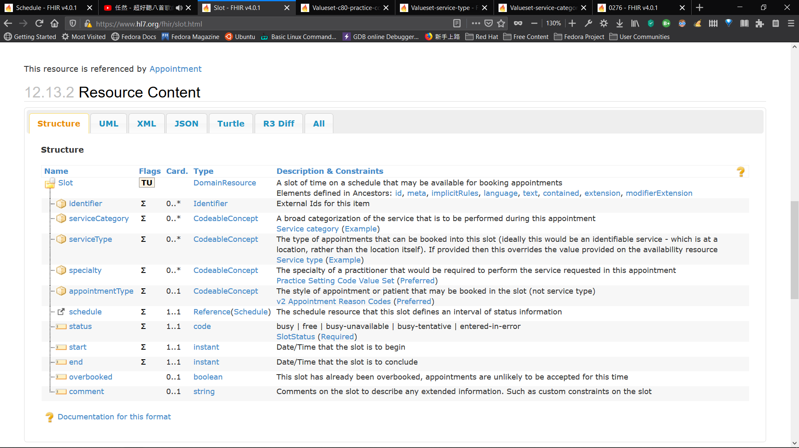
Notes:
url : https://www.hl7.org/fhir/slot.html

Slide 3
service-category
Code | Display | Definition
2 | Aged Care | Aged Care
17 | General Practice | General Practice/GP (doctor)
26 | Specialist Clinical Pathology | Specialist Clinical Pathology – requires referral
27 | Specialist Medical | Specialist Medical – requires referral
30 | Specialist Radiology/Imaging | Specialist Radiology/Imaging – requires referral
https://www.hl7.org/fhir/valueset-service-category.html
This value set contains 38 concepts
Examples:

Slide 4
service-type
Code | Display | Definition
4 | Aged Residential Care | Aged Residential Care
8 | Personal Care for Older Persons | Personal Care for Older Persons
165 | Cardiology | Cardiology
176 | Nephrology | Nephrology
382 | Medical Services | Medical Services
https://www.hl7.org/fhir/valueset-service-type.html
This value set contains 596 concepts
Examples:

Slide 5
specialty
Code | Display
394811001 | Geriatric medicine
394914008 | Radiology
394579002 | Cardiology
394589003 | Nephrology
394814009 | General practice
https://www.hl7.org/fhir/valueset-c80-practice-codes.html
Include these codes as defined in http://snomed.info/sct
Examples:

Slide 6
appointmentType
Code | Display
CHECKUP | A routine check-up, such as an annual physical
EMERGENCY | Emergency appointment
FOLLOWUP | A follow up visit from a previous appointment
ROUTINE | Routine appointment – default if not valued
WALKIN | A previously unscheduled walk-in visit
https://www.hl7.org/fhir/v2/0276/index.html
Examples:

Slide 7
SlotStatus
Code | Display
busy | Busy
free | Free
busy-unavailable | Busy ( Unavailable )
busy-tentative | Busy ( Tentative )
entered-in-error | Entered in error
https://www.hl7.org/fhir/valueset-slotstatus.html
Examples:

Slide 8
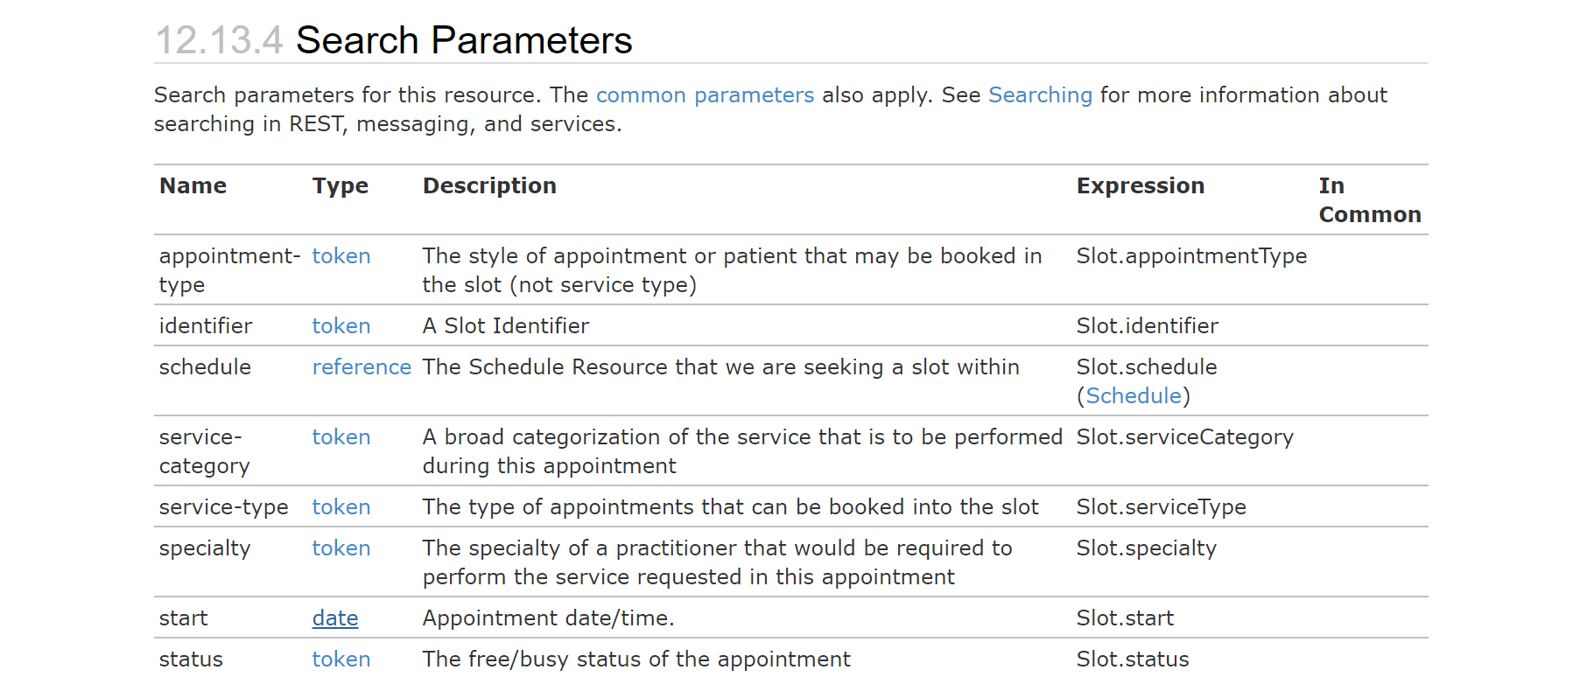
Notes:
url : https://www.hl7.org/fhir/slot.html

Slide 9
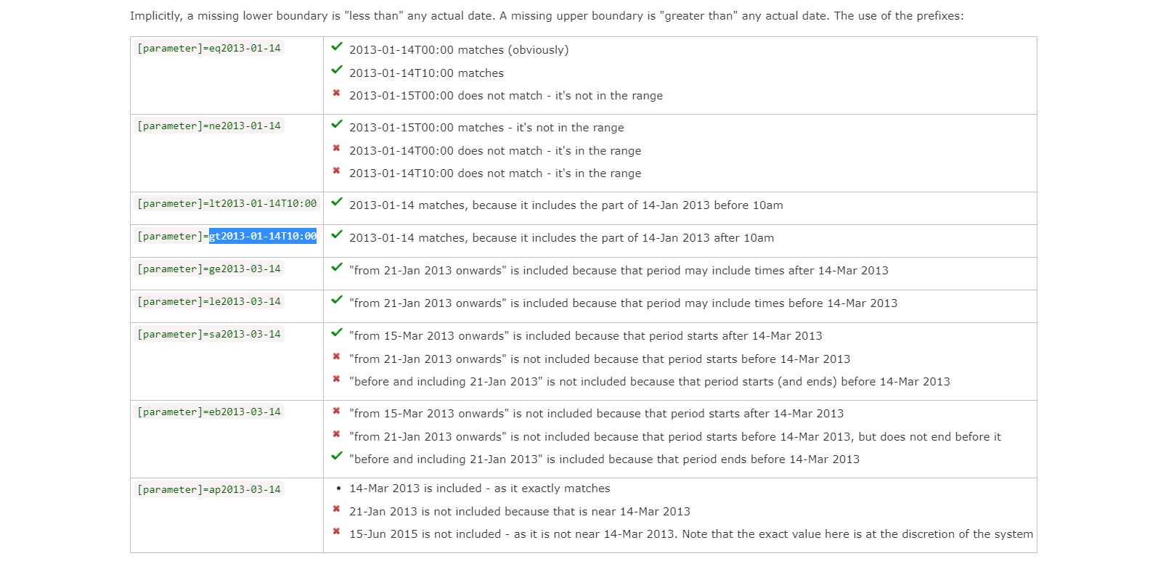
Notes:
url : https://www.hl7.org/fhir/slot.html

Slide 10
Handling Of Booking Limit
Notes:
url : https://www.hl7.org/fhir/slot.html

Slide 11
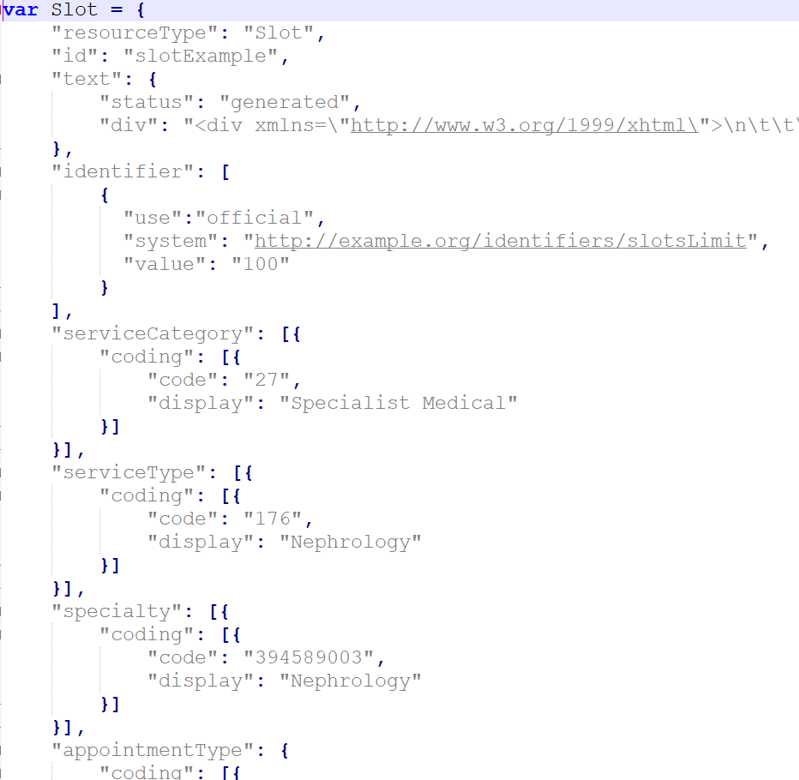
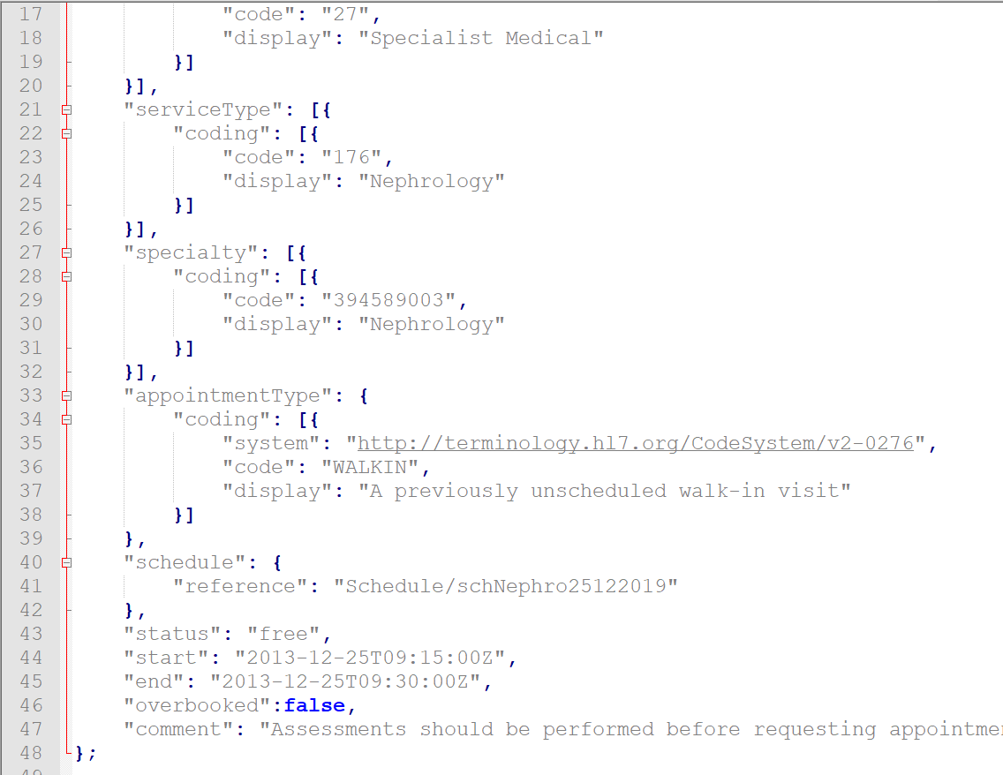
Handling Of Booking Limit

