Slide 1
JavaScript 函式&事件&Dialog
By Yuting Wu
2020/2/21

Slide 2
建立JavaScript函式
<script>
function 函式名稱 (參數1,參數2,...)
{
要執行的程式碼
}
</script>
函數名稱由英文字母、數字、及 _ 組成
括號()內 : 可能包括參數名，以逗號分隔
Notes:
For 99 乘法表

Slide 3
物件建構子函數Object Constructor
何時使用? 當物件擁有共同的屬性
function Person(firstname,lastname,age,eyecolor)
{
person.firstName = firstname;
person.lastName = lastname;
person.age = age;
person.eyeColor=eyecolor;
}
https://www.w3schools.com/js/tryit.asp?filename=tryjs_object_constructor4

Slide 4
如何呼叫函式 Function(1)
程式中直接呼叫
<script>
//宣告函式
function myfunction( )
{
alert("hello!");
}
myfunction( ); // 程式當中呼叫
</script>

Slide 5
如何呼叫函式 Function(2)
事件啟動(event driven)
滑鼠、鍵盤、時間等事件
<button onclick=“myFunction()”>Click me</button>
<script>
function myfunction( )
{
alert("hello!");
}
</script>

Slide 6
return:函式回應結果
遇到return，函式就會停止執行。回傳 return value
<script>
var result; //儲存結果 function myfunction(a, b) { return a * b; }
//回傳 a*b
result=myfunction(2,3);
document.write("相乘結果 ="+ result);
</script>

Slide 7
遞迴
自己呼叫自己
function factorial(n) {
if (n === 0) {
return 1;
}
return n * factorial(n - 1);
}
例如：輸入 n=5
第1次：5* factorial(5-1)
第2次：4* factorial(4-1)
第3次：3* factorial(3-1)
第4次：2* factorial(2-1)
第5次：1* factorial(1-1)

Slide 8
範例練習一
找出最大值
<body>
<p>Finding the largest number.</p>
<p id="demo"></p>
<script>
function findMax() {
var i;
var max=0;
for(i = 0; i < arguments.length; i++) {
if (arguments[i] > max) {
max = arguments[i];
}
}
return max;
}
//計算平均值練習
document.getElementById("demo").innerHTML = findMax(110, 125, 90);
</script>
</body>
https://www.w3schools.com/js/tryit.asp?filename=tryjs_function_arguments

Slide 9
範例練習二
<script>
// Constructor function for Person objects
function Person(first, last, age, eye) {
this.firstName = first;
this.lastName = last;
this.age = age;
this.eyeColor = eye;
this.name = function() {
return "My Name is " + this.firstName + " " + this.lastName
};
}
// Create a Person object
var myFather = new Person("John", "Doe", 50, "blue");
// Display full name
document.getElementById("demo").innerHTML =
myFather.name();
</script>
https://www.w3schools.com/js/tryit.asp?filename=tryjs_object_constructor6
Notes:
新增輸入框 按鈕顯示結果 將function 獨立出來

Slide 10


事件 Event
可以用來監測使用者的Events 行為
通常會搭配函式來使用
物件觸發事件
不同的物件有不同的事件
觸發事件

Slide 11
常見事件 Event
事件名稱 | 說明
onchange | An HTML element has been changed
onclick | The user clicks an HTML element
onmouseover | The user moves the mouse over an HTML element
onmouseout | The user moves the mouse away from an HTML element
onkeydown | The user pushes a keyboard key
onload | The browser has finished loading the page
https://www.w3schools.com/jsref/dom_obj_event.asp

Slide 12
範例-onchange
<body>
<p>Select a new car from the list.</p>
<select id="mySelect" onchange="myFunction()">
<option value="Audi">Audi</option>
<option value="BMW">BMW</option>
<option value="Mercedes">Mercedes</option>
<option value="Volvo">Volvo</option>
</select>
<p id="demo"></p>
<script>
function myFunction() {
var x = document.getElementById("mySelect").value;
document.getElementById("demo").innerHTML = "You selected: " + x;
}
</script>
</body>
https://www.w3schools.com/jsref/tryit.asp?filename=tryjsref_onchange

Slide 13
範例:addEventListener
<body>
<p>Press a key inside the text field to set a red background color.</p>
<input type="text" id="demo">
<script>
document.getElementById("demo").addEventListener("keypress", myFunction);
document.getElementById("demo").addEventListener("keyup", myFunction2);
function myFunction() {
document.getElementById("demo").style.backgroundColor = "red";
}
function myFunction2() {
document.getElementById("demo").style.backgroundColor = "blue";
}
</script>
</body>
https://www.w3schools.com/jsref/tryit.asp?filename=tryjsref_onkeypress_addeventlistener

Slide 14
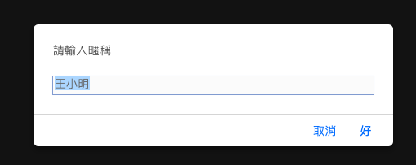
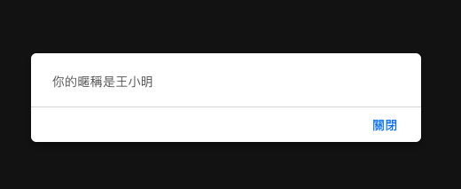
Dialog
Alert:彈出提示窗
Prompt：彈出輸入框
var nickname = prompt("請輸入暱稱", "王小明");
alert("你的暱稱是" + nickname);
Confirm：彈出確認框(確認,取消)

Slide 15
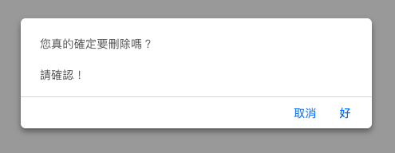
Dialog-Confirm
<script>
function del()
{
var msg = "您真的確定要刪除嗎？\n\n請確認！";
if (confirm(msg)==true)
{
alert("確定");
return true;
}
else
{
alert(“取消");
return false;
}
</script>

Slide 16
計算機
範例練習

Slide 17
String 字串處理
補充

Slide 18
字串物件
String 宣告
Var name= "mary ";
Var name=new String("mary ");
特殊字元: ' , "
var answer1 = "It's alright";
var answer2 = "He is called 'Johnny'";
var answer3 = 'He is called "Johnny"';
輸出結果:
It's alright
He is called 'Johnny'
He is called "Johnny"
https://www.w3schools.com/js/tryit.asp?filename=tryjs_string_quotes_mixed

Slide 19
跳脫字元Escape Character
var x = 'It\'s alright.'
var x = "We are the so-called \"Vikings\" from the north.";
var x = "The character \\ is called backslash.“
Code | Result | 說明
\' | ‘ | 單引號
\" | “ | 雙引號
\\ | \ | 反斜線
\n | New Line | 換行
\t | Horizontal Tabulator | 移動一個Tab位置

Slide 20
字串方法(1)
屬性
length:取得字串長度
範例: name.length
方法:尋找字串
Indexof :回傳字串中第一個符合的字串位置
lastIndexOf:回傳字串中後面符合的字串位置
var str = "Please locate where 'locate' occurs!";
var pos1 = str.IndexOf(“locate”);
Var pos2 = str.lastIndexOf(“locate”);
Var pos3 = str.lastIndexOf(“John”);
var pos4 = str.search("locate");
輸出結果:
pos1 =>回傳 7
pos2 =>回傳 21
pos3 =>回傳 -1
pos4 =>回傳 7

Slide 21
字串方法(2)
Extracting String Parts:取得某字串
slice(start, end)
substring(start, end)
substr(start, length)
範例:
var str = "Apple, Banana, Kiwi"; var res1 = str.slice(7, 13);
var res2 = str.slice(-12, -6);
var res3 = str.slice(7);
var res4 = str.slice(-12);
var res5 = str.substring(7, 13);
var res6 = str.substr(7, 6);
輸出結果:
res1 =>回傳 Banana
res2 =>回傳 Banana
res3 =>回傳 Banana, Kiwi
res4 =>回傳 Banana, Kiwi
res5 =>回傳 Banana
res6 =>回傳 Banana

Slide 22
字串方法(3)
Replacing String Content:取代字串
var str = "Please visit Microsoft and Microsoft!";
var n = str.replace("Microsoft", "W3Schools");
Converting to Upper and Lower Case:字母轉大小寫
var text1 = "Hello World!";
var text2 = text1.toUpperCase(); //轉大寫
var text3 = text1.toLowerCase(); //轉小寫
String.trim():移除空白鍵
var str = " Hello World! ";
alert(str.trim());
https://www.w3schools.com/js/js_strings.asp

