Slide 1
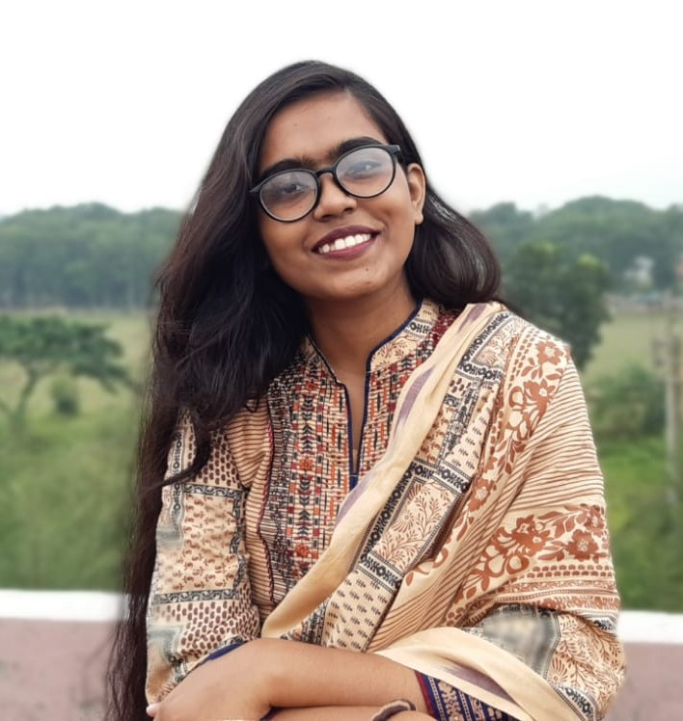
Nusrat Jahan Jonaki
I am a final-year undergraduate student pursuing a degree in Computer Science and Engineering at Khulna University of Engineering and Technology. With a strong passion for technology ,I am eager to contribute to innovative projects and continue learning in the field .
Education
SSC : Dhaka Board
Year : 2017
Result: 5.00
Skills:
Programming Language:
C , C++ , Java , Swift
Software Application: Efficient in Android Studio and Flutter
Website Development:
PHP, Laravel
HSC : Dhaka Board
Year : 2019
Result: 5.00
B.Sc. In CSE: Running student of final year.
cgpa : 3.79
Awards:
Language:
Dean's List for academic session 2019-2020 .
Fluent in English and Bangla

Slide 2
Hobbies:
Projects:
Traveling
Communicating with people
Reading
Photography
Watching films
Playing badminton, chess etc.
Gardening
Volunteering
School management project using C programming.
Money management application using Android Studio
Dual purpose car as peripheral project
Book Hoard (a online e-book website using Laravel )
Hospital management using MySQL database
BookIsH (an application for iOS device using swift language)
Development of android based (flutter) smart tax consultant software application.
Mini compiler using bison
Contact:
Phone : 01859409091
Email : nusratjonaki123@gmail.com
Academic Email : jonaki1907067@stud.kuet.ac.bd
Address : Rokeya hall , kuet , fulbarigate , Khulna .
Github Profile:
https://github.com/Jonaki067

