Slide 1
COVID-19 news on Twitter, a statistical analysis
Lu Yuk Ho 3035762554
Chiu Chin Fung 3035862542

Slide 2
Table of contents
1
Introduction and related works
2
Methods
3
Results
Discussion

Slide 3
Introduction

Slide 4
Introduction
Fake News as “ the deliberate presentation of false or misleading claims as news, where the claims are misleading by design” (Gefert,2018).
Sudden rise of COVID-19 assisted the outburst of misinformation about the disease (Shu et al.,2017)
Social Media platform plays an important role
Without fact-checking of pandemic information
Common topics and words that attack the eyeball and arousing fear among readers like healthcare and political issues

Slide 5
Related works
Believing in fake news
What is communicated, how it si communicated, who communicates it and where it is communicated. (Elgerly & Vraga, 2020)
Key Opinion Leader lead the information flow and drive the public opinion towards the COVID-19. ( Katz& Lazarsfeld, 1995).
Sharma et al.(2019) revealed the importance of sentiment analysis for the detection of fake news.
Research Gaps
Previous research has investigate the spread of fake news and misinformation and state-of -the-art detection of fake news
Lack investigation to focus mainly on the spreading dynamics between real and fake news

Slide 6
Research questions
1: What are the most common topics and types of words for identifying fake news about COVID-19 on Twitter?
2: What is the major sentiment in the real and fake news about COVID-19 on Twitter

Slide 7
Methods

Slide 8


Data collection
Already labelled
0 as COVID True claims
1 as COVID False claims

Slide 9
Sampling
Fake: 5,099
True: 24,901
Fake: 5,000
True: 5,000
Sample 2
Sample 1
Common topic and words (n = 10,000)
Sentiment analysis
(n = 30,000)

Slide 10

Variables of interest
post_text
Like_count
Retweet_
count
nchar
Sentiment
A piece of text on a tweet
Number of likes of a tweet
Number of retweets of a tweet
Number of characters in a tweet
Sentiment of a tweet

Slide 11
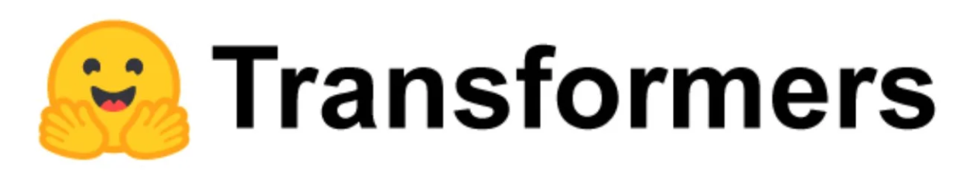
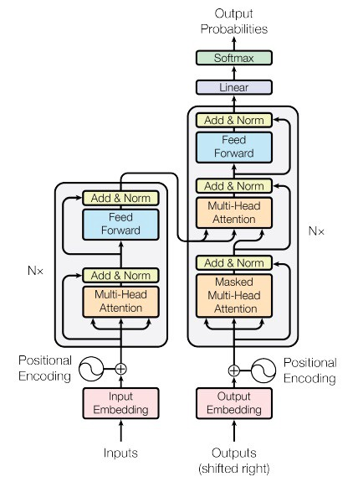
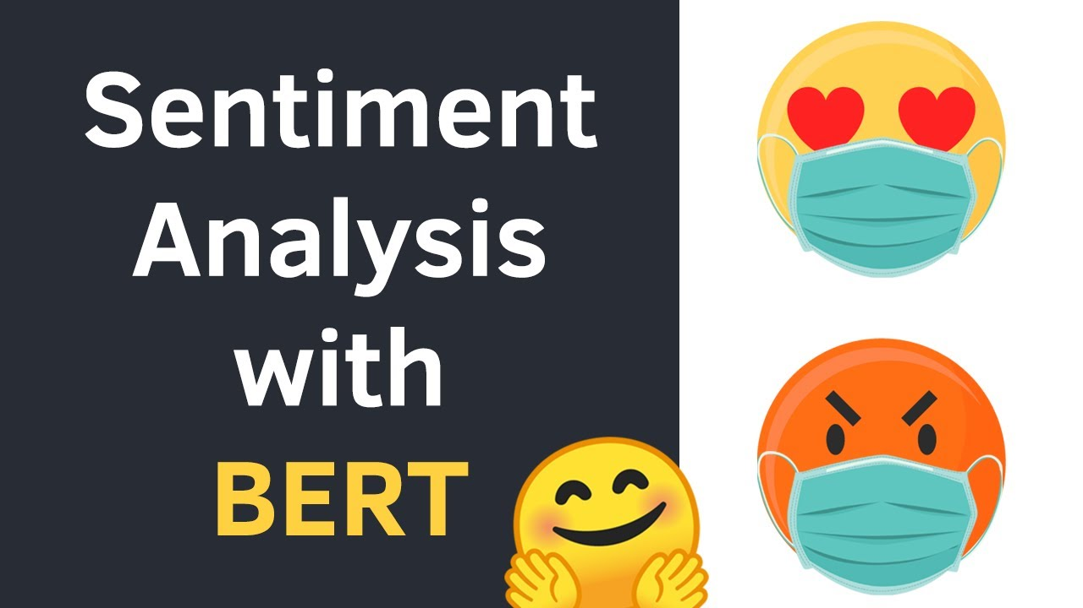
Sentiment analysis
An attention-grabbing method that learns the contextual relationships between words in a text
~ 94% accuracy

Slide 12
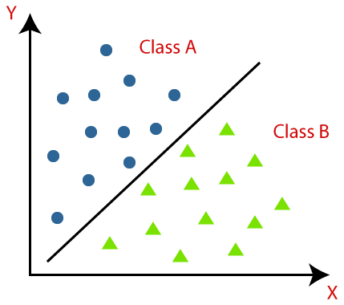
Machine learning algorithm
Classification
Naive Bayes
Multinomial
Log probability for feature importance
Random Forest
benchmark

Slide 13
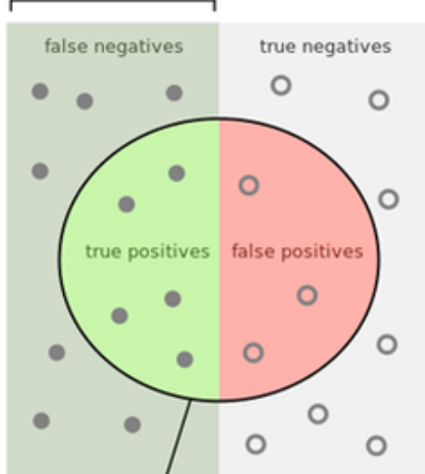
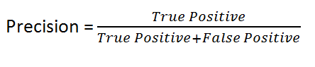
Evaluation
How many selected items are relevant?

Slide 14
Results &
Discussion

Slide 15
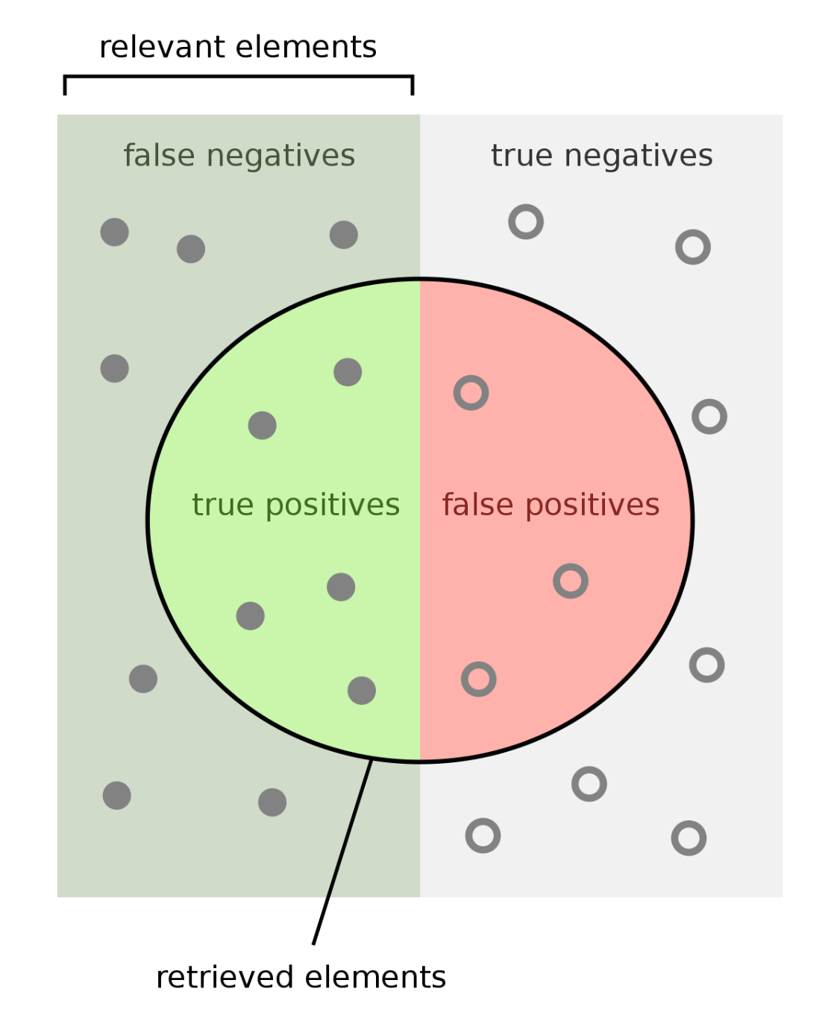
Naive Bayes Vs Random forest classifier
Precision score : 76.905% > 72.152%
Multinomial Naive Bayes Classifier
Pandey, 2022 | Agarwal et al., 2019
87% | 64%

Slide 16
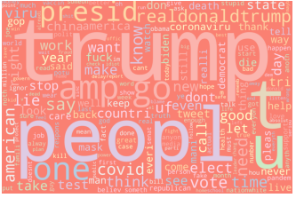
Word Cloud

Slide 17
Word cloud
From the word cloud, we can observe that some special words “ Trump” ,” President” and “COVID”appear usually.
Possible explanation : People believe in representation figure and Donald Trump words contain authority.
Consistent with the study by (Wang and Huang, 2021).
State that citizens can be persuaded by the authorities labeling a piece as real news and increase their belief in the news.
Muramaya et.al (2012) reveal that the impact of fake news to the public once the fake news is issued by the government

Slide 18
Word Cloud
Results also show that fake news is shared and spread quickly on Twitter
Donald Trump shared the news with topics about lies , death figures, which also shown in the word cloud.
Induce intense discussion ( Like, retweet..)
Consistent with the study of Brummette et al .(2018) on describing the spreading dynamics in twitter
They stated that fake news discussions take place in big clusters (i.e., online communities) dominated by members of the general public
People love to join different big communities to view and retweet posts they like and believe.

Slide 19


Sample 1
Samuel et al (2020)
91.43%
>>> Length of tweets > 70 >>>
57.14%

Slide 20
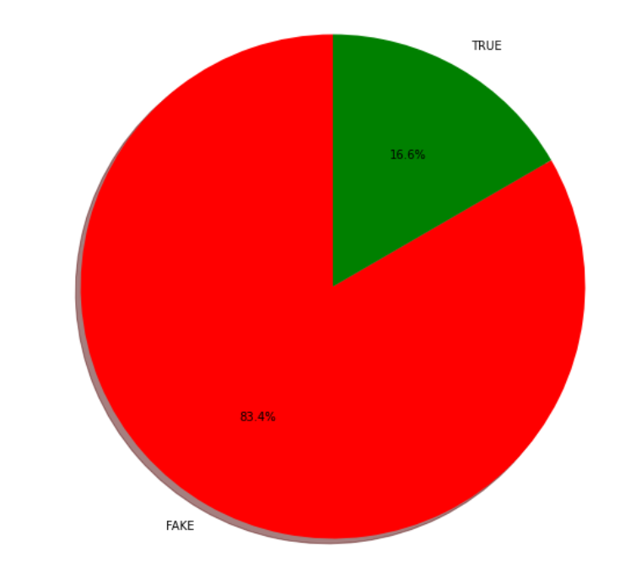
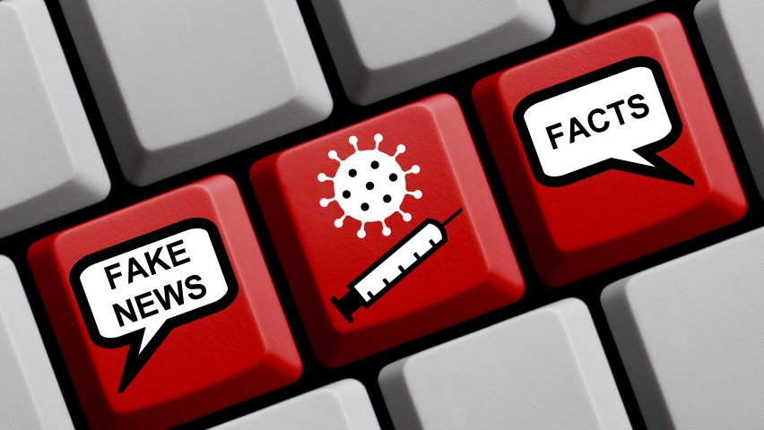
Sample 2

Slide 21
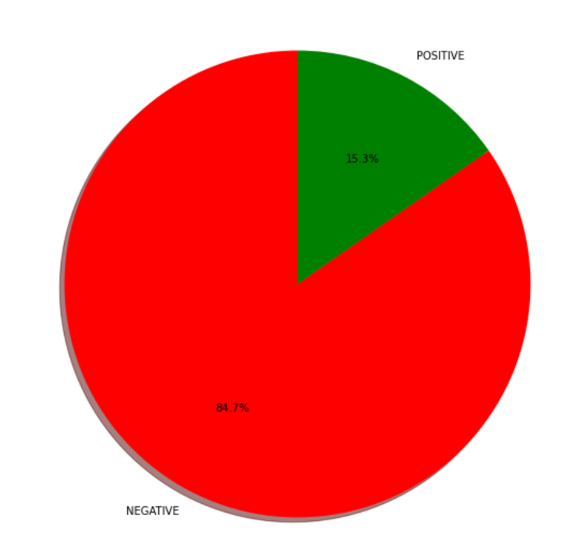
Major sentiment
draw public attention

Slide 22
Conclusion
Common topic - Donald Trump
Fake news & positive news - mainly negative
Limitations:
The sentiment variable is just an estimation
application of these estimates in machine learning algorithms
The precision score is relatively low
the relevance between headline and text

Slide 23
Thank you !
Q & A

