Slide 1
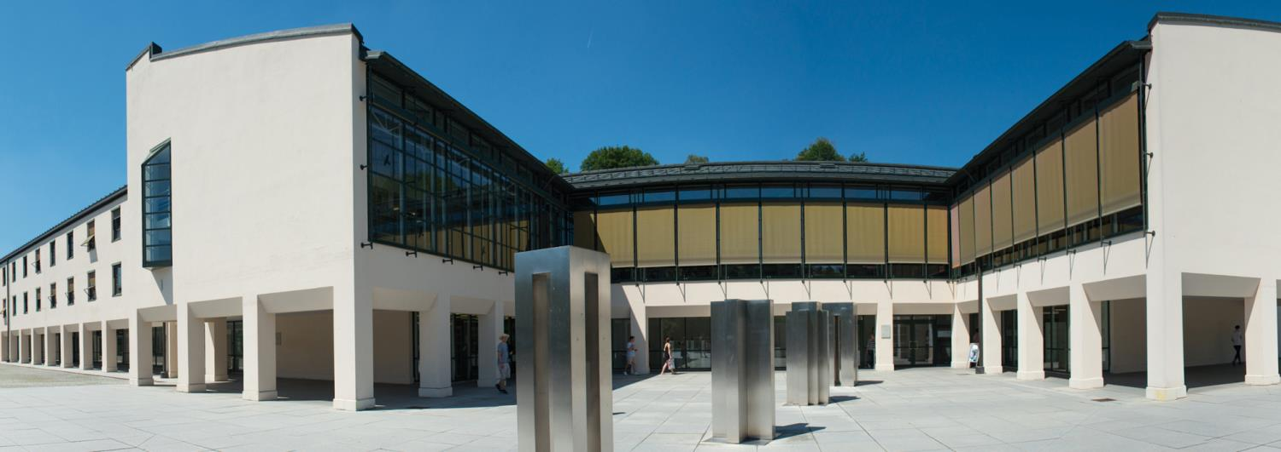
Using Large Language Models in Irony Detection – a comparative analysis
Jonas Barth
04.10.2024

Slide 2
Generative AI: Large Language Models
Large Language Models generate text based on probabilistic methods and training data
GPT: Generative Pretrained Transformer, transforms input based on internal parameters to generate output
Multiple iterations which continuously improve text generation consistency and content
GPT-3.5: 175 billion parameters, GPT-4: 1.7 trillion (estimated)
However: Still has problems! (Hallucination, Misinterpretation, etc.)

Slide 3
NLP and Irony Detection
Natural Language Processing (NLP): decoding and interpreting information stored in natural language
Various tasks are included, such as sentiment analysis or argument mining
NLP tasks difficult to achieve using rule-based algorithms (negation detection, irony detection, multipolarity)
Use LLMs!
Irony Detection even difficult for humans
Analyze and compare how LLMs perform this task!

Slide 4
Background
Irony and sarcasm closely related concepts: sarcasm can be viewed as a subform of verbal irony
Only the term “irony” in this paper and presentation
Other work done using LLMs for Irony Detection:
Aytekin et al.: different datasets, no GPT-4 models
Gole et al.: different dataset, different prompting format
Mu et al.: different datasets and balance, no GPT-4 models
Relevant paper, especially for GPT-4 analysis!

Slide 5
Methods – Terminology & Datasets
Terminology
Run: Evaluating the first 100 lines from a dataset
Run Set: A set of 10 runs with calculated average values
Datasets
SemEval-2018 Irony Detection task set – balanced
Reddit dataset – created from reddit comments (unbalanced)
Manual dataset – created from tweets and slightly pre-processed

Slide 6
Methods – Prompting and Models
Models
Mainly GPT-3.5 and GPT-4, also two python libraries: pysentimiento, TweetNLP
Prompting
Asking GPT to classify or label a tweet using different response formats depending on the prompt
Main Prompt:
“You are an irony detector. Respond with '1' (for yes) or '0' (for no) depending on whether you think the following statements are ironic.”
Code VSCode, OpenAI API, Pandas, numpy, matplotlib, Openpyxl

Slide 7
Methods – Run Types
Run Types
Multiple prompts were used to gauge effectiveness of classification:
Binary (seen before)
Confidence: Asking GPT to give a confidence percentage for its evaluation
Percentage: Evaluating the irony content as a percentage value
Sent Choice: Assigning one of multiple sentiment labels to a tweet
In addition, the binary prompt also had six sub prompts (prompt engineering).

Slide 8
Methods – Consistency
Consistency Metric
Examining the consistency of a specific row’s evaluation over a set of runs.
A run set of length 10 results in the following result tuple for one specific ironic-labelled row:
(1, 1, 0, 1, 1, 1, 0, 1, 1, 1)
8 correct, 2 wrong!
The proportion of correct evaluations: 0.8
Threshold is set to define when a row counts as consistent. Throughout the paper: 0.7
This row is consistently correct!

Slide 9
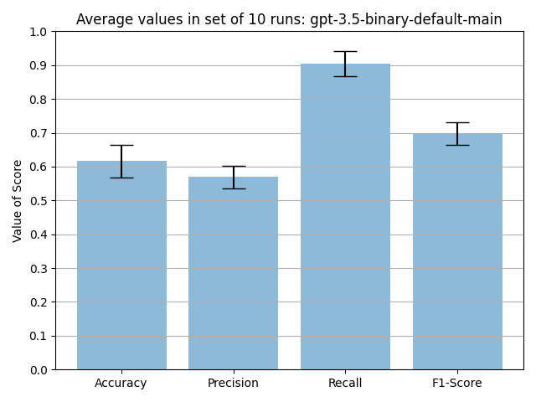
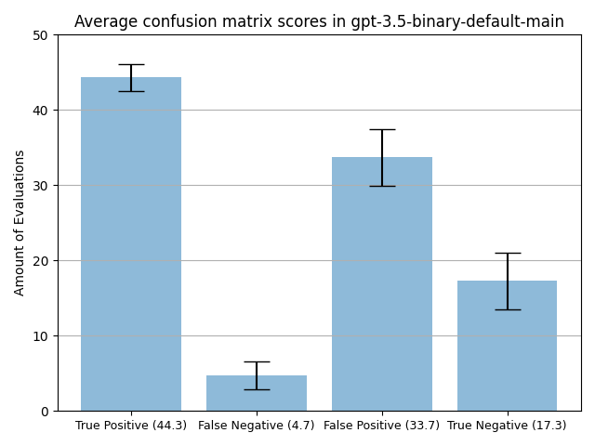
Results – GPT-3.5
GPT-3.5: Main Prompt
Average Scores
Confusion Matrix
Model not very sensitive, high false positive rate!

Slide 10
GPT-3.5: Examples
Need to get back in to college.. #feeling #this
Actual label: non-ironic. GPT-3.5: 8/10 ironic evaluations.
@user @user you don't know a damned thing about baseball, do you?
Actual label: non-ironic. GPT-3.5: 9/10 ironic evaluations.
well today is gonna be a great day 👍
Actual label: ironic. GPT-3.5: 9/10 non-ironic evaluations.
I refuse to be weak... #workout #motivation #fitfam
Actual label: non-ironic. GPT-3.5: 6/10 ironic evaluations.

Slide 11
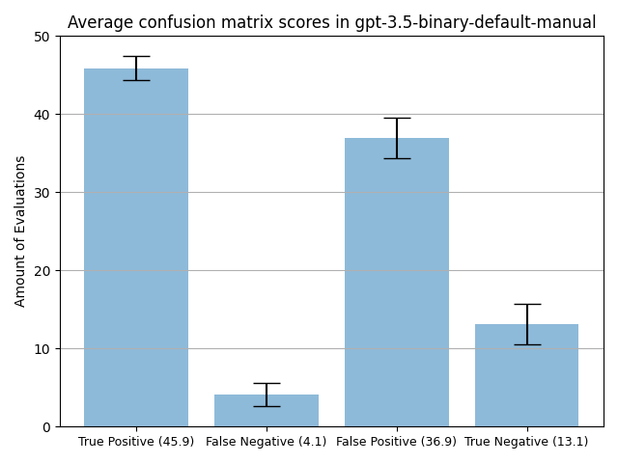
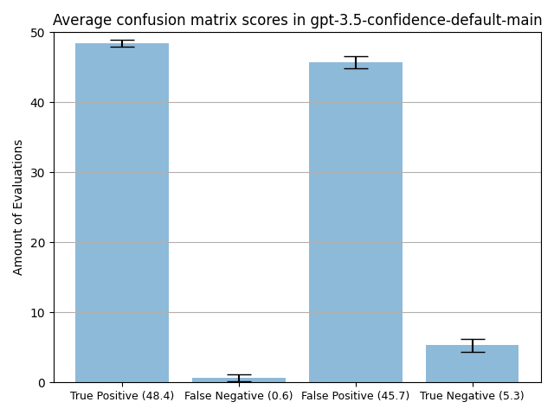
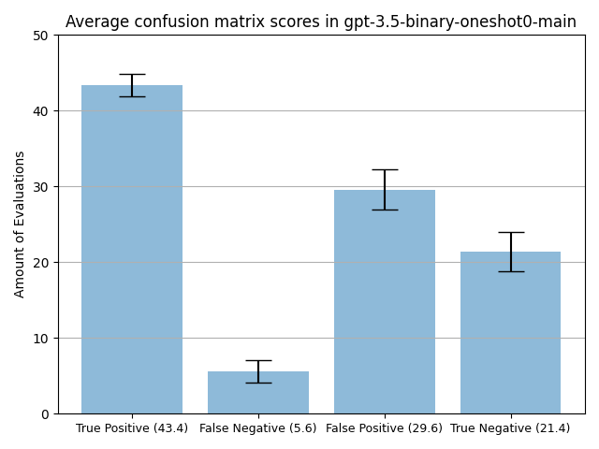
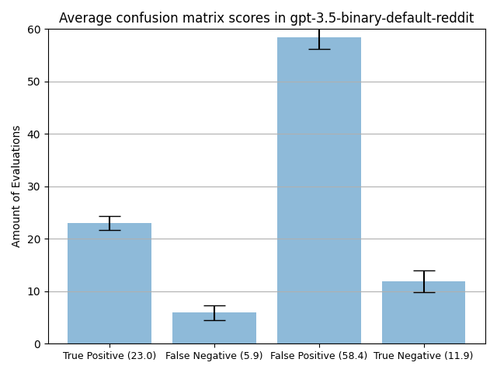
GPT-3.5: Pitfalls
Manual Dataset:
Confidence prompt:
Oneshot-0 sub-prompt:
Reddit Dataset:

Slide 12
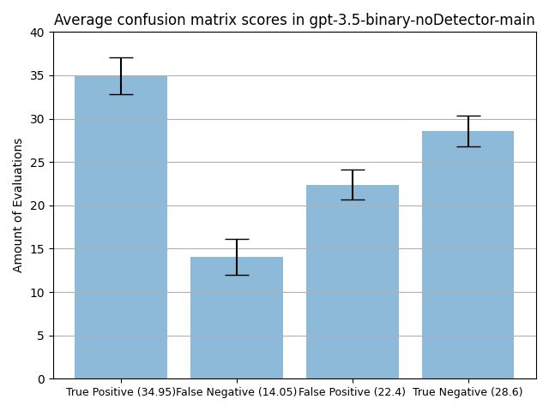
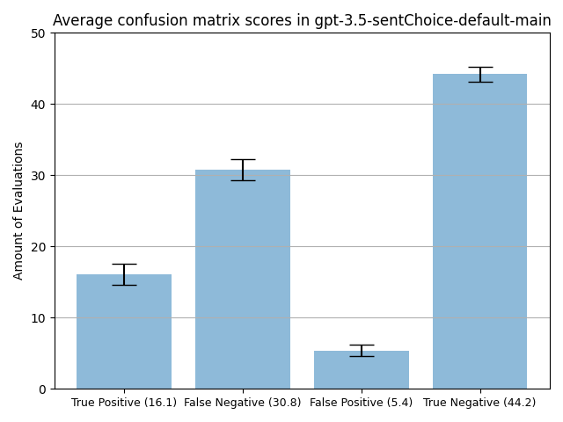
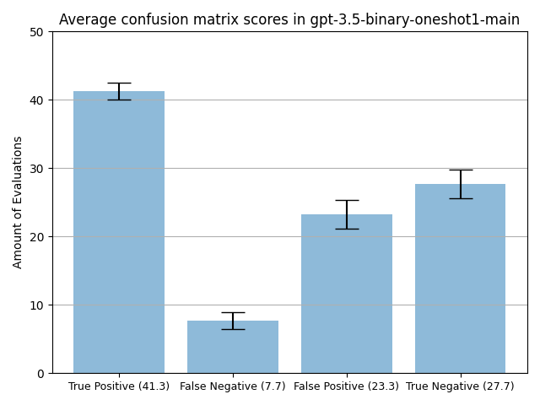
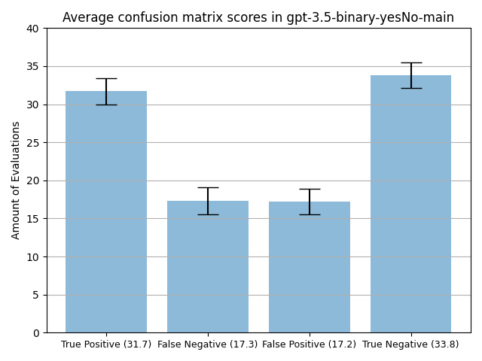
GPT-3.5: Malleability
NoDetector sub-prompt:
SentChoice prompt:
Oneshot-1 sub-prompt:
Yes/No sub-prompt:
Notes:
Conclusion: GPT-3.5 over-evaluates irony, is very malleable with even just slight changes to the prompt, overall best results have 2/3 correctly identified labels

Slide 13
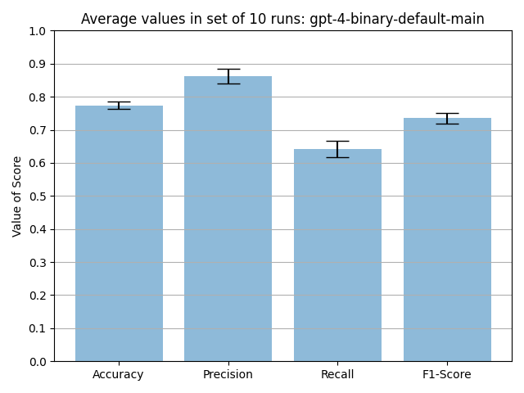
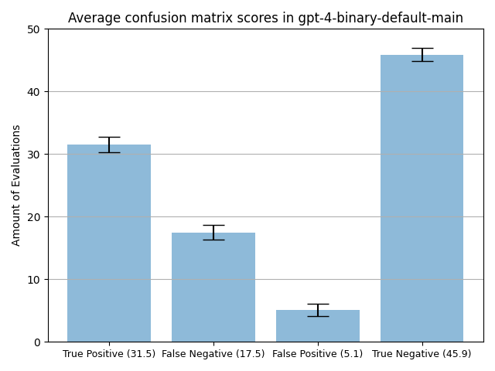
Results – GPT-4
GPT-4: Main Prompt
Average Scores
Confusion Matrix
Model more sensitive, higher precision, lower deviation!
Notes:
Very good non-irony detection. Even better than irony detection!

Slide 14

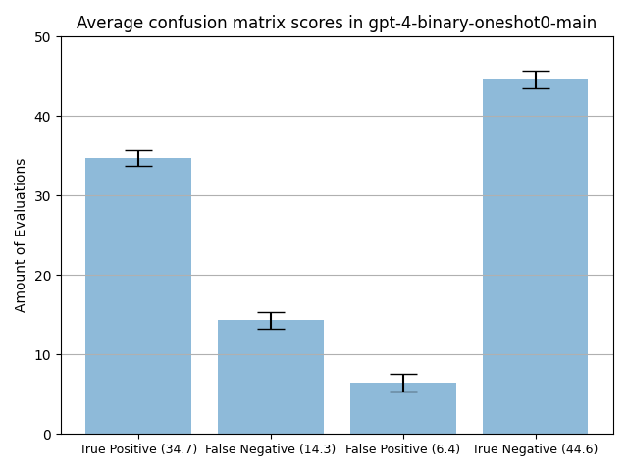

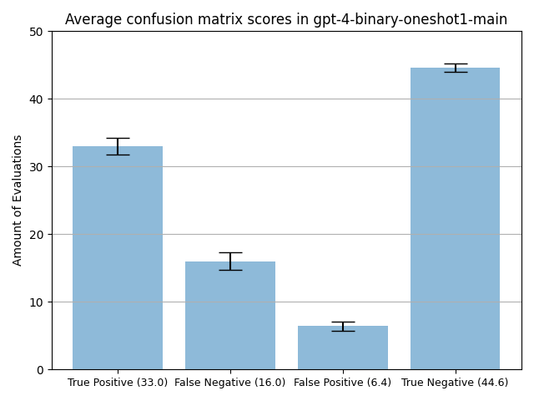
GPT-4: Consistency
Confidence prompt:
Oneshot-0 sub-prompt:
SentChoice prompt:
Oneshot-1 sub-prompt:
Notes:
LOWER STANDARD DEVIATION!

Slide 15
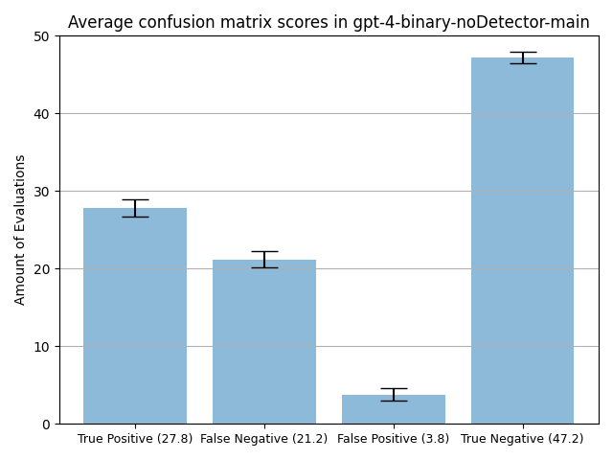
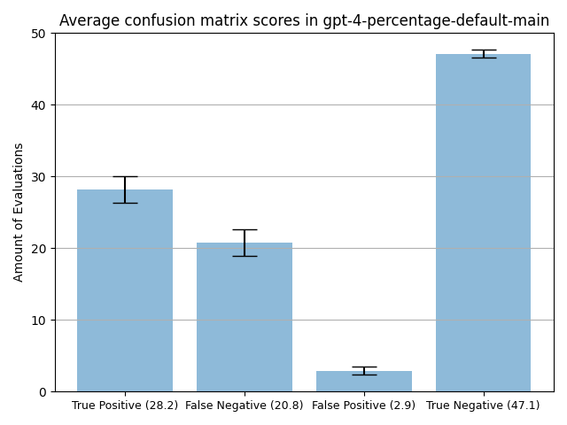
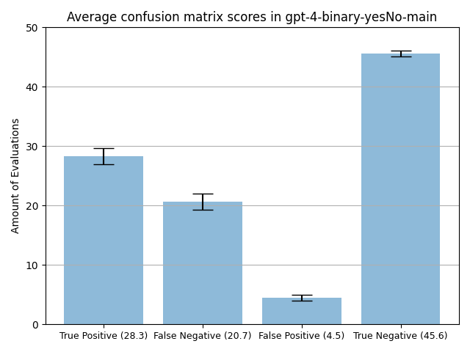
GPT-4: Consistency
NoDetector sub-prompt:
Percentage prompt:
Yes/No sub-prompt:
Extremely consistent, low deviation scores!
No or almost no malleability!
Notes:
LOWER STANDARD DEVIATION!

Slide 16
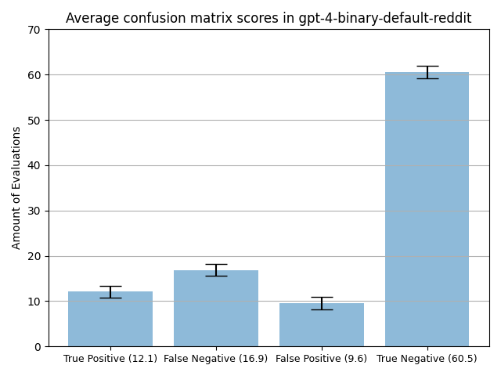
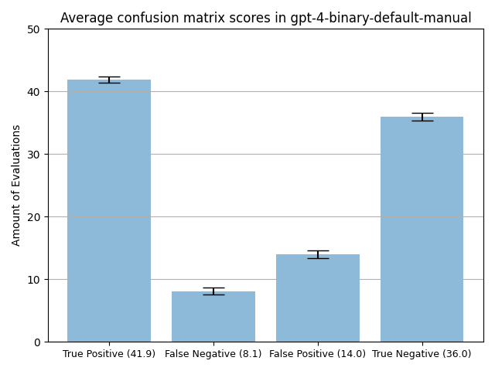
GPT-4: “Deviations”
Reddit Dataset:
Manual Dataset:
Notes:
Conclusion: Development visible from GPT-3.5 to GPT-4, performs better in every metric, better suited for irony detection overall

Slide 17
Other Models
TweetNLP
Based on roBERTa
Pre-trained on 60M tweets
Iron Detection one of multiple tasks
Pysentimiento
Based on BERTweet (based on roBERTa)
Trained on 850M tweets
Irony Detection one of multiple tasks
Some pretraining done on main dataset, thus using manual dataset for fairness!

Slide 18
Other Models: Comparison
Results | Accu-racy | Preci-sion | Recall | F1-Score | TP | FN | FP | TN
GPT-3.5 | 0.59 | 0.55 | 0.92 | 0.69 | 45.9 | 4.1 | 36.9 | 13.1
GPT-4 | 0.78 | 0.75 | 0.84 | 0.79 | 41.9 | 8.1 | 14.0 | 36.0
Tweet-NLP
pysentimiento

Slide 19
Other Models: Comparison
Results | Accu-racy | Preci-sion | Recall | F1-Score | TP | FN | FP | TN
GPT-3.5 | 0.59 | 0.55 | 0.92 | 0.69 | 45.9 | 4.1 | 36.9 | 13.1
GPT-4 | 0.78 | 0.75 | 0.84 | 0.79 | 41.9 | 8.1 | 14.0 | 36.0
Tweet-NLP | 0.61 | 0.60 | 0.68 | 0.64 | 34.0 | 16.0 | 23.0 | 27.0
pysentimiento | 0.71 | 0.66 | 0.86 | 0.75 | 43.0 | 7.0 | 22.0 | 28.0
GPT-3.5 performs worse than pre-trained models!
GPT-4 outperforms pre-trained models!

Slide 20
Future & Conclusion
Possible Future Experiments
Create sub-prompts for other prompts!
Acquire multiple datasets!
More run types/prompts!
Longer run sets, longer runs!
Pre-trained GPT-3.5?
Insights Gained
Stark difference between GPT-3.5 and GPT-4, massive difference in approach
GPT-3.5 generally unfit to separate irony from non-irony
Pre-train GPT-4 based models for even greater irony detection

Slide 21
Grand Finale
THANK YOU FOR YOUR ATTENTION!
If you have any questions, speak now or forever hold your peace
All Figures taken from:
https://www.github.com/Jonas-Barth/bachelor

