Slide 1
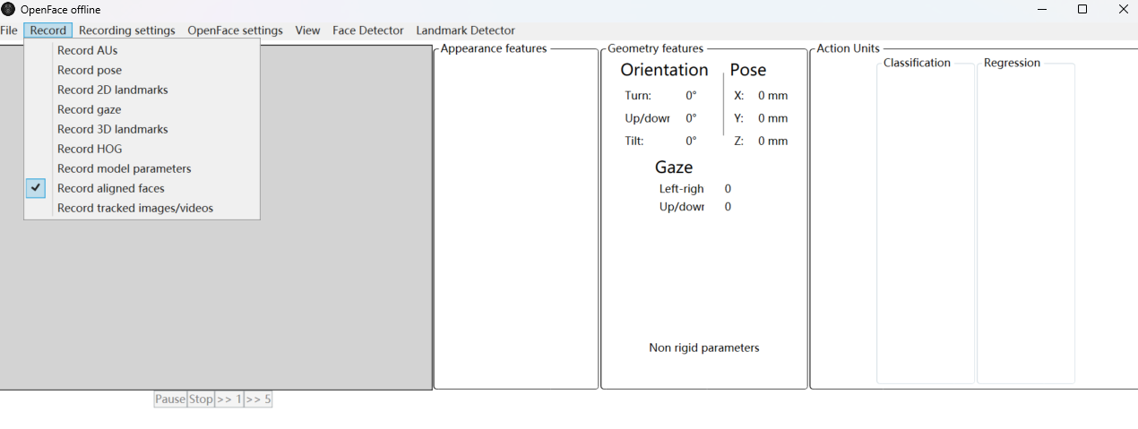
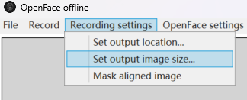
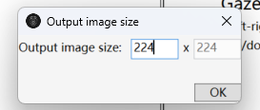
1. Use Openface to align faces
Download software: https://github.com/TadasBaltrusaitis/OpenFace/releases/tag/OpenFace_2.2.0
Unzip and run OpenFaceOffline.exe
Check 'Record aligned faces' under the 'Record' menu
Set the output image size to 224x224 under 'Recording settings'

Slide 2
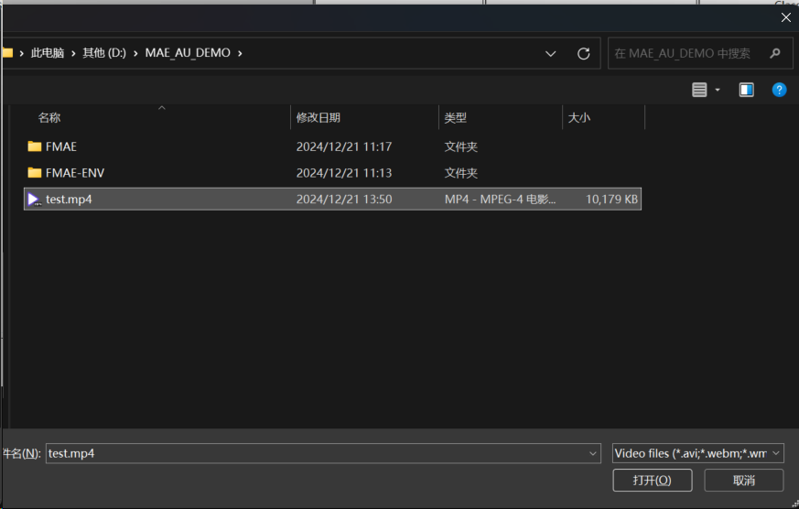
1. Use Openface to align faces
5. Select your video or image from the 'File' menu. Please make sure that there is only one face in the image. We provide a video for testing

Slide 3
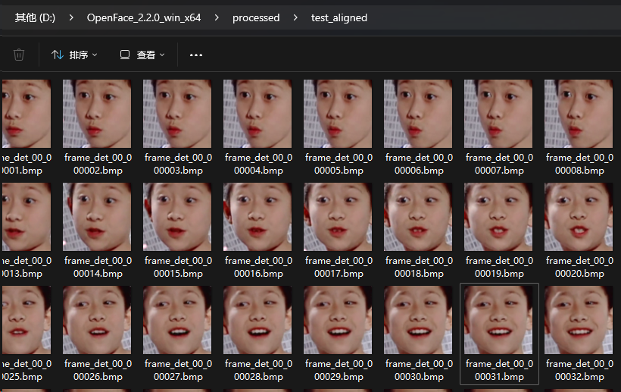
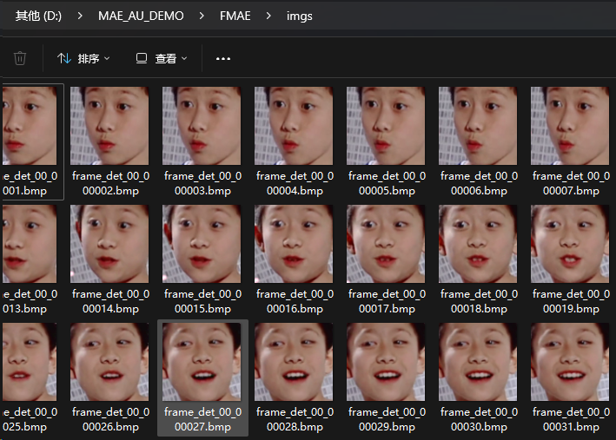
1. Use Openface to align faces
6. The aligned faces will be saved in the OpenFace/processed directory (test_aligned)
7. Move the images from this folder to the /FMAE/imgs/ directory
Alternatively, you can also use a custom face alignment algorithm to perform alignment.
Recommended image names: 1.jpg, 2.jpg, 3.jpg...
In addition, we recommend reserving more forehead area for better recognition of AU1 and AU2, and more neck area for better recognition of AU26/27.

Slide 4
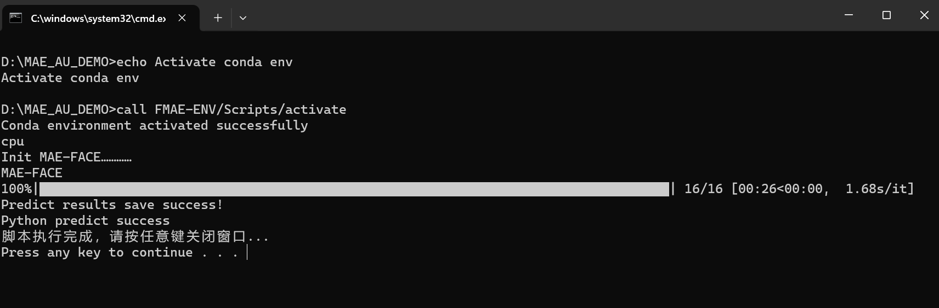
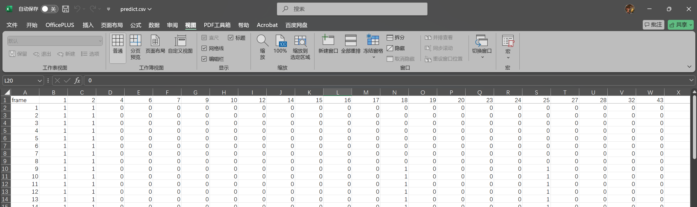
2. Perform AU inference
Double-click run_MAEFACE.bat to execute.
The prediction results will be saved in the FMAE/results/predict.csv.
The predicted AU features can be used for other tasks, such as disease classification or regression.
GPU is recommended for inference.
The demo machine does not come with a graphics card, so CPU mode is selected by default.
When using the GPU, ‘cuda’ will be displayed.
predict.csv

Slide 5
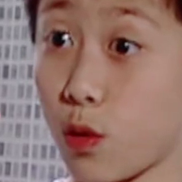
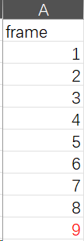
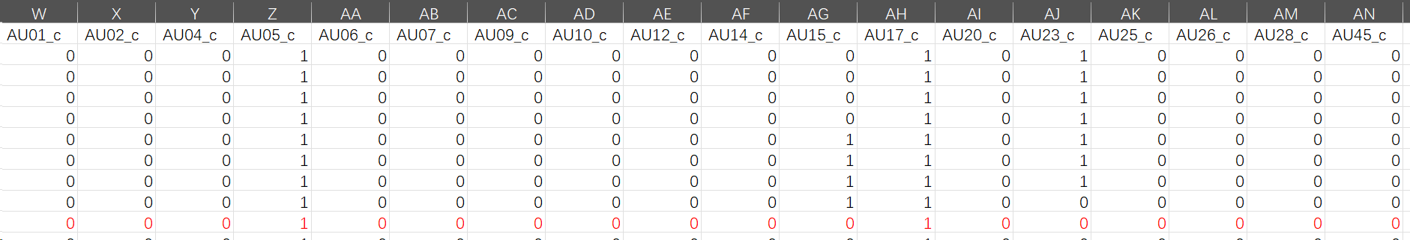
3. Data analysis
1 means AU is active, 0 means not active.
Our prediction results suggest that frame 9 may activate AU1, AU2, AU18, and AU25. Missing AU5/27.
Openface result: AU5 and AU17 (prediction error) may be activated. Missing AU1/2/18/25/27.
Openface
frame_det_00_000009.bmp

Slide 6
4. Change parameters
Open HRM_test_batch.py files in MAE_AU_DEMO\FMAE directory
Change the parameters you want to change
If you have more VRAM, you can increase batch_size and num_works to speed up inference
You can swap the model weight file to produce multiple "expert" predictions

Slide 7
Hope this tutorial can help you!

