Slide 1
Cross-sectional variation in the earnings response coefficient: Current evidence from S&P500 companies
Jonas Materna HU Berlin
28 June 2021

Slide 2
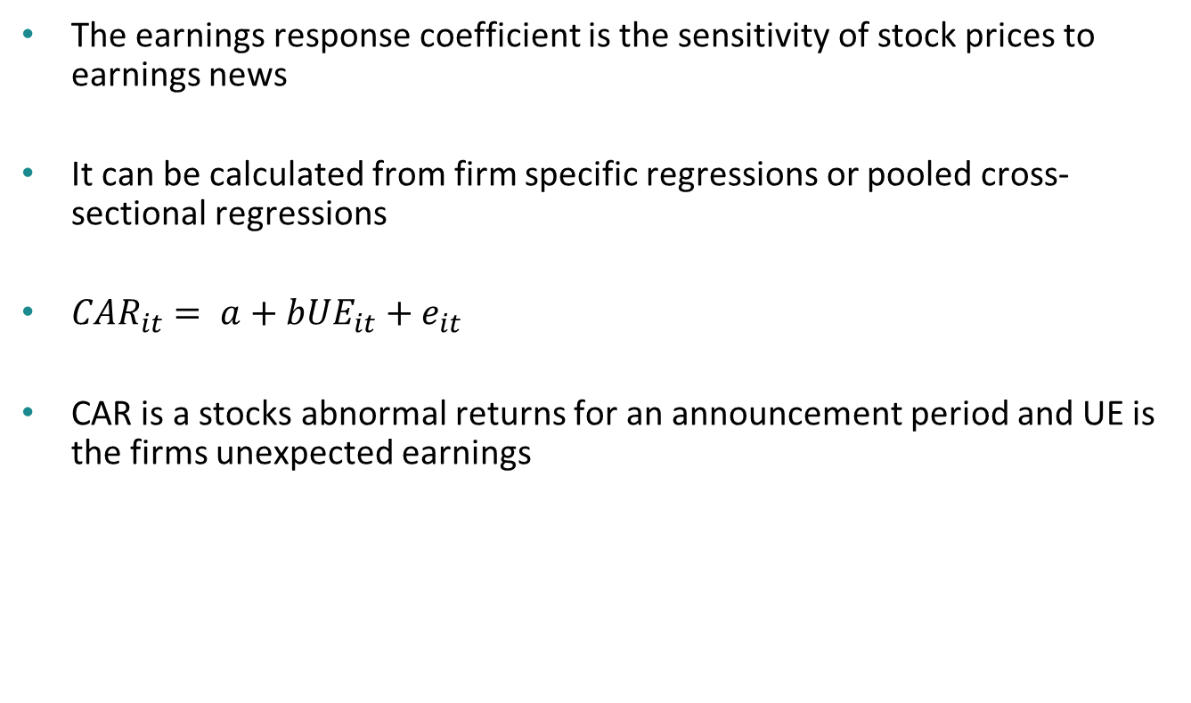
Earnings Response Coefficients
Basics
The earnings response coefficient is the sensitivity of stock prices to earnings news
It can be calculated from firm specific regressions or pooled cross-sectional regressions
${CAR}_{it}= a+b{UE}_{it}+e_{it}$
CAR is a stocks abnormal returns for an announcement period and UE is the firms unexpected earnings

Slide 3
Earnings Response Coefficients
Methodology
I use the cross sectional regression methodology
Unexpected earnings are the difference between the firms’ earnings forecast and actual earnings. For additional checks I also scale the difference by the absolute value of the forecasted EPS
Abnormal returns are calculated using the CAPM. In addition I use the simple difference of stock returns and market returns
CARs are calculated using a seven day time window centered around the announcement day
The ERC is than calculated for the cross section of S&P 500 companies

Slide 4
Earnings Response Coefficients
Results
The ERC in the complete dataset is 0.0259
The table below displays the ERC for the cross section of S&P 500 companies
Literature suggests a negative relation between leverage and ERC as well as risk and ERC. My results do not exactly agree with that
ERC | 0.2 | 0.4 | 0.6 | 0.8 | 0.99
Leverage | 0.0169 | 0.0309 | 0.0362 | 0.0359 | 0.0047
Size (Total Assets) | 0.0288 | 0.0166 | 0.0199 | 0.0335 | 0.0224
Risk (Beta) | 0.0163 | 0.0233 | 0.0384 | 0.0281 | 0.0241

Slide 5
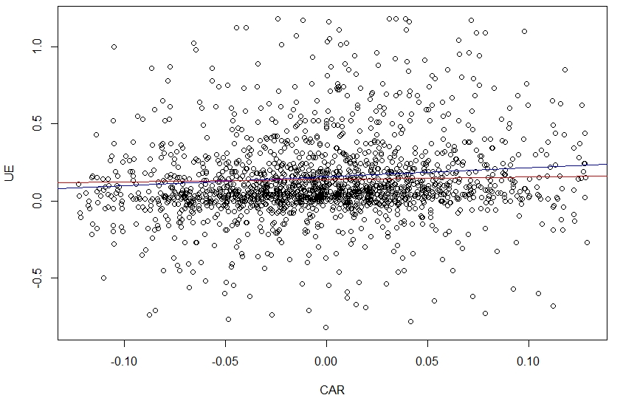
Earnings Response Coefficients
Results
The graph displays the relation between CAR an unexpected earnings
The blue line is a regression based on firms in the lowest leverage quantile, the red one is based on highly leveraged firms

Slide 6
Earnings Response Coefficients
Limitations
Theoretically the ERC is based on the assumption that earnings predict future dividends. However, I use accounting earnings which measure the firm’s dividend paying ability with an error
The forecasted earnings are based on analyst estimations and might not reflect market expectations
The results presented in this presentation are based on unscaled unexpected earnings
I use an ex post measure for expected returns

Slide 7
Earnings Response Coefficients
Literature
Collins, D.W., Kothari, S.P. (1989): An analysis of intertemporal and cross-sectional determinants of earnings response coefficients. Journal of Accounting and Economics, 11, 143-181.
Teets, W.R., Wasley, C.E. (1996): Estimating earnings response coefficients: Pooled versus firm-specific models. Journal of Accounting and Economics, 21, 279-295.
Bissessur, S.W., Veenman, D. (2016): Analyst information precision and small earnings surprises. Review of Accounting Studies, 21, 1327-1360.

