Slide 1
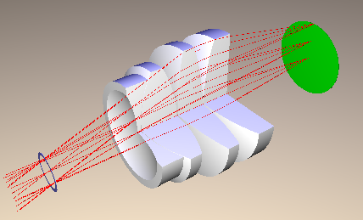
Optical Design Docu

