Slide 1
B050 data analysis

Slide 2
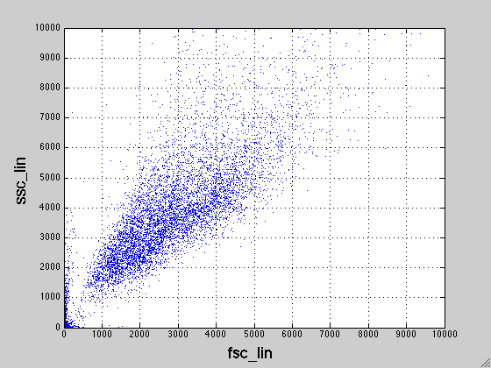
Representative Well
Notes:
Well, E9

Slide 3
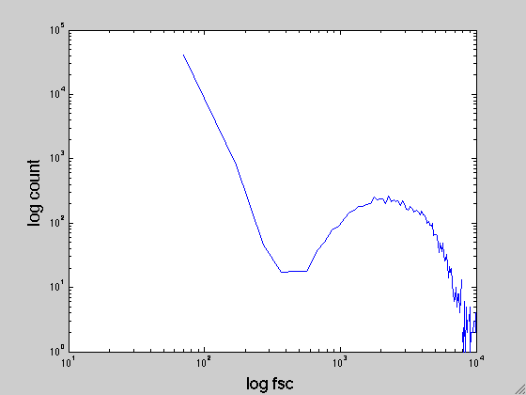
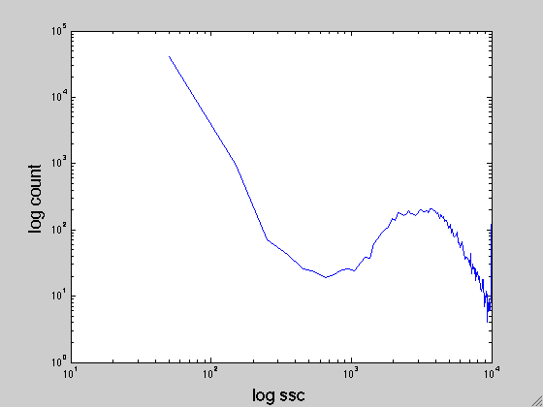
Representative Well

Slide 4
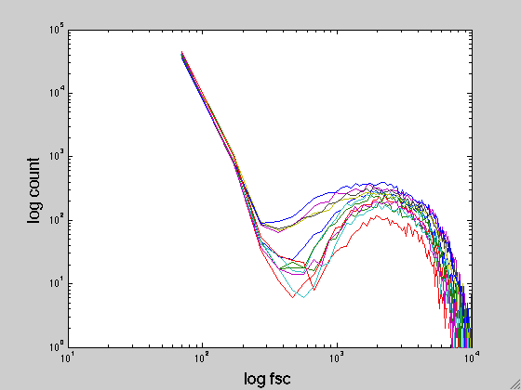
Overlay all the wells
Notes:
All the wells, with no SSC gating
Fsc hist overlaid

Slide 5
There is a tradeoff to set a SSC or FSC gating
Lower SSC gating leads to debris event
Higher SSC gating might leads to loss of cells

Slide 6
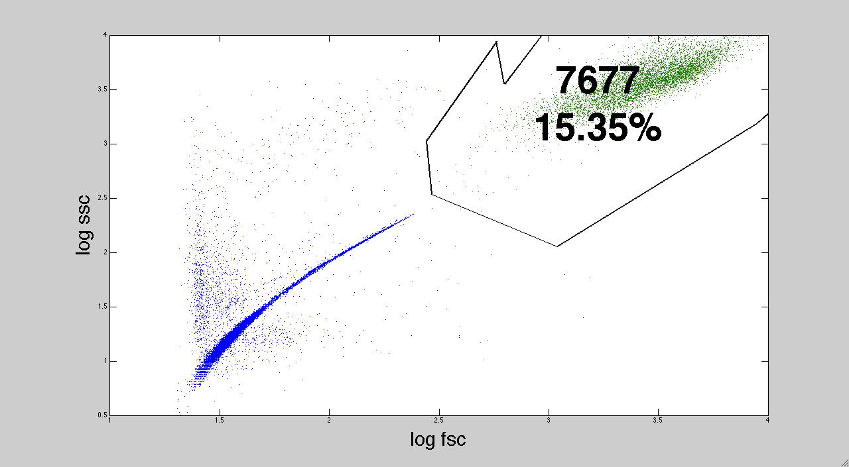
Manual selecting cells
Notes:
E9 well

Slide 7
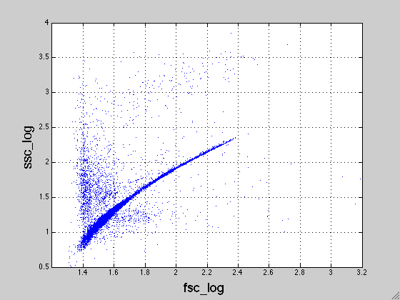
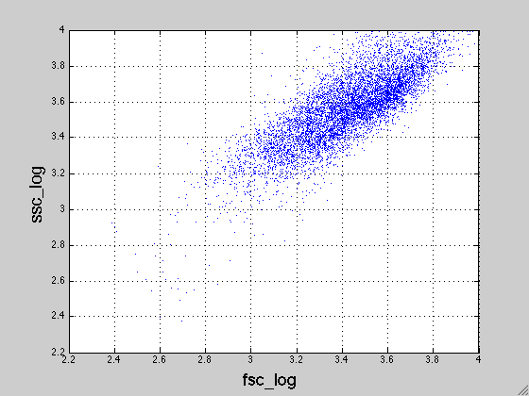
Manual selecting cells

Slide 8
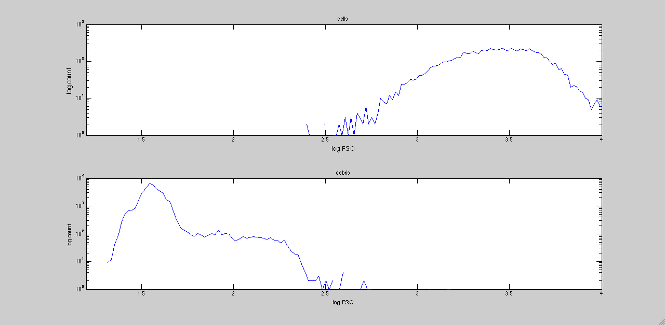
FSC

Slide 9
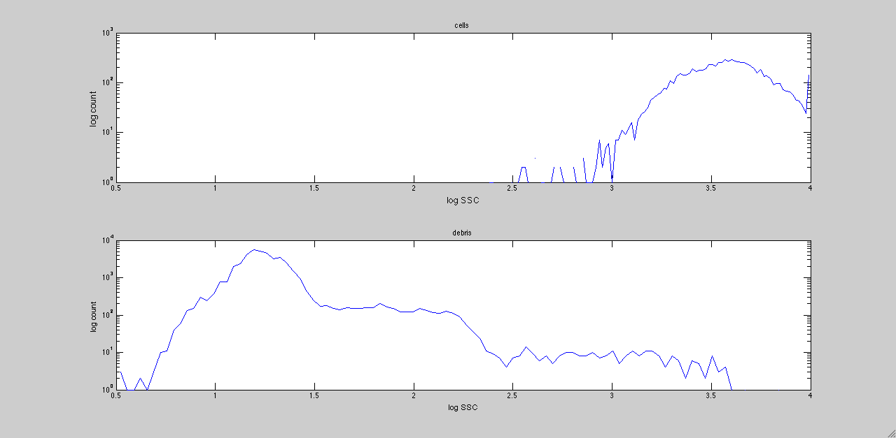
SSC

Slide 10
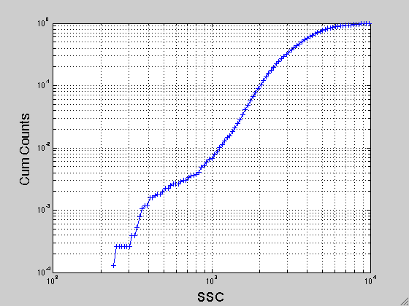
Cum Counts, ~.2%
Notes:
E9,
Also, tried D12

Slide 11
Outgrowth/Recovery

Slide 12
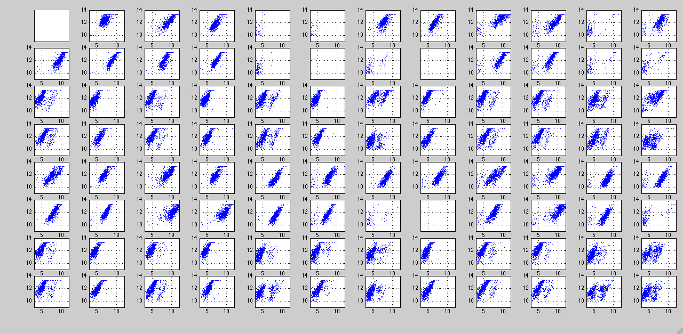
bfp_ssc

Slide 13
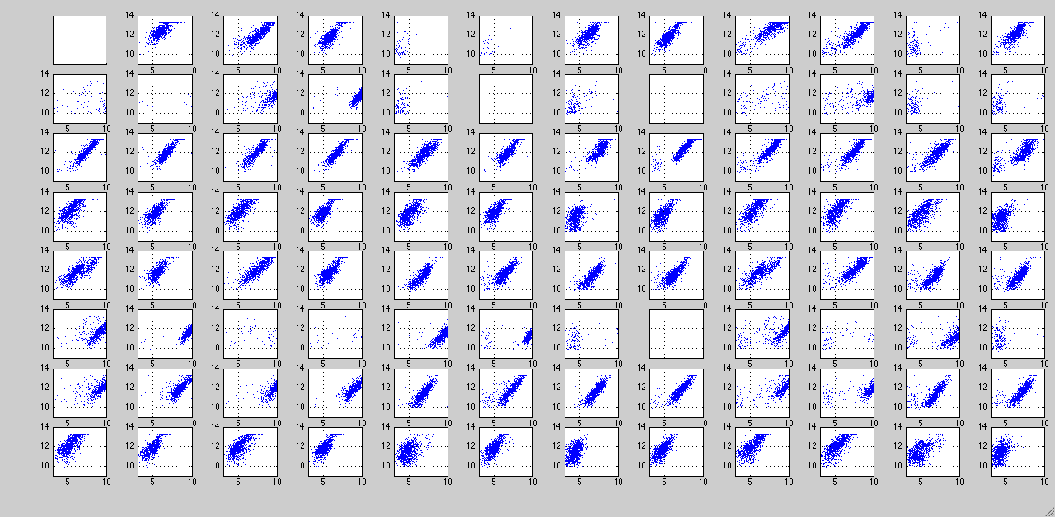
cfp_ssc

Slide 14
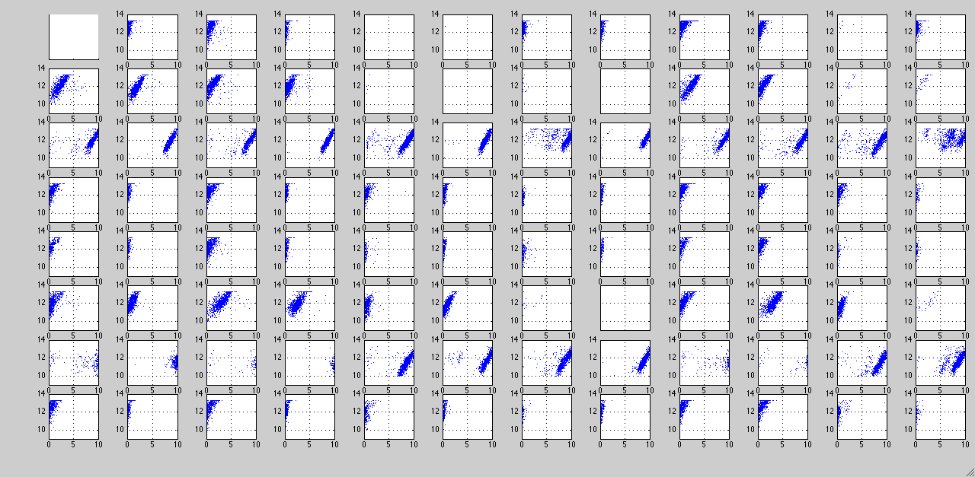
yfp_ssc

Slide 15
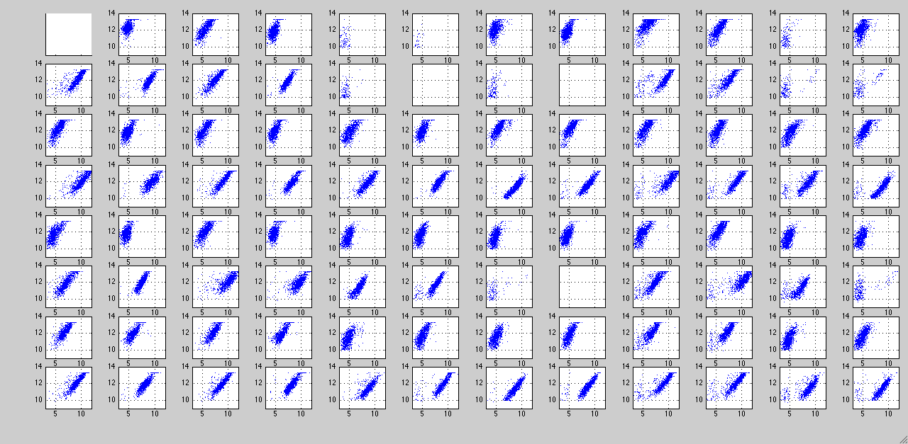
mch_ssc
Notes:
Strange, that CFP cells are on in mCh channel

Slide 16
Cell Density and Flowrate

Slide 17
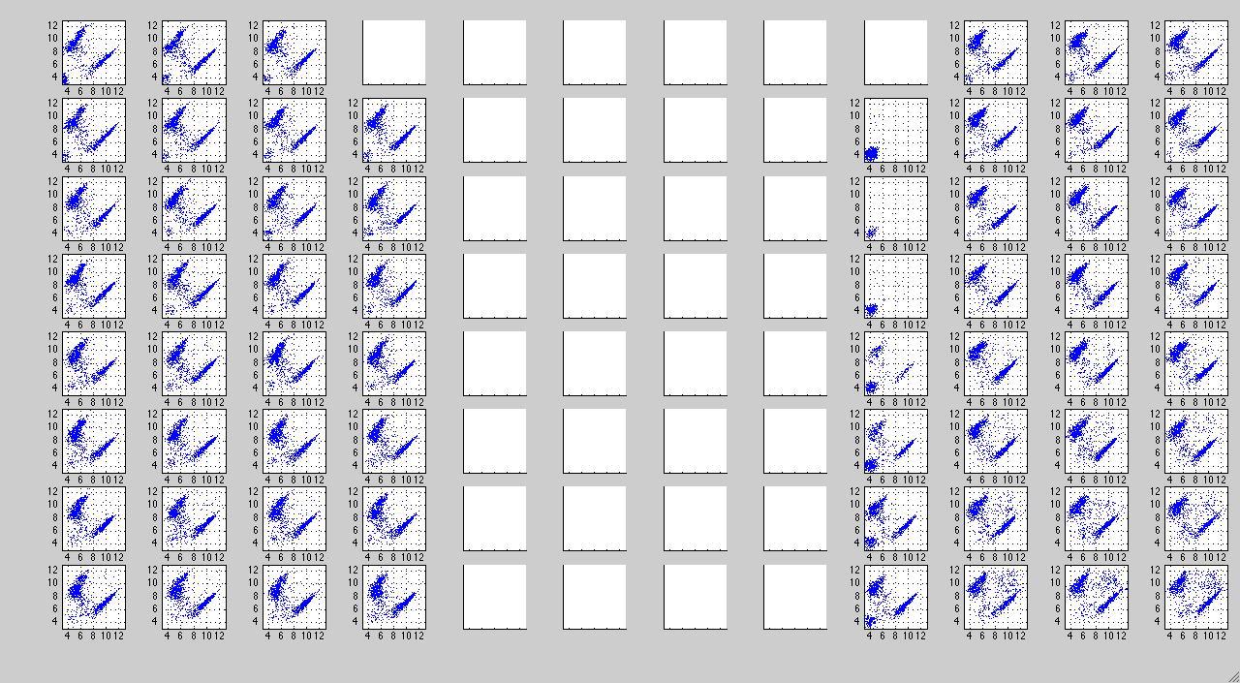
cfp_mCh
Notes:
Plate 2 in recovery folder

Slide 18
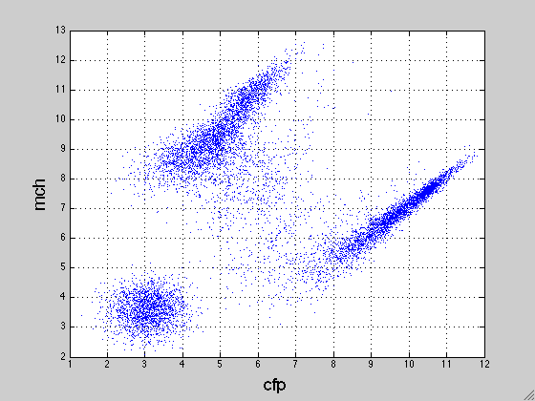
A1, the simplest well with the slowest flowrate

Slide 19
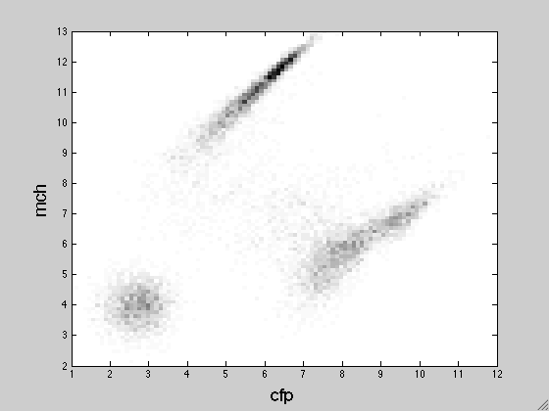

Slide 20
in order to see how acquisition parameters affect cell counts, segmentations are needed.

