Slide 1
Dweb lecture 3
ANVA

Slide 2
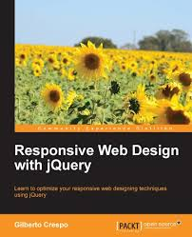
Contents
book: "Responsive Web Design with jQuery"
Chapters 1,2 and 3
intro to chapters 4 and 5

Slide 3
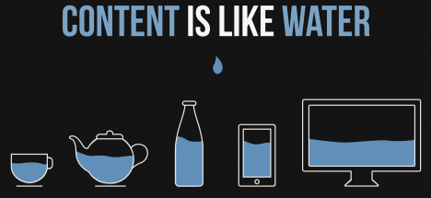
Chpt 1
Main point: what is responsive?
Ethan Marcotte -> def of responsive web design
Flexible grids layout
Fexible images and videos
Smart CSS -> media queries
Eg: from smartphone to desktop (breakpoints) Problems:
Mosue over VS touch events
Help filling data in form fields
Prioritizing the content (what comes first?)
Optimize site loading
Similar ideas
Fluid design: def using relative units of width (e.g. %) to adapt to different dimensions
Adaptive Web Design: def create interface that adaptsto users’ capabilites (from AND function) => mostly works for new devices, problems supporting legacy code on old browsers or devices
To achieve adaptive, variation of followng techniques: ...
Notes:
A site designed with RWD adapts the layout to the viewing environment by using fluid, proportion-based grids, flexible images, and CSS3 media queries, an extension of the @media rule, in the following ways:
The fluid grid concept calls for page element sizing to be in relative units like percentages, rather than absolute units like pixels or points
Flexible images are also sized in relative units, so as to prevent them from displaying outside their containing element.
Media queries allow the page to use different CSS style rules based on characteristics of the device the site is being displayed on, most commonly the width of the browser.
Responsive web design has become more important as the amount of mobile traffic now accounts for more than half of total internet traffic

Slide 4
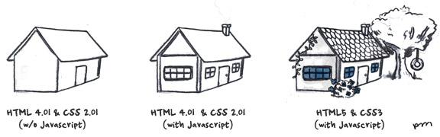
Chpt 1 (...)
To achieve adaptive, variation of followng techniques:
jQuery plugin to have touch events on mobile dev
Transform tables into responsive tables
Visual customization of form elements for desktop
Use geolocation to give more relevant contents
Change information hierarchy, where priorities are set (what to show larger? In which order?)
Central concept: progressive enhancement
Notes:
Progressive enhancement is a strategy for web design that emphasizes accessibility, semantic HTML markup, and external stylesheet and scripting technologies.

Slide 5
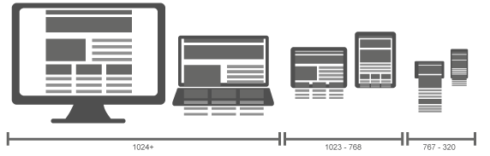
Chpt 1 (...)
Media queries
Classification of devices (page 10) -> breakpoints http://responsivedesign.is/strategy/page-layout/defining-breakpoints
CSS 2.1 -> focus on media types (print, screen, handheld)
CSS3 -> focus on media features
https://developer.mozilla.org/en-US/docs/Web/Guide/CSS/Media_queries
http://www.w3schools.com/cssref/css3_pr_mediaquery.asp
Width
Height
Orientation
resolution
Examples page 11 (fig 11)
@media only screen and (min-width: 1025px) { CSS }
like an IF
breakpoints

Slide 6
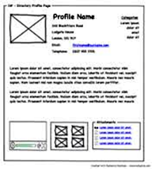
Chpt 1 (...)
Mobile-first approach
Because it forces to think about the essentials!
Examples: BAD page 12, GOOD fig page 13
Start with wireframe helps focusing on:
Functionalities
Priority of content
Architecture of information & arrangment of visual elements
Tools: https://wireframe.cc/ -> good, quick and low-fi more advanced:
balsamicMockups http://balsamiq.com/
OR: pen and paper http://www.creativebloq.com/ux/how-prototype-websites-paper-31514246 )
Inspiration: https://www.awwwards.com/50-examples-of-responsive-web-design.html

Slide 7

Exercise 1
Work in pairs (to get more discussion going)
Consider the the Quiz-R-us player page
What does the player need? See: Quiz_R_Us.docx for inspiration and data about what will be needed in the main page for a player:
perhaps a list of newly available quizzes
personal high-scores and those of friends
a history (of past quizzes) and/or a list of all unfinished quizzes
...
Make 2 wireframes for the player page:
first make a wireframe for the mobile version of the page (mobile-first)
then make another for the laptop version of the same page
The result should be 2 wireframe sketches of how the page/site would look like on a mobile device and on a laptop

Slide 8

Chpt 2
Responsive layouts/grids -> ”think in proportions, not in pixels”
Main goals:
Adapt with javascript
View objects in % -> flexibility
Learn about features of responsive grid systems
Use viewport meta-tag during page setup http://www.w3schools.com/css/css_rwd_viewport.asp
Use Fundation4 grid (and quick intro to others)
Tool: instead of creating images, use http://placehold.it/ example: https://placeholdit.imgix.net/~text?txtsize=33&txt=hello&w=350&h=150
Notes:
When creating mockups, instead of creating images, use place holders!

Slide 9
Chpt 2 (...)
To maintain compatibility with old browsers... Javascript instead of CSS3 media queries
Adapt.js -> self read
Respond.js -> gets the device dimensions dynamically
just add it in the head -> it reads our CSS3 media queries
if CSS3 is not present, it applies the styles dynamically ;)
Check out: http://scottjehl.github.io/Respond/test/test.html and http://scottjehl.github.io/Respond/test/test.css and http://scottjehl.github.io/Respond/test/test2.css
Notes:
-> respond.js: to change the layout for different resolutions just change the CSS!

Slide 10
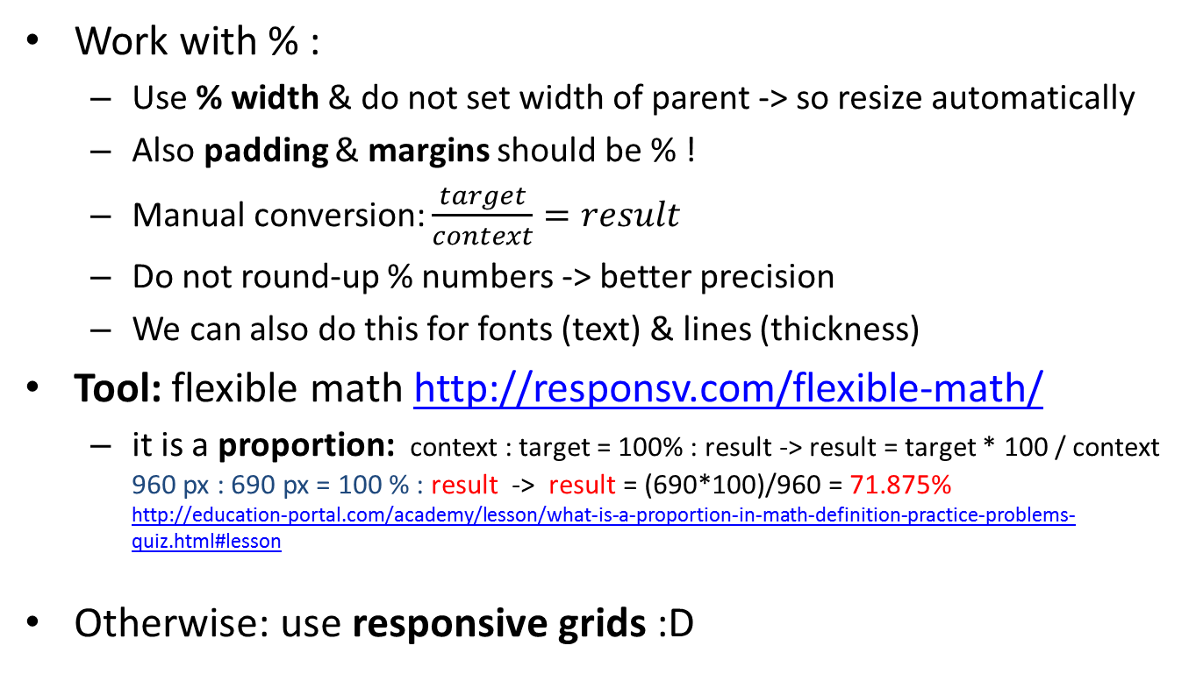
Chpt 2 (...)
Work with % :
Use % width & do not set width of parent -> so resize automatically
Also padding & margins should be % !
Manual conversion: $\frac{target}{context}=result$
Do not round-up % numbers -> better precision
We can also do this for fonts (text) & lines (thickness)
Tool: flexible math http://responsv.com/flexible-math/
it is a proportion: context : target = 100% : result -> result = target * 100 / context 960 px : 690 px = 100 % : result -> result = (690*100)/960 = 71.875% http://education-portal.com/academy/lesson/what-is-a-proportion-in-math-definition-practice-problems-quiz.html#lesson
Otherwise: use responsive grids :D
Notes:
Note: responsive grids calculate their width automatically...

Slide 11
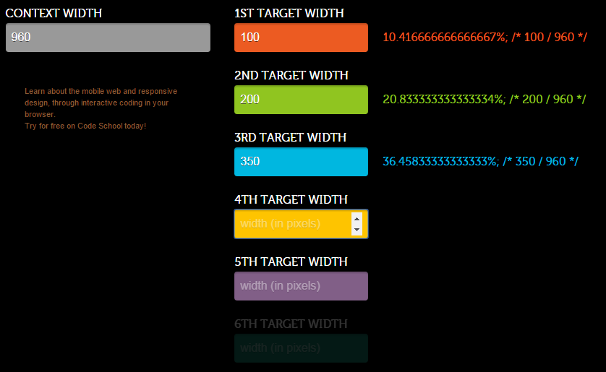

Slide 12
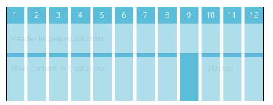
Chpt 2 (...)
Responsive grid system -> def.
A small collection of CSS files to develop quickly
Most grids have 12-16 columns (the smallest unit of measure)
Gutters are margins between columns
Example -> screenshot page 24
If page has very irregular
column size: don’t use grids!
header
12 cols
main contents 8 cols
empty
sidebar 3 cols

Slide 13
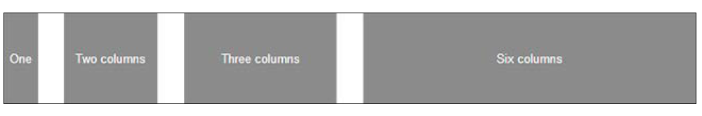
Chpt 2 (...)
Grid systems (see code from book/Chapter 2/ )
play a bit with http://www.w3schools.com/css/tryit.asp?filename=tryresponsive_cols
Fluid baseline (respond.js -> https://github.com/scottjehl/Respond )
3 columns folding layout
1 column on Phones / 2 cols on tablets / 3 cols on desktops -> example page 25
Simple, light, non-obtrusive
Pros/cons: page 27 bottom
1140 grid http://cssgrid.net/ (now retired)
Example page 28 and figure
12 columns (predef)
Features: see page 29 bottom
Foundation4 ...
Notes:
Play a bit: try changing
<div class="col-9">
<h1>The City</h1>
to
<div class="col-12">
<h1>The City</h1>

Slide 14
Chpt 2 (...)
Grid systems
Fluid baseline
1140 grid
Foundation4 (now versions 5 and 6)
Foundation 4 docs: http://foundation.zurb.com/sites/docs/v/4.3.2/
More complete/complex
1 em (typically) is 16 px -> so 1000 px = 62.5 em = 62.5 * 16
Features: see page 30 -> predefined classes + mobile-1st
em = ”M”, the size of the letter M of the font, in pixels
https://en.wikipedia.org/wiki/Em_(typography)

Slide 15

Chpt 2 (...)
Foundation (more)
Classes -> small-6 large-8 columns => meaning:
if on a small device -> 6 cols
If on a large device -> 8 columns
... and 768 px is the threshold (i.e. the breakpoint)
Nesting: figure and code page 31 -> 12 sub-columns!
Offsets: to make space horizontally
Measured in columns
Page 32 (middle) -> example
also ‘centered’ in the class
Push/pull: order the content horizont. (page 32 bottom & p. 33 top)

Slide 16
Chpt 2 (...)
Tools: Use photoshop (http://guideguide.me/) or gimp (http://docs.gimp.org/en/gimp-concepts-image-grid-and-guides.html) to make grid templates -> for layout creation
Viewport meta-tag http://css-tricks.com/snippets/html/responsive-meta-tag/
Also initial-scale can be used
https://css-tricks.com/probably-use-initial-scale1/

Slide 17

Exercise 2
Take your 2 wireframe pages from exercise 1, and put each one into a grid layout.
Find out column widths, in a 12 cols layout.
The result should be a copy of your wireframe images, with 12 columns marked.
To add more details to the pages consider making a ”Mood Board”
http://www.onextrapixel.com/2012/02/mood-boarding-methods-for-web-designers/
https://blog.hubspot.com/agency/mood-board-tools#sm.0019edtzxh6dcv811wn161zt1avaa

Slide 18

Chpt 3
Responsive navigation menus
Menu contains:
Logo, login, navigation options, search field, ...
Problem:
use little space
use efficiently
high usability
Solution: follow responsive navigation patterns!
Navigation: top VS left
VS

Slide 19
Chpt 3
Responsive navigation patterns
Where each works best?
http://bradfrost.github.io/this-is-responsive/patterns.html
Factors | TOP | LEFT
Scanning (visually in page) |  | Wins -> vertical scanning is more natural
Page space | Wins –> maximize vertical area
Items priority | TIE
Visibility | TIE
Topics & interests | Few, specific topics: high priority items. Easy to find contents. | E-commerce -> better left menu

Slide 20
Chpt 3
8 menu patterns
Article from Brad Frost (page 45, top)
Look at figures for each pattern -> smartphone/tablet/desktop
Top Nav: use <nav> tag (or CSS in IE8 or less)
Footer anchor: looks like top nav on desktop
‘&#9776;’ is ‘☰’ , used as menu’s text icon ☺
For desktop -> position at top, while default is at bottom
Toggle menu: menu button + slide down top nav menu
TOOL: responsive nav plugin
CSS3 touch
Works even if Javascript is disabled
Works on many systems
How to do it? See page 50-52
Select menu: menu as <select> tags
How to do it? Use TinyNav.js http://tinynav.viljamis.com/ -> page 54
http://bradfrost.github.io/this-is-responsive/patterns.html

Slide 21
Chpt 3
Footer-only: possible problem -> user cannot find menu
Multi-toggle: good for complex menus (nested)
Use <input type=”checkbox”>
And customize style
And jQuery to open/close submenus
Toggle & slide: like previous, but ”upwards”
See how: page 59-60
Off-canvas menu:
Use JPanelMenu jQuery plugin -> hides menu + shows when a button is pressed
Possibilities: animations, kebyoard shortcuts, choose direction
See figure page 61
How to? A bit of jQuery to specify how the JPanelMenu will work

Slide 22
Exercise 3
Choose 1 type/style of menu for your player page
Which kind?
How will it change from mobile to laptop?
Discuss/explain and write down your decision and alternatives (in pairs)
Design it: just sketch the menu (implementation later)
Remember: mobile-first approach, but it should work also on laptop...

Slide 23
Chpt 4 and 5
Chpt 4: responsive text
Chpt 5: prepare images and vidoes

Slide 24
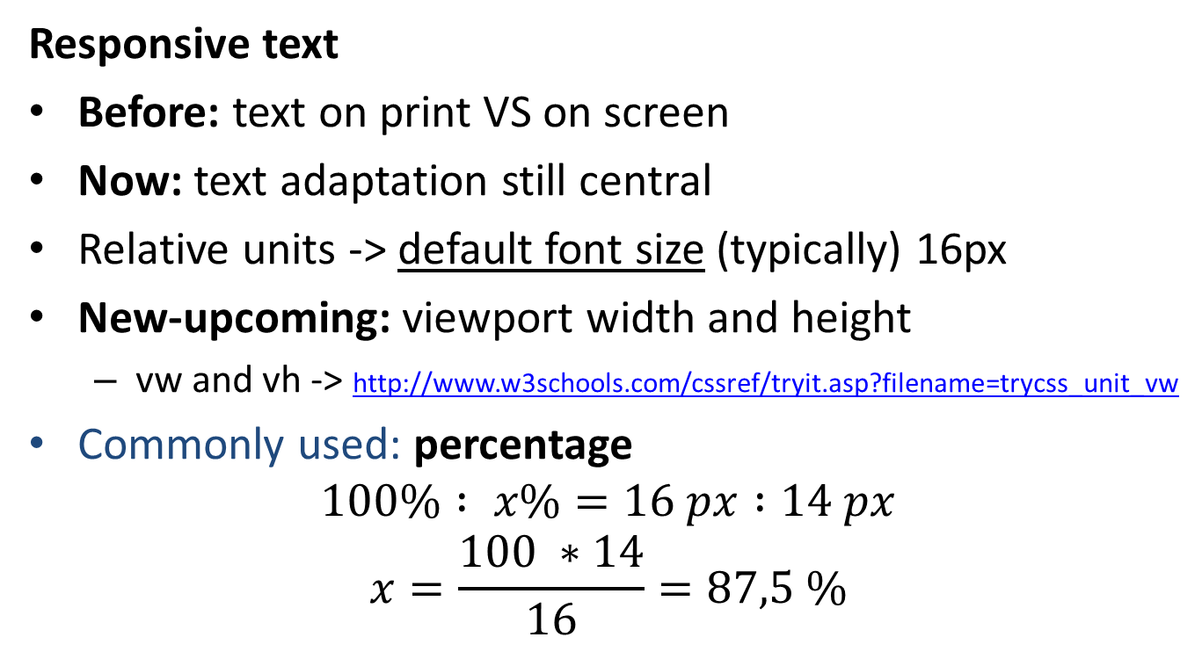
Chpt 4
Responsive text
Before: text on print VS on screen
Now: text adaptation still central
Relative units -> default font size (typically) 16px
New-upcoming: viewport width and height
vw and vh -> http://www.w3schools.com/cssref/tryit.asp?filename=trycss_unit_vw
Commonly used: percentage
$$100\% : x\%=16 px :14 px$$
$$x=\frac{100 ∗14}{16}=87,5 \%$$
Notes:
Viewport VW and VH http://www.w3schools.com/cssref/css_units.asp
vw -> Relative to 1% of the width of the viewport
vh -> Relative to 1% of the height of the viewport
Try out: http://www.w3schools.com/cssref/tryit.asp?filename=trycss_unit_vw

Slide 25
Chpt 4 (...)
Percentage:
Other solution: change default font size to 10 px
em: 1 em = 16 px -> 1.25 em = 20 px
relative to the font size of the parent element -> figure page 67
tool: http://pxtoem.com/ conversion tool
rem: (root em) rel to root of the elements, i.e. <html>
Customize font family -> for beauty
Using imgs instead of fonts is bad -> less responsive
tool: http://www.google.com/fonts good gallery of fonts
@font-face { font-family: ”...”; src: url(... TFF ...); }
tool: font squirrel http://www.fontsquirrel.com/
input a font -> output a ZIP file with a font kit -> exampe page 72 top
Possible options: Optimal -> only subfont to remove size of file Expert -> can select which charaters to include
http://www.w3schools.com/css/css3_fonts.asp

Slide 26
Chpt 4 (...)
Self read: how to use font squirrel -> page 71-74
Self read: various plugins and online tools to manipulate fonts

Slide 27
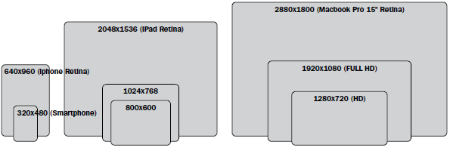
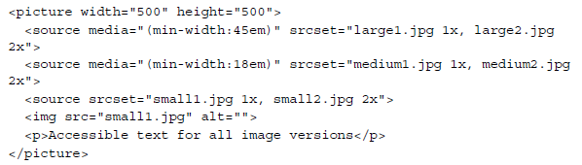
Chpt 5
Chpt 5: prepare images and vidoes
Scaling images depending on device size
Images breakpoints -> factors like screen resolution and bandwidth (keep it low)
<picture> tag
Notes:
<picture> explained: https://webdesign.tutsplus.com/tutorials/quick-tip-how-to-use-html5-picture-for-responsive-images--cms-21015

Slide 28
Chpt 5
More methods:
http://www.hongkiat.com/blog/serving-responsive-images/
Focal Point CSS framework http://www.cdnconnect.com/docs/focal-point-css/pure-html-css-responsive-high-resolution-images-solution “Focal Point is a small set of CSS classnames to help keep images cropped on the focal point for responsive designs. Using only HTML/CSS, web authors can specify an image's primary focus as the image scales on responsive webpages.”

Slide 29
Next lecture
From “Responsive Web Design with jQuery”
chapter 7 responsive tables
(chapter 9 and 11) testing the responsivness
chapter 12 website performance
Read: chapters 7 and 12
other chapters (just scan thru):
chapter 9 and 11

Slide 30
Task – player page
Finish up the exercises we did today in a coherent, ”usable” page: see folder task-playerPage\
Decide about fonts and colors:
check out https://www.viget.com/articles/color-contrast for a nice intro to colors and combinations
Implement your wireframe page:
use a 12 grid menu
implement it with foundation4 (see previous example) or bootstrap, you decide which one you’d like to use
implement your menu for the player page
images can be (1) found on google images or (2) faked with http://placehold.it/
The result should be a working page, but with fake, static data about a player and his/her quizzes

