Slide 1
DWeb lecture 4
ANVA

Slide 2
Topics
From “Responsive Web Design with jQuery”
chapter 7 responsive tables
(chapter 9 and 11) testing the responsivness
chapter 12 website performance

Slide 3
Responsive tables
Tables scale poorly:
minimal table width exceeds screen width
table gets too small (text too)
4 approaches to solve:
Expandable responsive tables
Stacked tables
Horizontal overflow
Link to full table

Slide 4
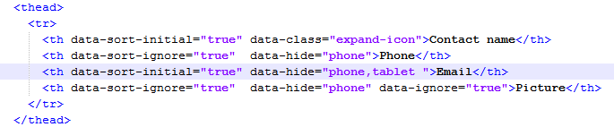
a) Expandable responsive tables
FooTable jQuery plugin
Decide which columns to hide (on mobile) / prioritize cols
Then, show more details on touch
Customization via DOM
Attributes data-* : data-class, data-hide, data-ignore, in the <TH>
Breakpoints (when is large screen, when is it mobile?)
addons: sorting and paging -> based on data-* attributes
On phone and table devices: hide email (examples/chapter7/footable/)
To test: change width of your browser

Slide 5
b) Stacked tables
StackedTables jQuery plugin http://johnpolacek.github.io/stacktable.js/
Swap horizontal with vertical ->
Good for tables with few columns
See how: book, page 145
examples/chapter7/stacktable

Slide 6
c) Horizontal overflow
Freeze 1st column + scroll down other cols
Good for large number of columns
See how: page 146 -> responsive-tables.js
examples/chapter7/responsive-table -> very unobtrusive
Breakpoint: 767px (but can be changed in the js code)
It can be combined with another trick:
CSS-only rotate table! http://css-tricks.com/rotated-table-column-headers/

Slide 7
d) Link to full table
Just show a link to the full table, on mobile phone
Tap/click on the link -> get the full table + swipe to see it all
How? See page 150
examples/chapter7/fulltable

Slide 8
Task1 - Reactive Tables for Quizzes
Work in pairs
Given a table about the quizzes that a creator is currently working on (see folder tasks)
Make the table ”responsive”
using 2 of the methods discussed before
but first: decide which info are more important and how the table should look like when on small screens
Test your solutions by resizing the browser window
you should have at least 2 versions of the table: 1 for small and 1 for large screens
20 min.

Slide 9
Website performance
General rule: ”a page should load in < 4 seconds”
User perception of loading time: different desktop VS mobile!
Client-side processing can be reduced:
Use a Content Delivery Network (CDN)
Fewer HTTP requests
Smaller payload these are opposites
Optimize client-side processing
& Test website peformance
https://blog.kissmetrics.com/loading-time/
Website Response Times: article http://www.nngroup.com/articles/website-response-times/
(see image loading-time-lrg.jpg )

Slide 10
1. Content Delivery Network
DEF: Collection of web servers, distributed
Proximity = fast access
the CDN makes pages load faster from the user's perspective
Examples:
http://www.mirror-image.com/
and http://www.limelight.com/ ( https://www.limelight.com/delivery/ )

Slide 11
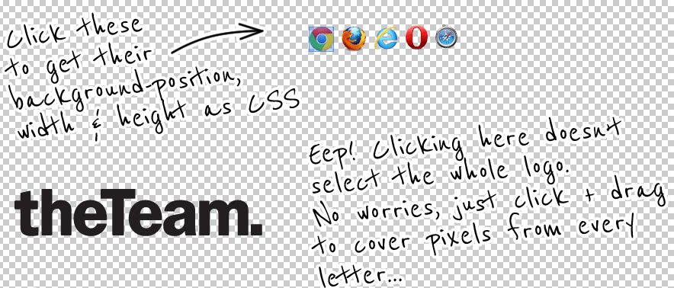
2. Fewer HTTP requests
Minimize # of HTTP requests
Conditional loaders -> requireJS http://requirejs.org/ and examples/requireJS
Combine many scripts in 1
Combine many CSS in 1
CSS sprites -> image consolidation -> merging theme images into one (book page 220) use spriteCow http://www.spritecow.com/ (example: examples/spriteCow )
Consolidate + Minifying
YUI compressor http://yui.github.io/yuicompressor/
Google’s Minify https://code.google.com/p/minify/
What is consolidation? http://www.guypo.com/consolidation-not-simple-addition/
.sprite { background: url('imgs/example.png') no-repeat -433px -51px; width: 33px; height: 33px; }
Notes:
I) Def:
RequireJS is a JavaScript file and module loader.
It is optimized for in-browser use, but it can be used in other JavaScript environments, like Rhino and Node.
Using a modular script loader like RequireJS will improve the speed and quality of your code.
More details about loading external modules: see ELO chpt 10 -> http://eloquentjavascript.net/10_modules.html
II) In the examples/requireJS folder you can see an example of how require works, with 3 small modules.
III) When using spriteCow, remember to open an image and SET THE BACKGROUND color (click on the transparent area)

Slide 12
TASK 2 – icons in the table
Work in pairs
Use spriteCow to add icons to your table (task 1). For example an icon can show if a quiz is published or not, and there could be an icon to symbolize the topic of a quiz (out of a palette of a few possible topics)
use icons from http://www.freepik.com/free-icons/ to add icons to your table
use GIMP (for example) to compose all the icons you need in a single large image
then use spriteCow to find the coordinates for the CSS of each icon you want, from the large image
test your table with icons, for small and large screens
20 min.

Slide 13
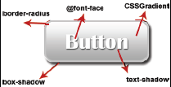
3. Smaller payload
Reduce size -> save bandwidth & load faster!
Progressive JPEG -> use lower resolutions for mobile + provide button to open original img on demand
Perceived as better!
Some tools to optimize images: see page 222
Take advantage of HTML5 and CSS3
HTML5: e.g. use nav and footer tags
semantic elements = more efficiently parsed page
CSS3: use dynamic artwork like gradients, rounded borders, shadows -> need for less images
http://blog.patrickmeenan.com/2013/06/progressive-jpegs-ftw.html [interesting video]

Slide 14
4. Optimize client-side processing
Test website peformance -> manual or automatic?
4 tools:
PageSpeed Insights -> google’s -> many useful suggestions! http://developers.google.com/speed/pagespeed/insights/ Example – testing google.dk : http://developers.google.com/speed/pagespeed/insights/?url=https%3A%2F%2Fwww.google.dk%2F
YSlow
WebPagetest
Mobitest
All tools make reports of a website

Slide 15
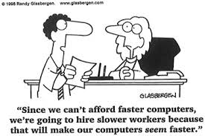
Testing the responsivness
Best: test on device
If not possible, then:
Simulate device with browser tool -> see [1]
Device emulator -> OPERA mobile emulator http://www.opera.com/developer/mobile-emulator
Unit testing responsivness
Work incrementally -> test often -> for every new feature
Regression testing -> after adding a new feature, test you did not break any existing feature
Do performance analysis for mobile pages (tools above)
[1] https://chrome.google.com/webstore/detail/ripple-emulator-beta/geelfhphabnejjhdalkjhgipohgpdnoc?hl=en
And intro: http://www.raymondcamden.com/2013/2/6/Using-Ripple-for-PhoneGap-Development

Slide 16
TASK 3 – require
Let’s create a table from data, dynamically. And we will use requirejs to structure our page
Start from the code for task 3: tasks/creatorAndreaBoard_task3.html
Rewrite it using requirejs; do the following:
create a main module (as in examples/requirejs)
create a function that creates the table from data. The function should return a string with the table definition, and take the data as input parameter. The function should work even with more complete data about the quiz creators. Use loops to generate the text of the table, instead of what you can see in tasks/creatorAndreaBoard_task3.html Make a module just for the function.
put the definition of the data in a second module
require both modules and use them in your main javascript module to create the table
20
min.

Slide 17
Next week
Start reading ELO chpt 4, chpt 5 and 6
Recursive functions (ELO chpt 4)
Lists (ELO end of chpt 5)
Closures (ELO end of chpt 4)
High-order functions (ELO chpt 6)

