Slide 1
Distributed Programming Lecture 8
Andrea Valente
anva@mmmi.sdu.dk

Slide 2
Topics
Reference book: Learning jQuery 4rd edition
Dynamic HTML:
the DOM: tree ADT, visiting trees
Recap of jQuery
Book chapters 1,2,3 and 5
jQuery look under the bonnet -> objects and high-order function
traversing the DOM (with and without jQuery)
Concepts: Objects, trees, high-order functions, recursion, tree traversal, DOM, selection and insertion, method chaining.

Slide 3
From last lecture...
How to:
be able to go from (HTML) text to DOM
and because a DOM is a tree data structure (a tree of objects) -> define a tree as an ADT in Javascript
be able to visit (or traverse) a tree ... and find data inside it
shortly recall how the HTML DOM works
learn some of the tricks jQuery uses
DONE

Slide 4
(4) HTML Document Object Model
Document Object Model -> a tree of objects
Overview http://www.w3schools.com/js/js_htmldom.asp
API: http://oreilly.com/catalog/jscript4/chapter/ch17.html
See: 01_javascript and DOM
Consider again some basic operations, and how to do them using only javascript:
searching for elements
getElementsByTagName -> returns a collection of HTML elements -> 01_searching_DOM.html
getElementById -> 02_searching_DOM_byID.html
modify elements
remove the first LI element of the page
then insert a new <P> as last element of the UL

Slide 5
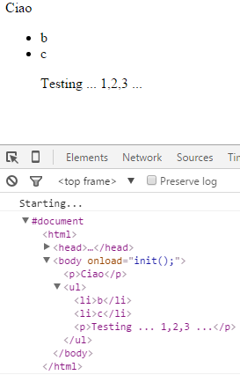
Modify elements (DOM)
http://www.w3schools.com/js/js_htmldom_elements.asp
DOM: http://eloquentjavascript.net/13_dom.html
API for DOM nodes: https://developer.mozilla.org/en-US/docs/Web/API/Node.appendChild
See: 03_modify_DOM.html the result is:

Slide 6


(5) Too boring! :/
Why not... create a library to simplify our task? ^_^
What tricks could we use?
let’s cheat and look at jQuery... for inspiration
pass functions to other functions (e.g. ready() or event’s callbacks) -> High-Order Functions ( HOFs )
call 1 function on a collection of objects -> HOFs again, e.g. map()
-> see: 02 jQuery tricks/01_appply function to entire array
method chaining (a design pattern) -> run (and look at the source) 02 jQuery tricks/ 02_chaining/RPGCharacter.html How does the RPGCharacter constructor work? How does method chaining work?
=>> Check out also version 2 => 02 jQuery tricks/ 02_chaining/RPGCharacter_v2.html <<=

Slide 7
Exercise – method chaining
25
min
Practice with method chaining
Modify the RPGCharacter example, by implementing new methods for the RPGCharacter ADT. The methods should be:
foundLevelUp() when the method is called, the character should receive 100 experience points (XP) and heal completely. Test that your method "chains" like all the others.
drinkPotion(potionName) the parameter potionName is a string, and it can be one of 3: "yellow", "blue" or "green" potions. If the character drings a yellow potion, it looses 10 health points, but receives 10 coins. Drinking the blue potions kills you instantly; while drinking a green potion restores you health to 100 and increases your XP of 2. Any potion with other names should have no effect on the character.
[Advanced] Change the RPGCharacter constructor: add attributes luck and strength.
RPGCharacter should also return a randomized character every time. Randomize: health in [70,100], xp in [10,50], luck in [2,8] and strength in [2,8].
Change the function getDamage, so that if strength is more than 6, only half of the damage is taken.
Change the function foundCoins, so that if luck is more than 6, amountOfCoins is doubled before adding it to the current money.
Finally, change the printState function to print also the new attributes.
Test your new RPGCharacter by creating 3 characters, then make them attack, get damage and find coins.
Notes:
Generate random number between 2 numbers:
http://stackoverflow.com/questions/4959975/generate-random-number-between-two-numbers-in-javascript

Slide 8
So far...
How to:
be able to go from (HTML) text to DOM
and because a DOM is a tree data structure (a tree of objects) -> define a tree as an ADT in Javascript
be able to visit (or traverse) a tree ... and find data inside it
shortly recall how the HTML DOM works
learn some of the tricks jQuery uses
DONE

Slide 9
jQuery (and Sizzle)
“In January 2009, jQuery's creator John Resig introduced a new open source JavaScript
project called Sizzle. A standalone CSS selector engine, Sizzle was written to allow any JavaScript library to use it with little or no modification to its codebase. In fact, jQuery has adopted Sizzle as its own selector engine ever since version 1.3. … The combination of Sizzle and jQuery's set of traversal methods makes jQuery an extremely powerful tool for finding elements on the page” [from the book, chapter 9]

Slide 10
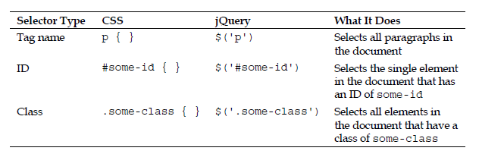
Selection with jQuery
syntax: $(selector).action()
a nice summary of selectors: http://www.w3schools.com/jquery/trysel.asp
summary of jQuery HTML and CSS Methods: http://www.w3schools.com/jquery/jquery_ref_html.asp
the elements referred to by the selector passed to $() are looped through automatically and implicitly
theParent
See: 03_traversing the DOM with jquery, 01 and 02

Slide 11
Insertion (and deletion) with jQuery
See 03_traversing the DOM with jquery/03_modify.html
(Check also: wrapping and unwrapping http://api.jquery.com/unwrap/ )
Setting attributes with value-callbacks (see 04_modify.html )
Removing elements: 05_modify.html
Cloning: 06_modify_clone.html
DOM manipulation methods in a nutshell (book page 136-137)

Slide 12
Exercise 2
25
min
Problem definition (folder 04 level-builder/ )
In an RPG game, a level can contain from 5 to 10 rooms (use a random value to decide how many).
Each room can have inside:
a treasure chest -> 50% probability of having it
a book -> 50% probability of having it
Each treasure chest can contain (or not, 50% probabilty):
100 gold coins
Each book can contain (or not, 50% probabilty for each item):
a map of the entire level
a golden bookmarker
Using jQuery:
Write a program that generates a random level, using nested DIVs to represent the rooms, chests, books ect. See the existing code for inspiration.
When the user clicks the button, place the player in a room with a book; if no room has a book, place him in the last room of the level. Note: there is already a DIV with ID player. You need to remove it and place it at the appropriate place, when the button is clicked.
Notes:
Generate random number between 2 numbers:
http://stackoverflow.com/questions/4959975/generate-random-number-between-two-numbers-in-javascript

Slide 13
Next time
Read chapter 9 “Learning jQuery” 4rd edition:
jQuery traversing -> page 241
custom pseudo-class (plugins)
Localstorage + JSON: read
https://www.w3schools.com/html/html5_webstorage.asp
http://stackoverflow.com/questions/2010892/storing-objects-in-html5-localstorage

Slide 14
Portfolio
As you know at this point, there is no need for you to get your portfolio tasks approved, but...
I suggest that you finish the stuff you are already working on... take it as practice for the written exam.
I will give you a more precise list of material for the exam ASAP

