Slide 1
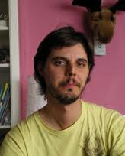
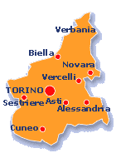
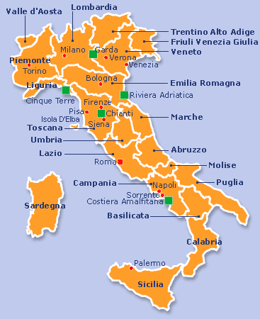
Background: education
Andrea Valente anva@mmmi.sdu.dk
Computer Science Master (Torino University): computer graphics specialization, but thesis on type systems for object-based languages
Ph.D. on formal languages, theory and implementation of calculi for mobility
Post-doc, research and teaching at AAU Esbjerg

Slide 2
Background: teaching
From 2003 - Aalborg University different semesters in Medialogy (Esbjerg and Copenhagen), and Software Engineering, both bachelor and master:
various Software Design courses, basic and OO programming
Multimedia programming and Introduction to Programming (medialogy bachelor and software engineering)
HCI, Math 1 and 2 in the basis year, Computer Games and Image Processing (Med4)
From 2014 – Syddansk University
Java programming (software engineering)
Courses about client- and server-side programming in Javascript (learning and experience technology)

Slide 3
Research interests
e-learning/game-based learning,
knowledge management, formal languages,
tangible interaction, user-centered design
Research/papers:
  Paper Turing Machine
  Prime Slaughter
  One-dimensional games

Slide 4
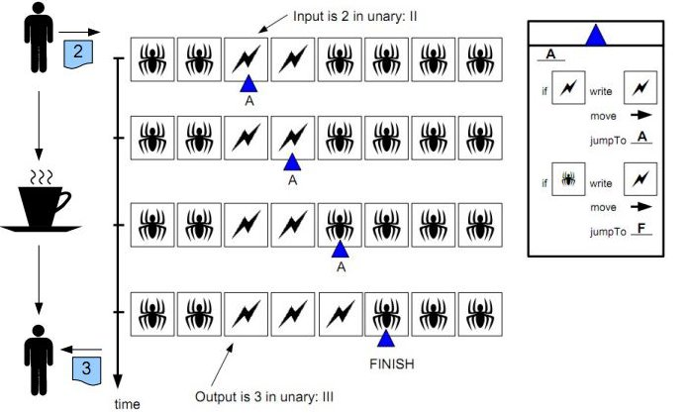
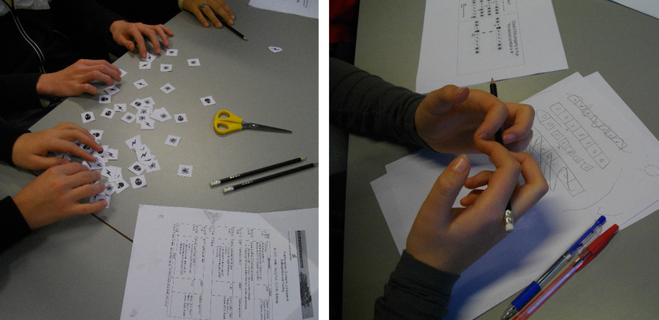
Paper Turing Machine
CS as a game -> sense making

Slide 5

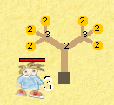



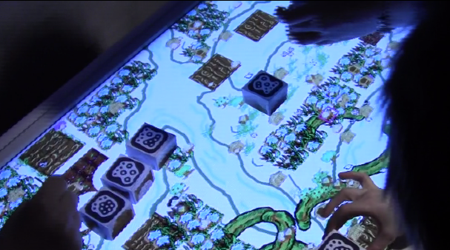
Prime Slaughter
Computer game design for playful math-learning.
Transpose abstract mathematical concepts into playful visual interaction
Prime factorization
Numbers as monsters, swords and trees
Design based on results from
Emanuela's MicroCulture

Slide 6
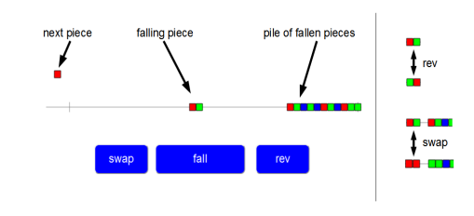
1D games
Slides:
http://www.slideshare.net/andrea270872/social-exploration-of-1d-games
1Dminos is a transposition of Tetris onto 1D

