Slide 1
Night of Innovation
Introduction to Machine Learning

Slide 2
Outline
Objective
Dataset
The Perceptron
CRISP-DM
Further Actions

Slide 3
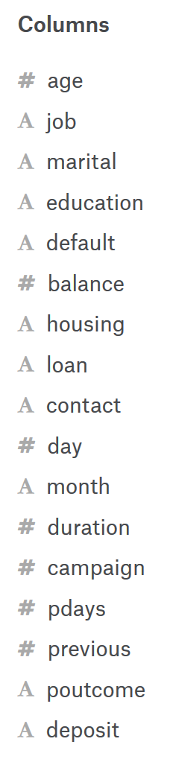
Dataset
Bank dataset to predict if a customer will use deposit
11.2k Customers with 17 features
Numerical and categorical data:

Slide 4
Examples
Nr | age | job | marital | education | default | balance | housing | loan | contact | day | month | duration | campaign | pdays | previous | poutcome | deposit
11003 | 35 | management | single | tertiary | no | 805 | no | no | cellular | 17 | sep | 613 | 1 | -1 | 0 | unknown | no
3439 | 40 | technician | married | tertiary | no | 206 | no | no | cellular | 23 | apr | 499 | 6 | 185 | 4 | success | yes

Slide 5

Objective
Find a predictive function
$$f\left(x\right) :R^{n} ×\left\{−1,1\right\}$$
Or in python
def predict(X):
…
return y
y = predict(X)

Slide 6
Objective
Learn such a function from the data that the prediction of deposit is as accurate as possible

Slide 7
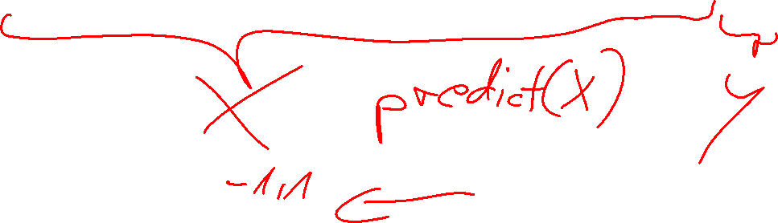
Examples
Nr | age | job | marital | education | default | balance | housing | loan | contact | day | month | duration | campaign | pdays | previous | poutcome | deposit
11003 | 35 | management | single | tertiary | no | 805 | no | no | cellular | 17 | sep | 613 | 1 | -1 | 0 | unknown | no
3439 | 40 | technician | married | tertiary | no | 206 | no | no | cellular | 23 | apr | 499 | 6 | 185 | 4 | success | yes

Slide 8
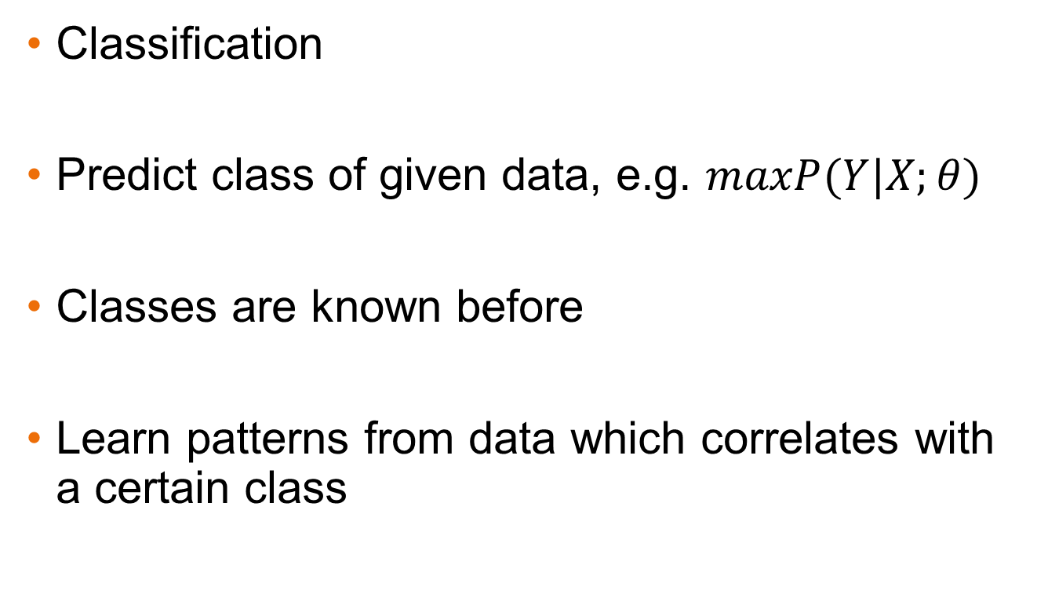

Supervised Machine Learning
Classification
Predict class of given data, e.g. $maxP(Y|X;θ)$
Classes are known before
Learn patterns from data which correlates with a certain class

Slide 9
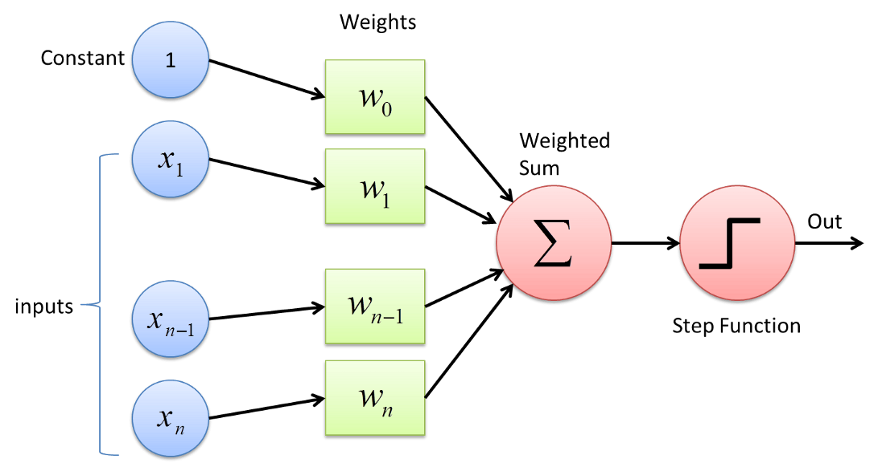
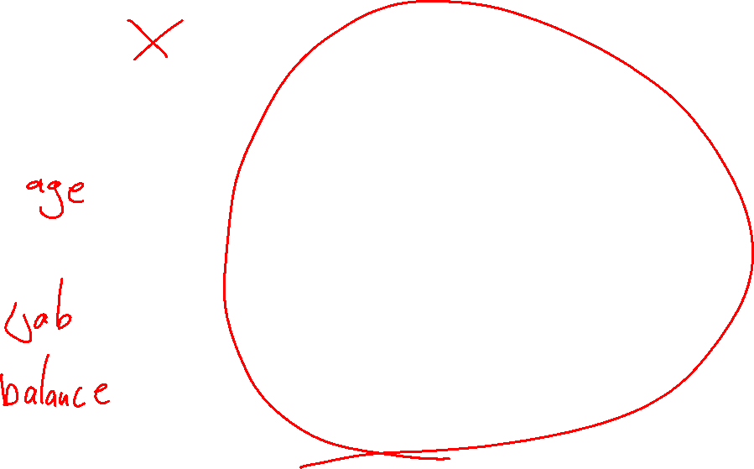
The Perceptron
https://towardsdatascience.com/perceptron-learning-algorithm-d5db0deab975

Slide 10
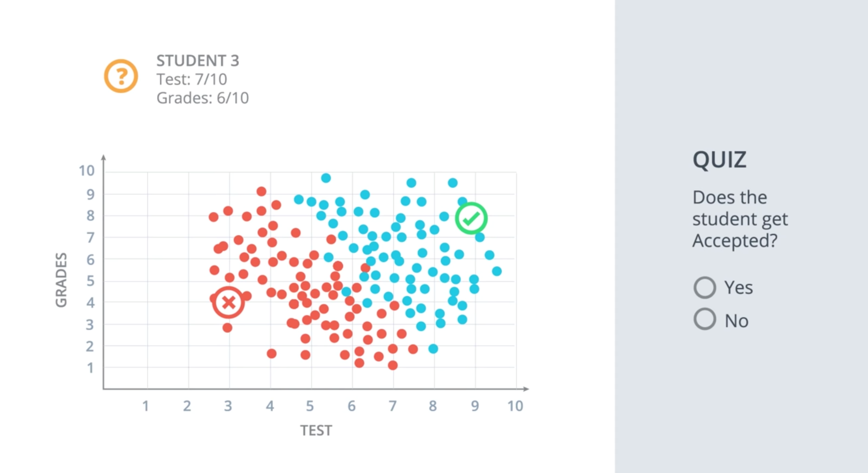
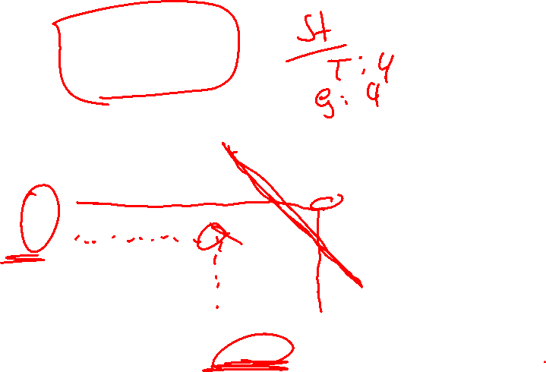
Classification

Slide 11
The Perceptron
The math behind the Perceptron

Slide 12
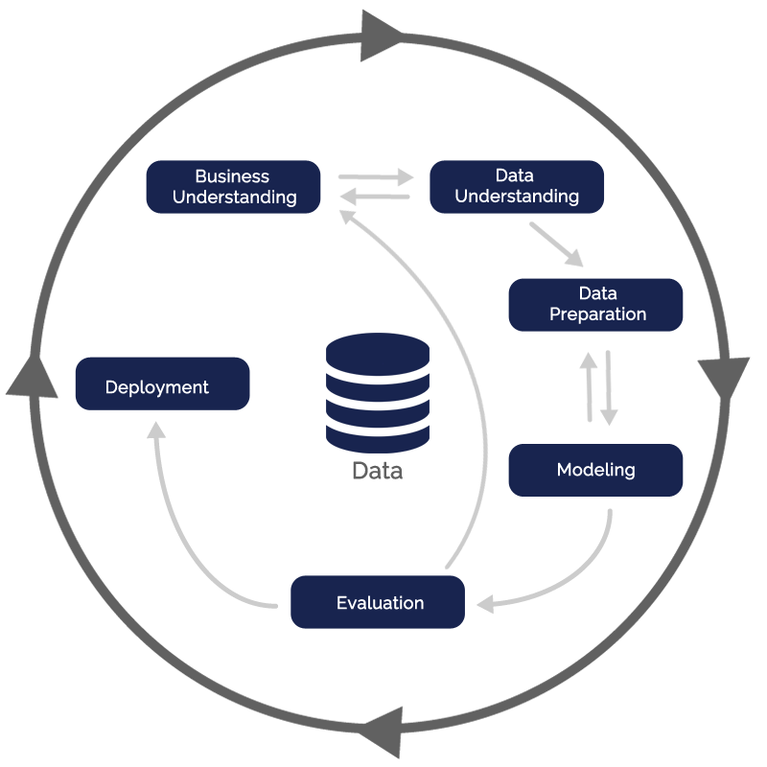
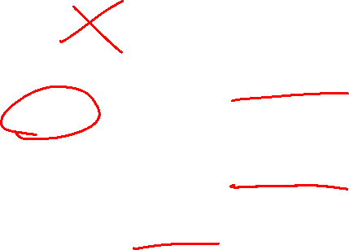
CRISP-DM
https://blog.magrathealabs.com/crisp-dm-and-what-i-did-wrong-70c4e7e8656

Slide 13

CRISP-DM
https://blog.magrathealabs.com/crisp-dm-and-what-i-did-wrong-70c4e7e8656

Slide 14
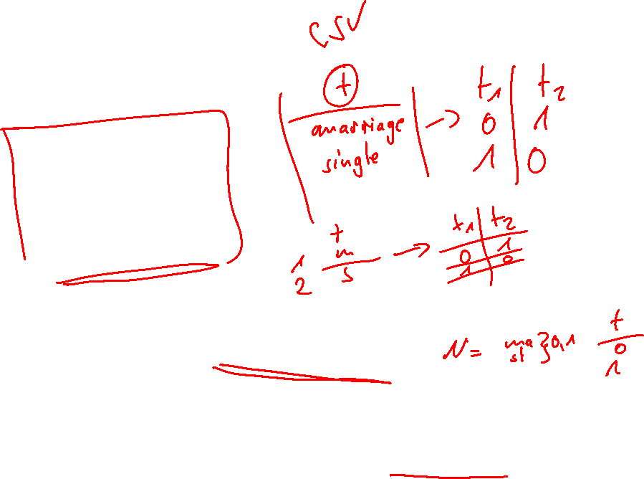
Data Preparation
Datatypes
Numeric
Categorical
Cardinal
Ordinal
Machine Learning works in Euclidean space
Note there are few exceptions
Dataset must be converted in Euclidean space
Solutions: One-Hot Encoding / Numerical Encoding

Slide 15
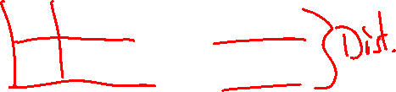
Data Preprocessing
Stabilize numerical data to avoid issues in similarity or dissimilarity measure
Example: Age and Height of Human
P1: 18 Years and 1.8m
P2: 64 Years and 1.6m
Differences: 46 and 0.2m
This can cause problems because years independent of its interpretation is dominant factor

Slide 16
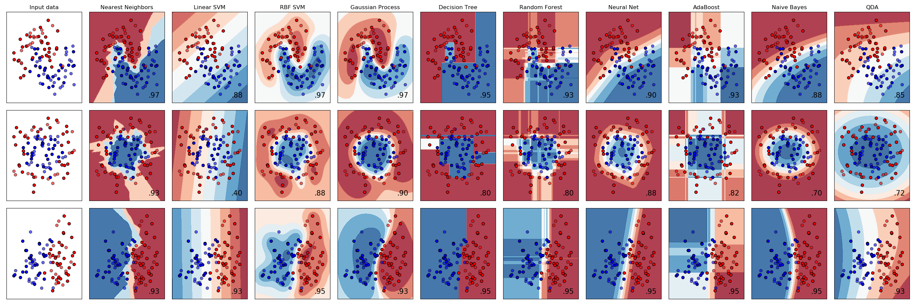
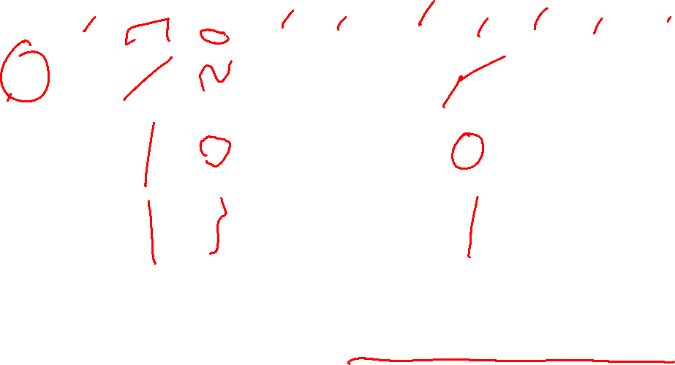
Machine Learning Algorithms
https://scikit-learn.org/stable/auto_examples/classification/plot_classifier_comparison.html

Slide 17
Evaluation
The competition is about accuracy.
No other benchmark value is important!
Accuracy: Ratio of predicted classes to ground truth classes of given data in percent.
Team with highest accuracy over test-set is winner of competition.

Slide 18

Intro Scikit and Keras
Three steps to learn and evaluate a model by these frameworks
Skicit/Keras Preperations
0. model.compile (Keras specific)
model.fit(X,y)
model.score(test_X) # outputs accuracy

Slide 19

Further Reading
The Data Science Design Manual
https://towardsdatascience.com
https://machinelearningmastery.com/
Tutorials on framework website

Slide 20
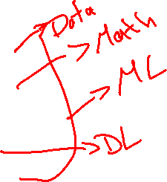
Further Actions
Requirements
Python 3.5 or above (3.6 is ideal), Anaconca or Pip
Update to packages to latest version.
Pandas
Numpy
Skikit-Learn
Keras
Dataset and Notebook
https://github.com/ChristophRaab/MLH

Slide 21

Further Actions
17-18 study and design thinking
Develop a strategy how to solve the problem
Cover the topics of CRISP
18-19 p.m Q & A
19-20 Dinner
First Sprint

