Slide 1
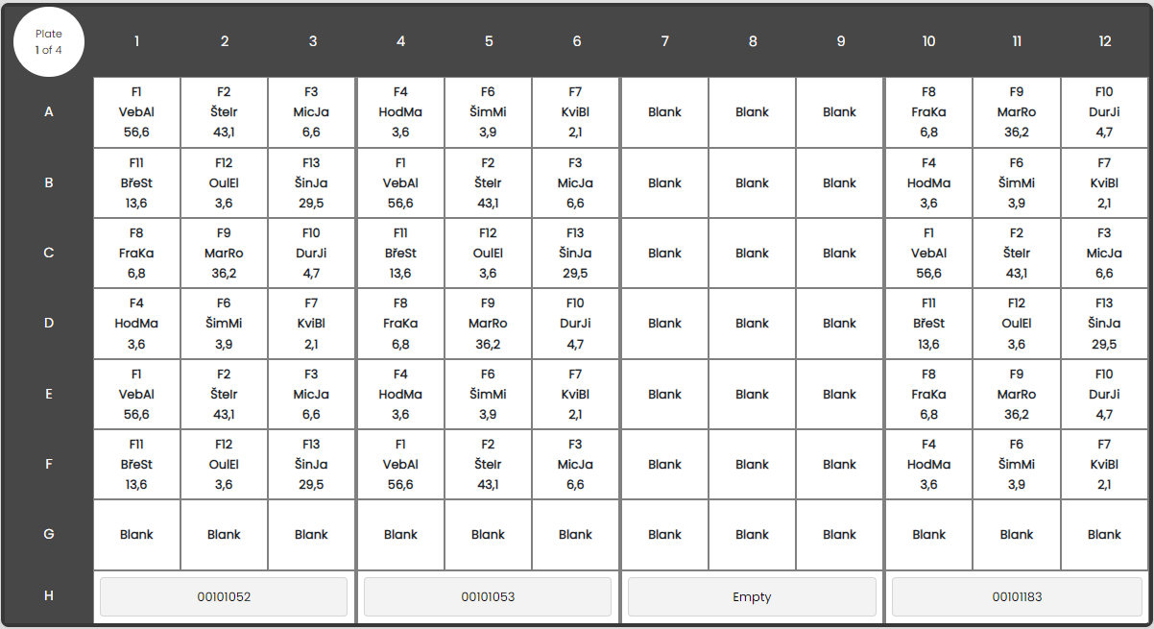
Mark slide as empty
Johannes

Slide 2
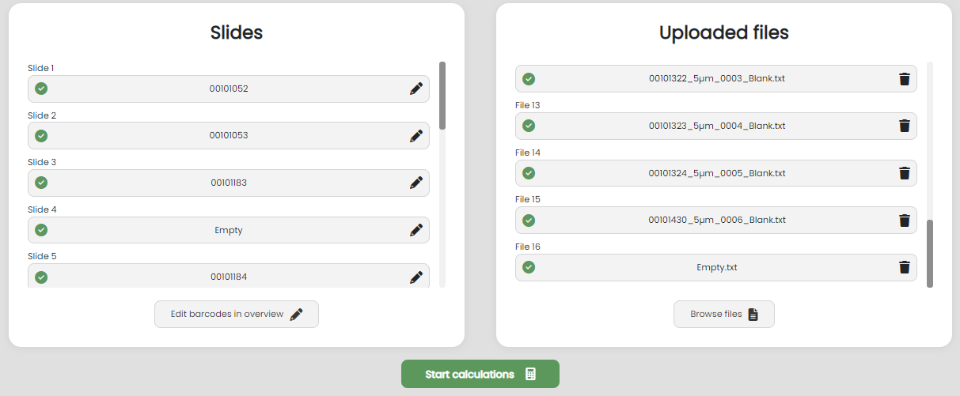
Mark slide as empty
Johannes

Slide 3

Mark slide as empty
Johannes

Slide 4
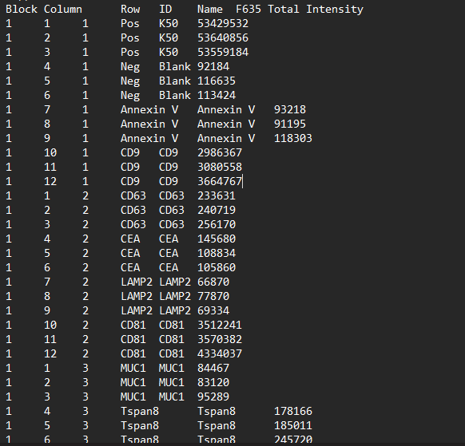
Pos and Neg must be described as such under ID in the txt files from mapix

Slide 5
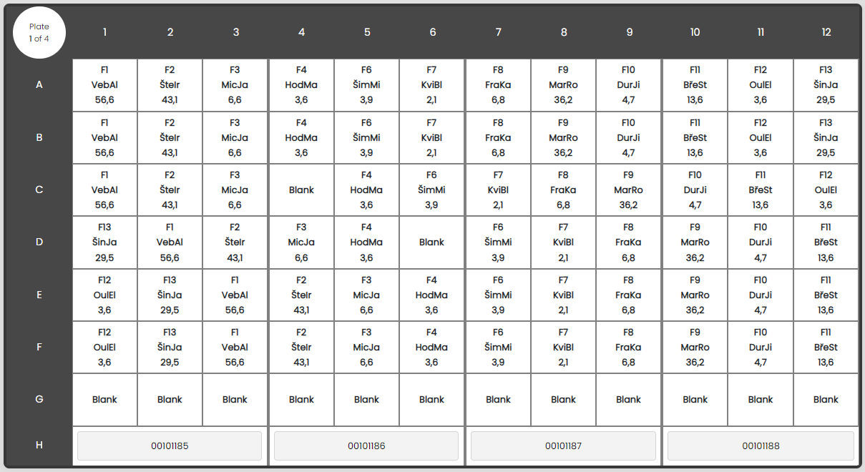
Choose blank block for calculations
Johannes

Slide 6
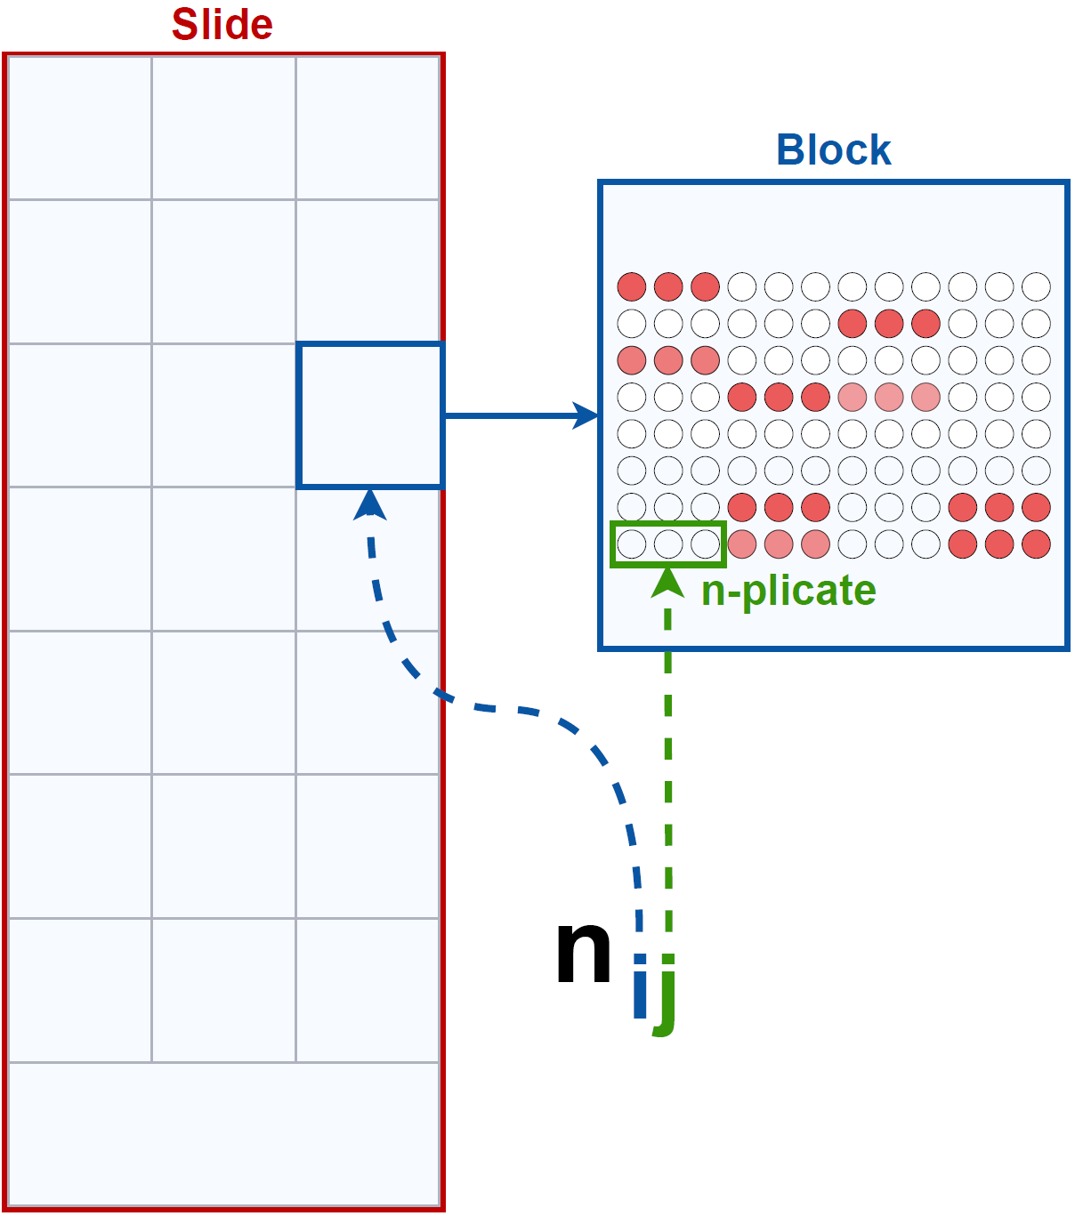
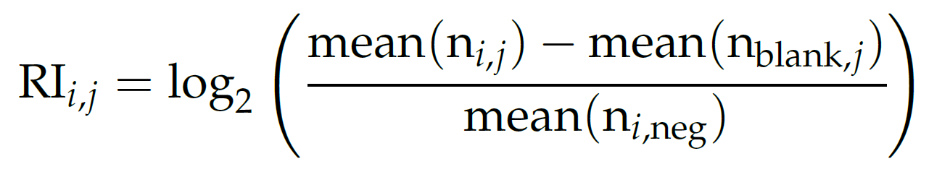
All spots in an n-plicate in the blank block are flagged
Johannes
Invalidation af slide
(Eq. 2.1, s. 5)
(Fig. 2.3, s. 6)

