Slide 1
Skeletal-Part Representation and Depositional Context
Study advances to date — a catch-up from first principles
Research update

Slide 2
Why are we studying skeletal-part representation?
Archaeological question: can the anatomical pattern of a human skeletal assemblage tell us something reproducible about how that accumulation formed?
Formation processes do not leave the same anatomical signature.
Whole bodies, selectively transported remains, carnivore accumulations, geological transport, and intensive anthropogenic processing can produce different representation profiles.
The goal is not to read intention directly from bones.
The goal is to quantify how closely an observed assemblage resembles known reference distributions.
Working idea: depositional and taphonomic processes affect which parts enter, survive, are recovered, and remain represented.

Slide 3
First principles: the main abundance terms
MNE — Minimum Number of Elements
Minimum number of anatomical elements needed to explain the observed fragments.
MNI — Minimum Number of Individuals
Minimum number of individuals needed to account for the represented remains.
MNAU — Minimum Number of Anatomical Units
Standardizes an element count by how many of that anatomical unit occur in a complete skeleton.
[ MNAU_j= ]
%MNAU / adjusted proportional representation
MNI-normalized skeletal-part representation. It retains both how much of the skeleton is represented and where representation occurs.

Slide 4
SPR and ReMNAU: what is actually being measured?
SPR — Skeletal-Part Representation
The anatomical distribution of represented skeletal elements in an assemblage.
%MNAU asks: How much of each skeletal part is represented?
ReMNAU asks: Given what survives, how is that representation distributed across the body?
For relative representation:
[ p_{ij}= ]
The multivariate workflow uses a Hellinger transform:
[ h_{ij}= ]
This reduces the overall magnitude signal and emphasizes relative anatomical configuration.

Slide 5
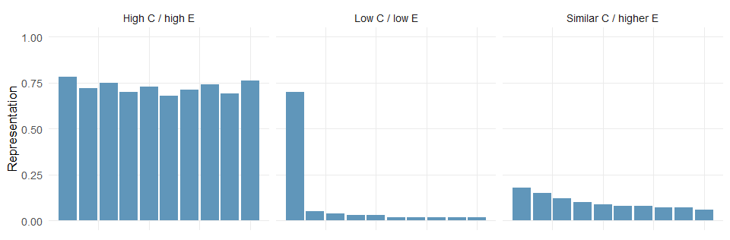
Two core ideas: abundance and evenness
Figure 1

Slide 6
Mean abundance, C: “How much of the body is represented overall?”
Evenness, E: “How evenly is the represented material distributed anatomically?”
Two assemblages can have similar overall abundance but very different anatomical concentration.

Slide 7
The inferential chain
[ ]
The strongest direct inference from SPR concerns:
whole-body representation, anatomical retention, and selectivity.
It does not directly measure:
intention, ritual meaning, or a uniquely funerary behaviour.
Equifinality: different formation processes can sometimes produce similar SPR profiles.

Slide 8
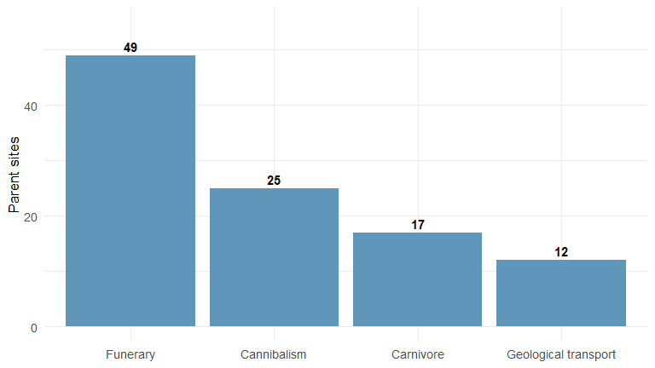
The archaeological reference dataset
Figure 2

Slide 9
Full database: 411 rows from 152 parent sites.
The parent site is the independent archaeological unit.
Restricted four-process benchmark: 103 parent sites.
Reference processes: Funerary Context, Cannibalism / anthropogenic processing, Carnivore-related, Geological transport.
Unknown/uncertain assemblages are projected after model fitting rather than treated as known training labels.

Slide 10
Seven ways of representing the same archaeological signal
C only — mean whole-body abundance.
Evenness only — anatomical regularity/concentration.
C + evenness — simple, interpretable two-variable model.
Adjusted %MNAU — direct proportional representation across skeletal parts.
ReMNAU — relative anatomical composition after magnitude reduction.
Engineered features — abundance, dominance, continuity, density, axial/appendicular contrasts, etc.
Combined — integrates direct and engineered representations.
Purpose: test whether the signal is merely “more skeleton” or whether anatomical configuration adds reproducible information.

Slide 11
How the supervised analysis is validated
Unit of validation: parent archaeological site.
Grouped cross-validation keeps all records from one site together.
Preprocessing is estimated from training data, not from the held-out site.
The same archaeological signal is tested across different model geometries.
Four current classifier families
Logistic regression — interpretable linear benchmark.
Random forest — nonlinear interactions and thresholds.
RBF support-vector machine — smooth nonlinear boundary.
K-nearest neighbours — local similarity in feature space.

Slide 12
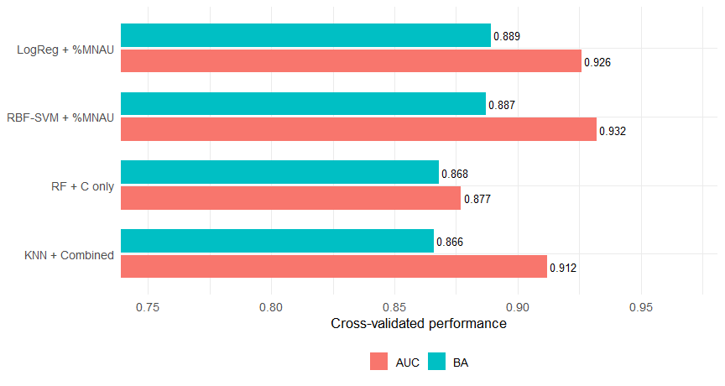
Main supervised advance: the signal is reproducible
Figure 3

Slide 13
Current full-reference binary analyses reach approximately:
Balanced accuracy: 0.86–0.89
ROC-AUC: 0.92–0.93 for the strongest current combinations.
Direct adjusted %MNAU is consistently among the strongest representations.
The key result is robustness across representations and algorithms, not one winning decimal score.

Slide 14
What are the models actually learning?
1. Overall representation is the dominant signal
Mean abundance alone is already strongly predictive.
2. But “more bones = burial” is insufficient
Evenness adds information.
ReMNAU remains discriminative after reducing absolute magnitude.
Detailed relative anatomical structure identifies which regions are selectively retained or lost.
3. PCA gives the same interpretation
%MNAU PC1 ≈ whole-body abundance/completeness ($r≈0.99$ with C).
ReMNAU PC1 ≈ relative anatomical concentration/evenness.

Slide 15
Unsupervised analyses provide an independent check
PCA and clustering are fitted without archaeological labels.
Across representations, the recurring intrinsic contrast is broadly:
[ ]
When archaeological labels are inspected afterwards, funerary and non-funerary contexts are strongly enriched on different sides of this structure.
Interpretation: supervised classifiers are exploiting organization already present in SPR space rather than creating the pattern from the labels alone.

Slide 16
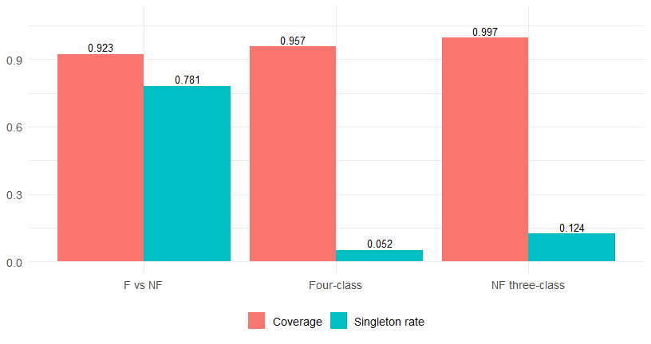
Moving from forced labels to uncertainty: conformal prediction
Figure 4

Slide 17
The current uncertainty layer uses 90% class-conditional (Mondrian) conformal prediction.
Binary outputs can be:
{F} — only the funerary reference class retained.
{NF} — only the non-funerary reference class retained.
{F, NF} — both retained: the assemblage is compatible with both reference distributions.
A singleton set is not “90% probability of burial.” The 90% refers to repeated-sampling coverage under the conformal assumptions.

Slide 18
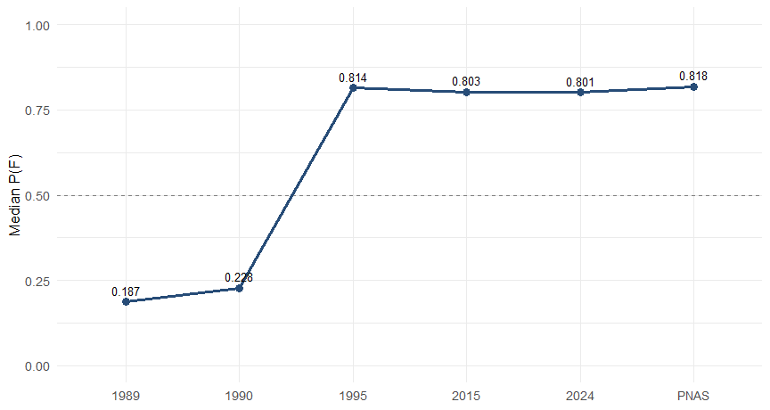
Sima de los Huesos: a recovery trajectory
Figure 5

Slide 19
The sequence 1989 → 1990 → 1995 → 2015 → 2024 → PNAS is interpreted as successive recovery/publication states of the same accumulation, not changing prehistoric behaviour.
1989–1990: sparse, predominantly NF-like / ambiguous SPR.
1995: major increase in whole-body representation.
2015–2024–PNAS: consistently high funerary-reference affinity.
The archaeological inference is stronger evidence for relatively complete whole-body input and lower anatomical selectivity, not a direct proof of funerary intention.

Slide 20
Beyond the binary question
The study now tests several related classification problems:
Primary: Funerary vs non-funerary.
Four-process: - Funerary Context - Cannibalism / anthropogenic processing - Carnivore-related - Geological transport
Conditional non-funerary task: - Cannibalism vs Carnivore vs Geological transport
Conditional human-associated comparison: - Cannibalism-reference vs Funerary-reference distributions
This extends the question from “broad whole-body retention or not?” toward “what kind of selective profile is present?”

Slide 21
Which anatomical regions carry the secondary signal?
After composition is normalized, the clearest positive funerary-reference shifts repeatedly involve:
radius · ulna · vertebrae · hands · clavicle · foot · scapula
The broad pattern is not simply “more limbs.” It is retention of a wider anatomical range, including:
forearm elements;
axial skeleton;
hands and distal elements;
shoulder-girdle elements.
These are frequently reduced in selective non-funerary profiles.

Slide 22
Taphonomic interpretation: from classification to explanation
A feature-engineering and RFE stage ranks 63 taphonomic/anatomical variables, with a reduced analytical core of 10 retained variables.
The retained core emphasizes:
postcranial completeness;
appendicular representation;
upper vs lower and proximal vs distal limbs;
girdle representation;
foot representation;
low-density survival.
A separate automated workflow tests eight metadata-driven hypotheses using:
Kruskal–Wallis → effect sizes → FDR → Dunn tests → PCA → PERMANOVA / dispersion checks.
This asks why different SPR profiles occur, not merely whether they can be classified.

Slide 23
A second methodological advance: how much anatomical detail is useful?
The project also evaluates approximately 1,000 alternative skeletal-resolution vectors per task across 11 skeletal sections:
cranium · teeth · hyoid · vertebrae · thorax · shoulder · arms · hands · pelvis · legs · foot
Candidate schemes are evaluated using:
macro-F1 as the main ranking criterion;
minimum class recall;
performance variability;
balanced accuracy;
overall accuracy.
The study then asks which section-specific increases in detail improve performance after adjusting for all other sections.

Slide 24
The evidence chain now in place
1. Measurement
SPR can be expressed as abundance, evenness, direct %MNAU, relative composition, and taphonomic summaries.
2. Prediction
Known reference contexts are discriminated with strong grouped out-of-sample performance.
3. Robustness
The result persists across feature spaces and classifier families.
4. Independent structure
Unsupervised analyses recover the same broad organization.
5. Uncertainty
Conformal sets distinguish confident from ambiguous cases.
6. Archaeological application
Sima and other target assemblages can be positioned relative to the reference distributions.
7. Explanation and design
Feature-selection, taphonomic hypotheses, and skeletal-resolution experiments identify what information drives the signal.

Slide 25
Current scientific interpretation
Skeletal-part representation contains a strong and reproducible signal related to depositional context.
The signal is dominated by:
[ + + ]
The appropriate interpretation is probabilistic funerary-reference affinity and degree of whole-body retention, not a diagnostic test of past intention.
Discussion
Which archaeological comparisons are most informative next?
Which taphonomic variables best explain the remaining overlap?
At what anatomical resolution do we gain useful signal rather than additional complexity?

Slide 26
Source material used for this update
This presentation synthesizes the uploaded project documents and scripts, especially:
SPR_structured_results_writeup(3).md
SPR_structured_writeup(3).md
SPR_ML_structured_synthesis(3).md
automated_skeletal_workflow(4/5).R
collect_scores_by_level(2).R
q1_level_accuracy_analysis_V4_NO_EMMEANS(2).R
classification consolidation and level-plotting scripts
The deck deliberately focuses on scientific advances completed to date and omits workflow-refinement / streamlining issues.

