Slide 1
How to not write a
Starcraft build simulator.
27. Jan 2015
Simon Rainer, Sebastian Haubner,
Andreas Lindsteding, Jonas Gröger

Slide 2
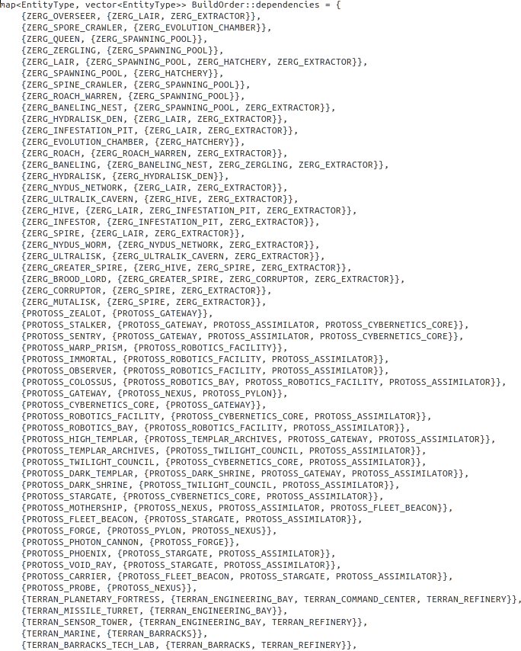

Slide 3
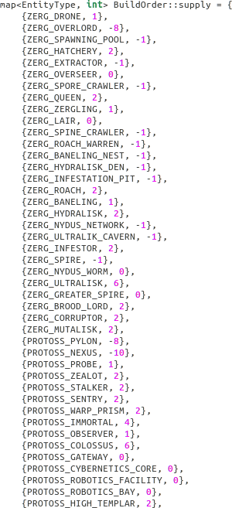
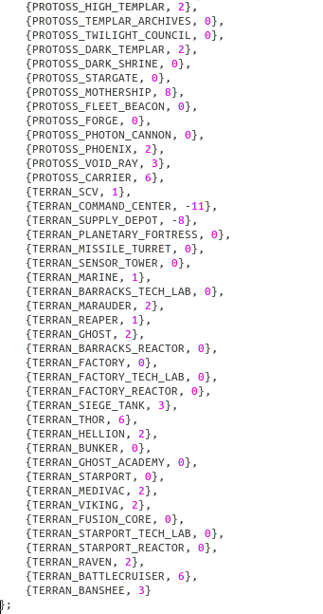

Slide 4
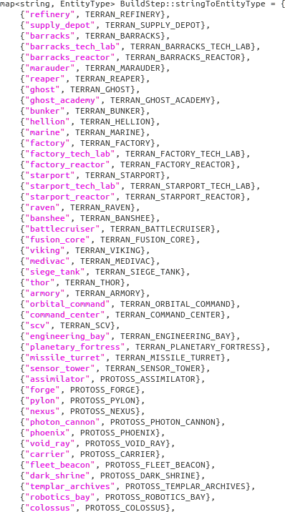
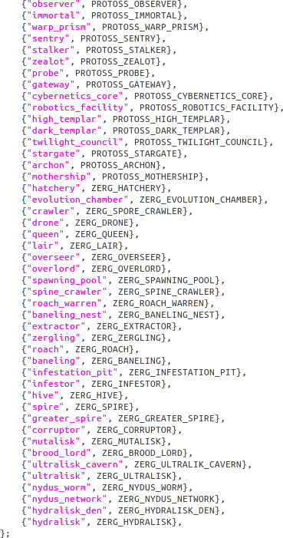

Slide 5
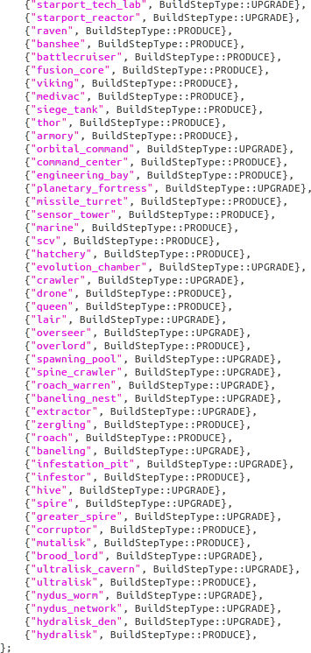
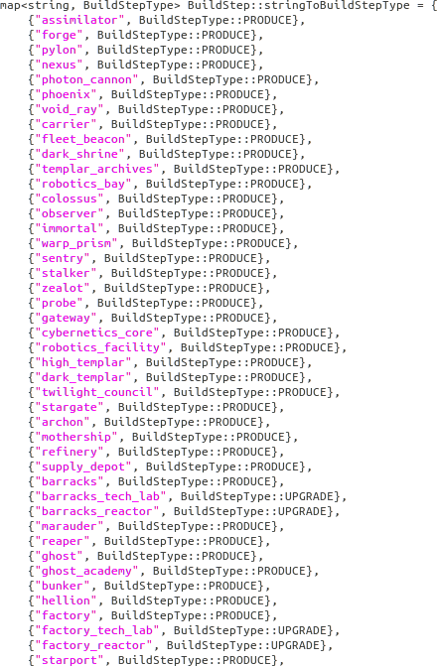

Slide 6
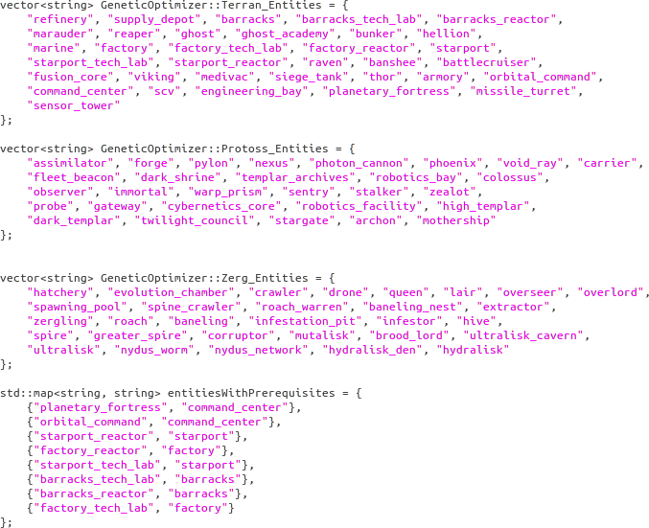

Slide 7


Slide 8
char *entity = “siege_tank”;
const unsigned long noLists = 20000;
const unsigned long numberOfGenerations = 500;
// Create random build list
std::vector<pair<unsigned long, BuildOrder *>> *bList = generateRandomLists(noLists, entity);
// Iterate: rate and mutate
for (int gen = 0; gen < numberOfGenerations; gen++)
{
// Calculates how much progress a certain buildList achieved.
rateBuildLists(*bList);
// Mutates using delete, add and change operations.
// Mutates less fit build lists more often then better performing ones.
mutateBuildLists(*bList, entity);
}

Slide 9
The End.
27. Jan 2015
Simon Rainer, Sebastian Haubner,
Andreas Lindsteding, Jonas Gröger

