Slide 1
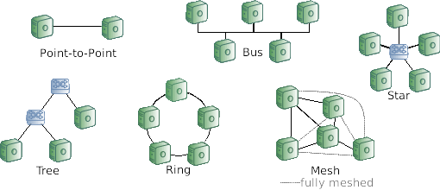
Network topologies
Most common topologies:
  Bus
  Star
  Tree
  Ring
  Mesh

Slide 2


Communication modes
Connectionsless (e.g. LAN)
  Data transported in packets
  Spontaneous transmission without reservation
  Source and destination specified for each packet
Connection oriented (e.g. Phone)
  Connection establishment (reservation of a transmission channel)
  Data transmission as a stream
  Disconnection (release of the transmission channel)

Slide 3
Maximum Transmission Unit
Maximum Transmission Unit (MTU) defines the largest data size a protocol layer can pass onward
All Ethernet v2 Networks have a MTU of at least 1500 Byte
  The largest frames sent are therefore 1526 Bytes long (including preamble, header and checksum trailer)
Many networks implement larger MTUs, so called Jumbo Frames
  Typically 9000 Bytes MTU
  Better paylod-to-header ratio increasing efficiency
  Reduces CPU load (more about this below)
Notes:
First slide after “The Ethernet v2 Header” (Slide 17)

Slide 4
Maximum segment size (MSS)
The maximum size of an IP datagram is 2^16=65536 bytes
The maximum possible amount of data sent within a TCP segment is therefore:
2^16-20-20=65496 as the minimum size of a IP and TCP header is 20
To avoid IP fragmentation the MSS of a connection is adapted to the IP MTU:
MSS = MTU – 40

