Slide 1
Network Programming
Lecture 1
LAN Programming – The Basics
Jonas Kunze
University of Mainz – NA62
Inverted CERN School of Computing, 24-25 February 2014

Slide 2
Outline
Recap of the TCP/IP model
ISO/OSI and TCP/IP
User Datagram Protocol (UDP)
Transmission Control Protocol (TCP)
Network programming with BSD Sockets
Code snippets
Performance
Alternatives to BSD Sockets
Network Protocols in User Space

Slide 3
The ISO/OSI reference model
Communications protocols are divided into independent layers
Every layer offers a service to the overlying layer

Slide 4
Interplay between OSI layers
Every layer encapsulates the message into a Protocol Data Unit (PDU)
PDUs typically consist of a Header and a Data section
Communication partners exchange PDUs by using the next lower layer
Receiver unpacks PDUs in reverse order (like a stack)

Slide 5
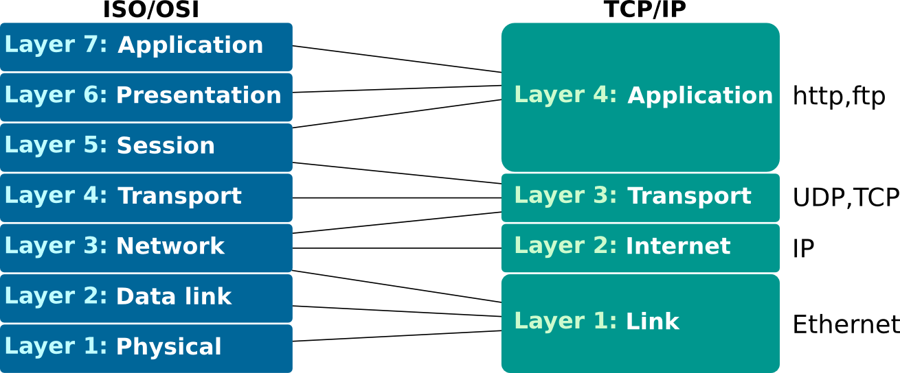
The TCP/IP model
The ISO/OSI model is just a theoretical model with almost no implementation
The most common communications protocols are part of the Internet Protocol Suite (TCP/IP model)
Some ISO/OSI layers are merged
No strict separation between layers

Slide 6
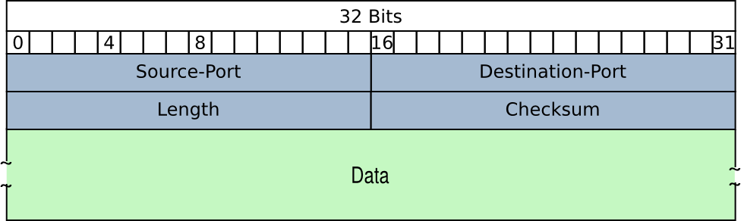
User Datagram Protocol (UDP)
UDP is connectionless and unreliable like IP
Source-Port: The port of the process sending the datagram
Destination-Port: The port number the datagram should be forwarded to
Length: The length of the whole PDU in Bytes ( 8 < length < 65535 )
Checksum: Calculated with the whole PDU and data from the IP header

Slide 7
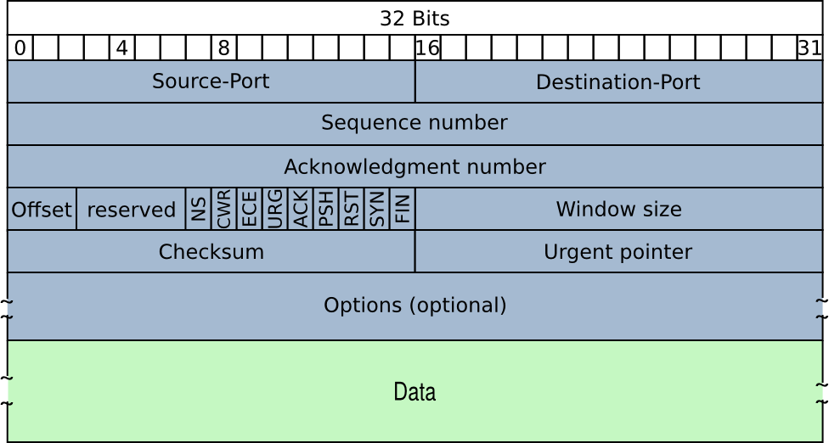
Transmission Control Protocol (TCP)
Much more powerful and complex communication service than UDP
Important application layer protocols based on TCP
World Wide Web (HTTP)
Email (SMTP)

Slide 8
Transmission Control Protocol (TCP)
TCP is reliable:
Error-free: fragments are retransmitted in case they did not arrive at the destination (timeout)
preserving order without duplicates
TCP is connection oriented
Connection establishment necessary before data can be sent
Connection defined by IP and port number (like UDP) of source and destination
Connections are always point-to-point and full-duplex
It implements flow control and congestion avoidance
Data is transmitted as an unstructured byte stream

Slide 9
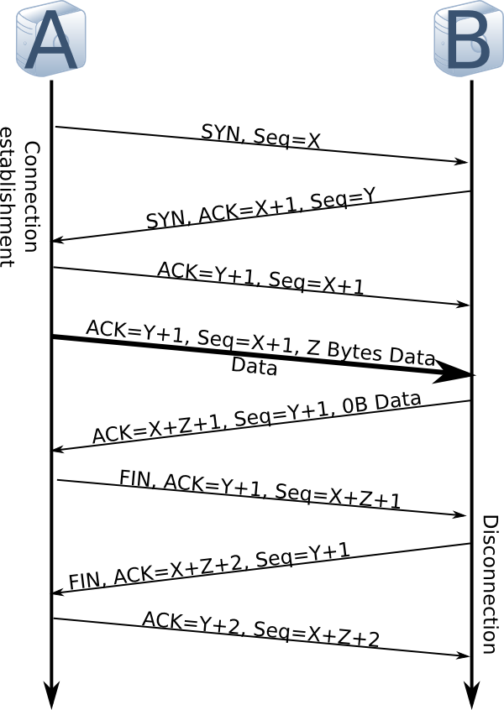
TCP data flow
A sends frame with SYN and random Sequence number X
B acknowledges with ACK=X+1 and random Sequence number Y
A acknowledges the reception
A sends Z bytes
B increases the sequence by Z to acknowledge the data reception
Disconnection works like connection establishment but with FIN instead of SYN

Slide 10
Flow Control and Congestion Avoidance
Frames are only rarely dropped because of transmission errors (e.g. bit flip)
Connections are typically either working without transmission errors or not at all
Main reason for dropped frames are overloads of the receiver or the network
TCP implements two mechanisms to avoid overloading:
Flow control: Avoids overloading of the receiver
Congestion avoidance: Reduces the sending rate in case that fragments are dropped by the network

Slide 11
TCP's Flow Control: Sliding Window
Each node has a receiving and sending buffer
In each segment a node specifies how many bytes it can receive
Receiver window size: Number of free bytes in the receiving buffer
If a node has sent as many unacknowledged bytes as the window size is large it will stop sending and wait for the next acknowledgment
With each acknowledgment the window slides to the right

Slide 12
TCP's Congestion Avoidance
Congestion window: Specifies the maximum number of bytes that may be sent without acknowledgment depending on the network capacity
Max bytes that may be sent = min(sliding win, congestion win)
The congestion avoidance algorithm:
Initialize the congestion window to typically 2 x MSS (slow start)
Send until one of the two windows are filled
If a segment is acknowledged: Increase the congestion window
Doubled until threshold reached, then linearly
If acknowledgment timed out (frame dropped by network):
Set threshold to half the current congestion window and go back to slow start

Slide 13
TCP's Congestion Avoidance

Slide 14
Sending Buffer
When an application sends data chunks to the TCP stack two different approaches can be applied:
Low latency
Data chunks sent directly as they are
Disadvantage: Many small IP packets will be transmitted (low efficiency)
High throughput
Buffer data and send larger segments
Higher latency but more efficient

Slide 15
Nagle’s Algorithm
An algorithm to reach the high throughput approach:
Send first chunk of data arriving at the TCP stack directly
Fill sending buffer with new incoming data without sending
If the buffer reaches the MSS : Send a new frame clearing the buffer
If all sent segments are acknowledged: Send a new frame clearing the buffer
Nagle’s algorithm is used in almost all TCP implementations
Can be deactivated to reduce latency (e.g. for X11 applications)

Slide 16
Switch off Nagle's Algorithm
This is only rarely necessary!
Within your program:
System wide:
int flag = 0;
setsockopt( socket, /* socket affected */
IPPROTO_TCP, /* set option at TCP level */
TCP_NODELAY, /* name of option */
(char ) &flag, /* the actual value */
sizeof(int)); /* length of option value */
echo 1 > /proc/sys/net/ipv4/tcp_low_latency

Slide 17
TCP vs UDP
TCP: A lot of bookkeeping and additional data transmission for acknowledgments
UDP: Just sends the data as it is
But...
TCP: Flow control, congestion avoidance, Nagle's algorithm
Typical rule of thumb:
TCP for high throughput, reliability and/or congestion avoidance
UDP for low latency and broadcasts/multicasts (not possible with TCP)

Slide 18
A Quick RTT Test
This test was performed with hpcbench:
hpcbench.sourceforge.net

Slide 19
Outline
Recap of the TCP/IP model
ISO/OSI and TCP/IP
User Datagram Protocol (UDP)
Transmission Control Protocol (TCP)
Network programming with BSD Sockets
Code snippets
Performance
Interrupt Coalescing
NAPI
Alternatives to BSD Sockets
Network Protocols in User Space

Slide 20
BSD Sockets
Linux supports TCP/IP as its native network transport
BSD Sockets is a library with an interface to implement network communications using any TCP/IP layer below the application layer
Important functions
socket() opens a new socket
bind() assigns socket to an address
listen() prepares socket for incoming connections
accept() creates new socket for incoming connection
connect() connects to a remote socket
send() / write() sends data
recv() / read() receives data

Slide 21
TCP Code Snippet
Simple TCP socket accepting connections and receiving data:
Complete examples to be found at: http://github.com/JonasKunze
socket = socket(AF_INET, SOCK_STREAM, 0);
serv_addr.sin_family = AF_INET;
serv_addr.sin_port = htons(8080);
serv_addr.sin_addr.s_addr = INADDR_ANY;
bind(socket, (struct sockaddr *) &serv_addr, sizeof(serv_addr));
listen(socket, 5);
connectionSocket = accept(socket, (struct sockaddr *) &cli_addr, &clilen);
recv(connectionSocket, buffer, sizeof(buffer), 0);

Slide 22
TCP vs UDP: Throughput
Single threaded blocking sender and receiver, reliable network
Small frames induce high
CPU load → packet loss
TCP achieves higher
throughput

Slide 23
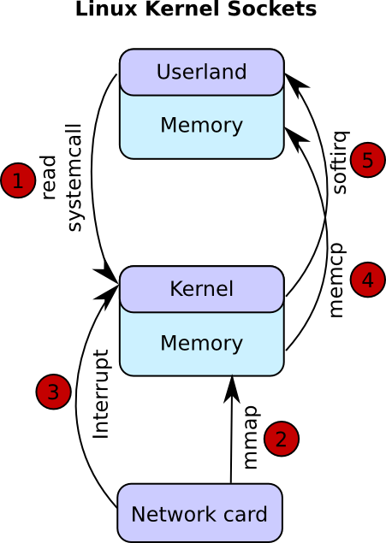
Down to the Kernel
When data arrives at the NIC:
Data copied to kernel space (DMA)
NIC sends interrupt
Kernel copies data to the corresponding user space buffer (socket)
Kernel informs user space application

Slide 24
Interrupt Coalescing
Technique to reduce interrupt load
Interrupts are held back until...
… a certain number of frames have been received...
… or a timer times out
Now the kernel can process several frames at once
Higher efficiency with just little increase of latency
# print current settings
ethtool -c eth0
# change settings
ethtool -C eth0 rx-usecs 0 # 0 is adaptive mode for many drivers
ethtool -C eth0 rx-frames 12

Slide 25
Interrupt Coalescing
Small values overload the CPU → Packet loss
High values lead to buffer overflow → Packet loss
First bin shows adaptive mode

Slide 26
NAPI
An alternative to interrupts is polling:
Kernel periodically checks for new data in the NIC buffer
High polling frequencies induce high memory loads
Low polling frequencies lead to high latencies and packet loss
NAPI: Linux uses both
Interrupts per default
Polling in case of high data rates incoming
The kernel still needs to copy incoming data!

Slide 27
Outline
Recap of the TCP/IP model
ISO/OSI and TCP/IP
User Datagram Protocol (UDP)
Transmission Control Protocol (TCP)
Network programming with BSD Sockets
Code snippets
Performance
Alternatives to BSD Sockets
Network Protocols in User Space
Example: pf_ring DNA
Reliability on top of UDP?
Reliability without acknowledgment

Slide 28
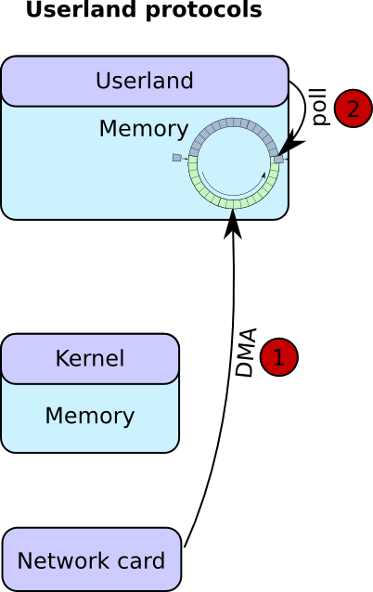
Network Protocols in User Space
Following approach can be implemented in the user space to avoid double copies
NIC copies incoming data to a user space buffer (DMA)
The user space application polls the buffer
The user space application may enable interrupts for low data rates
The kernel is only used for the initialization
0% CPU used for accessing the data

Slide 29
Example: pf_ring DNA
Proprietary user space driver by ntop
Does not implement any protocol
You need to implement them: ETH, IP, UDP, TCP, ARP, IGMP...
Compatible with all 1 GbE and 10 GbE NICs running on PCI-E
Full line rate (1-10 GbE) with any frame size
Round trip time below 5 µs
Hardware filtering (only Intel and Silicom NICs)
Very efficient Intrusion prevention systems possible (Snort)
Other userspace drivers: Netmap, Intel DPDK, OpenOnload

Slide 30
Reliability on top of UDP?
At CERN experiments most data senders are FPGAs
Very fast in parallel jobs
Typically fully loaded by algorithms
Sometimes there's no space left for a fully implemented TCP/IP stack
I've seen many groups implementing reliable protocols on top of IP
In most cases the result was TCP without flow and congestion control
Being compatible with TCP/UDP relieves the software developers
You don't need to implement the protocol on the receiver side
Instead you can use standard libraries

Slide 31
Reliability without acknowledgment
Sometimes it's not even possible to store data until the acknowledgment is received
You should use pure UDP in this case
As soon as datagrams are sent out you have to trust the network
Make sure that you don't overload switches/routers/receiver nodes
Check every node whether frames are dropped
Switch/Router:
show interfaces ...
Linux:
cat /proc/net/udp

Slide 32
Summary
TCP is more than just reliable
It implements a maximum efficient data transmission
BSD sockets provide a nice API for simple network programming
For more complex architectures networking libraries are recommended
Linux' network sockets are not as efficient as they could be
High performance network drivers provide efficient alternatives to BSD sockets but they generate additional work for the developer team

