Slide 1
Network Programming
Lecture 2
Network Programming Libraries
Jonas Kunze
University of Mainz - NA62
Inverted CERN School of Computing, 24-25 February 2014

Slide 2
TCP in C code
The BSD socket API is minimalistic
  No multithreading
    Handling multiple connections typically via fork()
  No data management
  No direct access to the configurable parameters
There is no exception handling or OOP in C
There is no C++ socket API in the std library
#include <stdio.h>
#include <sys/types.h>
#include <sys/socket.h>
#include <netinet/in.h>
int main( int argc, char *argv[] )
{
int sockfd, newsockfd, portno, clilen;
char buffer[256];
struct sockaddr_in serv_addr, cli_addr;
int n;
sockfd = socket(AF_INET, SOCK_STREAM, 0);
bzero((char *) &serv_addr, sizeof(serv_addr));
portno = 1324;
serv_addr.sin_family = AF_INET;
serv_addr.sin_addr.s_addr = INADDR_ANY;
serv_addr.sin_port = htons(portno);
bind(sockfd, (struct sockaddr *) &serv_addr,
sizeof(serv_addr));
listen(sockfd,5);
clilen = sizeof(cli_addr);
while (1) {
newsockfd = accept(sockfd,
(struct sockaddr *) &cli_addr, &clilen);
pid = fork();
if (pid == 0) {
close(sockfd);
dosomething(newsockfd);
exit(0);
} else {
close(newsockfd);
}
}
}

Slide 3
Boost.Asio
Intro
Asynchronous operations
Concurrency without threads
Handling multiple TCP connections
Multithreading
Thread Pools - Code Snippet

Slide 4
Boost.Asio
Boost.Asio is a C++ library for low-level I/O programming with a consistent asynchronous model including a BSD socket interface
BSD Socket API (Linux) | Equivalents in Boost.Asio
socket descriptor - int | For TCP: ip::tcp::socket For UDP: ip::udp::socket
sockaddr_in, sockaddr_in6 | For TCP: ip::tcp::endpoint For UDP: ip::udp::endpoint
accept() | For TCP: ip::tcp::acceptor::accept()
bind() | For TCP: ip::tcp::socket::bind() For UDP: ip::udp::socket::bind()
... | ...

Slide 5
Boost.Asio
Boost.Asio uses an object as an interface to the operating system: io_service
The io_service object is passed to I/O objects like ip::tcp::socket
The I/O objects will forward requests to the io_service object
  io_service translates errors to boost::system::error_code objects
  The I/O objects will throw these objects
boost::asio::io_service io_service;
boost::asio::ip::tcp::socket socket(io_service);
tcp::resolver resolver(io_service);
try{
socket.connect(socket, *resolver.resolve({hostname, portNum}));
socket.send(boost::asio::buffer("message"));
} catch( boost::system::system_error& error ){
cerr << error.what() << endl;
}

Slide 6
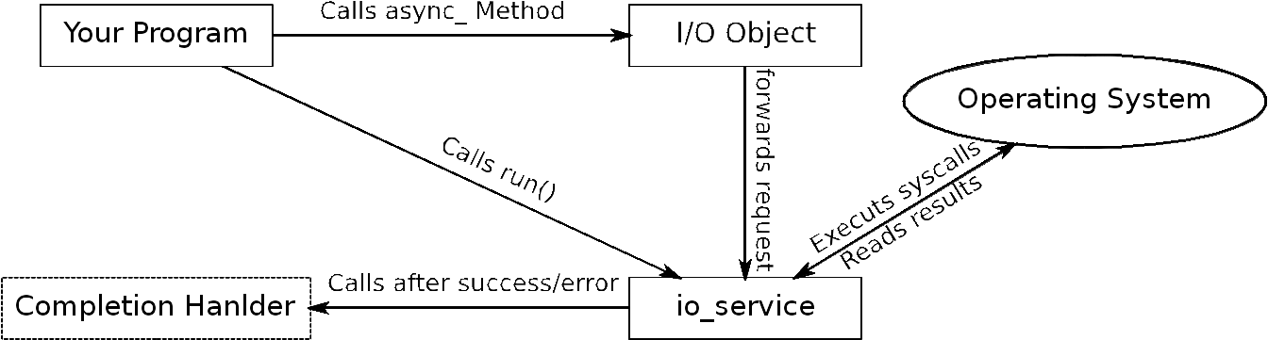
Boost.Asio: Asynchronous operations
I/O objects implement non-blocking/asynchronous operations
  E.g. boost::asio::ip::tcp::socket::async_connect
Completion handler function passed to async_ functions
io_service.run() calls the completion handler as soon as results of async_ functions are available

Slide 7
Boost.Asio: Asynchronous operations
Simple TCP connection example:
void MyClass::handle_connect(const boost::system::error_code& error) {
if (!error) { doSomething(); }
}
...
socket.async_connect(socket, *resolver.resolve({hostname, portNum}),
boost::bind(&MyClass::handle_connect, this, boost::asio::placeholders::error));
io_service.run();
Even simpler with C++11 using a lambda function:
socket.async_connect(*resolver.resolve({hostname, portNum}),
[this](boost::system::error_code error, tcp::resolver::iterator) {
if (!error) { doSomething(); }
});
io_service.run();

Slide 8
Concurrency without threads
Handling multiple TCP connections
One io_service can handle several I/O objects and async_ operations
io_service::run() will block until all requests have been handled
sock1.async_read_some(readBuffer, [](boost::system::error_code error, std::size_t){
if (!error) {std::cout << "Socket 1 received something" << std::endl;}
});
sock2.async_read_some(readBuffer, [](boost::system::error_code error, std::size_t){
if (!error) {std::cout << "Socket 2 received something" << std::endl;}
});
io_service.run();
cout << “Both sockets received something” << endl;

Slide 9
Simple TCP Echo Server
class EchoServer {
public:
Server(boost::asio::io_service& io_service, short port) :
acceptor_(io_service, tcp::endpoint(tcp::v4(), port)),
connectionSocket_(io_service) {
do_accept();
}
private:
void do_accept() {
acceptor_.async_accept(connectionSocket_, [this](boost::system::error_code ec) {
if (!ec) {
std::make_shared<Session>(std::move(connectionSocket_))->do_read();
}
do_accept();
});
}
tcp::acceptor acceptor_;
tcp::socket socket_;
};

Slide 10
Simple TCP Echo Server
class Session: public std::enable_shared_from_this<Session> {
private:
tcp::socket socket_;
enum {
bufferSize = 1024
};
char buffer_[bufferSize];
public:
Session(tcp::socket&& socket) :
socket_(std::move(socket)) {
}
void do_read();
void do_write(std::size_t length);
};

Slide 11
Simple TCP Echo Server
void Session::do_read() {
auto self(shared_from_this());
socket_.async_read_some(boost::asio::buffer(buffer_, bufferSize),
[this, self](boost::system::error_code ec, std::size_t length) {
if (!ec) {
do_write(length);
}
});
}
void Session::do_write(std::size_t length) {
auto self(shared_from_this());
boost::asio::async_write(socket_, boost::asio::buffer(buffer_, length),
[this, self](boost::system::error_code ec, std::size_t /*length*/) {
if (!ec) {
do_read();
}
});
}
Notes:
auto self(shared_from_this()); needed so that Session outlives the async operation. Session was

Slide 12
Simple TCP Echo Server
int main(int argc, char* argv[]) {
try {
boost::asio::io_service io_service;
EchoServer s(io_service, 1234);
io_service.run();
} catch (std::exception& e) {
std::cerr << "Exception: " << e.what() << std::endl;
}
return 0;
}
Notes:
auto self(shared_from_this()); needed so that Session outlives the async operation. Session was

Slide 13
Multithreading
io_service::run() can be called by multiple threads simultaneously
async_ operations will be distributed among these threads
One approach is to launch a thread pool running the whole lifetime
  N threads spawned at the beginning (typically N=number of CPU cores)
  async_ operations call each other (io_service::run() never quits)
    E.g. handle_read calls socket.async_write(...handle_write...),
    handle_write calls socket.async_read(...handle_read...)
  This way N threads can handle M connections → very efficient

Slide 14
Echo Server with Thread Pools
boost::asio::io_service io_service;
EchoServer s(io_service, 1234);
std::vector<std::thread> threadPool;
for (std::size_t i = 0; i < std::thread::hardware_concurrency(); ++i) {
threadPool.push_back(
std::thread(
[&]() {
io_service.run();
}
)
);
}
for(auto& thread : threadPool){
thread.join();
}

Slide 15
Message passing via TCP
TCP only offers a continuous data stream
  Although data is typically sent to sockets in chunks the receiver may see different chunks using socket.read()
  The application layer program has to split the stream into messages
There are three common approaches
  Implicitly
  Explicitly
  Line-Based

Slide 16
Implicit approach
1. The protocol defines the message length implicitly
  Every message has the same length
  The client always reads as many bytes as a message is long
int msgLength = 42;
char reply[msgLength];
boost::asio::read(socket, boost::asio::buffer(msg, msgLength));

Slide 17
Explicit approach
2. The message length is explicitly specified in a message header
  The client reads as many bytes as the header is long, determines the message length from the header and reads that many bytes
uint16_t msgLength;
boost::asio::read(socket, boost::asio::buffer(msgLength, 2));
char message[msgLength];
boost::asio::read(socket, boost::asio::buffer(message, msgLength));

Slide 18
Line-Based approach
3. Messages in the stream are separated by delimiters (e.g. “\r\n”)
  The client reads until it finds a delimiter
  Boost.Asio provides a special read operation for this
boost::asio::streambuf msgBuffer;
size_t messageLength = boost::asio::read_until(socket, msgBuffer, "\r\n");
std::istream is(&msgBuffer);
std::string message;
is >> message;

Slide 19
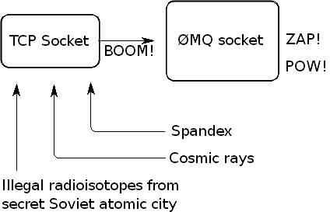
ØMQ
What ØMQ says about their socket library (http://zguide.zeromq.org/page:all):
We took a normal TCP socket, injected it with a mix of radioactive isotopes stolen from a secret Soviet atomic research project, bombarded it with 1950-era cosmic rays (...) It's sockets on steroids.

Slide 20
ØMQ
ØMQ is a highly parallelizable socket library (middleware)
It offers a uniform API (ØMQ sockets) to transport messages over different channels:
  TCP, multicast, IPC (process to process), inproc (thread to thread)
ØMQ sockets express several messaging patterns
  Not only one to one
Cross Platform (Linux, Windows, Mac, etc...)
Implementations in many(!!!) different languages:
  C/C++, Java, Python, Ruby, PHP, Perl, Node.js, C#, Clojure, CL, Delphi, Erlang, F#, Felix, Go, Haskell, Haxe, Lua, Objective-C, Q, Racket, Scala, Tcl, Ada, Basic, ooc …
OpenSource

Slide 21
ØMQ compared to BSD TCP sockets
Message based – No data stream
Messages go across an arbitrary transport: TCP, multicast, IPC, inproc
Multiple connections per socket (in- and outgoing)
Connections are hidden to the user
  There is no accept – The user only binds the socket to an address
  Automatic connect and reconnect in case of disconnection
  The application only receives messages from anonymous sender
    User needs to add sender address to message

Slide 22

ØMQ – REQ-REP
Clients “connect” to a service and send a REQuest
The server REPlies to each request
Sending is done asynchronously (background I/O thread spawned by ØMQ)
If the server is down the message will be sent later
This represents a remote procedure call or task distribution pattern

Slide 23
ØMQ – Simple REP Server
int main() {
zmq::context_t context(1);
zmq::socket_t socket(context, ZMQ_REP);
socket.bind("tcp://*:5555");
while (true) {
zmq::message_t request;
socket.recv(&request);
zmq::message_t reply(5);
memcpy((void *) reply.data(), "World", 5);
socket.send(reply);
}
return 0;
}

Slide 24
ØMQ – Simple REQ Client
int main() {
zmq::context_t context(1);
zmq::socket_t socket(context, ZMQ_REQ);
socket.connect("tcp://localhost:5555");
zmq::message_t request(6);
memcpy((void *) request.data(), "Hello", 5);
socket.send(request);
zmq::message_t reply;
socket.recv(&reply);
return 0;
}

Slide 25

ØMQ – REQ-REP Notes
The REQ-REP socket pair is in lockstep
  Server and client have to call send and recv alternately
  Server automatically sends to the node it got the last message (recv) from
    All the connection handling done by ØMQ
If the client is started before the server the message will still be sent even if the client does not wait for the response
The connection can be established from both sides (true for all patterns)

Slide 26
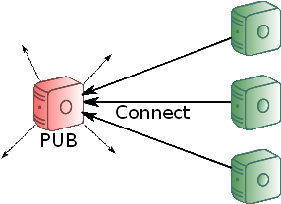
ØMQ – PUB-SUB
Server PUBlishes data irrespective of the number of connected clients
Clients SUBscribe to the data by connecting to the server
Subscription to messages by data prefix (filter)
If no client is connected the data will be lost (slow joiner symptom)
This represents a data distribution pattern

Slide 27
ØMQ – Simple PUB Server
int main() {
zmq::context_t context(1);
zmq::socket_t socket(context, ZMQ_PUB);
socket.bind("tcp://*:5555");
while (true) {
zmq::message_t data(11);
memcpy((void *) data.data(), "Hello World", 11);
socket.send(reply);
usleep(100000);
}
return 0;
}

Slide 28
ØMQ – Simple SUB Client
int main() {
zmq::context_t context(1);
zmq::socket_t socket(context, ZMQ_SUB);
socket.connect("tcp://localhost:5555");
// Subscribe to messages starting with “Hello”
socket.setsockopt(ZMQ_SUBSCRIBE, "Hello", 5);
zmq::message_t data;
socket.recv(&data);
return 0;
}

Slide 29
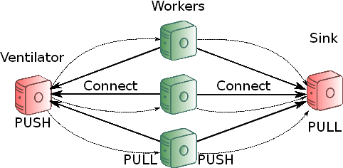
ØMQ – Pipeline
Ventilator: Produces task that can be processed in parallel
These tasks are than PUSHed evenly to the connected Workers
After processing the tasks the Workers push the results to a Sink
Basic load balancing

Slide 30
ØMQ – Pipeline Worker
int main() {
zmq::context_t context(1);
zmq::socket_t ventilator(context, ZMQ_PULL);
ventilator.connect("tcp://localhost:5557");
zmq::socket_t sink(context, ZMQ_PUSH);
sink.connect("tcp://localhost:5558");
while (1) {
zmq::message_t task;
ventilator.recv(&task);
zmq::message_t result = doSomeWork(task);
sink.send(result);
}
return 0;
}

Slide 31
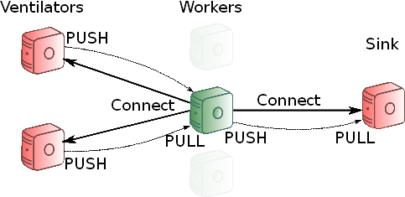
ØMQ – N-t-M communication
With the pipeline pattern we have N workers pulling from one ventilator
It is possible to connect one ØMQ socket to several endpoints
The messages will be scheduled fairly from all ventilators
ventilator.connect("tcp://ventilator1:5557");
ventilator.connect("tcp://ventilator2:5557");

Slide 32
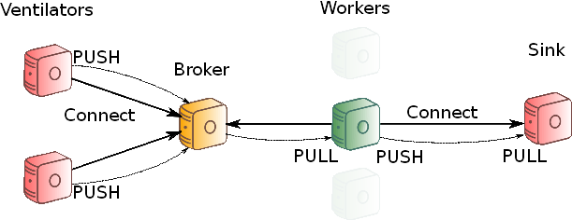
ØMQ – Broker
With the last design the workers need to know all ventilators (hostnames)
If a new ventilator is added all the workers have to connect (evtl. Restart)
One easy design to fix this: Add a central broker

Slide 33
ØMQ – Broker
This is easily implemented with a zmq_proxy forwarding messages:
int main() {
zmq::context_t context(1);
// Socket facing ventilators
zmq::socket_t frontend(context, ZMQ_PULL);
frontend.bind("tcp://*:5556");
// Socket facing workers
zmq::socket_t backend(context, ZMQ_PUSH);
backend.bind("tcp://*:5557");
zmq_proxy(frontend, backend, NULL);
return 0;
}

Slide 34
ØMQ – Broker
Now you only have to change one line in the ventillator:
socket.bind("tcp://*:5559"); → socket.connect("tcp://localhost:5559");
And again you can start ventilators, workers, broker and sink in whatever order you like:
Messages are queued as close to the receiver as possible

Slide 35
ØMQ – IPC
So far we used: socket.bind("tcp://*:5555");
  Clients can connect via any available IP (*) using TCP on port 5555
To run the same programs locally one should use:
  If servers and clients are run as separate programs:
    zmq_bind(socket, "ipc:///tmp/helloWorld");
  If all endpoints are running as separate threads within one process:
    zmq_bind(socket, "inproc:///helloWorld");
Start developing your software with many modules communicating with IPC
Than outsource heavy loaded services to external boxes just by changing
ipc → tcp

Slide 36
ØMQ – Multithreading
ØMQ are not thread safe!
But they are extremely lightweight
  Create one (or more) sockets per thread
  Use these ØMQ sockets to exchange messages between the threads
  Use a proxy to distribute work over the threads

Slide 37
ØMQ – Worker Threads
void workerThread(zmq::context_t& context) {
zmq::socket_t ventilator(context, ZMQ_PULL);
ventilator.connect("inproc://workers");
zmq::socket_t sink(context, ZMQ_PUSH);
sink.connect("tcp://localhost:5558");
while (1) {
zmq::message_t task;
ventilator.recv(&task);
zmq::message_t result = doSomeWork(task);
sink.send(result);
}
}

Slide 38
ØMQ – Worker Proxy
int main() {
zmq::context_t context(1);
zmq::socket_t ventilatorsBroker(context, ZMQ_PULL);
ventilatorsBroker.connect("tcp://localhost:5560");
zmq::socket_t workers(context, ZMQ_PUSH);
workers.bind("inproc://workers");
std::vector < std::thread > threadPool;
for (std::size_t i = 0; i < std::thread::hardware_concurrency(); ++i) {
threadPool.push_back(std::thread([&]() {
workerThread(context);
}));
}
zmq::proxy(ventilatorsBroker, workers, NULL);
return 0;
}

Slide 39
ØMQ – Documentation
There's much more functionality in ØMQ!
Read the great guide: http://zguide.zeromq.org (you will laugh a lot!)
The examples in this lecture are based on the examples from the zguide

Slide 40
ØMQ – Data Presentation
ØMQ only offers a raw data transport (message length + bytes)
The user is responsible for the formatting
  String presentation
  Endianess
  Serialization
Python:
socket.send ("Hello") // Will send only 5 bytes
C++:
char buffer [256];
int size = zmq_recv (socket, buffer, 255, 0);
buffer[size]='\0'; // Missing termination added

Slide 41
Apache Thrift
From http://thrift.apache.org:
Thrift is a scalable cross-language Remote Procedure Call (RPC) framework developed by Facebook
  So you can call a Java Method from a PHP script running on a remote host
It's an open source project in the Apache Software Foundation
The Apache Thrift software framework, for scalable cross-language services development, combines a software stack with a code generation engine to build services that work efficiently and seamlessly between C++, Java, Python, PHP, Ruby, Erlang, Perl, Haskell, C#, Cocoa, JavaScript, Node.js, Smalltalk, OCaml and Delphi and other languages.

Slide 42
Thrift – Interface Definition
Services are defined by Interface Definition Language (IDL) in .thrift files
  Defines namespace, data structures, types, methods and services
  Similar to C syntax
  Basic types are bool, byte, i16/32/64, double, string, map<t1,t2>, list<t1>, set<t1>
#!/usr/bin/thrift --gen cpp
namespace cpp ch.cern.icsc14
enum Operation {
ADD = 1,
SUBTRACT = 2,
MULTIPLY = 3,
DIVIDE = 4
}
struct Work {
1: i32 num1,
2: i32 num2,
3: Operation op
}
service Calculator {
i32 calculate(1:Work w)
}

Slide 43
Thrift – Compiling Thrift Files
Thrift compiles the IDL files to server (and client) source code
It generates thousands of lines of code with placeholders
Calculator_server.skeleton.cpp:
using namespace ::ch::cern::icsc14;
class CalculatorHandler : virtual public CalculatorIf {
public:
CalculatorHandler() {
// Your initialization goes here
}
int32_t calculate(const Work& w) {
// Your implementation goes here
printf("calculate\n");
}
};

Slide 44
Thrift – The Client
boost::shared_ptr<TSocket> socket(new TSocket("localhost", 9090));
boost::shared_ptr<TTransport> transport(new TBufferedTransport(socket));
boost::shared_ptr<TProtocol> protocol(new TBinaryProtocol(transport));
CalculatorClient client(protocol);
transport->open();
Work work;
work.op = Operation::SUBTRACT;
work.num1 = 15;
work.num2 = 10;
int32_t diff = client.calculate(work);
std::cout << diff << std::endl;
transport->close();

Slide 45
Thrift – Interchangeable Layers
The generated code runs on top of three interchangeable layers
  Protocols
    TBinaryProtocol
    TJSONProtocol
    …
  Transports
    TSocket
    TframedTransport (needed for TNonblockingServer)
    …
  Servers
    TSimpleServer (Single threaded, blocking)
    TNonblockingServer (Multithreaeded)
    ...

Slide 46
Thrift – Documentation
There is only very little documentation online
Useful links:
  http://wiki.apache.org/thrift/ThriftUsage
  http://thrift-tutorial.readthedocs.org/
  http://www.slideshare.net/dvirsky/introduction-to-thrift
  http://diwakergupta.github.io/thrift-missing-guide
Installation: git clone https://git-wip-us.apache.org/repos/asf/thrift.git thrift
Good Luck!

