Slide 1
Network Programming
Lecture 1
LAN Programming – The Basics
Jonas Kunze
University of Mainz - NA62
Inverted CERN School of Computing, 24-25 February 2014

Slide 2
Recommendations to lecturers
Handout and slide master:
Do not forget to update
  the top page
  the slide master
  and the handout master
with the data of your lecture

Slide 3
Communication networks
Definition
Computer networks
Classification of computer networks
Network topologies
Communication modes
Local Area Network (LAN) standards

Slide 4
Communication networks
Consists of distributed stations (nodes) exchanging information
  e.g. PCs, Phones
Uses one or several communication media
  e.g. copper cables, optical fibers, „air“
Information produced by a server may travel through additional nodes (e.g. router, gateway) before arriving at the client
In most networks the communication is bi-directional
  A server can be a client at the same time
Examples: Telephone, Radio, Computer networks, Internet

Slide 5
Computer networks
Typical areas of application:
  Communication (Email)
  Data networks (file server, www)
  Function sharing (printer, database server)
  Load sharing (load balancing, reliability)
Components of computer networks
  Hardware: Network Interface Card (NIC), Router
  Software: e.g. TCP/IP implementation in the OS

Slide 6
Classification of computer networks
Typically classified by it's size:
1 m Desk Personal Area Network (PAN)
10 m Room Local Area Network (LAN)
100 m Building
1 km Campus Metropolitan Area Network (MAN)
10 km City
100 km Country Wide Area Network (WAN)
1000 km Continent
10000 km Planet Internet

Slide 7
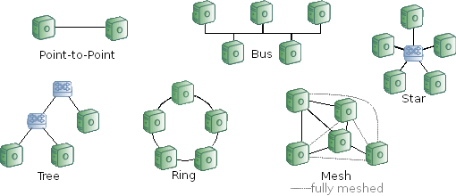
Network topologies
Most common topologies:
  Bus
  Star
  Tree
  Ring
  Mesh

Slide 8


Communication modes
Connectionsless (e.g. LAN)
  Data transported in packets
  Spontaneous transmission without reservation
  Source and destination specified for each packet
Connection oriented (e.g. Phone)
  Connection establishment (reservation of a transmission channel)
  Data transmission as a stream
  Disconnection (release of the transmission channel)

Slide 9
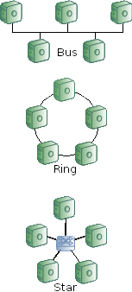
Local Area Network (LAN) standards
Ethernet (IEEE 802.3, 10 Mbps)
  Good old coaxial cables
Token Ring (IEEE 802.5, 4/16/100 Mbps)
  Competitor of Ethernet in 80's and 90's
(10)Gigabit-Ethernet (IEEE 802.3a(b/n), 1/10 Gbps)
  Today's standard network
InfiniBand (e.g. 10/20/40/56 Gbps)
  HPC standard (low latency RDMA)

Slide 10
Communications protocols
Protocols

Slide 11
Why do we need protocols?
Communication partners have to “speak the same language”
Media access (collision detection)
Error detection
Segmentation
Order preservation
Data formats / semantics (e.g. endianness)
Routing
Priority
...

Slide 12
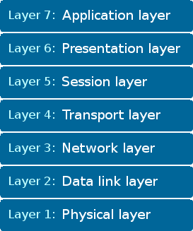
The ISO/OSI reference model
Standardization of communication protocols is mandatory
Open Systems Interconnection model
  Groundbreaking concept developed by ISO (International Organization for Standardization)
  Subdivision of communication protocols into 7 independent layers

Slide 13
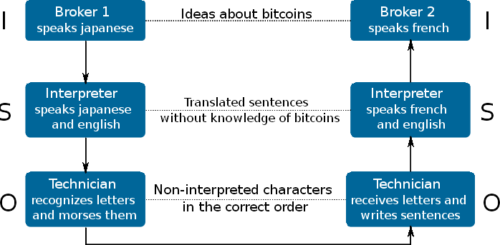
Concept of the OSI model
Communication protocols are divided into independent layers
Each layer optimized for only few tasks

Slide 14
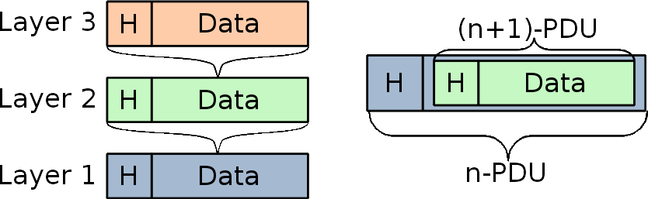
Interplay between OSI layers
Every layer offers a service to the overlying layer
Every layer subdivides the message into Protocol Data Units (PDUs)
  PDUs typically consists of a Header and a Data section
Communication partners exchange PDUs by using the next lower layer

Slide 15
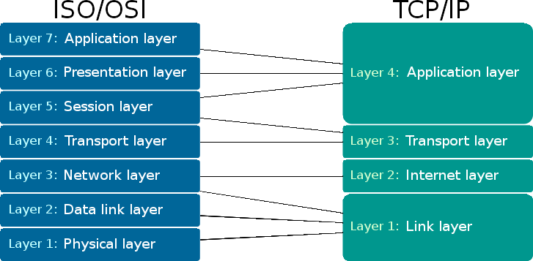
The TCP/IP model
The ISO/OSI model is just a theoretical model with almost no implementation
It has been seen that it is more appropriate to merge some OSI layers
The most common communication protocols are part of the internet protocol suite (TCP/IP model)

Slide 16
TCP/IP Layer 1-2
1. Link Layer
  Only vaguely defined
  The protocols have to be able to send and receive Layer 2 (IP) datagrams through the local network
  Hardware independent protocol: implementation varies from one network to the other
2. Internet Layer
  Host to host connectivity
  Internetworking: Sending packets across potentially multiple networks
  Source and destination addressed by IP address
  Routing: forwarding packets to a router closer to the final destination
  Best effort, "unreliable" protocol

Slide 17
TCP/IP Layer 3-4
3. Transport Layer
  Process to process connectivity (applications addressed by port number)
  Error control, segmentation, flow control, congestion control
  Best known: TCP (connection oriented), UDP (connectionless)
4. Application Layer
  Program specific communication protocols
  Typically implemented as reusable libraries (see lecture 2)
  Data presentation (endianess)
  Session handling, encryption
  Examples: http, ftp, Telnet

Slide 18
Ethernet - a Link Layer Protocol
Ethernet protocols defined by the protocol family IEEE 802.3
Ethernet II defined in 1982
Many different protocols for
  Different data rates: 10/100 Mbps, 1/10/40/100 Gbps
  Only 2 different media: copper, optical fiber
Specialized for LANs: addressing via “MAC” addresses

Slide 19
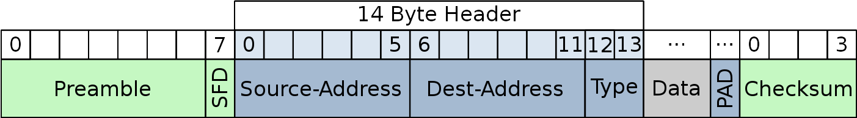
The Ethernet Header
Preamble: Used for synchronization (7 Bytes 10101010...)
  Obsolete but still implemented
Start Frame delimiter: 10101011
MAC-Addresses: Unique identifier assigned to network interfaces
  See “cat /sys/class/net/eth0/address”
Type: Indicates which protocol is encapsulated (link to layer 2!)
PAD: Padding (frame must be at least 64 bytes long)
Checksum: CRC checksum

