Slide 1
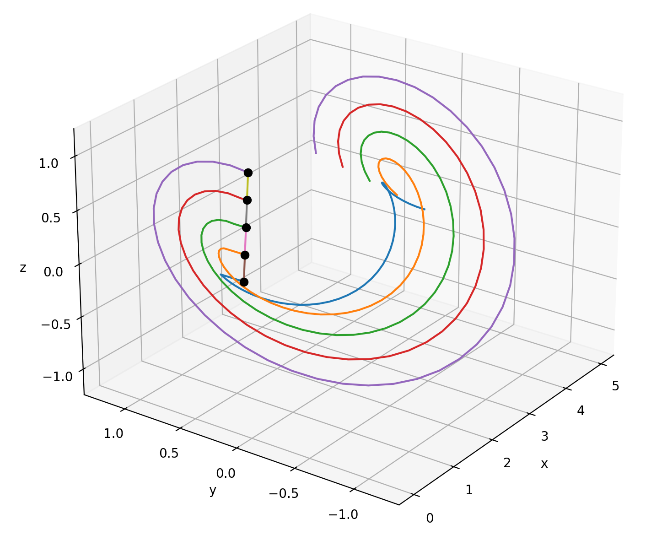
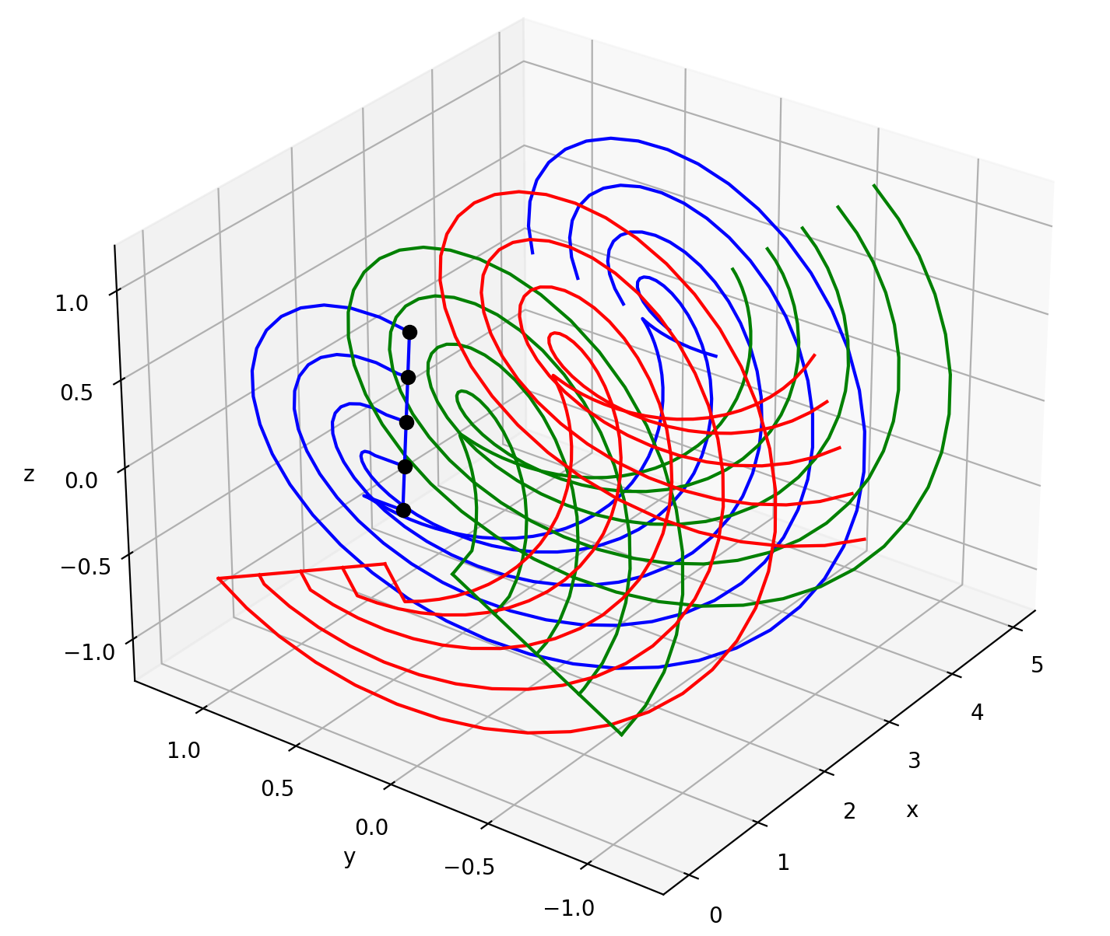
Class VortexSystem

Slide 2
What is meant with “vortex system”?
All vortices related to a blade or rotor, namely trailing and bound vortices.
What VortexSystem is based on:
A vortex system of separated trailing and bound vortices (not one horseshoe vortex per blade element)
Control points
What VortexSystem can do:
Calculate the coordinates of all vortices
Visualise the vortex system
Calculate factors which, when multiplied with circulation values, yield the induced velocities at the control points
Insert picture of wing use here

Slide 3
For the user – general idea
Blade representation: VortexSystem sees the blade as a collection of blade elements. Every element has a bound vortex with a constant circulation. The difference in bound circulation from element to element is shed as a trailing vortex. Each trailing vortex has a constant circulation along ist length.
Needed from the user: The circulation values for each bound vortex. From those, the circulation for the trailing vortices can be calculated. Additionally, control points have to be given for which the induced velocities will be calculated.

Slide 4
For the user – important to know
Coordinate system (see slide 6 for a visualisation): The right hand rule is followed. The origin lies in the axis of rotation of the rotor. The first axis points downstream along the axis of rotation. The second axis points to the left looking downstream at the rotor. The third axis points upwards (parallel to the tower). These descriptions are not valid for tilted shaft turbines. Anlges follow the right hand rule.
It is assumed that the blade‘s leading edge lies on the first axis, which means that the leading edge points directly into the axis of rotation.

Slide 5
For the user - inputs
Function | Parameter | Description
set_blade() | r_elements | Radial positions separating the blade elements.
 | c_elements | Chord at r_elements
 | blade_rotation | Rotational position of the blade with respect to the freestream
 | rotor_rotation_speed | Rotational speed of the rotor
 | n_blades | Number of blades of the rotor
set_wake() | wake_speed | Speed at which the wake is convected
 | wake_length | Length of the wake
 | resolution | Number of elements per trailing vortex
set_control_points() | x_control_points (and y and z) | Set coordinates of coordinates along axis 1 (x), 2 (y) and 3 (z)

Slide 6
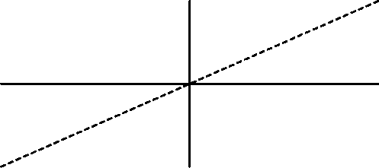
3
1
rotor
2
inflow

