Slide 1
Random 4 - Ski Jumping
Jonas Mohler, Isaak Hanimann, Sven Glauser

Slide 2
Ski Jumping
Events | Men’s Individual | Women’s Individual | Men’s Team
#Athlets | 1 |  | 4
Phases | Qualifying Phase | Final Phase
Performances | 1st Round | 1st Round | 2nd Round
Participating Teams | 50 | 50 | 30
Transition | Best 40 + 10 Prequalified | Best 30
Winner |  | Best of 1st and 2nd Round combined
What means ‘best’?
Most Total Points, where Total Points = distance + points by judges
Special:
Points in Men’s Team are summed up
Score is a ranked list, mapping Teams to Points
Team | Points
C | 100
A | 78

Slide 3
Requirements not in UML but Alloy
Team and it’s members must be from the same Country
Time Constraints:
  At most one performance at a location at the same time
  A team can’t have multiple performances at the same time
Summing up points
Specific cases how medals are distributed

Slide 4
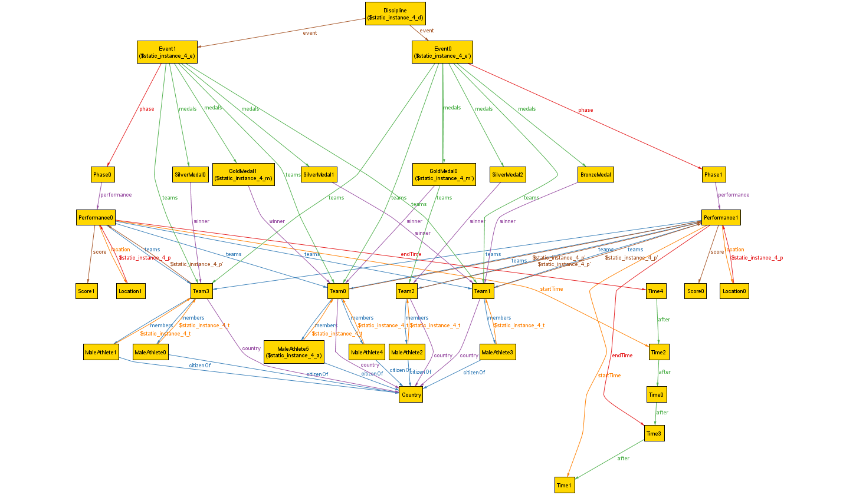
One we could generate: Instance 4

Slide 5
One we could not: Instance 1
An Instance with exactly:
  7 Performances
  2 Locations
  4 Times
→ No two Performances at the same place at the same time
→ we should not be able to generate this!!

Slide 6
Simplifications
No bidirectional associations:
  Relations were the UML would imply bidirectional association (i.e. participant for Team and Event) were modelled unidirectional
  Facts model the multiplicity of the relation
  Less Instances of Sigs Alloy needs to generate
→ With correct facts, no change of the model

Slide 7
Simplifications
Generate Instances with different sizes of Sets for the Sigs
  I.e. Ski Jumping requires 50 Teams in qualification round, running Alloy with a maximum of 50 Instances per Sig will take a long time...
  → Give a lower bound to Sigs of which we know we won't need that many to check our model (i.e. 2 Events)
  → Way less computation for Alloy with no change in the model (if the bounds are carefully picked)

Slide 8
Teamwork
UML: 1st draft each one for himself, then merged it together
Alloy: Most part we sat together and distributed ad hoc
Presentation: General, UML, Alloy
Rest: Questions, Administrative, Clean-up
Challenges
Finding out in Alloy which facts contradict each other – in other words: finding out why no model can be generated

