Slide 1

Energy Finance
Deep Learning & Energy prices
Energy Finance
May 2018
Jeppe Johansen (32596) | Jonas Christensen (32704)

Slide 2
1. Motivation & Project Outline
Can energy prices be predicted using Deep Learning?
Motivation
Project Outline
Good predictions is an competitive advantage
Energy prices are known to be very volatile
Modern prediction techniques have shown to be very powerful
Self-driving cars, content suggestions etc.
Highly nonlinear
Modern prediction techniques might be useful for energy price prediction
Collect different data sources on American states
Weather, GDP, longitude & latitude etc.
Create a cross sectional data set with monthly observations.
Use deep learning to predict energy prices
Use relevant benchmarks to evaluate results
1. Motivation & Project Outline
2. Data & Visualization
3. Machine Learning
4. Deep Learning
5. Benchmarks
6. Results

Slide 3
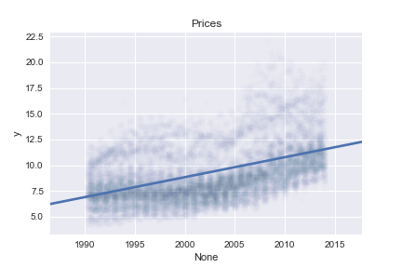
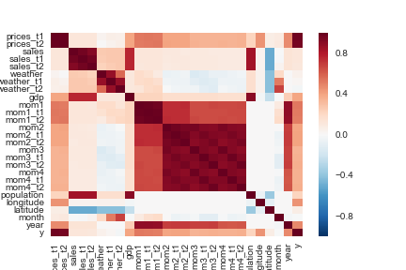
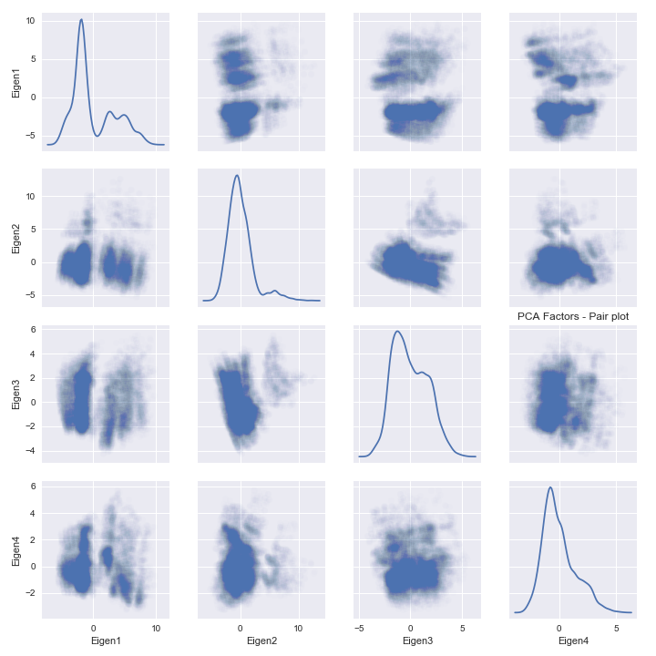
2. Data & Visualizations
The data
Visualizations
48 American states on monthly basis
1990 to 2013
Weather, GDP, geographical, Population, sales, prices GDP
Obs. Lagged 3 months
28 variables & 13000 observations
Response variable: prices in next month.
Correlations (left)
Upward trend in prices
PCA (right) linear projection from 28 → 4 variables
Tendency to clusters
1. Motivation & Project Outline
2. Data & Visualizations
3. Machine Learning
4. Deep Learning
5. Benchmarks
6. Results

Slide 4
3. Machine Learning
Machine Learning basics
Machine Learning (supervised learning) in practice
Statistical problems can be separated into 2 spheres
Prediction
Hypothesis testing
Machine Learning deals with predictions
Define a loss function L that measures the accuracy of a model.
Machine Learning aims to achieve best out of sample performance
Machine Learning is less concerned with asymptotic properties of estimators and more concerned with performance.
Decide on a loss function
MSE (mean squared error)
Split data into a test set and a training set.
Training data is for construction of model
Test data is for getting out-of-sample performance measure
Tune hyper parameters
Find model with best training setting performance
Get test data performance as measure of model quality
1. Motivation & Project Outline
2. Data & Visualizations
3. Machine Learning
4. Deep Learning
5. Benchmarks
6. Results

Slide 5
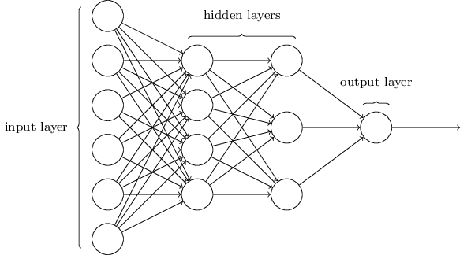
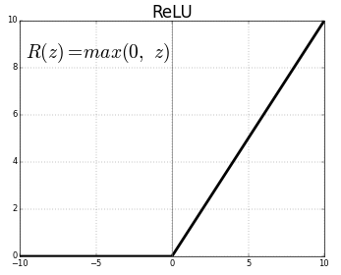
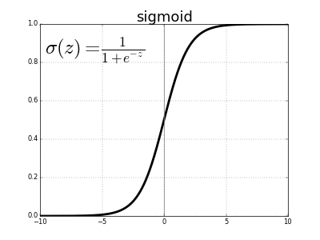
4. Deep Learning
Deep Neural networks
Projections
Started in the 60’s as an attempt to model the a brain (network of neurons)
Has in the later years shown great performance leaps
Alpha Go, speech recognition, image recognition
How a DNN works:
Construct a network (a directed graphs) of nodes and edges.
Each node has an activation function (usually sigmoid), that takes the sum of earlier nodes as input times a weight for each input.
The weights updated (gradient descent) to get better performance
Our Model:
Layer 1: 16 (Relu)
Layer 2: 16 (Relu)
Layer 3: 10 (Relu)
Total number of parameters: 1053
1. Motivation & Project Outline
2. Data & Visualizations
3. Machine Learning
4. Deep Learning
5. Benchmarks
6. Results

Slide 6
5. Benchmarks
The Benchmarks
Measuring the benchmarks
Last periods prices
Last periods prices is usually a good benchmark in time series econometrics
Linear Regression
Standard econometric tool
Random Forest
Popular Machine Learning algorithm
Rarely overfits
Converges fast
Easy to tune
The test train split
Test size 20 %, Train size 80 %
Mean Squared Error
Hard to interpret
Nice mathematical properties
The standard in regression
Mean absolute Error
Easy to interpret
How much on average do the model “miss the target”
No nice mathematical properties
1. Motivation & Project Outline
2. Data & Visualization
3. Machine Learning
4. Deep Learning
5. Benchmarks
6. Results

Slide 7
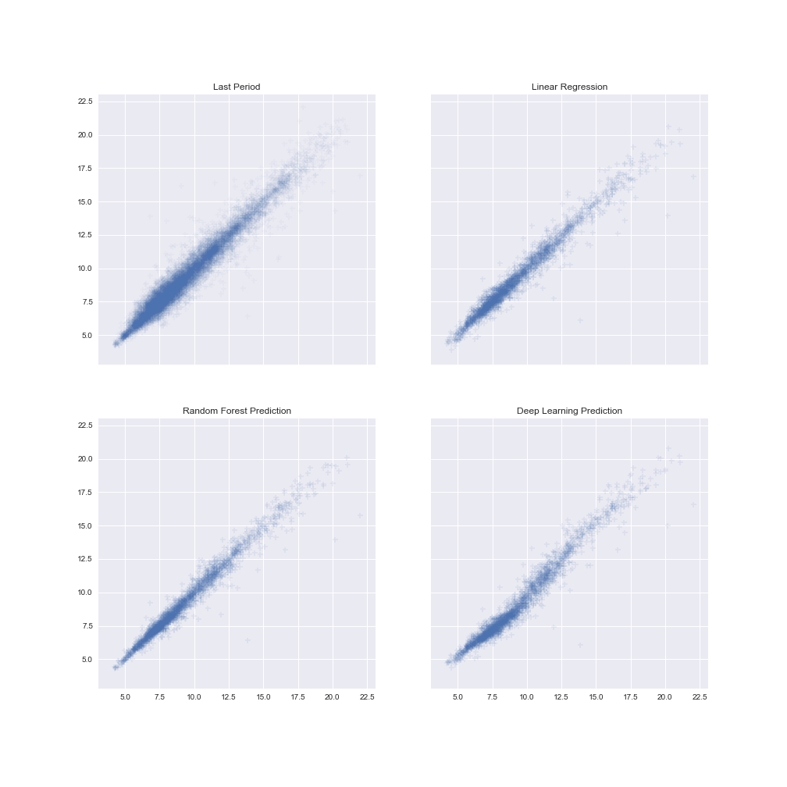
6. Results
Motivation
Predictions vs. actual
Model | Mean Absolute Error | Mean Squared Error
Last Period | 0,45 | 0,42
Linear Regression | 0,37 | 0,31
Random Forest | 0,31 | 0,25
Deep Learning | 0,45 | 0,39
Best performing model is Random Forest
Deep Learning: slightly better than last price
Deep Learning model under predicts prices in certain price interval
1. Motivation & Project Outline
2. Data & Visualizations
3. Machine Learning
4. Deep Learning
5. Benchmarks
6. Results

