Slide 1
Deep Learning & Energy prices

Slide 2
Motivation
How well does a deep learning model predict electricity prices compared to other models?
Is it possible to set up a successful model based on data scraped from public sources?

Slide 3
Project design
1)
Basics of Machine Learning
What is Deep learning?
2)
Data sources
Data collection
Data manipulation
3)
Deep learning model
Benchmarking
Results

Slide 4

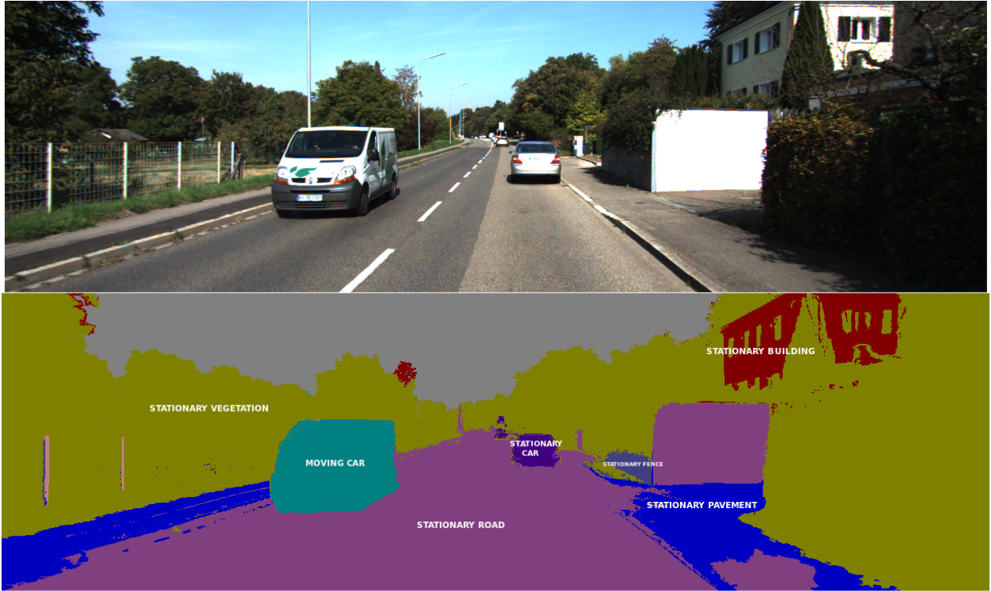
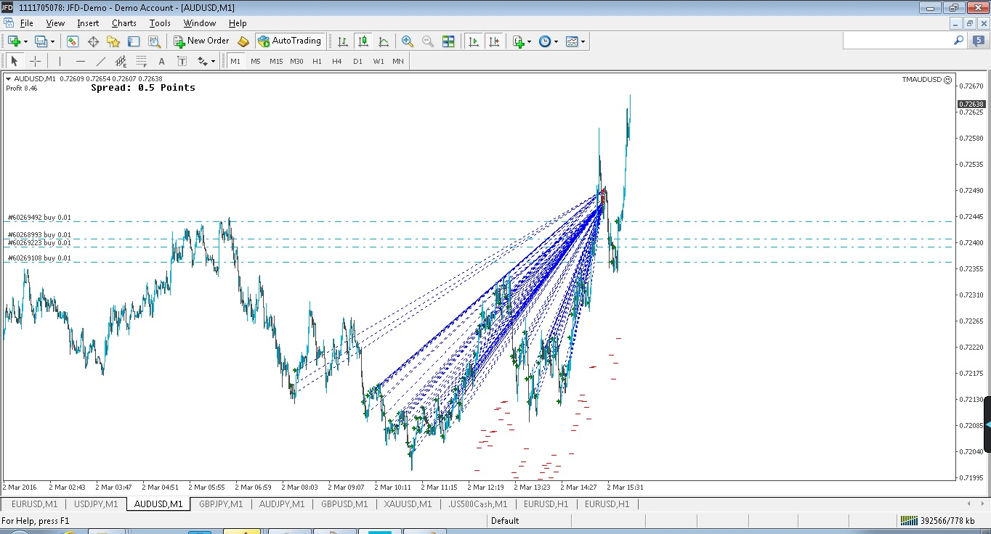
What is Deep Learning?
What it does
Finds hidden patterns in large datasets
Flexible functional form (unlike linear regression)
It is not well understood, why it is so successful
One disadvantage
No meaningful parameter estimates

Slide 5
Data sources
Prices and sold amouts: ”The US Energy Information Administration”
Population: Censusgov
GDP: Bea.gov
Weather: ndcd.noaa.gov
Longitudes/Latitudes: inkplant.com

Slide 6
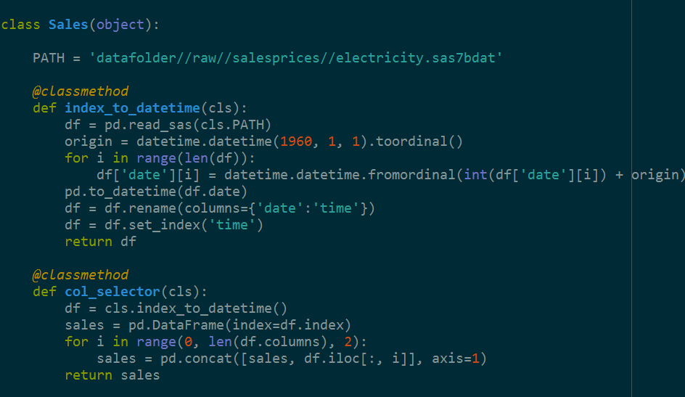
Construction of data set
Joining all data sources in one dataset
Computing variance, skewness and kurtosis as of sales and prices for a given period

Slide 7
Response variables
To forecast electricity prices in period t, we use:
Prices: t-3, t-2, t-1
Sales: t-3, t-2, t-1
Weather: t-1
GDP: t-1
Sales variance, skewness and curtosis
Price variance, skewness and curtosis
Population in 2013
Longtitude/latitude

Slide 8
PCA of data

Slide 9
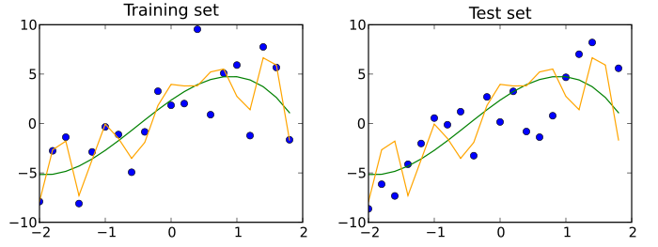

Machine learning basics
Splitting the dataset in test and training
Collecting more data will improve the model precision

Slide 10
Temperature
Deep Learning algorithm (Python Script)
Size of each state (population)
GDP
What will happen to electricity prices next month?
Electricity prices
Amount of electricity sold
Data from 1990-2013 covering 48 American states (Hawaii and Alaska excluded)
Approx. 17.000 observations
Longtitude/latitude
Variance, skewness and kurtosis

Slide 11
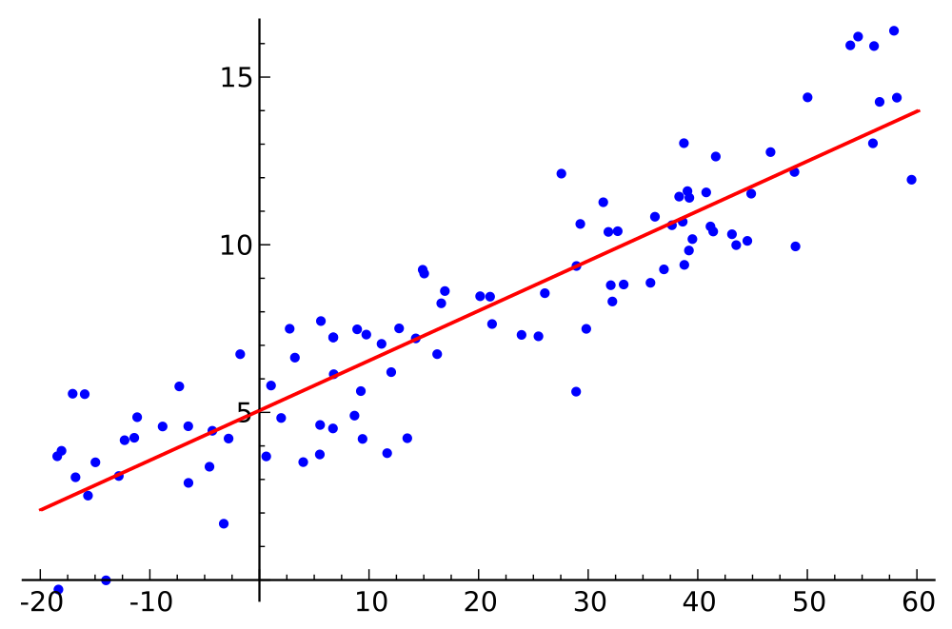


Benchmarking
Linear regression
Price of previous month
Random Forest estimation

Slide 12
Results

