Slide 1
CrowdPlay by Gruppe 02 - Anders W. Birkelund - Rune D. Rask - Khaled G. Edwan - Jonas R. Hartogsohn 8/6 2017

Slide 2
Why?

Slide 3
Why?

Slide 4
What?

Slide 5
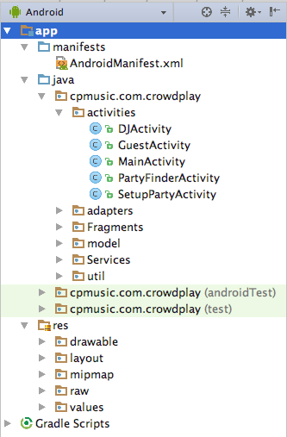
App project structure

Slide 6
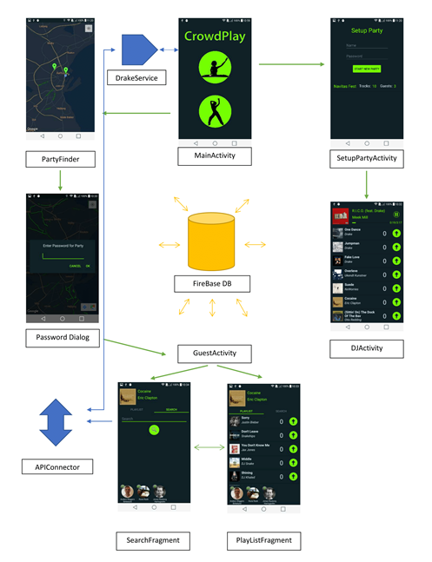
Main app components

Slide 7
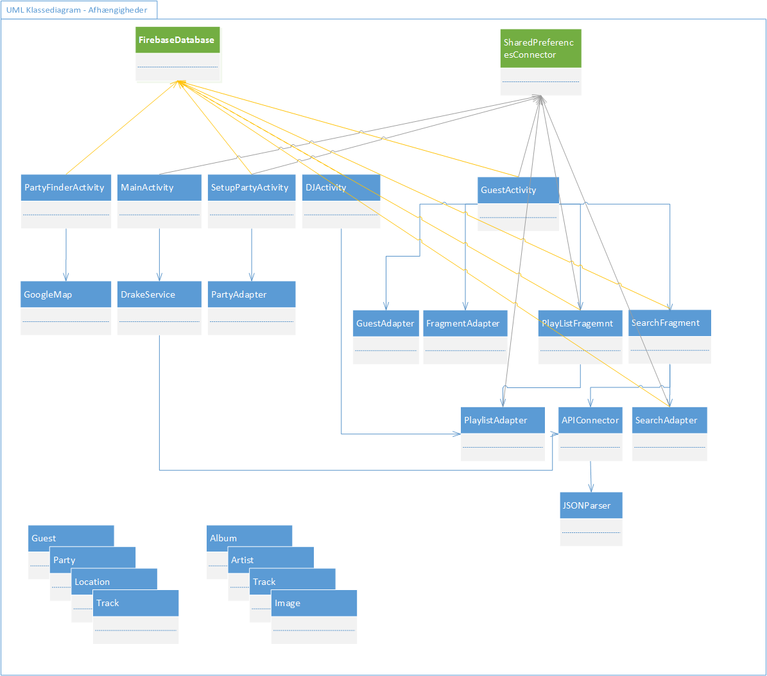
UML Class Diagram

Slide 8
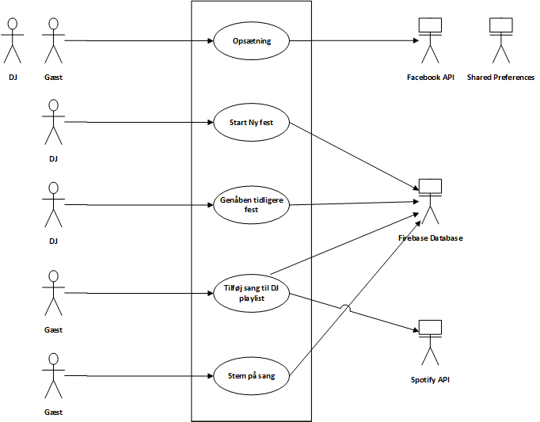
Use Case Diagram

Slide 9
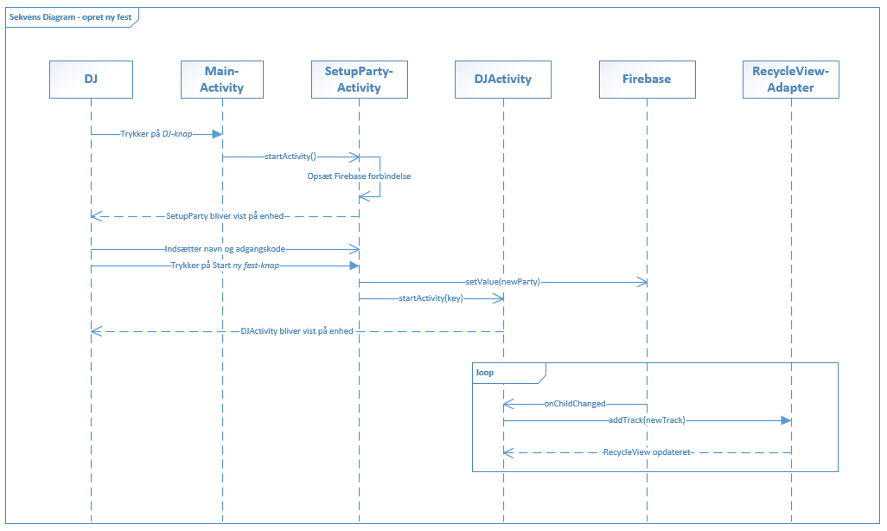
Sekvens-diagram “Start ny fest”

Slide 10
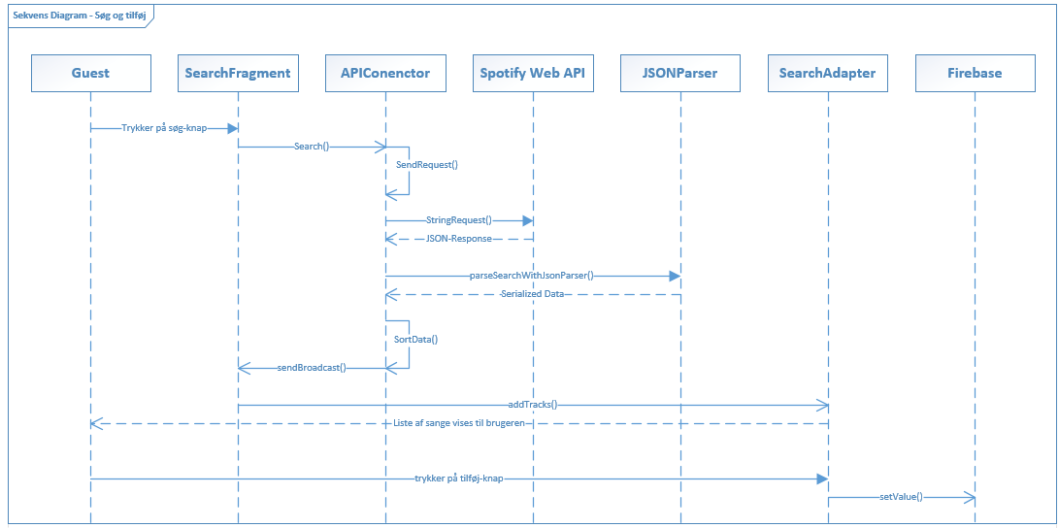
Sekvens-Diagram “Søg og tilføj”

Slide 11
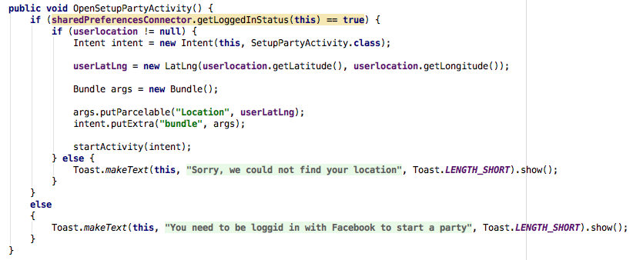
Code Snippets StartActivity

Slide 12
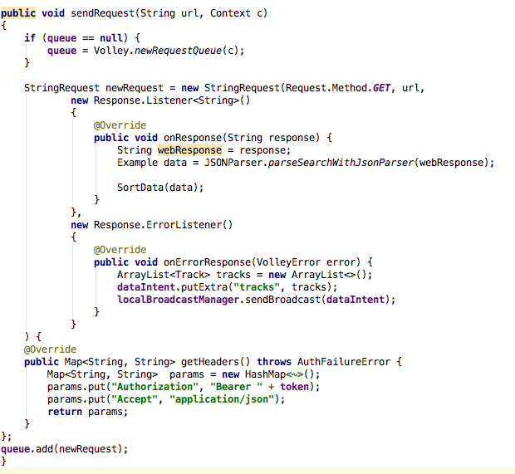
Code Snippets URL-Request

Slide 13
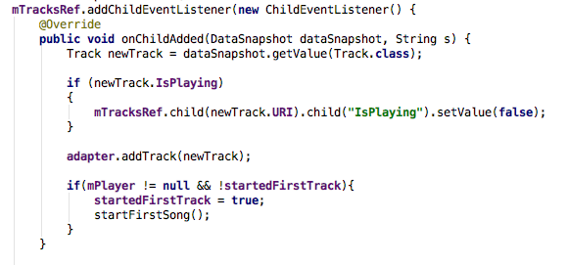
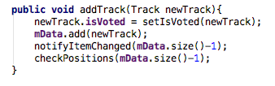
Code Snippets Firebase + RecyclerAdapter

