Slide 1
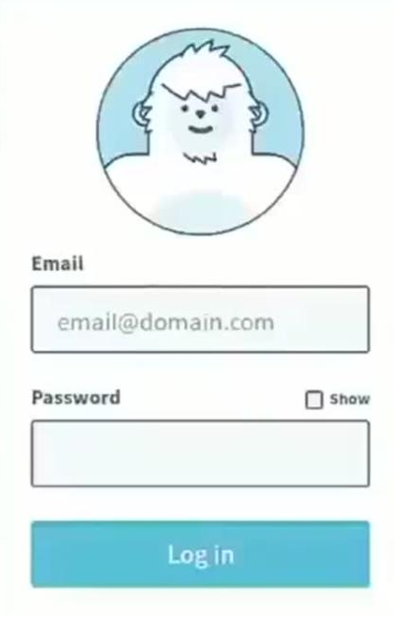

Slide 2


FF-12: Login Animation. Stickman meme faces
FAT FOXES

Slide 3


FF-12: Login Animation. Stickman meme faces
LOL TINDER

Slide 4
FF-12: Login Animation
FAT FOXES

Slide 5

FF-5: Register/Login
Welcome to Fat Foxes!
Let’s get started
SIGN IN
FAT FOXES
Email
Password
Register
Or

Slide 6

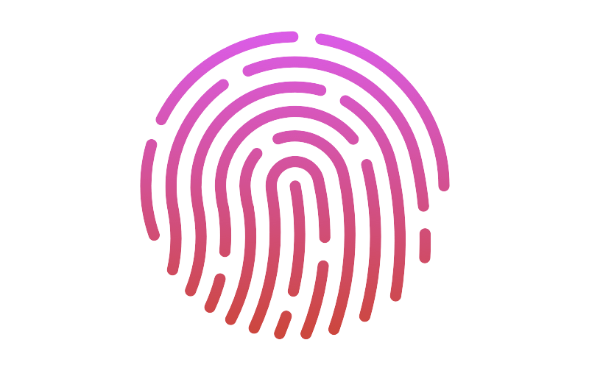
FF-5: Register/Login
Good morning,
Donald Trump
???
SIGN IN
Help me
Email
Password
Log In
Use Touch ID

Slide 7
FF-5: Register/Login
Login
Register

Slide 8
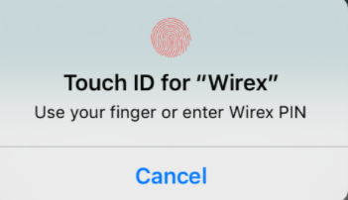
FF-5: Register/Login
Welcome to Fat Foxes!
Let’s get started
SIGN IN
Register
Email
Password
Register
Or
Notes:
Good morning, Good afternoon, or Good evening.

Slide 9
FF-5: Register/Login
Good morning,
Donald Trump
Register and Help
?
SIGN IN
???
Email
Help me
Password
Log In
Use Touch ID
Notes:
Good morning, Good afternoon, or Good evening.

Slide 10
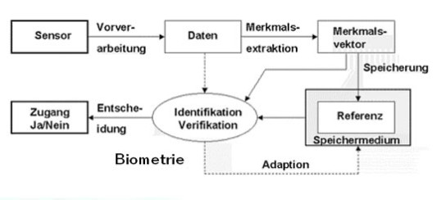

Slide 11
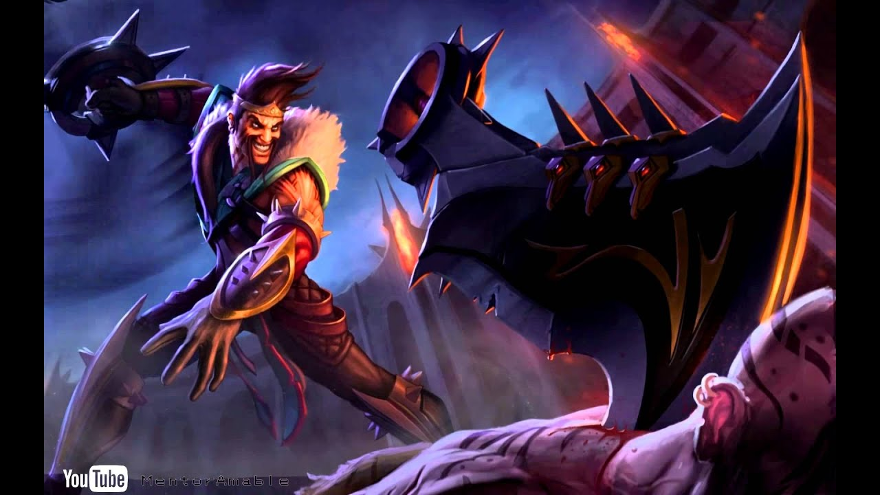
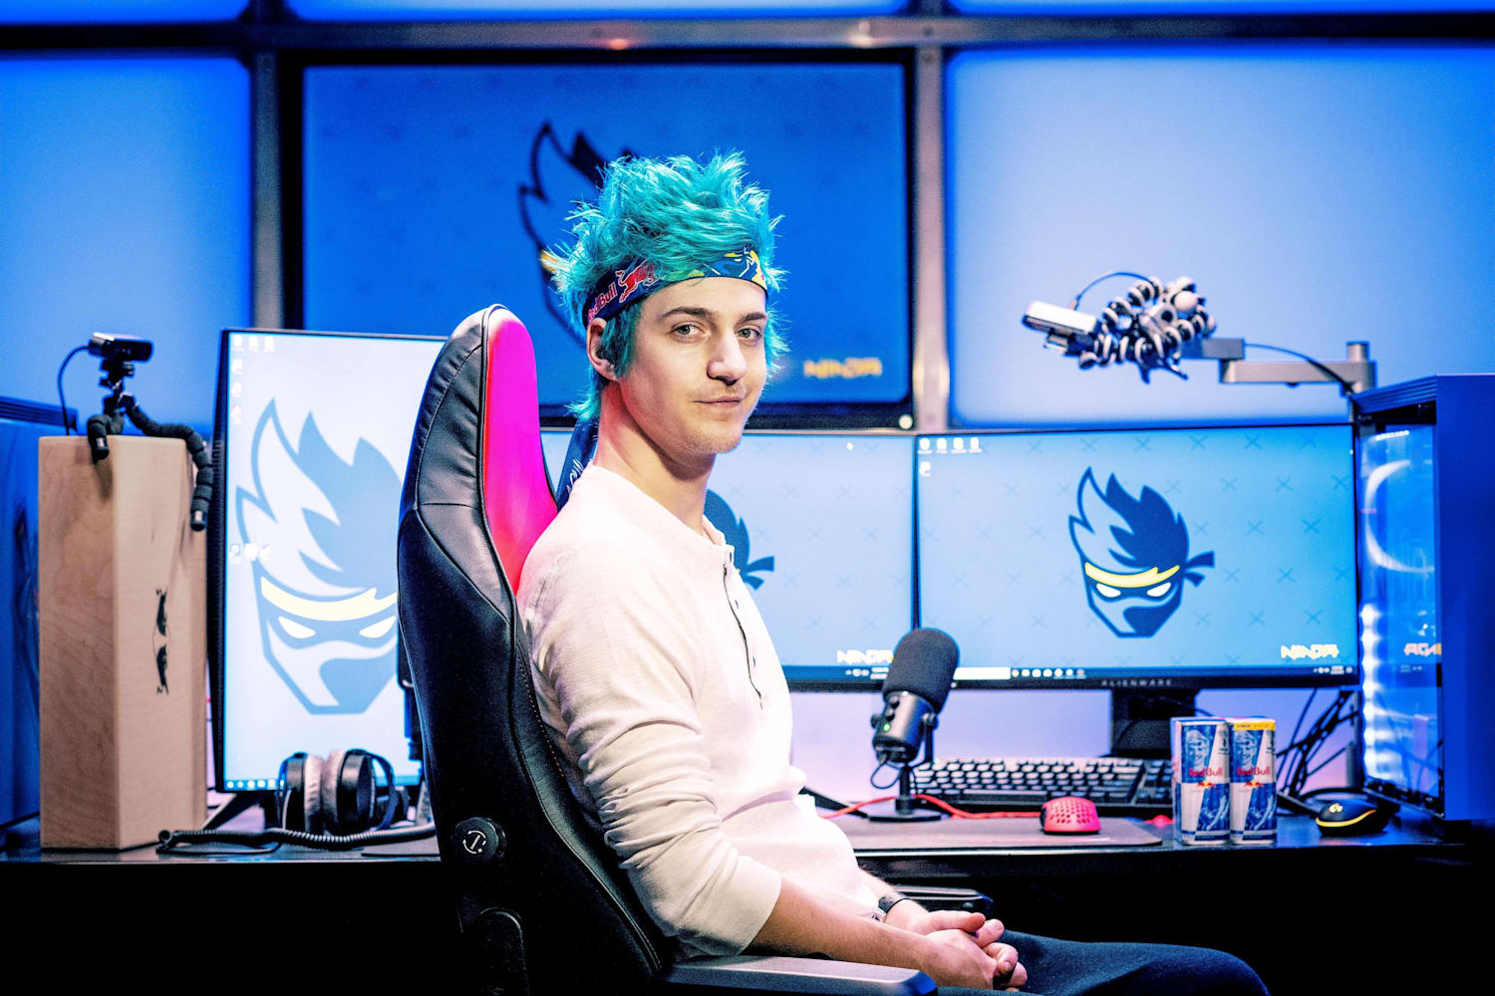

FF-8: Swipe on other users
Profile
Duo / Group
Chat
Ninja, 27
Frankfurt Am Main, Germany
About me:
Looking for:
Communicative
Fun
Team work
Casual Gaming
Conversations
Team work
More

Slide 12
FF-8: Swipe on other users
Profile
Duo / Group
Chat
Ninja, 27
Frankfurt Am Main, Germany
“I’m a kickass ADC so hmu for some DUO Q adventures!”
About me:
Looking for:
Communicative
Fun
Team work
Casual Gaming
Conversations
Team work
Summary
Gaming
Personal

Slide 13
FF-8: Swipe on other users
Profile
Duo / Group
Chat
Ninja, 27
Frankfurt Am Main, Germany
About me:
Looking for:
Communicative
Fun
Team work
Casual Gaming
Conversations
Team work
Summary
Gaming
Personal

Slide 14
FF-8: Swipe on other users
Profile
Duo / Group
Chat
Summary
Gaming
Personal

Slide 15
FF-6: Manage my profile
Profile
Fat Foxes
Chat
Ninja, 27
Frankfurt Am Main, Germany
Gaming Accounts
Discovery settings
Personal settings
General settings

Slide 16
FF-6: Manage my profile
Profile
Duo / Group
Chat
Ninja, 27
Frankfurt Am Main, Germany
Generalsettings
Edit my Profile
Gaming Accounts
More

Slide 17
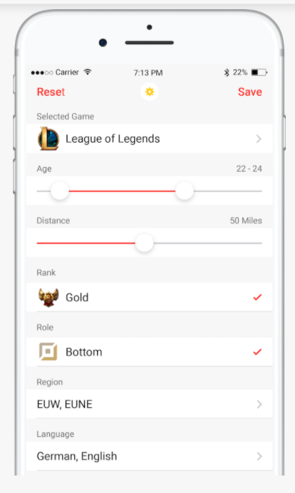
FF-7: Set my discovery preference
Discovery settings
About me
Looking for
RESET
SAVE

Slide 18
FF-7: Set my discovery preference
Discovery settings
About me
Looking for

Slide 19






FF-10: Overview page of my matches
Profile
Fat Foxes
Chat
New Matches
Joker
Magico
Jungleboy
Team SoloMid
Blitz
Duo
Groups
Groups
Fakerlol
Hey yo!
Bjergsen
Ye I am down for...
Rekkles
You down for ...
Bjergsen
Ye I am down for ...
New chat + Search with filter function

Slide 20



FF-10: Overview page of my matches
Profile
Fat Foxes
Chat
New Matches
Joker
Magico
Jungleboy
Team SoloMid
Blitz
Chats
Groups
Chats
Groups
Chats
Team SoloMid
Online (4)
Team Braunschweig
Online (0)
Team FFM
Online (4)
Team USA
Online (1)

Slide 21
FF-10: Overview page of my matches
Profile
Fat Foxes
Chat
New Matches
Joker
Magico
Jungleboy
Dr.Mundo
Blitz
Groups
Chats
Groups
Chats
Groups
Fakerlol
Hey yo!
Bjergsen
Ye I am down for...
Rekkles
You down for ...
Bjergsen
Ye I am down for ...

Slide 22
FF-10: Overview page of my matches
Profile
Fat Foxes
Chat
Groups = Grouped matched
New Matches
Joker
Magico
Jungleboy
Dr.Mundo
Blitz
Chats
Groups
Chats
Groups
Chats
Tryharding ranked
Online (5)
Random chill
Online (0)
ARAM
Online (4)
Delivery guys
Online (1)

Slide 23
FF-10: Overview page of my matches
Profile
Fat Foxes
Chat
New Matches
Joker
Magico
Jungleboy
Dr.Mundo
Blitz
Chats
Groups
Chats
Groups
Chats
Tryharding ranked
Online (5)
Random chill
Online (0)
ARAM
Online (4)
Delivery guys
Online (1)

Slide 24
FF-10: Overview page of my matches
Profile
Fat Foxes
Chat
New Matches
Joker
Magico
Jungleboy
Dr.Mundo
Blitz
Groups
Chats
Groups
Chats
Groups
Fakerlol
Your turn!
Hey yo!
Bjergsen
Ye I am down for some games around 9pm
Rekkles
Your turn!
You down for some tryhardz?
Bjergsen
Ye I am down for some games around 9pm

Slide 25
FF-9: Chat with my matches

Slide 26
FF-11: Connect with matches via other programs

Slide 27
FF-13: Link and verify my account

Slide 28
FF-14: Link and verify my account

