Slide 1
Mizu
Viki lauvrys
Jonas Saelens

Slide 2
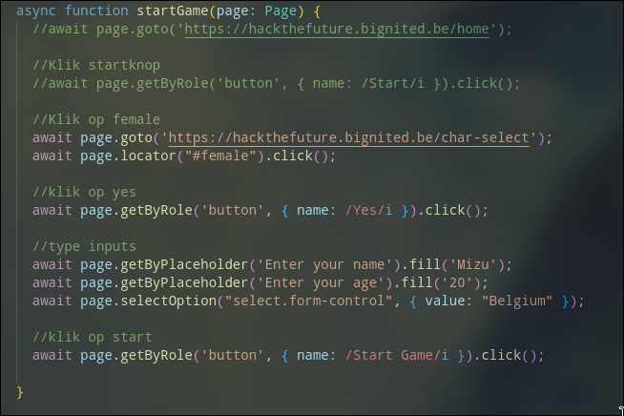
char-select

Slide 3
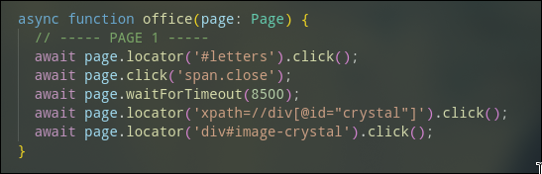
Office

Slide 4
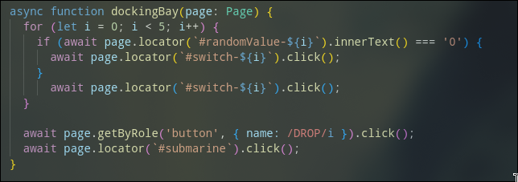
docking-bay

Slide 5
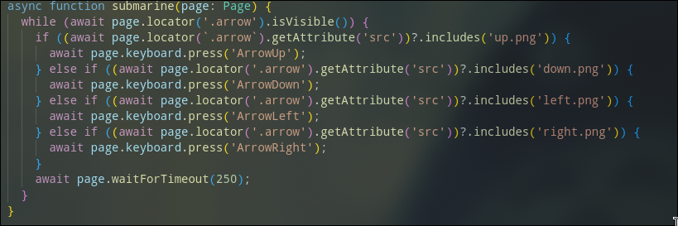
submarine

Slide 6
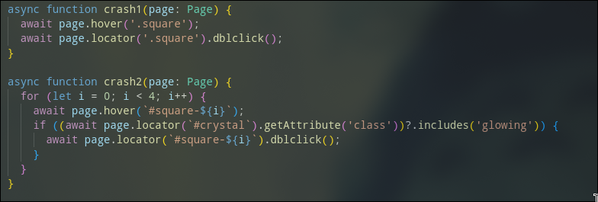
crash

Slide 7
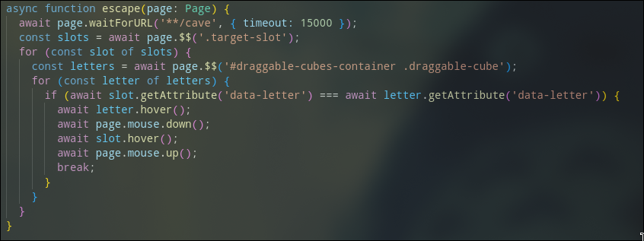
escape

Slide 8
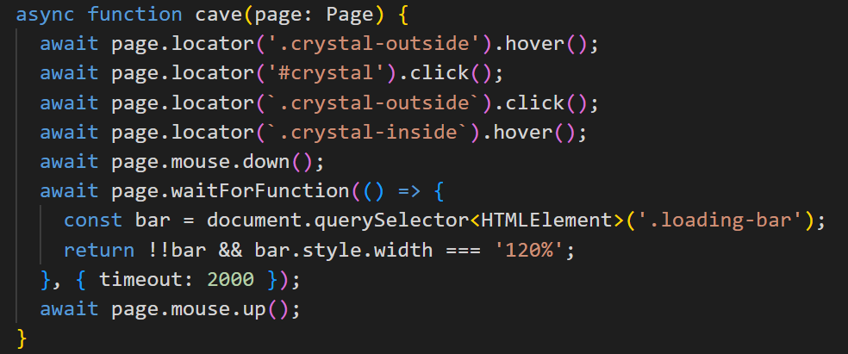
cave

Slide 9
Boss

