Slide 1
PHC Quality Weekly Performance Week Commencing: {{WC_DAY1}}{{WC_DAY2}}/{{WC_MONTH}}/{{WC_YEAR}} QHSE Manager: Jonas Simonaitis Date: {{MEET_DAY}}/{{MEET_MONTH}}/{{MEET_YEAR}} Site: Repose Furniture

Slide 2

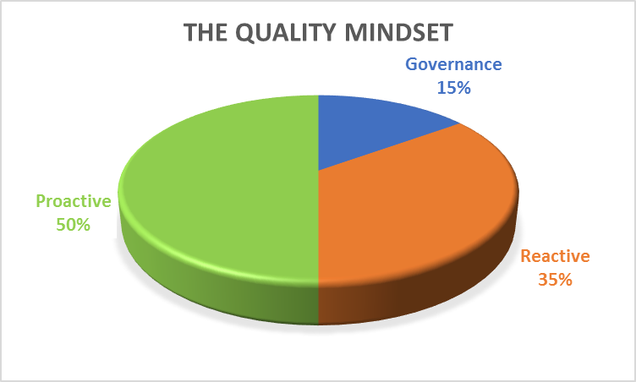


Heatmap Purpose
Business weekly quality performance slide pack – Objective
The BWQP is a standard document across the organisation, used to articulate the health of quality back to the relevant facility. It takes two forms, one weekly and a second monthly to align the quality measures monitored in the function with those required by the business to comply with ISO9001. It should be presented each week to the site Leadership team and then sent to the regional head of compliance - quality for onward communication of the health of quality for the site.

Slide 3
PMUK: Week 18
– Box Quality Update 28/04/2026
Achievements:
Maintenance/Calibration model built and included into RepNet.
Improvement works on internal NCR management. (Will close out 60% of open action from area inspections).
Walkabout completed in Foam Area.
Next priority task this week:
Order Intake model to be built into RepNet.
Finish NCR model inside the RepNet – desired outcome – 100% PHC and ISO 9001 compliance.
Risk & Issues:
N/A
Support or Help needed:
N/A

Slide 4
PMUK: Week 18
– Box Quality Update –30/04/2026
Achievements:
Internal NCR Management and cross over with RepNet 95% completed.
Closed of REPO-0027 SCAR Seminar.
Air Monitoring Survey – Remedial works to be planned in
Noise Exposure Survey – Remedial works to be planned in
Walkabout in 1 area completed Week 17.
Next priority task this week:
Compliance walkabout scheduled in 2 areas.
Trial and capture NCR process in procedure.
Risk & Issues:
N/A
Audit Schedule
Type | External | Internal | Sub-Con
Plan for year | - | 7 | -
YTD Plan Comp. | - | 7 | -
YTD Actual Comp. | - | 7 | -
Schedule Adherence % | - | 100% | -
Support or Help needed:
N/A

Slide 5
NA: Wk.{{WK_NUM}} Customer Complaints Performance Update
KPI – Customer Complaints
KPI – Analysis by Customer
KPI – Analysis of theme / fault code
Summary of Actions to improve
Liability Y / N | IRP/NC # | RC- Code Or Concern | Action | Owner | Comp. Date
Y | {{S5R1_TKT}} | {{S5R1_RC}} | {{S5R1_ACTION}} | JU
Y | {{S5R2_TKT}} | {{S5R2_RC}} | {{S5R2_ACTION}} | WH
Notes:
Man (People) – Human Factors such as skills, training, communication, or behaviour that may affect the process.
Machine - Includes tools, equipment, and technology involved in the process that might cause issues.
Materials – Covers raw materials, components, or consumables used in the process and their quality or availability.
Method – Refers to procedures, policies, or techniques followed in the process and whether they are effective or followed correctly.
Measurements – Involves the accuracy and reliability of data, measurements, and feedback systems used to monitor the process.
Mother Nature (Environment) Considers external factors such as environmental conditions (temperature, humidity) or organisational culture that could influence the outcome.

Slide 6
NA: Wk.{{WK_NUM}} Warranty Returns Performance Update
KPI – Warranty Returns
KPI – Analysis by Customer
Analysis of theme / fault code
Summary of Actions to improve
Liability Y / N | IRP/NC # | RC- Code Or Concern | Action | Owner | Comp. Date
Y | {{S6R1_TKT}} | {{S6R1_RC}} | {{S6R1_ACTION}} | JS
Notes:
Man (People) – Human Factors such as skills, training, communication, or behaviour that may affect the process.
Machine - Includes tools, equipment, and technology involved in the process that might cause issues.
Materials – Covers raw materials, components, or consumables used in the process and their quality or availability.
Method – Refers to procedures, policies, or techniques followed in the process and whether they are effective or followed correctly.
Measurements – Involves the accuracy and reliability of data, measurements, and feedback systems used to monitor the process.
Mother Nature (Environment) Considers external factors such as environmental conditions (temperature, humidity) or organisational culture that could influence the outcome.

Slide 7
NA: Wk.{{WK_NUM}} Internal Performance Update
KPI – Internal errors by month
KPI – Analysis by Part Number
Analysis of theme / fault code
Summary of Actions to improve
IRP /NC # | RC Code / concern | Action | Owner | Comp. Date
{{S7R1_TKT}} | {{S7R1_RC}} | {{S7R1_ACTION}} | {{S7R1_OWNER}}
{{S7R2_TKT}} | {{S7R2_RC}} | {{S7R2_ACTION}} | {{S7R2_OWNER}}
Notes:
Man (People) – Human Factors such as skills, training, communication, or behaviour that may affect the process.
Machine - Includes tools, equipment, and technology involved in the process that might cause issues.
Materials – Covers raw materials, components, or consumables used in the process and their quality or availability.
Method – Refers to procedures, policies, or techniques followed in the process and whether they are effective or followed correctly.
Measurements – Involves the accuracy and reliability of data, measurements, and feedback systems used to monitor the process.
Mother Nature (Environment) Considers external factors such as environmental conditions (temperature, humidity) or organisational culture that could influence the outcome.

Slide 8
NA: Wk.{{WK_NUM_PREV}} Concessions Performance Update
KPI – Concession raised by week
KPI – Analysis by Part Number
Analysis of theme / fault code
Summary of Actions to improve
IRP /NC # | RC Code / concern | Action | Owner | Comp. Date
Y | R001 | 2 Proform Demo Chairs manufactured using old mechanism | JS
 |  | Harvest bolt – to be recorded | MM
Notes:
Man (People) – Human Factors such as skills, training, communication, or behaviour that may affect the process.
Machine - Includes tools, equipment, and technology involved in the process that might cause issues.
Materials – Covers raw materials, components, or consumables used in the process and their quality or availability.
Method – Refers to procedures, policies, or techniques followed in the process and whether they are effective or followed correctly.
Measurements – Involves the accuracy and reliability of data, measurements, and feedback systems used to monitor the process.
Mother Nature (Environment) Considers external factors such as environmental conditions (temperature, humidity) or organisational culture that could influence the outcome.

Slide 9
NA: Wk.{{WK_NUM_PREV}} Supplier Performance
KPI – Supplier [SCARS] returns by month
KPI – Analysis by Part Number
To be developed
Analysis of theme / fault code
Summary of Actions to improve
IRP /NC # | RC Code / concern | Action | Owner | Comp. Date
- | REPO-0026 | Proform mechanisms had to be returned for rework. | Prism Rhyl
- | REPO-0027 | A pallet of 2423 mechs sent with wrong back mottors installed | Seminar | 29/04/2026
- | REPO-0028 | Issue with failing handsets, over last 6 months more and more failty handsets found internally and post deliveries | Seminar

Slide 10
Quality – PHC –CoPQ £500 x IRP Raised per Issue
Weekly Target = £750
Monthly Target = £3000
Target for the year = < £9000
Total £{{S10_SCRAP_WK_GBP}}
Monthly Actual to date = £{{S10_SCRAP_MO_GBP}}
Top 3 Pt No. and Issues
Target based on 50% reduction requirements for 2024 – 2025 Actual = £ xxxx TBC
Weekly Target = £400
Monthly Target = £1600
Target for the year = < £4800
Total £{{S10_REWORK_WK_GBP}}
Monthly Actual to date = £{{S10_REWORK_MO_GBP}}
Top 3 Pt No. and Issues
Target based on 50% reduction requirements for 2024 – 2025 Actual = £ xxxx TBC
Weekly Target = £500
Monthly Target = £500
Target for the year = < £6000
Total £{{S10_CONC_WK_GBP}}
Monthly Actual to date = £{{S10_CONC_MO_GBP}}
Top 3 Pt No. and Issues
No cost affected by concession so far in 2025
Target based on 50% reduction requirements for 2024 – 2025 Actual = £ xxxx TBC

Slide 11
Site: Bi-Weekly Ops – Compliance Performance Update –Wk {{WK_NUM_PREV}}
KPI – Analysis by Element
KPI – Analysis by Sub-Element
Analysis by Open v Closed.
Summary of Actions to improve
IRP /NC # | RC Code / concern | Action | Owner | Comp. Date
N/A | N/A | Weekly emails sent out with overdue actions to area managers. | JS

Slide 12
NA: Wk.{{WK_NUM_PREV}} Scrap Performance Update
KPI – Scrap parts by month
KPI – Analysis by Part Number
Analysis of theme / fault code
Summary of Actions to improve
IRP /NC # | RC Code / concern | Action | Owner | Comp. Date
- | - | {{S12_SCRAP_COUNT}} Scrap instance(s) in week {{WK_NUM_PREV}}
Notes:
This KPI is asking for a weekly chart that shows how much waste (scrap) was produced compared to the total number of products sold. It wants the % based on the number of items NOT their cost.
Man (People) – Human Factors such as skills, training, communication, or behaviour that may affect the process.
Machine - Includes tools, equipment, and technology involved in the process that might cause issues.
Materials – Covers raw materials, components, or consumables used in the process and their quality or availability.
Method – Refers to procedures, policies, or techniques followed in the process and whether they are effective or followed correctly.
Measurements – Involves the accuracy and reliability of data, measurements, and feedback systems used to monitor the process.
Mother Nature (Environment) Considers external factors such as environmental conditions (temperature, humidity) or organisational culture that could influence the outcome.

