Slide 1








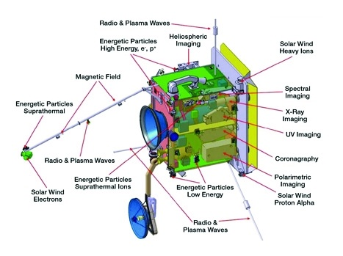
The Solar Wind Analyser SWA is made of 3 separate instruments
Heavy Ion System (HIS)
SwRI & UMich, USA
Proton Alpha System (PAS)
IRAP, France
Electron Analyser System (EAS)
UCL-MSSL
Data Processing Unit DPU, 3 companies, Italy
Details in A&A special issue
https://doi.org/10.1051/0004-6361/201937259

