Slide 1
Project Pong
Daftar Isi :
Window Screen
Button
Paddle
Anggota Kelompok :
Jonas Tan
Evan Kevin
Jeremi Nathanael
Samuel Steven
Junwin Cong
Ball
2P_Mode

Slide 2
Windows Screen
Initial Display
BACK

Slide 3
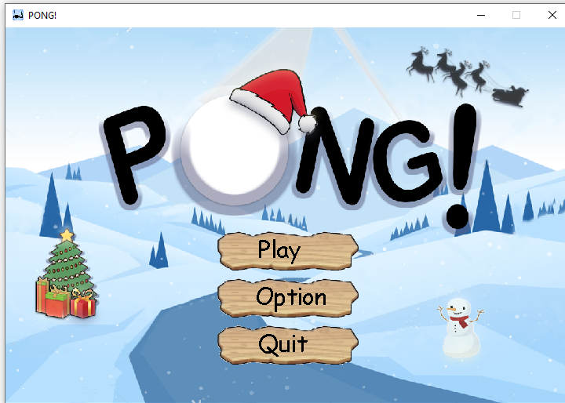
BACK

Slide 4
Paddle
Paddle Reflection
BACK

Slide 5
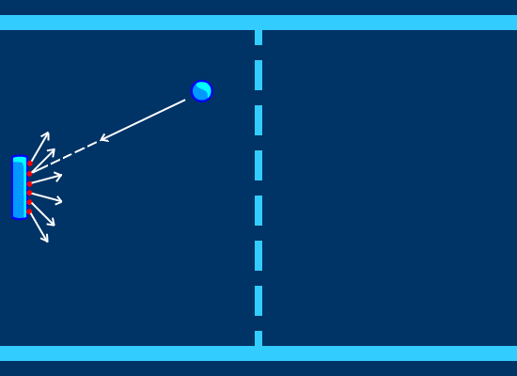
BACK

Slide 6
Ball
Gerakan & Pantulan Bola
BACK

Slide 7
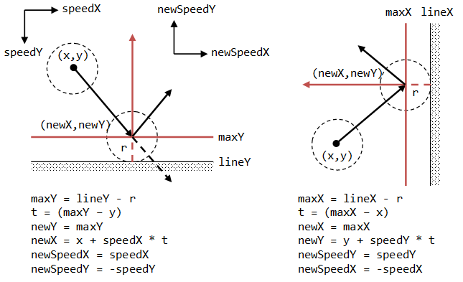
BACK

Slide 8
Main Program 2P
Button
BACK

Slide 9
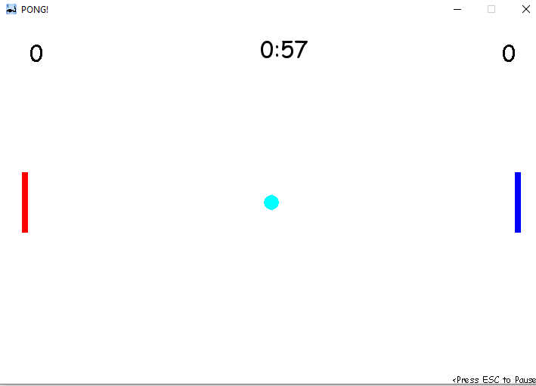
BACK

Slide 10
Button
Button
BACK

Slide 11
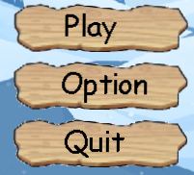
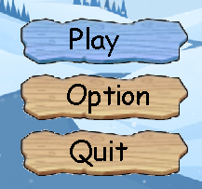
BACK

