Slide 1

What if you could be healthy along with your friends and family earning some discounts??

Slide 2




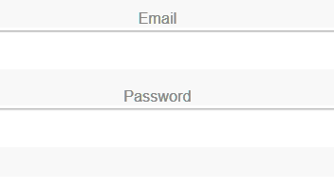










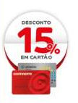





Average of 3000 kcal a day Sugar free Lactose Intolerance
Healtly Habits
Competition Circle
Promotion Earned
Badges
LOGIN
Notes:
After access the link above and login with continente online credentials, users can add items to their baskets and get nutritional info. The idea is to improve it to compare the basket total (by nutrient like sugar, protein, etc) and compare it with previous added friends. Instead of a typical ranking we will show different emoticons (sad, sick, normal or happy) one for each friend.

