Slide 1
Depthmonitor
Students: Jasper Maes & Jonas Vanhulst
Notes:
Dries

Slide 2
Agenda
Project
Timeline
Components
Demos
1
Notes:
Dries

Slide 3
Timeline
January & February
March
April
May
Product Research
Product Development
PLC programming
Python ads
Python dashboard
Data research
Product Development
Arduino programming
Documentation
Debugging
Product launch
Final Touch
Working Product
Github repository
Reading documentation
Installations
Calculations
Project application
2

Slide 4
Project overview
3

Slide 5
Used Components
Analog
10-80cm
Individual pixels
Analog 15cm – 6.45m
Analog 35cm – 6m

Slide 6
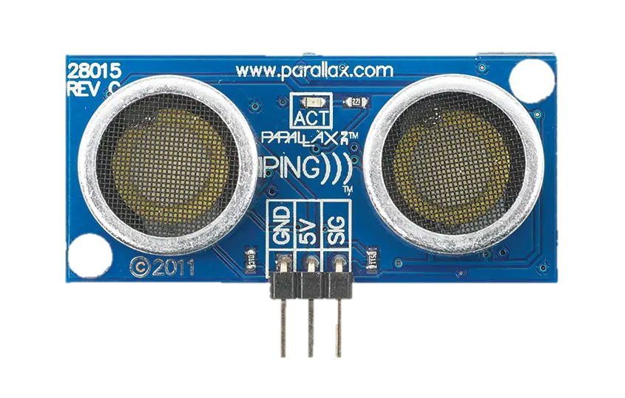
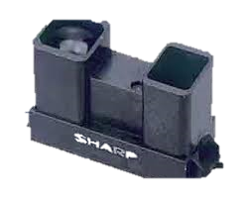
Other researched components
High peak voltage
Trigger and echo
Easy programable
Inaccurate
Analog values
Digital values
Only high or low
Easy programable
4

Slide 7
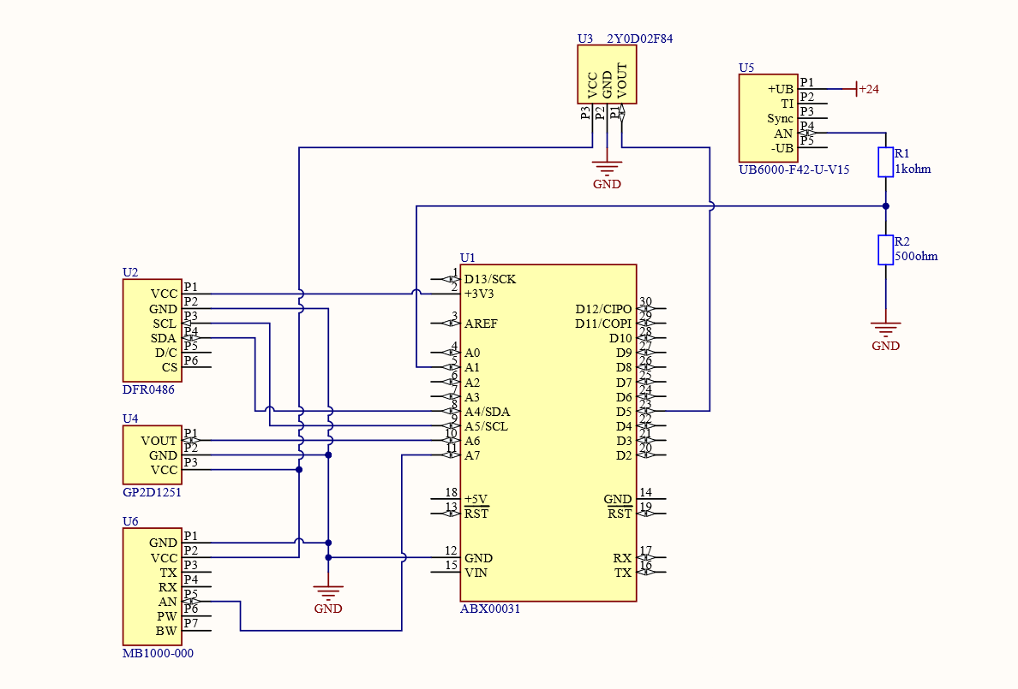
Arduino connections

Slide 8
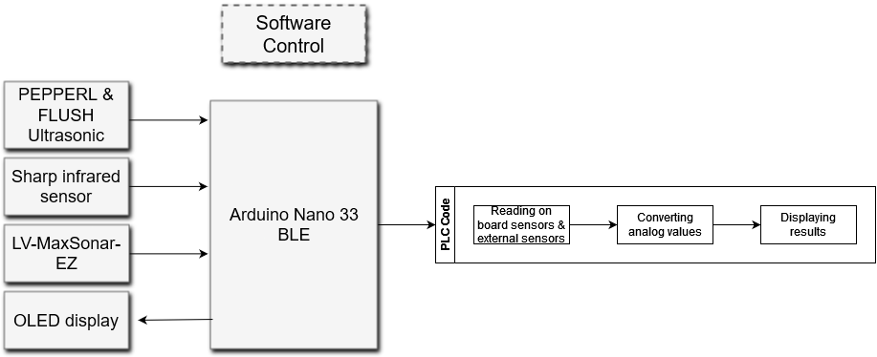
Arduino software

Slide 9
Demo’s
6

