Slide 1


ROSKILDE FESTIVAL
2026
QSTOP
ROSKILDE FESTIVAL 2026

Slide 2
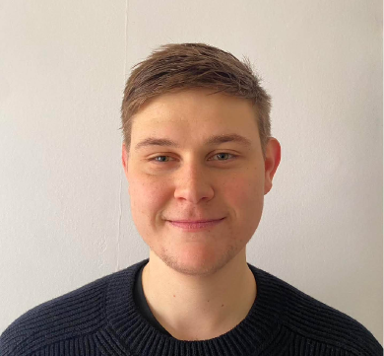
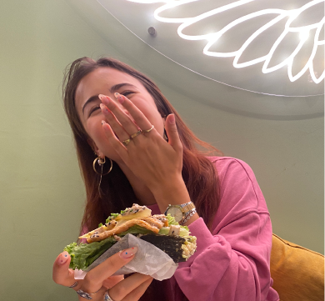
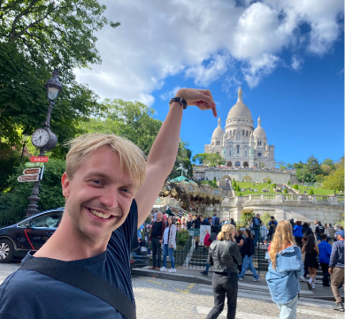
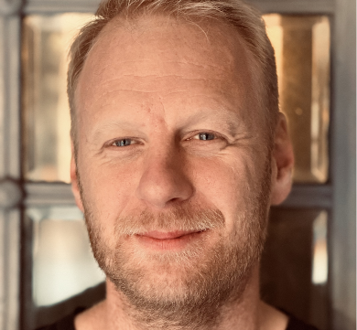
ROSKILDE FESTIVAL
2026
QSTOP
THE TEAM
CHRISTIAN SCHWARTZ
ANDREA TRIFUNOVIĆ
PETER HAUGSTED
JONAS VIGNAL-OLSEN
2
Notes:
We are Qstop....

Slide 3
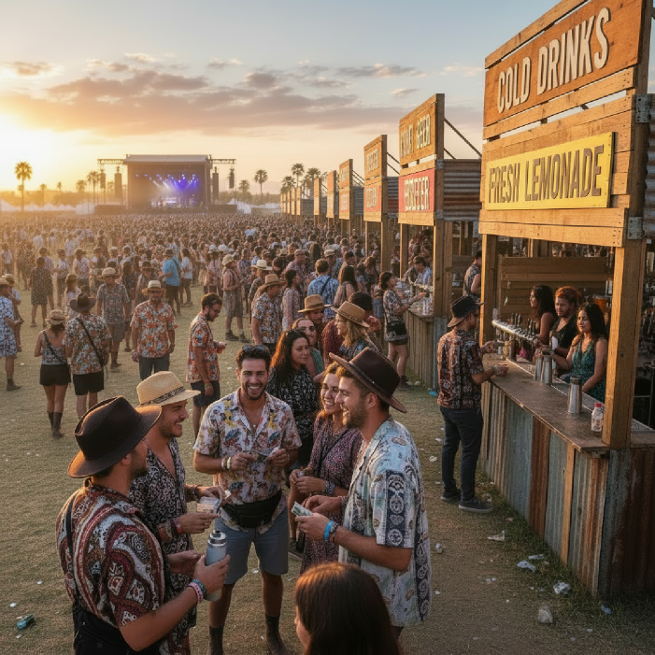
ROSKILDE FESTIVAL
2026
QSTOP
15 MINUTES LINE TO ORDER.
Notes:
The average customer is waiting 15 minutes in line to order their food or drinks, time they are missing out on in concerts or having fun with their friends.

Slide 4
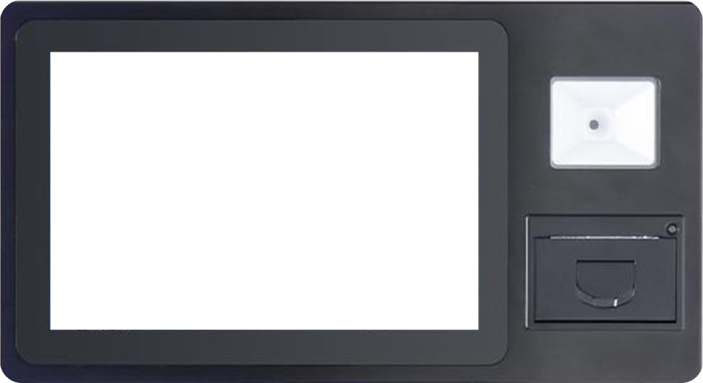
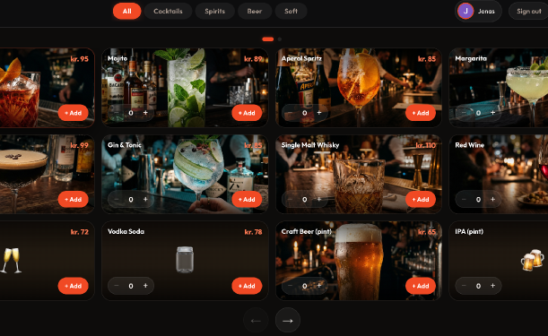
ROSKILDE FESTIVAL
2026
QSTOP
INNOVATIVE ORDERING PLATFORM
Notes:
We are Qstop, an innovative platform for ordering food and drinks in place with many people, such as festivals, concerts, and sports events. Our goal is to have a quick and easy ordering system for customers.

Slide 5
ROSKILDE FESTIVAL
2026
QSTOP
CUSTOMER JOURNEY
01
02
03
04
CHOOSE ORDER
PAY CONTACT LESS
RECIEVE RECEIPT
PICK-UP ORDER
02
Notes:
On our platform the customers choose their drinks or food, pay contact less and receive a receipt to show for pick-up

Slide 6
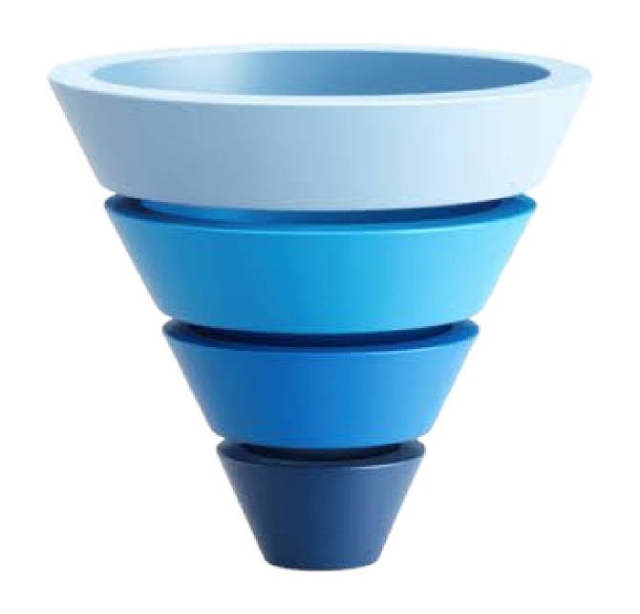
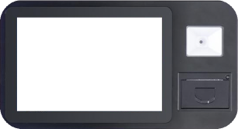
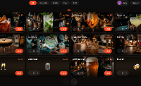
ROSKILDE FESTIVAL
2026
QSTOP
ORDERING
TIME CONSUMER
PAYING
STAFF
TIME
6
Notes:
The big time consumers lay in ordering, making choices and paying for the order. With the Qstop platform, we are removing the bottleneck, that lays in people ordering drinks or food with the front staff. The current solutions with standing in line and order with the staff is a time consumer and resolve into long queues with waiting time, due to the limited numbers of staff taking orders.

Slide 7
ROSKILDE FESTIVAL
2026
QSTOP
TWO EMPLOYES
PER UNIT SAVED
7
Notes:
The Qstop platforms can reduce two employes per platform and have the advantage that multiple platforms can be installed next to the bar or kitchen.

Slide 8
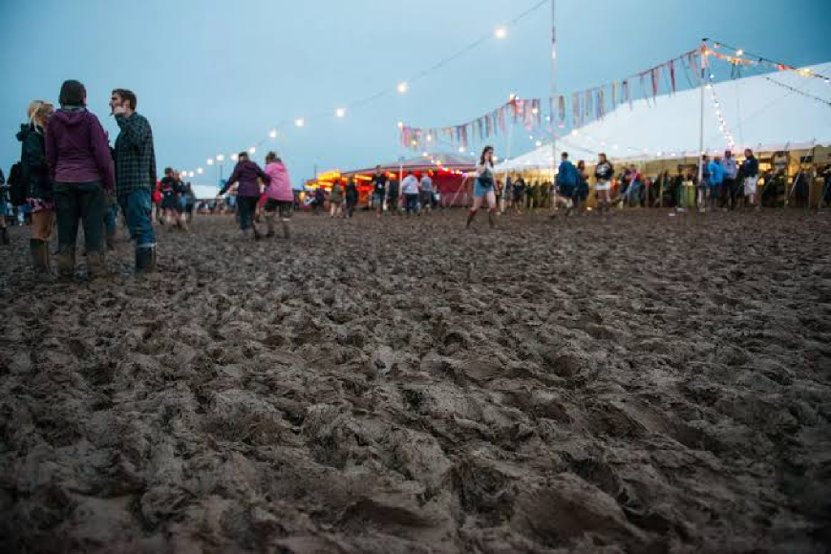
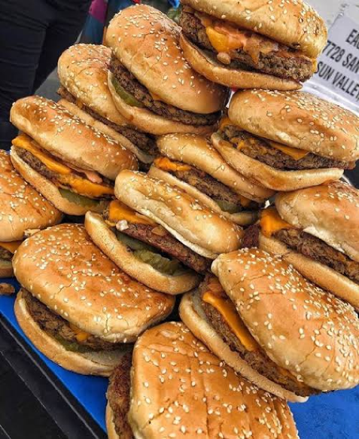
ROSKILDE FESTIVAL
2026
QSTOP
IMPACT
8
Notes:
Another win is that the platform can reduce the heavy foot traffic of people standing in long lines on the same spot and in this way make the impact on the ground less. The bar or kitchen also have the option to push specific drinks or food they want to sell, for example too many produced burgers or too many draft beers already poured up.

Slide 9

ROSKILDE FESTIVAL
2026
QSTOP
Notes:
In this way, Qstop is making a smarter and more efficient solution with problem-free ordering and bigger revenue for the bar or kitchen. Together we can make the event experience better for everybody. we are Qstop ”Your break, without the wait”

Slide 10
ROSKILDE FESTIVAL
2026
QSTOP
THANK YOU
10
Notes:
MIC DROP !

