Slide 2
Motivation

Slide 3
Overview
Introduction
Background: PDR on Hardware
PDR on Software
Implementation in Ultimate
Evaluation
Related Work
Future Work
Conclusion

Slide 4
Overview
Introduction
Background: PDR on Hardware
PDR on Software
Implementation in Ultimate
Evaluation
Related Work
Future Work
Conclusion

Slide 5
1. Introduction

Slide 6
Overview
Introduction
Background: PDR on Hardware
PDR on Software
Implementation in Ultimate
Evaluation
Related Work
Future Work
Conclusion

Slide 7
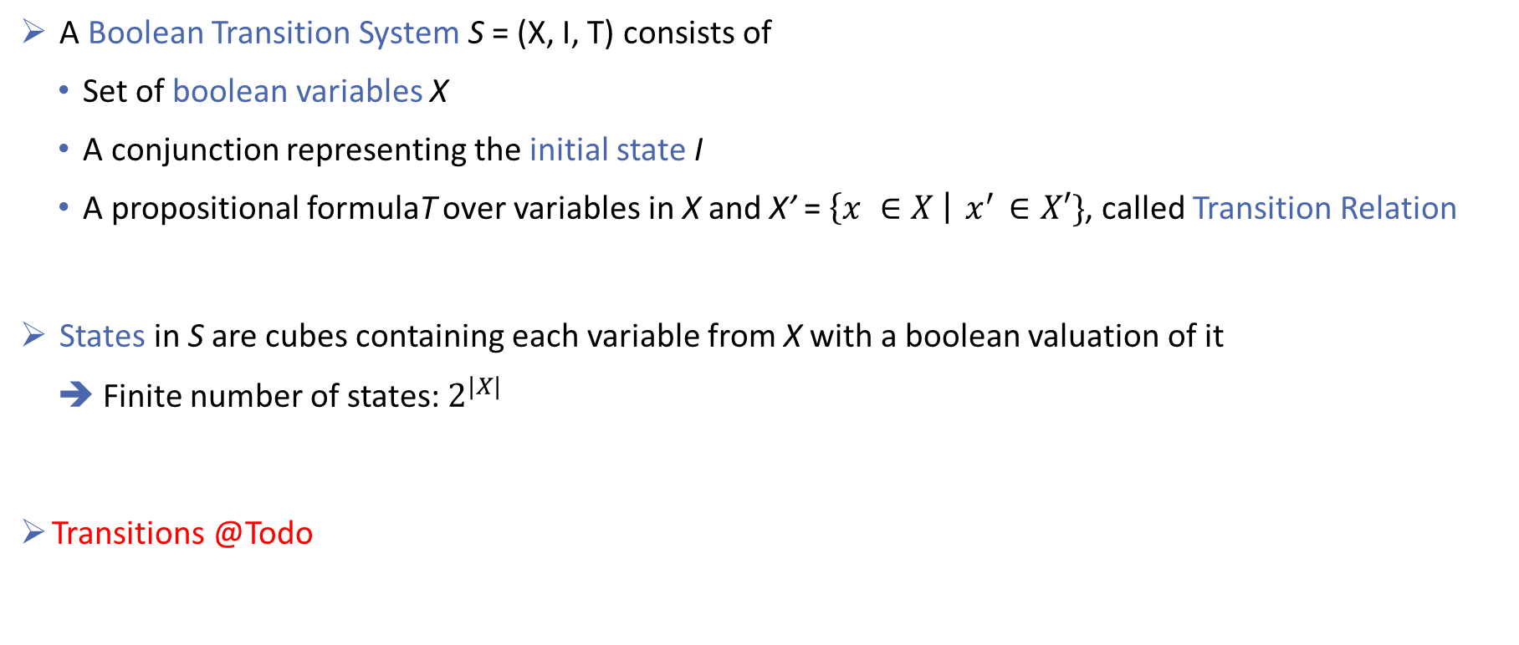
2.1 Preliminaries: Boolean Transition System
A Boolean Transition System S = (X, I, T) consists of
Set of boolean variables X
A conjunction representing the initial state I
A propositional formulaT over variables in X and X’ = $\left\{x ∈X \right|{ x}^{′} ∈X′\}$, called Transition Relation
States in S are cubes containing each variable from X with a boolean valuation of it
➔ Finite number of states: $2^{|X|}$
Transitions @Todo
Notes:
Folie für boolean Transition System

Slide 8
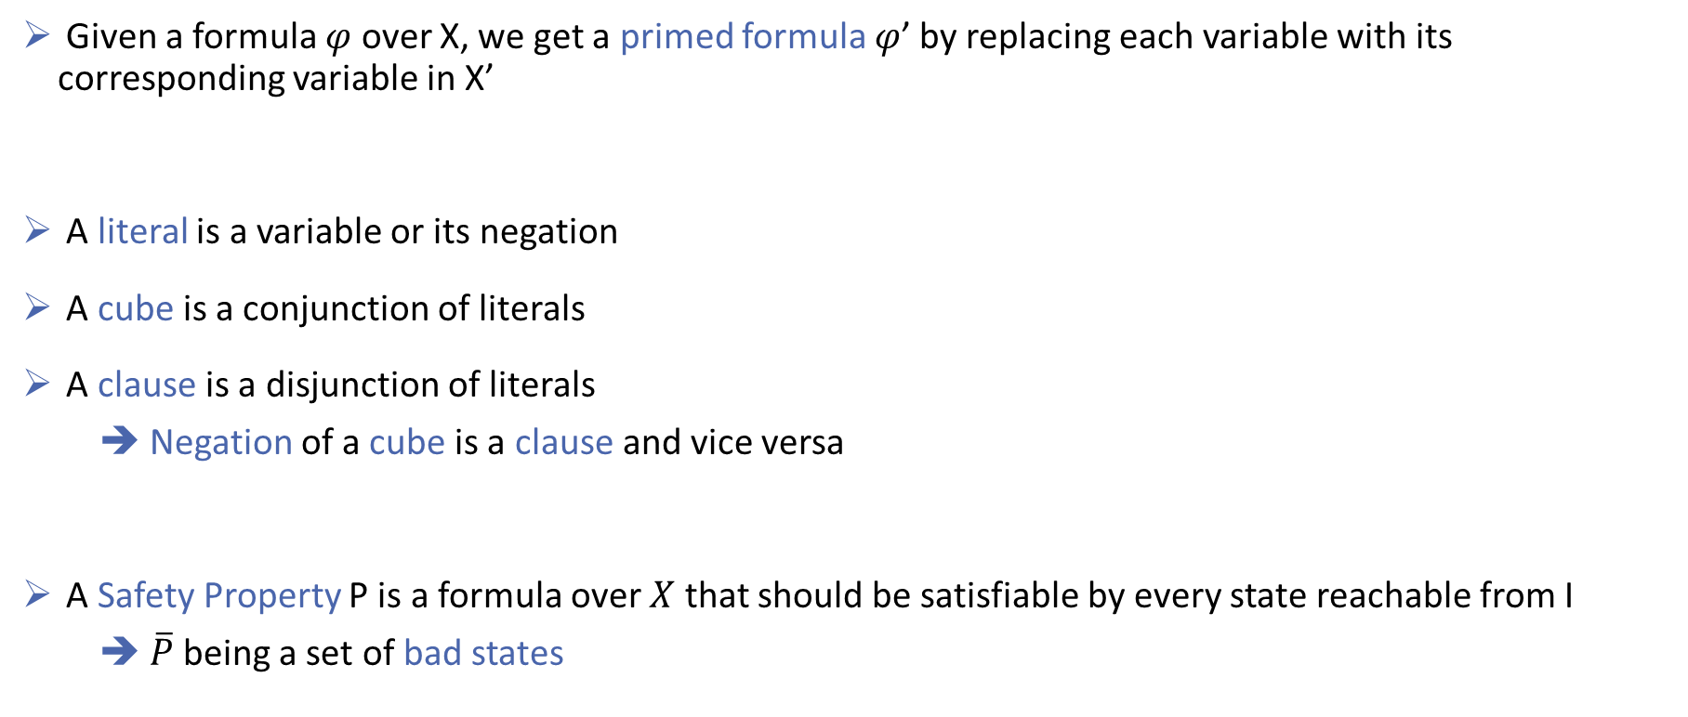
2.1 Preliminaries: Formulas
Given a formula $φ$ over X, we get a primed formula $φ$’ by replacing each variable with its corresponding variable in X’
A literal is a variable or its negation
A cube is a conjunction of literals
A clause is a disjunction of literals
➔ Negation of a cube is a clause and vice versa
A Safety Property P is a formula over $X$ that should be satisfiable by every state reachable from I
➔$\overline{P}$ being a set of bad states

Slide 9

2.2 Algorithm: Overview
PDR on hardware checks if states in $\overline{P}$ are reachable from $I$
For that it uses cubes of clauses, called Frames
Frame $F_{i }$represents an over-approximation of reachable states in at most i transitions from I
PDR maintains sequence of frames $[F_{0}, F_{1}, …, F_{k}]$, called trace

Slide 10
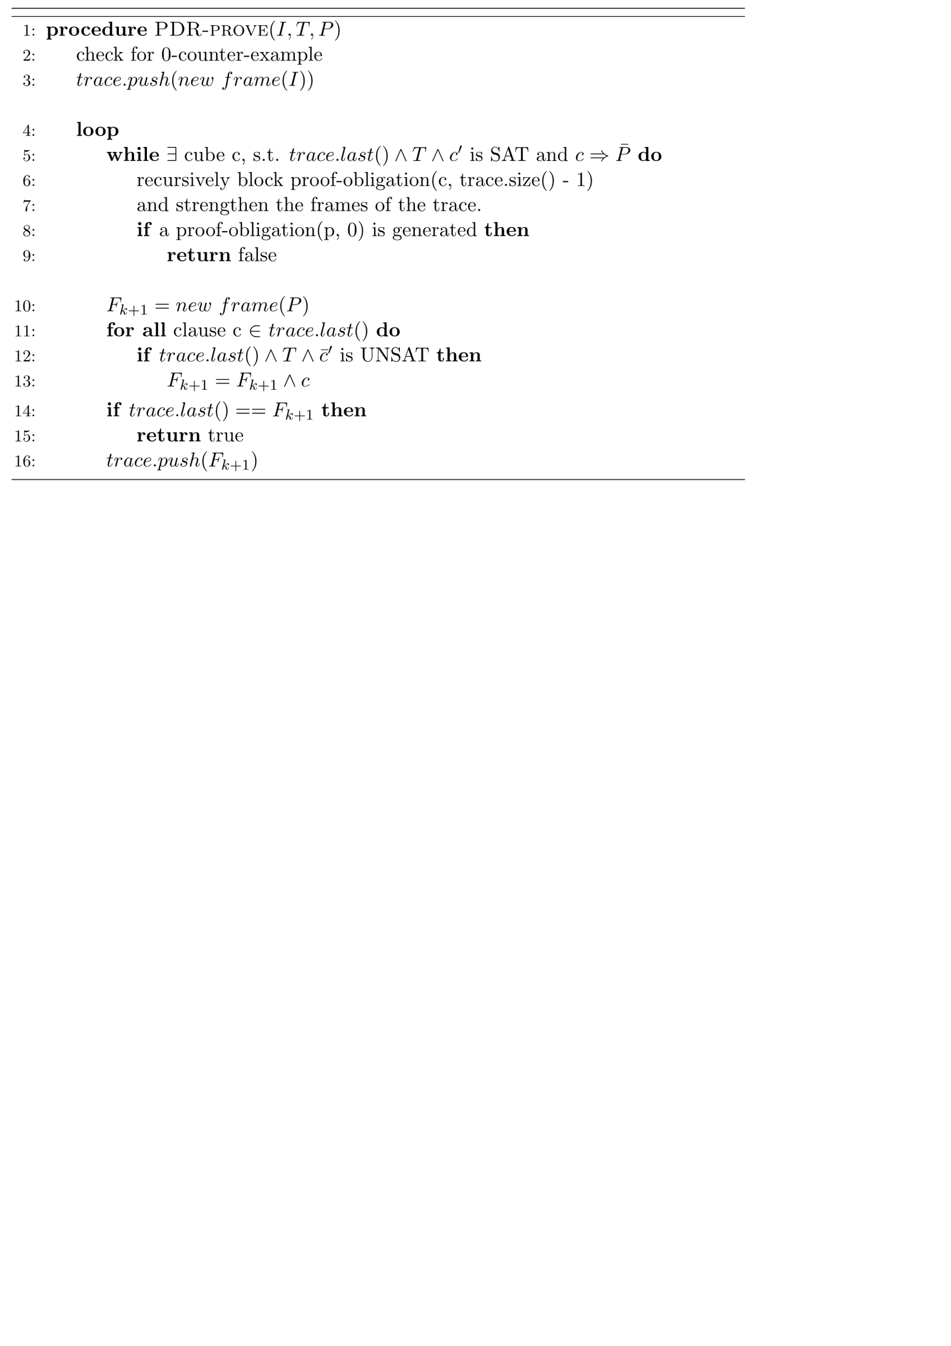
2.2 Algorithm: Pseudo-Code
Notes:
Next Transition Phase

Slide 11
2.2 Algorithm: Pseudo-Code
Notes:
Eingekreiste Codezeilen erklären. In subsequenten Folien, nur die Phasen eingezeichnet lassen die gerade Erklärt werden
Check for 0 CTI
Next Transition Phase
Blocking-Phase
Propagation-Phase

Slide 12
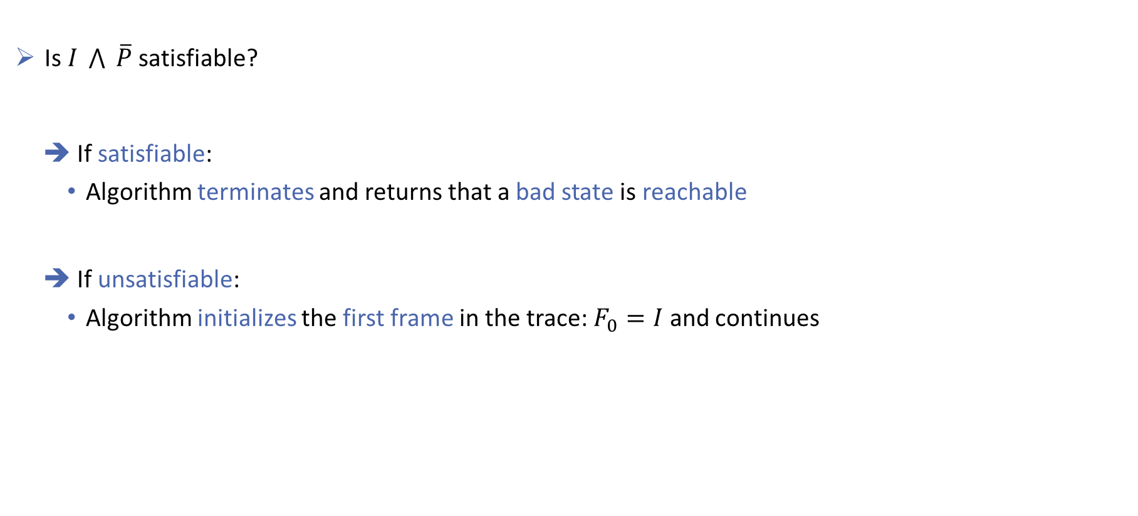
2.2 Algorithm: Checking for 0-Counter-Example
Is $I \bigwedge{ \overline{P}}$ satisfiable?
If satisfiable:
Algorithm terminates and returns that a bad state is reachable
If unsatisfiable:
Algorithm initializes the first frame in the trace: $F_{0}=I$ and continues

Slide 13
2.2 Algorithm: Pseudo-Code
Next Transition Phase
Notes:
Next Transition Phase

Slide 14
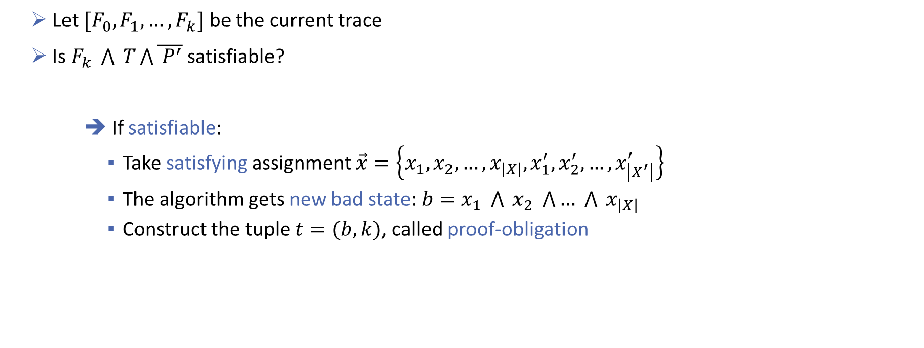
2.2 Algorithm: Next Transition Phase
Checking if the next state is a good state:
Let $[F_{0}, F_{1}, …, F_{k}]$ be the current trace
Is $F_{k} \bigwedge{ T\bigwedge{\overline{ P^{′}}}}$ satisfiable?
➔ If satisfiable:
Take satisfying assignment $\vec{x}=\left\{x_{1},x_{2}, …,x_{\left|X\right|},x_{1}^{′},x_{2}^{′}, …,x_{\left|X^{′}\right|}^{′}\right\}$
The algorithm gets new bad state: $b=x_{1} \bigwedge{ x_{2}} \bigwedge{… \bigwedge{{ x}_{\left|X\right|} }}$
Construct the tuple $t=(b, k)$, called proof-obligation

Slide 15

2.2 Algorithm: Next Transition Phase
Checking if the next state is a good state:
Let $[F_{0}, F_{1}, …, F_{k}]$ be the current trace
Is $F_{k} \bigwedge{ T\bigwedge{\overline{ P^{′}}}}$ satisfiable?
➔ If unsatisfiable:
Continue with the next phase

Slide 16
2.2 Algorithm: Pseudo-Code
Blocking-Phase
Notes:
Blocking Phase

Slide 17
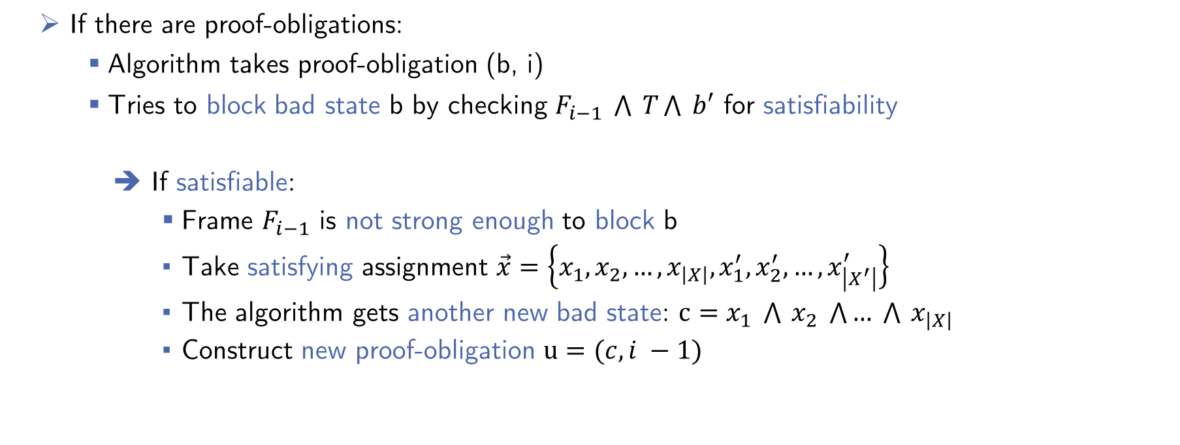
2.2 Algorithm: Blocking-Phase
Note: useful to have
Piece of pseudo-code?
Proving that new bad states are not reachable
If there are proof-obligations:
Algorithm takes proof-obligation (b, i)
Tries to block bad state b by checking $F_{i−1} \bigwedge{ T}\bigwedge{ b′}$ for satisfiability
If satisfiable:
Frame $F_{i−1}$ is not strong enough to block b
Take satisfying assignment $\vec{x}=\left\{x_{1},x_{2}, …,x_{\left|X\right|},x_{1}^{′},x_{2}^{′}, …,x_{\left|X^{′}\right|}^{′}\right\}$
The algorithm gets another new bad state: $c=x_{1} \bigwedge{ x_{2}} \bigwedge{… \bigwedge{{ x}_{\left|X\right|} }}$
Construct new proof-obligation $u=(c, i −1)$
Notes:
Vielleicht Code Snippet auf die Folie?

Slide 18
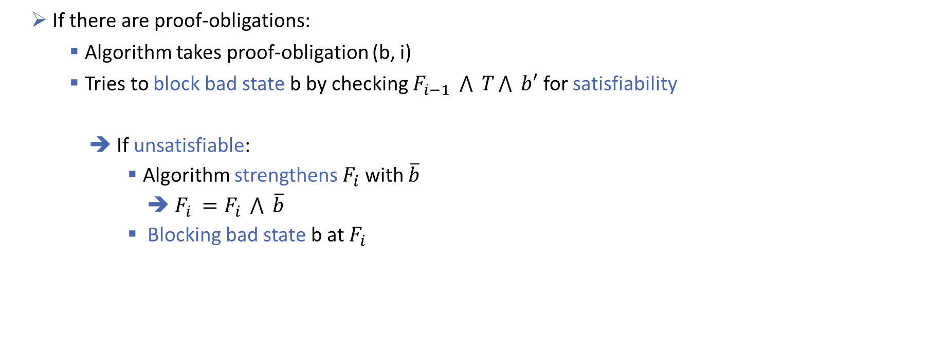
2.2 Algorithm: Blocking-Phase
Proving that new bad states are not reachable
If there are proof-obligations:
Algorithm takes proof-obligation (b, i)
Tries to block bad state b by checking $F_{i−1} \bigwedge{ T}\bigwedge{ b′}$ for satisfiability
If unsatisfiable:
Algorithm strengthens $F_{i}$ with $\overline{b}$
➔ $F_{i }=F_{i} \bigwedge{ \overline{b}}$
Blocking bad state b at $F_{i }$
Notes:
Vielleicht Code Snippet auf die Folie?

Slide 19

2.2 Algorithm: Blocking-Phase
This continues recursively until:
There are no proof-obligations left
➔ Algorithm continues with the next phase
A proof-obligation $(d, 0)$ is created
➔ Proving that a bad state can be reached, terminating the algorithm
Notes:
Vielleicht Code Snippet auf die Folie?

Slide 20
2.2 Algorithm: Pseudo-Code
Propagation-Phase
Notes:
Propagation Phase

Slide 21
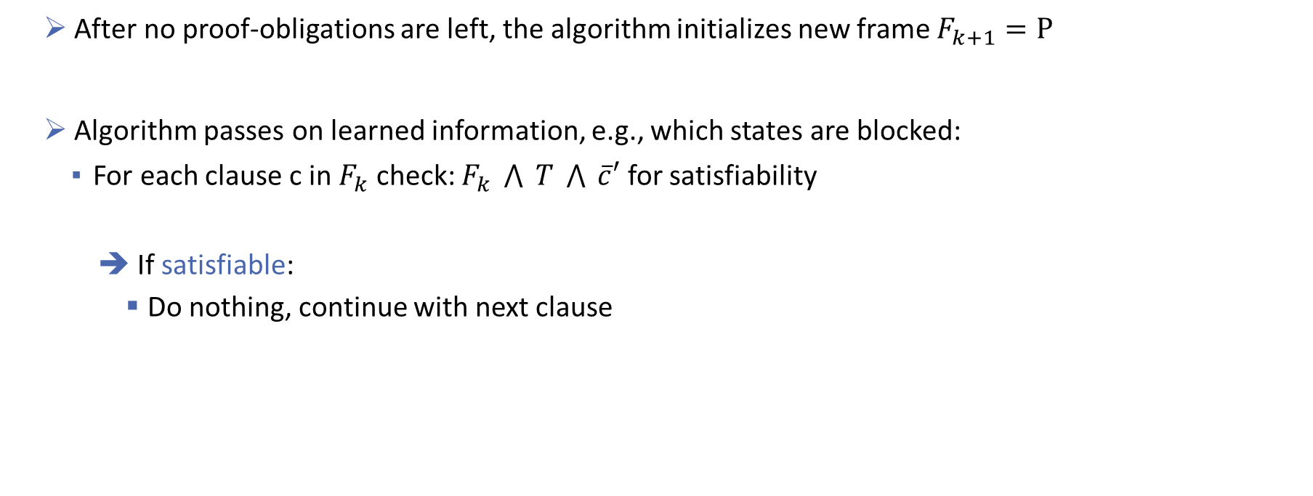
2.2 Algorithm: Propagation-Phase
Propagating learned information:
After no proof-obligations are left, the algorithm initializes new frame $F_{k+1}=P$
Algorithm passes on learned information, e.g., which states are blocked:
For each clause c in $F_{k}$ check: $F_{k} \bigwedge{ T} \bigwedge{ \overline{c}′}$ for satisfiability
If satisfiable:
Do nothing, continue with next clause

Slide 22
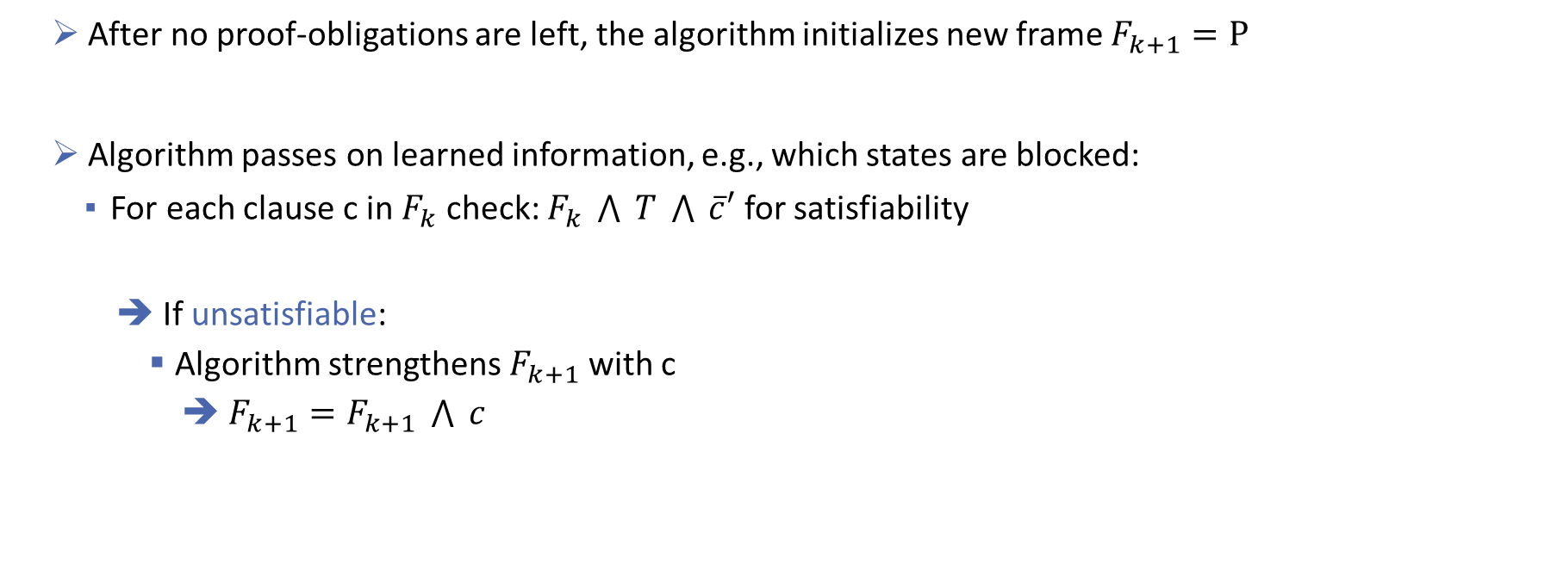
2.2 Algorithm: Propagation-Phase
Propagating learned information:
After no proof-obligations are left, the algorithm initializes new frame $F_{k+1}=P$
Algorithm passes on learned information, e.g., which states are blocked:
For each clause c in $F_{k}$ check: $F_{k} \bigwedge{ T} \bigwedge{ \overline{c}′}$ for satisfiability
If unsatisfiable:
Algorithm strengthens $F_{k+1}$ with c
➔ $F_{k+1}=F_{k+1} \bigwedge{ c}$

Slide 23

2.2 Algorithm: Propagation-Phase
Check for termination:
After all clauses have been tested, algorithm checks if $F_{k} ≡ F_{k+1}$
If so, the algorithm has found a fixpoint and terminates
➔ No states of $\overline{P}$ are reachable

Slide 24

2.2 Algorithm: Propagation-Phase
Check for termination:
After all clauses have been tested, algorithm checks if $F_{k} ≡ F_{k+1}$
If not, the algorithm continues with a new Next Transition Phase

Slide 25
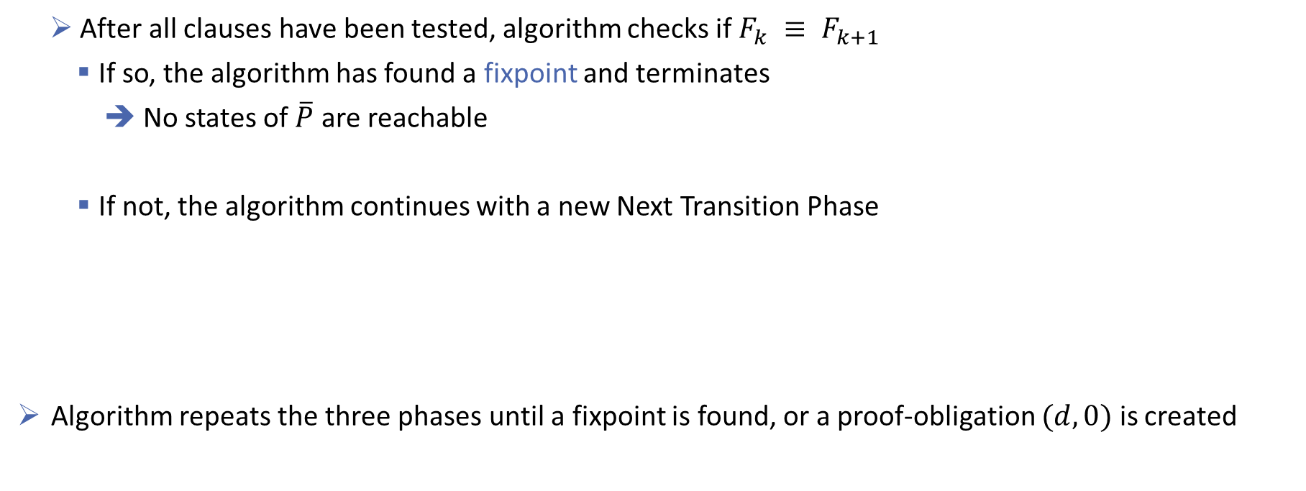
2.2 Algorithm: Propagation-Phase
Check for termination:
After all clauses have been tested, algorithm checks if $F_{k} ≡ F_{k+1}$
If so, the algorithm has found a fixpoint and terminates
➔ No states of $\overline{P}$ are reachable
If not, the algorithm continues with a new Next Transition Phase
Algorithm repeats the three phases until a fixpoint is found, or a proof-obligation $(d, 0)$ is created

Slide 26
2.2 Algorithm: Pseudo-Code TEMPLATE
Notes:
Eingekreiste Codezeilen erklären. In subsequenten Folien, nur die Phasen eingezeichnet lassen die gerade Erklärt werden
Check for 0 CTI
Next Transition Phase
Blocking-Phase
Propagation-Phase

Slide 27
2.3 Example

Slide 28
2.4 Possible Improvements
Blocking one state at a time is ineffective:
Generalize blocked states
➔ Eliminate insignificant cubes from states, that are not used by UNSAT-cores
Ternary Simulation to reduce proof-obligations:
Extend binary variables with a new value: unknown
Check state variables of proof-obligations for importance
➔ Eliminate unimportant state variables

Slide 29
Overview
Introduction
Background: PDR on Hardware
PDR on Software
Implementation in Ultimate
Evaluation
Related Work
Future Work
Conclusion

Slide 30
3.1 Preliminaries
For using PDR on software, lift the algorithm from propositional logic to first-order logic
We base our approach on the technique described by Lange et al.

Slide 31
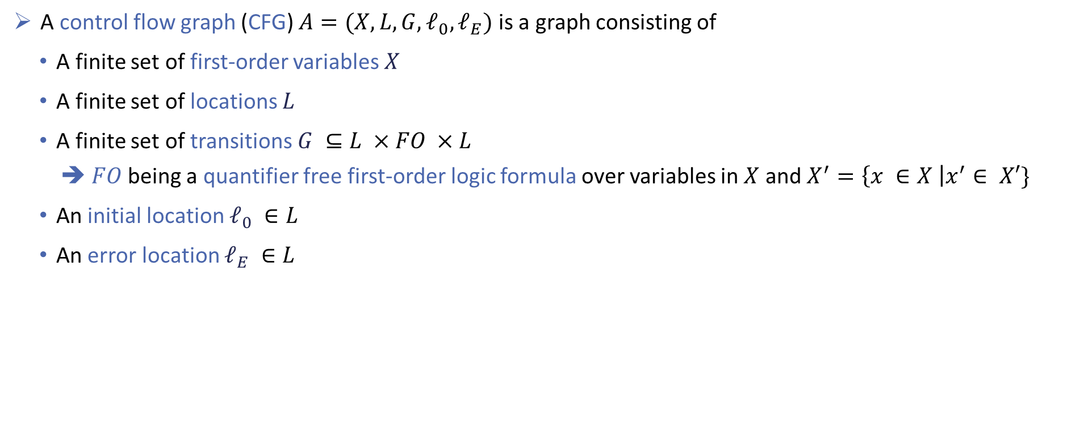
3.1 Preliminaries: Control Flow Graph
A control flow graph (CFG) $A=(X, L, G, ℓ_{0}, ℓ_{E})$ is a graph consisting of
A finite set of first-order variables $X$
A finite set of locations $L$
A finite set of transitions $G ⊆L ×FO ×L$
$FO$being a quantifier free first-order logic formula over variables in $X$ and $X^{′}=\left\{x ∈X \right|x^{′}∈ X′\}$
An initial location $ℓ_{0} ∈L$
An error location $ℓ_{E} ∈L$

Slide 32

3.1 Preliminaries: Control Flow Graph
The transition formula $T_{ℓ_{1}→{ ℓ}_{2}}$ from location $ℓ_{1}$ to location $ℓ_{2}$ is defined as:
$T_{ℓ_{1}→{ ℓ}_{2}}=\left\{\begin{matrix}\left(ℓ_{1}, t,ℓ_{2}\right), & \left(ℓ_{1}, t,ℓ_{2}\right) ∈G \\ false, & otherwise\end{matrix}\right.$

Slide 33

3.1 Preliminaries: Control Flow Graph
The transition formula $T_{ℓ_{1}→{ ℓ}_{2}}$ from location $ℓ_{1}$ to location $ℓ_{2}$ is defined as:
$T_{ℓ_{1}→{ ℓ}_{2}}=\left\{\begin{matrix}\left(ℓ_{1}, t,ℓ_{2}\right), & \left(ℓ_{1}, t,ℓ_{2}\right) ∈G \\ false, & otherwise\end{matrix}\right.$
➔ Global Transition Formula $T= \bigvee_{\left(ℓ_{1}, t,ℓ_{2}\right) ∈G}{{ T}_{ℓ_{1}→{ ℓ}_{2}}}$

Slide 34
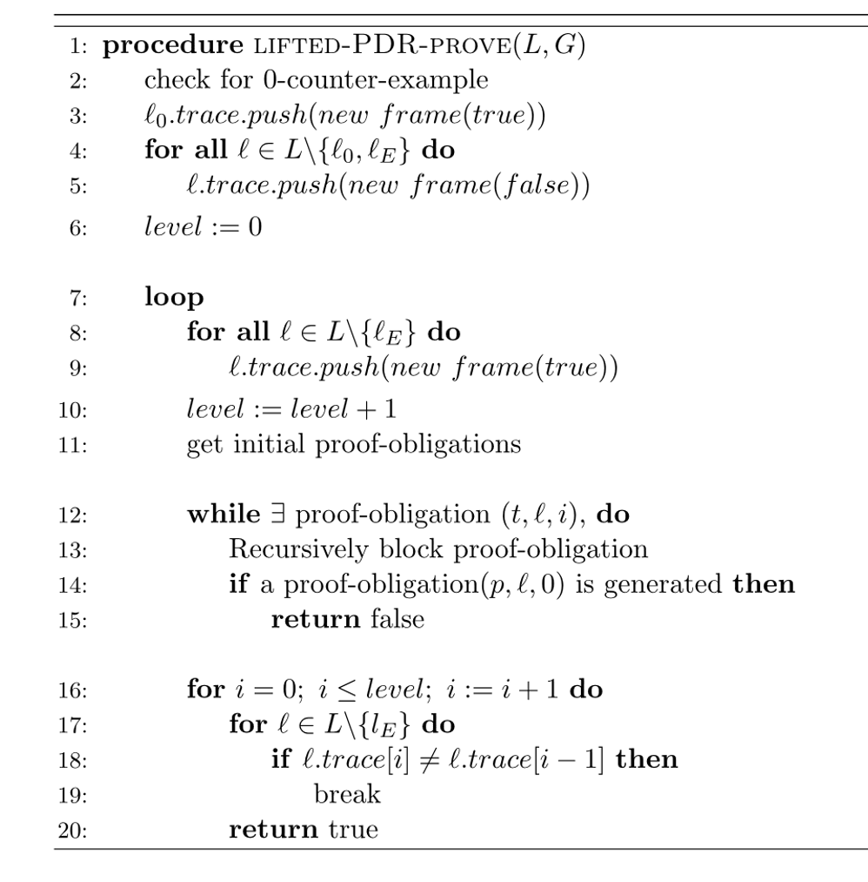
3.2 Lifted Algorithm: Pseudo-Code
Notes:
Links soll Lifted Algorithm Pseudocode hin, wieder Zeilenabstand ist 0, Rechts ist dann wiederPlatz für Erklärungen.

Slide 35
3.2 Lifted Algorithm: Pseudo-Code
Notes:
Links soll Lifted Algorithm Pseudocode hin, wieder Zeilenabstand ist 0, Rechts ist dann wiederPlatz für Erklärungen.

Slide 36

3.2 Lifted Algorithm: Checking for 0-Counter-Example
Is $ℓ_{0}=ℓ_{E}$ ?
Yes:
Algorithm terminates, returning that $ℓ_{E}$ is reachable
No:
Algorithm continues

Slide 37
3.2 Lifted Algorithm: Pseudo-Code
Notes:
Links soll Lifted Algorithm Pseudocode hin, wieder Zeilenabstand ist 0, Rechts ist dann wiederPlatz für Erklärungen.

Slide 38
3.2 Lifted Algorithm: Pseudo-Code
Notes:
Links soll Lifted Algorithm Pseudocode hin, wieder Zeilenabstand ist 0, Rechts ist dann wiederPlatz für Erklärungen.

Slide 39

3.2 Lifted Algorithm: Local Traces
There is no global trace $[F_{0}, F_{1}, …, F_{k}]$
➔ Every location $ℓ∈L ∖ {\{ℓ}_{E}\}$has its own local trace $[F_{0, ℓ}, F_{1,ℓ}, …, F_{k,ℓ}]$
Lifted frames are cubes of first-order formulas
@ToDo, explain changes to proofobligations

Slide 40
3.2 Lifted Algorithm: Pseudo-Code
Notes:
Links soll Lifted Algorithm Pseudocode hin, wieder Zeilenabstand ist 0, Rechts ist dann wiederPlatz für Erklärungen.

Slide 41

3.2 Lifted Algorithm: Initialization
Initialize each local frames:
$F_{0, ℓ}=\left\{\begin{matrix}true, & ℓ= ℓ_{0} \\ false, & otherwise\end{matrix}\right.$

Slide 42
3.2 Lifted Algorithm: Pseudo-Code
Next Level Phase
Notes:
Links soll Lifted Algorithm Pseudocode hin, wieder Zeilenabstand ist 0, Rechts ist dann wiederPlatz für Erklärungen.

Slide 43

3.2 Lifted Algorithm: Next Level Phase
Initializing the next level:
Let k be the current level:
Every location $ℓ ∈L ∖\{ℓ_{E}\}$ has trace $[F_{0, ℓ}, …,F_{k,ℓ}]$
Algorithm initzializes new level $k+1$ for all locations $ℓ ∈L ∖\{ℓ_{E}\}$
Adding new frame $F_{k+1, ℓ}=true$

Slide 44
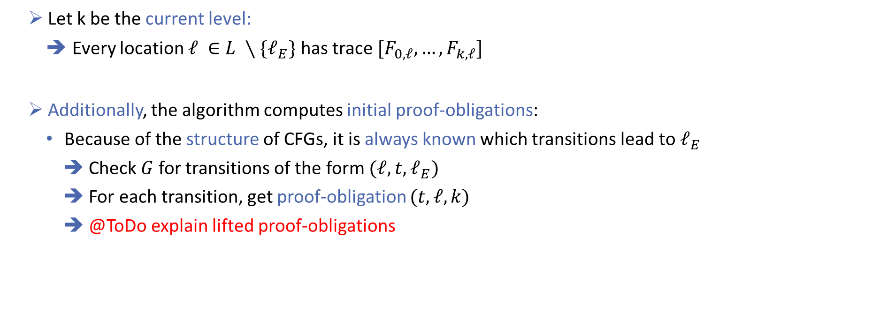
3.2 Lifted Algorithm: Next Level Phase
Initializing the next level:
Let k be the current level:
Every location $ℓ ∈L ∖\{ℓ_{E}\}$ has trace $[F_{0, ℓ}, …,F_{k,ℓ}]$
Additionally, the algorithm computes initial proof-obligations:
Because of the structure of CFGs, it is always known which transitions lead to $ℓ_{E}$
Check $G$ for transitions of the form $(ℓ, t, ℓ_{E})$
For each transition, get proof-obligation $(t, ℓ, k)$
@ToDo explain lifted proof-obligations

Slide 45
3.2 Lifted Algorithm: Pseudo-Code
Blocking-Phase
Notes:
Links soll Lifted Algorithm Pseudocode hin, wieder Zeilenabstand ist 0, Rechts ist dann wiederPlatz für Erklärungen.

Slide 46
3.2 Lifted Algorithm: Blocking-Phase
Blocking-Phase not nested in preceding phase:
➔ No longer optional:
In each iteration we have at least the initial proof-obligations

Slide 47
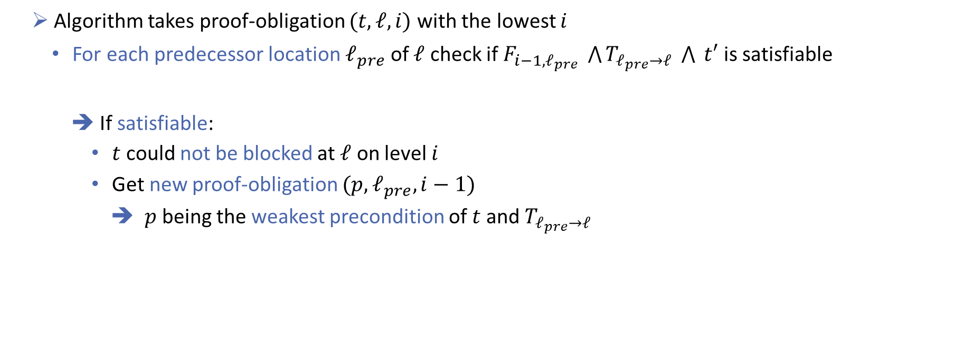
3.2 Lifted Algorithm: Blocking-Phase
Checking if bad transitions are reachable:
Algorithm takes proof-obligation $(t, ℓ, i)$ with the lowest $i$
For each predecessor location $ℓ_{pre}$ of $ℓ$ check if $F_{i−1,ℓ_{pre}} \bigwedge{T_{ℓ_{pre}→ℓ}} \bigwedge{ t′}$ is satisfiable
If satisfiable:
$t$ could not be blocked at $ℓ$ on level $i$
Get new proof-obligation ${(p, ℓ}_{pre}, i−1)$
➔ $p$ being the weakest precondition of $t$ and $T_{ℓ_{pre}→ℓ}$

Slide 48
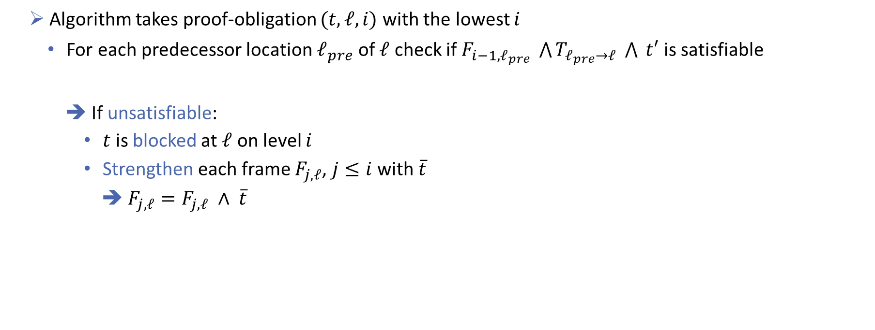
3.2 Lifted Algorithm: Blocking-Phase
Checking if bad transitions are reachable:
Algorithm takes proof-obligation $(t, ℓ, i)$ with the lowest $i$
For each predecessor location $ℓ_{pre}$ of $ℓ$ check if $F_{i−1,ℓ_{pre}} \bigwedge{T_{ℓ_{pre}→ℓ}} \bigwedge{ t′}$ is satisfiable
If unsatisfiable:
$t$ is blocked at $ℓ$ on level $i$
Strengthen each frame $F_{j,ℓ}$, $j≤i$ with $\overline{t}$
➔ $F_{j,ℓ}=F_{j,ℓ} ∧ \overline{t}$

Slide 49

3.2 Lifted Algorithm: Blocking-Phase
This continues recursively until:
➔ There are no proof-obligations left:
Algorithm continues with the next phase
➔ A proof-obligation $(d, ℓ, 0)$ is created
Proving that there exists a feasible path to $ℓ_{E}$

Slide 50
3.2 Lifted Algorithm: Pseudo-Code
Propagation-Phase
Notes:
Links soll Lifted Algorithm Pseudocode hin, wieder Zeilenabstand ist 0, Rechts ist dann wiederPlatz für Erklärungen.

Slide 51

3.2 Lifted Algorithm: Propagation-Phase
No more propagation of learned information
Only checking for termination
Trying to find a global fixpoint:
Is there an $i$ where $F_{i−1, ℓ}=F_{i, ℓ}$ for every $ℓ∈L∖\{ℓ_{E}\}$ ?

Slide 52

3.2 Lifted Algorithm: Propagation-Phase
No more propagation of learned information
Only checking for termination
Trying to find a global fixpoint:
Is there an $i$ where $F_{i−1, ℓ}=F_{i, ℓ}$ for every $ℓ∈L∖\{ℓ_{E}\}$ ?
➔ Yes:
Algorithm terminates returning that there is no feasible path to $ℓ_{E}$

Slide 53

3.2 Lifted Algorithm: Propagation-Phase
No more propagation of learned information
Only checking for termination
Trying to find a global fixpoint:
Is there an $i$ where $F_{i−1, ℓ}=F_{i, ℓ}$ for every $ℓ∈L∖\{ℓ_{E}\}$ ?
➔ No:
Algorithm continues with the next level

Slide 54
3.3 Example
Notes:
Only one, take the one with less steps. Because time

Slide 55
3.4 Possible Improvements: Generalization of Proof-Obligations
Using the weakest precondition:
➔ Over approximation of predecessor states
➔ Algorithm does not need to generate an explicit proof-obligation for each predecessor state
Using the disjunctive normal form (DNF):
➔ Negation of a cube is a clause:
Split large proof-obligations into smaller ones by taking each cube of the DNF as a separate proof-obligation

Slide 56
3.4 Possible Improvements: Generalization of Proof-Obligations
Using Interpolation:
Instead of strengthening frames with the negated proof-obligation, compute an interpolant
@ToDo MOAR

Slide 57
Overview
Introduction
Background: PDR on Hardware
PDR on Software
Implementation in Ultimate
Evaluation
Related Work
Future Work
Conclusion

Slide 58
4.1 Implementation: Introduction Ultimate

Slide 59
4.2 Implementation: CEGAR-Scheme with PDR

Slide 60
4.3 Implemented Improvements

Slide 61
Overview
Introduction
Background: PDR on Hardware
PDR on Software
Implementation in Ultimate
Evaluation
Related Work
Future Work
Conclusion

Slide 62
5.1 Data Comparison
Notes:
Hier vielleicht beide Graphen und dann was dazu sagen.

Slide 63
5.2 Discussion

Slide 64
Overview
Introduction
Background: PDR on Hardware
PDR on Software
Implementation in Ultimate
Evaluation
Related Work
Future Work
Conclusion

Slide 65

6. Related Work
There are several other techniques of using PDR on software:
Bit-Blasting:
Encode variables as bitvectors
Use new variable $pc$ to keep track of program location
Use unmodified hardware PDR algorithm on that
➔ Drawback: tedious handling of $pc$ variable
Notes:
Vielleicht die anderen Approaches so Erwähnen wie in PDR_in_ICFG_Ex2, also einfach nur so oberflächlich anschneiden

Slide 66
6. Related Work
There are several other techniques of using PDR on software:
Using Abstract Reachability Trees (ART):
Exploiting the partitioning of program’s state space by unwinding the CFG into an ART
@ToDo: introducing ARTs and how algo works
Notes:
Vielleicht die anderen Approaches so Erwähnen wie in PDR_in_ICFG_Ex2, also einfach nur so oberflächlich anschneiden

Slide 67
Overview
Introduction
Background: PDR on Hardware
PDR on Software
Implementation in Ultimate
Evaluation
Related Work
Future Work
Conclusion

Slide 68
7.1 Implementing Further Improvements
There are possible ways to make our PDR algorithm more efficient:
Interpolation:
Ultimate already supports ways of computing interpolants
Instead of strengthening frames with negated proof-obligation, add interpolant
Helps with loops
Notes:
Nichts Ausführliches

Slide 69
7.1 Implementing Further Improvements
There are possible ways to make our PDR algorithm more efficient:
Dealing with procedures:
Ultimate verifies C programs that contain procedure calls
Our algorithm cannot deal with them:
Problems arise due to PDR‘s linear backwards-search nature
Possible solutions:
Modify PDR to deal with procedures non-linearly
Calculate procedure summary and attach that to the CFG, removing the procedure altogether
Notes:
Nichts Ausführliches

Slide 70
Overview
Introduction
Background: PDR on Hardware
PDR on Software
Implementation in Ultimate
Evaluation
Related Work
Future Work
Conclusion

Slide 71
8. Conclusion

