Slide 2
Introduction: Motivation
PDR was first devised as hardware verification technique in 2010 by Aaron Bradley¹
➔ Surprisingly won 3rd place at CAV 2010 hardware checking competition²

Slide 3
Introduction: Motivation
PDR was first devised as hardware verification technique in 2010 by Aaron Bradley¹
➔ Surprisingly won 3rd place at CAV 2010 hardware checking competition²
“This new method appears to be the most important contribution to bit-level formal verification in almost a decade” ³
3: Niklas Een, Alan Mishchenko, and Robert Brayton. 2011. Efficient implementation of property directed reachability. In Proceedings of the International Conference on Formal Methods in Computer-Aided Design (FMCAD '11). FMCAD Inc, Austin, TX, 125-134.

Slide 4
Introduction: Motivation
PDR was first devised as hardware verification technique in 2010 by Aaron Bradley¹
➔ Surprisingly won 3rd place at CAV 2010 hardware checking competition²
“This new method appears to be the most important contribution to bit-level formal verification in almost a decade” ³
Using PDR on software may have similar performance!
3: Niklas Een, Alan Mishchenko, and Robert Brayton. 2011. Efficient implementation of property directed reachability. In Proceedings of the International Conference on Formal Methods in Computer-Aided Design (FMCAD '11). FMCAD Inc, Austin, TX, 125-134.

Slide 5
Introduction: Motivation
Our goals:
Use PDR on software in the verification framework Ultimate¹
➔ Combining Trace Abstraction and PDR
Comparison to existing techniques

Slide 6
Overview
How does our PDR algorithm work?
Preliminaries
Running Example
Related Work
How do we use PDR in Ultimate?
Combination of Trace Abstraction and our PDR algorithm
Implemented Improvements

Slide 7
Overview
Evaluation:
Comparison of Trace Abstraction using PDR and Trace Abstraction using Nested Interpolants
What can be done in the future?
Implementing more Improvements

Slide 8
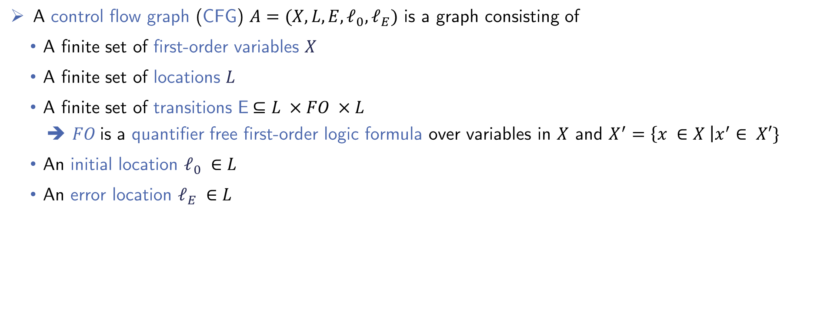
PDR Algorithm: Preliminaries
A control flow graph (CFG) $A=(X, L, E, ℓ_{0}, ℓ_{E})$ is a graph consisting of
A finite set of first-order variables $X$
A finite set of locations $L$
A finite set of transitions E$⊆L ×FO ×L$
$FO$is a quantifier free first-order logic formula over variables in $X$ and $X^{′}=\left\{x ∈X \right|x^{′}∈ X′\}$
An initial location $ℓ_{0} ∈L$
An error location $ℓ_{E} ∈L$

Slide 9

PDR Algorithm: Datastructures
Frame $F_{i, ℓ}$:
Represents a first-order formula
$ℓ$ is the corresponding location
$i$ is the corresponding level
Each location has multiple assigned frames
Proof-Obligation $(p,ℓ,i)$:
$p$ is a first-order formula
$ℓ$ is the corresponding location
$i$ is the corresponding level
➔ Need to be blocked

Slide 10
PDR Algorithm: Description
Starts with checking for a 0-Counter-Example
Repeats three phases until termination:
1. Next Level Initialization Phase
2. Blocking-Phase
3. Propagation-Phase

Slide 11















Example: Running Example
$$ℓ_{0}$$
$$p ≠0$$
$$ℓ_{1}$$
$$n<0$$
$$ℓ_{5}$$
$$n≥0$$
$n^{′}=n−1$
$$ℓ_{2}$$
$$p=0$$
$$ℓ_{E}$$
$$n≠0$$
$$n=0$$
$$ℓ_{3}$$
$$ℓ_{4}$$
$$p^{′}=0$$

Slide 12
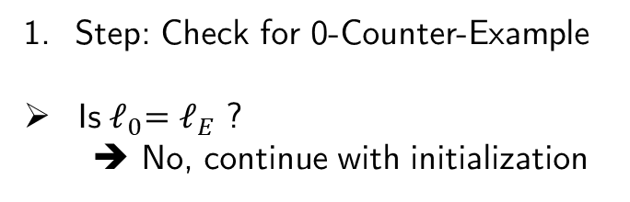


Example:
$$ℓ_{0}$$
$$p ≠0$$
$$ℓ_{1}$$
$$n<0$$
$$ℓ_{5}$$
$$n≥0$$
Step: Check for 0-Counter-Example
Is${ ℓ}_{0}=ℓ_{E}$ ?
➔ No, continue with initialization
$n^{′}=n−1$
$$ℓ_{2}$$
$$p=0$$
$$ℓ_{E}$$
$$n≠0$$
$$n=0$$
$$ℓ_{3}$$
$$ℓ_{4}$$
$$p^{′}=0$$

Slide 13
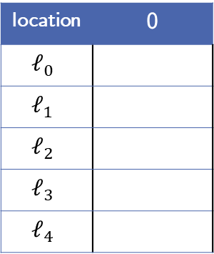

Example:
location | 0
$$ℓ_{0}$$
$$ℓ_{1}$$
$$ℓ_{2}$$
$$ℓ_{3}$$
$$ℓ_{4}$$
$$ℓ_{0}$$
$$p ≠0$$
$$ℓ_{1}$$
$$n<0$$
$$ℓ_{5}$$
$$n≥0$$
2. Step: Initialization of level 0
$F_{0, ℓ}=\left\{\begin{matrix}\text{T}, & ℓ= ℓ_{0} \\ \text{F}, & otherwise\end{matrix}\right.$
$n^{′}=n−1$
$$ℓ_{2}$$
$$p=0$$
$$ℓ_{E}$$
$$n≠0$$
$$n=0$$
$$ℓ_{3}$$
$$ℓ_{4}$$
$$p^{′}=0$$

Slide 14
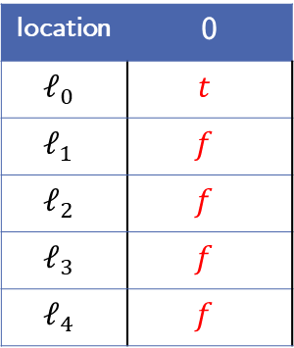
Example:
location | 0
$$ℓ_{0}$$ | $$t$$
$$ℓ_{1}$$ | $$f$$
$$ℓ_{2}$$ | $$f$$
$$ℓ_{3}$$ | $$f$$
$$ℓ_{4}$$ | $$f$$
$$ℓ_{0}$$
$$p ≠0$$
$$ℓ_{1}$$
$$n<0$$
$$ℓ_{5}$$
$$n≥0$$
2. Step: Initialization of level 0
$F_{0, ℓ}=\left\{\begin{matrix}\text{T}, & ℓ= ℓ_{0} \\ \text{F}, & otherwise\end{matrix}\right.$
$n^{′}=n−1$
$$ℓ_{2}$$
$$p=0$$
$$ℓ_{E}$$
$$n≠0$$
$$n=0$$
$$ℓ_{3}$$
$$ℓ_{4}$$
$$p^{′}=0$$

Slide 15
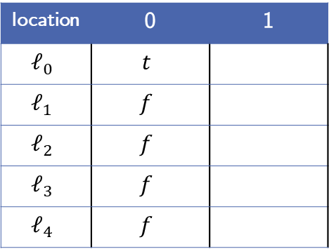
Example:
location | 0 | 1
$$ℓ_{0}$$ | $$t$$
$$ℓ_{1}$$ | $$f$$
$$ℓ_{2}$$ | $$f$$
$$ℓ_{3}$$ | $$f$$
$$ℓ_{4}$$ | $$f$$
$$ℓ_{0}$$
$$p ≠0$$
$$ℓ_{1}$$
$$n<0$$
$$ℓ_{5}$$
$$n≥0$$
3. Step: Level 1
Initialize level 1 frames as true
$n^{′}=n−1$
$$ℓ_{2}$$
$$p=0$$
$$ℓ_{E}$$
$$n≠0$$
$$n=0$$
$$ℓ_{3}$$
$$ℓ_{4}$$
$$p^{′}=0$$

Slide 16
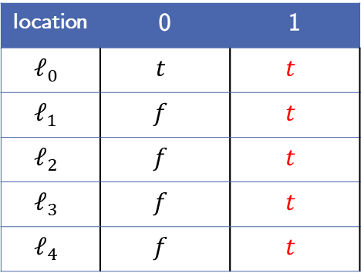
Example:
location | 0 | 1
$$ℓ_{0}$$ | $$t$$ | $$t$$
$$ℓ_{1}$$ | $$f$$ | $$t$$
$$ℓ_{2}$$ | $$f$$ | $$t$$
$$ℓ_{3}$$ | $$f$$ | $$t$$
$$ℓ_{4}$$ | $$f$$ | $$t$$
$$ℓ_{0}$$
$$p ≠0$$
$$ℓ_{1}$$
$$n<0$$
$$ℓ_{5}$$
$$n≥0$$
3. Step: Level 1
Initialize level 1 frames as true
$n^{′}=n−1$
$$ℓ_{2}$$
$$p=0$$
$$ℓ_{E}$$
$$n≠0$$
$$n=0$$
$$ℓ_{3}$$
$$ℓ_{4}$$
$$p^{′}=0$$

Slide 17



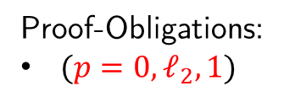
Example:
location | 0 | 1
$$ℓ_{0}$$ | $$t$$ | $$t$$
$$ℓ_{1}$$ | $$f$$ | $$t$$
$$ℓ_{2}$$ | $$f$$ | $$t$$
$$ℓ_{3}$$ | $$f$$ | $$t$$
$$ℓ_{4}$$ | $$f$$ | $$t$$
$$ℓ_{0}$$
$$p ≠0$$
$$ℓ_{1}$$
$$n<0$$
$$ℓ_{5}$$
$$n≥0$$
3. Step: Level 1
Get initial proof-obligation
Proof-Obligations:
$(p=0,ℓ_{2}, 1)$
$n^{′}=n−1$
$$ℓ_{2}$$
$$p=0$$
$$ℓ_{E}$$
$$n≠0$$
$$n=0$$
$$ℓ_{3}$$
$$ℓ_{4}$$
$$p^{′}=0$$

Slide 18
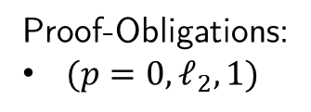
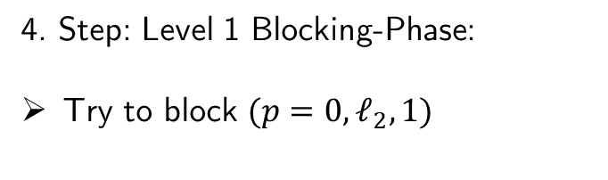
Example:
location | 0 | 1
$$ℓ_{0}$$ | $$t$$ | $$t$$
$$ℓ_{1}$$ | $$f$$ | $$t$$
$$ℓ_{2}$$ | $$f$$ | $$t$$
$$ℓ_{3}$$ | $$f$$ | $$t$$
$$ℓ_{4}$$ | $$f$$ | $$t$$
$$ℓ_{0}$$
$$p ≠0$$
$$ℓ_{1}$$
$$n<0$$
$$ℓ_{5}$$
$$n≥0$$
4. Step: Level 1 Blocking-Phase:
Try to block $(p=0,ℓ_{2}, 1)$
Proof-Obligations:
$(p=0,ℓ_{2}, 1)$
$n^{′}=n−1$
$$ℓ_{2}$$
$$p=0$$
$$ℓ_{E}$$
$$n≠0$$
$$n=0$$
$$ℓ_{3}$$
$$ℓ_{4}$$
$$p^{′}=0$$

Slide 19


Example:
location | 0 | 1
$$ℓ_{0}$$ | $$t$$ | $$t$$
$$ℓ_{1}$$ | $$f$$ | $$t$$
$$ℓ_{2}$$ | $$f$$ | $$t$$
$$ℓ_{3}$$ | $$f$$ | $$t$$
$$ℓ_{4}$$ | $$f$$ | $$t$$
$$ℓ_{0}$$
$$p ≠0$$
$$ℓ_{1}$$
$$n<0$$
$$ℓ_{5}$$
$$n≥0$$
4. Step: Level 1 Blocking-Phase:
Try to block $(p=0,ℓ_{2}, 1)$
Predecessor $ℓ_{1}$:
$F_{0,ℓ_{1}} ∧ T_{ℓ_{1} →ℓ_{2}} ∧ p^{′}=0$
Proof-Obligations:
$(p=0,ℓ_{2}, 1)$
$n^{′}=n−1$
$$ℓ_{2}$$
$$p=0$$
$$ℓ_{E}$$
$$n≠0$$
$$n=0$$
$$ℓ_{3}$$
$$ℓ_{4}$$
$$p^{′}=0$$

Slide 20
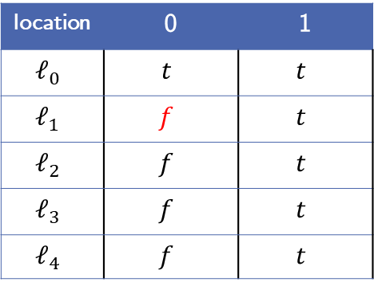


Example:
location | 0 | 1
$$ℓ_{0}$$ | $$t$$ | $$t$$
$$ℓ_{1}$$ | $$f$$ | $$t$$
$$ℓ_{2}$$ | $$f$$ | $$t$$
$$ℓ_{3}$$ | $$f$$ | $$t$$
$$ℓ_{4}$$ | $$f$$ | $$t$$
$$ℓ_{0}$$
$$p ≠0$$
$$ℓ_{1}$$
$$n<0$$
$$ℓ_{5}$$
$$n≥0$$
4. Step: Level 1 Blocking-Phase:
Try to block $(p=0,ℓ_{2}, 1)$
Predecessor $ℓ_{1}$:
$f_{ } ∧ n≥0 ∧ p^{′}=0$
Proof-Obligations:
$(p=0,ℓ_{2}, 1)$
$n^{′}=n−1$
$$ℓ_{2}$$
$$p=0$$
$$ℓ_{E}$$
$$n≠0$$
$$n=0$$
$$ℓ_{3}$$
$$ℓ_{4}$$
$$p^{′}=0$$

Slide 21
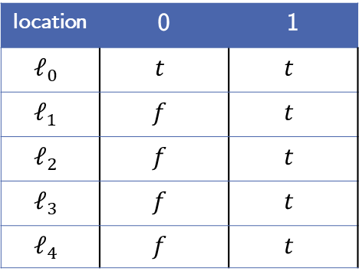
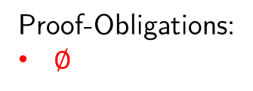
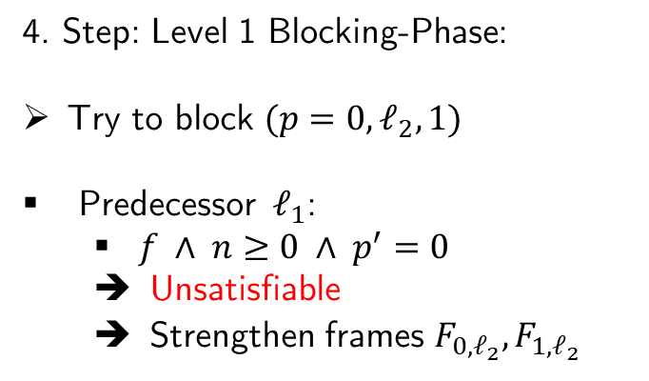
Example:
location | 0 | 1
$$ℓ_{0}$$ | $$t$$ | $$t$$
$$ℓ_{1}$$ | $$f$$ | $$t$$
$$ℓ_{2}$$ | $$f$$ | $$t$$
$$ℓ_{3}$$ | $$f$$ | $$t$$
$$ℓ_{4}$$ | $$f$$ | $$t$$
$$ℓ_{0}$$
$$p ≠0$$
$$ℓ_{1}$$
$$n<0$$
$$ℓ_{5}$$
$$n≥0$$
4. Step: Level 1 Blocking-Phase:
Try to block $(p=0,ℓ_{2}, 1)$
Predecessor $ℓ_{1}$:
$f_{ } ∧ n≥0 ∧ p^{′}=0$
Unsatisfiable
Strengthen frames $F_{0,ℓ_{2}},F_{1,ℓ_{2}}$
Proof-Obligations:
$∅$
$n^{′}=n−1$
$$ℓ_{2}$$
$$p=0$$
$$ℓ_{E}$$
$$n≠0$$
$$n=0$$
$$ℓ_{3}$$
$$ℓ_{4}$$
$$p^{′}=0$$

Slide 22
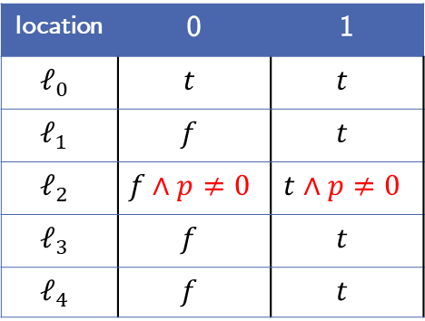
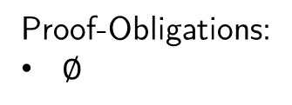
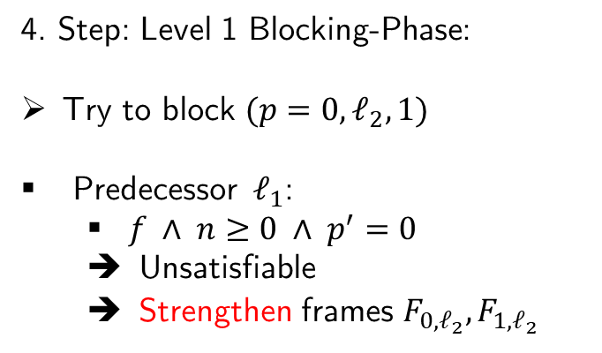
Example:
location | 0 | 1
$$ℓ_{0}$$ | $$t$$ | $$t$$
$$ℓ_{1}$$ | $$f$$ | $$t$$
$$ℓ_{2}$$ | $$f∧p≠0$$ | $$t∧p≠0$$
$$ℓ_{3}$$ | $$f$$ | $$t$$
$$ℓ_{4}$$ | $$f$$ | $$t$$
$$ℓ_{0}$$
$$p ≠0$$
$$ℓ_{1}$$
$$n<0$$
$$ℓ_{5}$$
$$n≥0$$
4. Step: Level 1 Blocking-Phase:
Try to block $(p=0,ℓ_{2}, 1)$
Predecessor $ℓ_{1}$:
$f_{ } ∧ n≥0 ∧ p^{′}=0$
Unsatisfiable
Strengthen frames $F_{0,ℓ_{2}},F_{1,ℓ_{2}}$
Proof-Obligations:
$∅$
$n^{′}=n−1$
$$ℓ_{2}$$
$$p=0$$
$$ℓ_{E}$$
$$n≠0$$
$$n=0$$
$$ℓ_{3}$$
$$ℓ_{4}$$
$$p^{′}=0$$

Slide 23
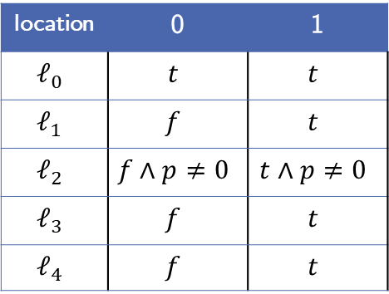
Example:
location | 0 | 1
$$ℓ_{0}$$ | $$t$$ | $$t$$
$$ℓ_{1}$$ | $$f$$ | $$t$$
$$ℓ_{2}$$ | $$f∧p≠0$$ | $$t∧p≠0$$
$$ℓ_{3}$$ | $$f$$ | $$t$$
$$ℓ_{4}$$ | $$f$$ | $$t$$
$$ℓ_{0}$$
$$p ≠0$$
$$ℓ_{1}$$
$$n<0$$
$$ℓ_{5}$$
$$n≥0$$
5. Step: Level 1 Propagation-Phase
Is there a global fixpoint?
Proof-Obligations:
$∅$
$n^{′}=n−1$
$$ℓ_{2}$$
$$p=0$$
$$ℓ_{E}$$
$$n≠0$$
$$n=0$$
$$ℓ_{3}$$
$$ℓ_{4}$$
$$p^{′}=0$$

Slide 24

Example:
location | 0 | 1
$$ℓ_{0}$$ | $$t$$ | $$t$$
$$ℓ_{1}$$ | $$f$$ | $$t$$
$$ℓ_{2}$$ | $$f∧p≠0$$ | $$t∧p≠0$$
$$ℓ_{3}$$ | $$f$$ | $$t$$
$$ℓ_{4}$$ | $$f$$ | $$t$$
$$ℓ_{0}$$
$$p ≠0$$
$$ℓ_{1}$$
$$n<0$$
$$ℓ_{5}$$
$$n≥0$$
5. Step: Level 1 Propagation-Phase
Is there an $i$ where $F_{i−1, ℓ}=F_{i, ℓ}$ for $ℓ∈L∖\{ℓ_{E}\}$ ?
Proof-Obligations:
$∅$
$n^{′}=n−1$
$$ℓ_{2}$$
$$p=0$$
$$ℓ_{E}$$
$$n≠0$$
$$n=0$$
$$ℓ_{3}$$
$$ℓ_{4}$$
$$p^{′}=0$$

Slide 25
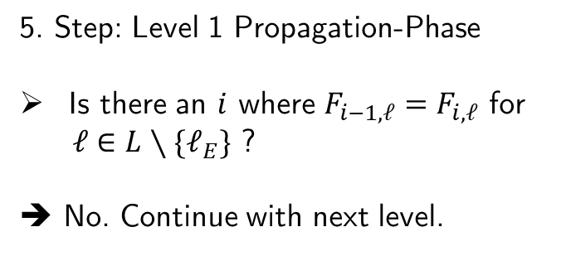
Example:
location | 0 | 1
$$ℓ_{0}$$ | $$t$$ | $$t$$
$$ℓ_{1}$$ | $$f$$ | $$t$$
$$ℓ_{2}$$ | $$f∧p≠0$$ | $$t∧p≠0$$
$$ℓ_{3}$$ | $$f$$ | $$t$$
$$ℓ_{4}$$ | $$f$$ | $$t$$
$$ℓ_{0}$$
$$p ≠0$$
$$ℓ_{1}$$
$$n<0$$
$$ℓ_{5}$$
$$n≥0$$
5. Step: Level 1 Propagation-Phase
Is there an $i$ where $F_{i−1, ℓ}=F_{i, ℓ}$ for $ℓ∈L∖\{ℓ_{E}\}$ ?
➔ No. Continue with next level.
Proof-Obligations:
$∅$
$n^{′}=n−1$
$$ℓ_{2}$$
$$p=0$$
$$ℓ_{E}$$
$$n≠0$$
$$n=0$$
$$ℓ_{3}$$
$$ℓ_{4}$$
$$p^{′}=0$$

Slide 26

Example:
location | 0 | 1
$$ℓ_{0}$$ | $$t$$ | $$t$$
$$ℓ_{1}$$ | $$f$$ | $$t$$
$$ℓ_{2}$$ | $$f∧p≠0$$ | $$t∧p≠0$$
$$ℓ_{3}$$ | $$f$$ | $$t$$
$$ℓ_{4}$$ | $$f$$ | $$t$$
$$ℓ_{0}$$
$$p ≠0$$
$$ℓ_{1}$$
$$n<0$$
$$ℓ_{5}$$
$$n≥0$$
6. Step: Level 2
Initzialize new frames
Add initial proof-obligation
$(p=0,ℓ_{2}, 2)$
Proof-Obligations:
$∅$
$n^{′}=n−1$
$$ℓ_{2}$$
$$p=0$$
$$ℓ_{E}$$
$$n≠0$$
$$n=0$$
$$ℓ_{3}$$
$$ℓ_{4}$$
$$p^{′}=0$$

Slide 27
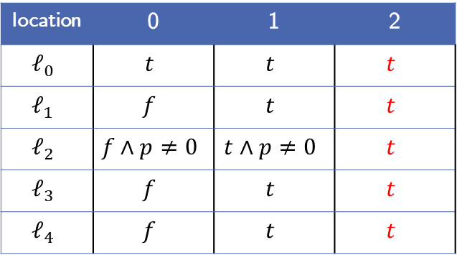

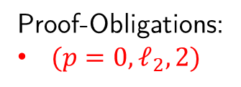
Example:
location | 0 | 1 | 2
$$ℓ_{0}$$ | $$t$$ | $$t$$ | $$t$$
$$ℓ_{1}$$ | $$f$$ | $$t$$ | $$t$$
$$ℓ_{2}$$ | $$f∧p≠0$$ | $$t∧p≠0$$ | $$t$$
$$ℓ_{3}$$ | $$f$$ | $$t$$ | $$t$$
$$ℓ_{4}$$ | $$f$$ | $$t$$ | $$t$$
$$ℓ_{0}$$
$$p ≠0$$
$$ℓ_{1}$$
$$n<0$$
$$ℓ_{5}$$
$$n≥0$$
6. Step: Level 2
Initzialize new frames
Add initial proof-obligation
$(p=0,ℓ_{2}, 2)$
Proof-Obligations:
$(p=0,ℓ_{2}, 2)$
$n^{′}=n−1$
$$ℓ_{2}$$
$$p=0$$
$$ℓ_{E}$$
$$n≠0$$
$$n=0$$
$$ℓ_{3}$$
$$ℓ_{4}$$
$$p^{′}=0$$

Slide 28
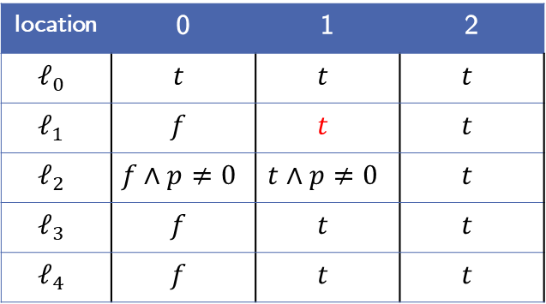

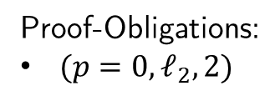
Example:
location | 0 | 1 | 2
$$ℓ_{0}$$ | $$t$$ | $$t$$ | $$t$$
$$ℓ_{1}$$ | $$f$$ | $$t$$ | $$t$$
$$ℓ_{2}$$ | $$f∧p≠0$$ | $$t∧p≠0$$ | $$t$$
$$ℓ_{3}$$ | $$f$$ | $$t$$ | $$t$$
$$ℓ_{4}$$ | $$f$$ | $$t$$ | $$t$$
$$ℓ_{0}$$
$$p ≠0$$
$$ℓ_{1}$$
$$n<0$$
$$ℓ_{5}$$
$$n≥0$$
7. Step: Level 2 Blocking-Phase:
Try to block $(p=0,ℓ_{2}, 2)$
Predecessor $ℓ_{1}$:
$t ∧ n≥0 ∧ p^{′}=0$
Proof-Obligations:
$(p=0,ℓ_{2}, 2)$
$n^{′}=n−1$
$$ℓ_{2}$$
$$p=0$$
$$ℓ_{E}$$
$$n≠0$$
$$n=0$$
$$ℓ_{3}$$
$$ℓ_{4}$$
$$p^{′}=0$$

Slide 29
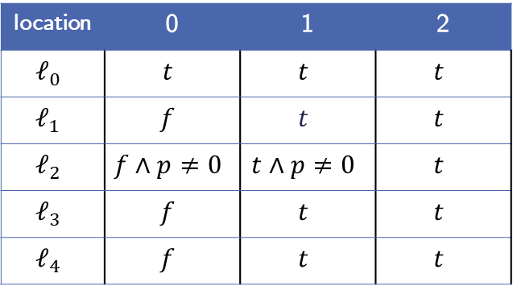
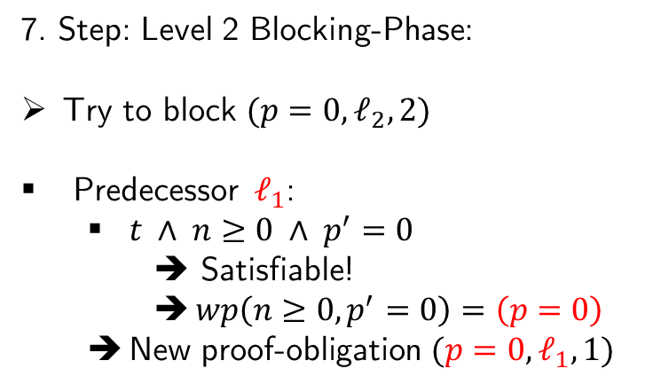
Example:
location | 0 | 1 | 2
$$ℓ_{0}$$ | $$t$$ | $$t$$ | $$t$$
$$ℓ_{1}$$ | $$f$$ | $$t$$ | $$t$$
$$ℓ_{2}$$ | $$f∧p≠0$$ | $$t∧p≠0$$ | $$t$$
$$ℓ_{3}$$ | $$f$$ | $$t$$ | $$t$$
$$ℓ_{4}$$ | $$f$$ | $$t$$ | $$t$$
$$ℓ_{0}$$
$$p ≠0$$
$$ℓ_{1}$$
$$n<0$$
$$ℓ_{5}$$
$$n≥0$$
7. Step: Level 2 Blocking-Phase:
Try to block $(p=0,ℓ_{2}, 2)$
Predecessor $ℓ_{1}$:
$t ∧ n≥0 ∧ p^{′}=0$
➔ Satisfiable!
$wp\left(n≥0, p^{′}=0\right)=\left(p=0\right)$
New proof-obligation $(p=0,ℓ_{1},1)$
Proof-Obligations:
$(p=0,ℓ_{2}, 2)$
$n^{′}=n−1$
$$ℓ_{2}$$
$$p=0$$
$$ℓ_{E}$$
$$n≠0$$
$$n=0$$
$$ℓ_{3}$$
$$ℓ_{4}$$
$$p^{′}=0$$

Slide 30
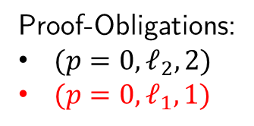
Example:
location | 0 | 1 | 2
$$ℓ_{0}$$ | $$t$$ | $$t$$ | $$t$$
$$ℓ_{1}$$ | $$f$$ | $$t$$ | $$t$$
$$ℓ_{2}$$ | $$f∧p≠0$$ | $$t∧p≠0$$ | $$t$$
$$ℓ_{3}$$ | $$f$$ | $$t$$ | $$t$$
$$ℓ_{4}$$ | $$f$$ | $$t$$ | $$t$$
$$ℓ_{0}$$
$$p ≠0$$
$$ℓ_{1}$$
$$n<0$$
$$ℓ_{5}$$
$$n≥0$$
7. Step: Level 2 Blocking-Phase:
Try to block $(p=0,ℓ_{2}, 2)$
Predecessor $ℓ_{1}$:
$t ∧ n≥0 ∧ p^{′}=0$
➔ Satisfiable!
$wp\left(n≥0, p^{′}=0\right)=\left(p=0\right)$
New proof-obligation $(p=0,ℓ_{1},1)$
Proof-Obligations:
$(p=0,ℓ_{2}, 2)$
$(p=0,ℓ_{1},1)$
$n^{′}=n−1$
$$ℓ_{2}$$
$$p=0$$
$$ℓ_{E}$$
$$n≠0$$
$$n=0$$
$$ℓ_{3}$$
$$ℓ_{4}$$
$$p^{′}=0$$

Slide 31

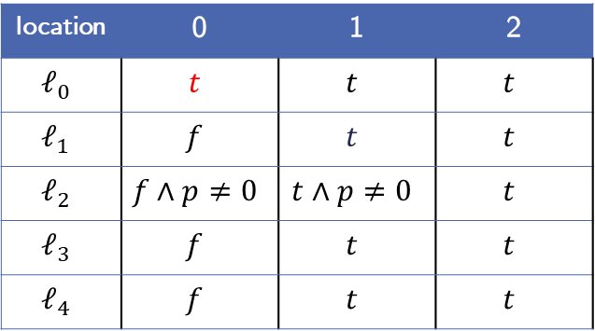

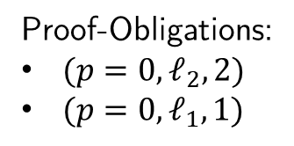
Example:
location | 0 | 1 | 2
$$ℓ_{0}$$ | $$t$$ | $$t$$ | $$t$$
$$ℓ_{1}$$ | $$f$$ | $$t$$ | $$t$$
$$ℓ_{2}$$ | $$f∧p≠0$$ | $$t∧p≠0$$ | $$t$$
$$ℓ_{3}$$ | $$f$$ | $$t$$ | $$t$$
$$ℓ_{4}$$ | $$f$$ | $$t$$ | $$t$$
$$ℓ_{0}$$
$$p ≠0$$
$$ℓ_{1}$$
$$n<0$$
$$ℓ_{5}$$
$$n≥0$$
7. Step: Level 2 Blocking-Phase:
Try to block $(p=0,ℓ_{1},1)$
Predecessor $ℓ_{0}$:
$t ∧p ≠0 ∧ p^{′}=0$
Proof-Obligations:
$(p=0,ℓ_{2}, 2)$
$(p=0,ℓ_{1},1)$
$n^{′}=n−1$
$$ℓ_{2}$$
$$p=0$$
$$ℓ_{E}$$
$$n≠0$$
$$n=0$$
$$ℓ_{3}$$
$$ℓ_{4}$$
$$p^{′}=0$$

Slide 32
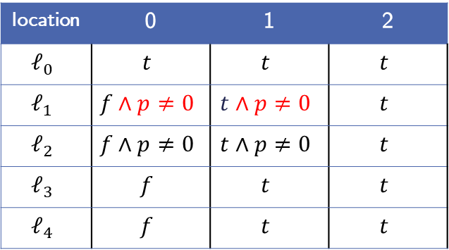

Example:
location | 0 | 1 | 2
$$ℓ_{0}$$ | $$t$$ | $$t$$ | $$t$$
$$ℓ_{1}$$ | $$f∧p≠0$$ | $$t∧p≠0$$ | $$t$$
$$ℓ_{2}$$ | $$f∧p≠0$$ | $$t∧p≠0$$ | $$t$$
$$ℓ_{3}$$ | $$f$$ | $$t$$ | $$t$$
$$ℓ_{4}$$ | $$f$$ | $$t$$ | $$t$$
$$ℓ_{0}$$
$$p ≠0$$
$$ℓ_{1}$$
$$n<0$$
$$ℓ_{5}$$
$$n≥0$$
7. Step: Level 2 Blocking-Phase:
Try to block $(p=0,ℓ_{1},1)$
Predecessor $ℓ_{0}$:
$t ∧p ≠0 ∧ p^{′}=0$
Unsatisfiable!
Strengthen frames $F_{0,ℓ_{1}},F_{1,ℓ_{1}}$
Proof-Obligations:
$(p=0,ℓ_{2}, 2)$
$(p=0,ℓ_{1},1)$
$n^{′}=n−1$
$$ℓ_{2}$$
$$p=0$$
$$ℓ_{E}$$
$$n≠0$$
$$n=0$$
$$ℓ_{3}$$
$$ℓ_{4}$$
$$p^{′}=0$$

Slide 33
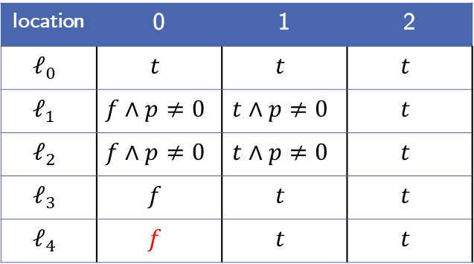



Example:
location | 0 | 1 | 2
$$ℓ_{0}$$ | $$t$$ | $$t$$ | $$t$$
$$ℓ_{1}$$ | $$f∧p≠0$$ | $$t∧p≠0$$ | $$t$$
$$ℓ_{2}$$ | $$f∧p≠0$$ | $$t∧p≠0$$ | $$t$$
$$ℓ_{3}$$ | $$f$$ | $$t$$ | $$t$$
$$ℓ_{4}$$ | $$f$$ | $$t$$ | $$t$$
$$ℓ_{0}$$
$$p ≠0$$
$$ℓ_{1}$$
$$n<0$$
$$ℓ_{5}$$
$$n≥0$$
7. Step: Level 2 Blocking-Phase:
Try to block $(p=0,ℓ_{1},1)$
Predecessor $ℓ_{4}$:
$f∧n^{′}=n−1∧ p^{′}=0$
Proof-Obligations:
$(p=0,ℓ_{2}, 2)$
$(p=0,ℓ_{1},1)$
$n^{′}=n−1$
$$ℓ_{2}$$
$$p=0$$
$$ℓ_{E}$$
$$n≠0$$
$$n=0$$
$$ℓ_{3}$$
$$ℓ_{4}$$
$$p^{′}=0$$

Slide 34
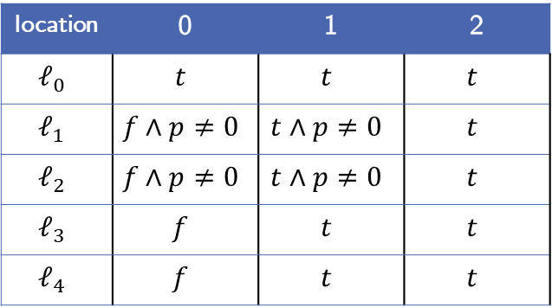

Example:
location | 0 | 1 | 2
$$ℓ_{0}$$ | $$t$$ | $$t$$ | $$t$$
$$ℓ_{1}$$ | $$f∧p≠0$$ | $$t∧p≠0$$ | $$t$$
$$ℓ_{2}$$ | $$f∧p≠0$$ | $$t∧p≠0$$ | $$t$$
$$ℓ_{3}$$ | $$f$$ | $$t$$ | $$t$$
$$ℓ_{4}$$ | $$f$$ | $$t$$ | $$t$$
$$ℓ_{0}$$
$$p ≠0$$
$$ℓ_{1}$$
$$n<0$$
$$ℓ_{5}$$
$$n≥0$$
7. Step: Level 2 Blocking-Phase:
Try to block $(p=0,ℓ_{1},1)$
Predecessor $ℓ_{4}$:
$f∧n^{′}=n−1∧ p^{′}=0$
➔ Unsatisfiable!
Proof-Obligations:
$(p=0,ℓ_{2}, 2)$
$(p=0,ℓ_{1},1)$
$n^{′}=n−1$
$$ℓ_{2}$$
$$p=0$$
$$ℓ_{E}$$
$$n≠0$$
$$n=0$$
$$ℓ_{3}$$
$$ℓ_{4}$$
$$p^{′}=0$$

Slide 35
Example:
location | 0 | 1 | 2
$$ℓ_{0}$$ | $$t$$ | $$t$$ | $$t$$
$$ℓ_{1}$$ | $$f∧p≠0$$ | $$t∧p≠0$$ | $$t$$
$$ℓ_{2}$$ | $$f∧p≠0$$ | $$t∧p≠0$$ | $$t$$
$$ℓ_{3}$$ | $$f$$ | $$t$$ | $$t$$
$$ℓ_{4}$$ | $$f$$ | $$t$$ | $$t$$
$$ℓ_{0}$$
$$p ≠0$$
$$ℓ_{1}$$
$$n<0$$
$$ℓ_{5}$$
$$n≥0$$
7. Step: Level 2 Blocking-Phase:
Try to block $(p=0,ℓ_{1},1)$
Predecessor $ℓ_{4}$:
$f∧n^{′}=n−1∧ p^{′}=0$
➔ Unsatisfiable!
Proof-Obligations:
$(p=0,ℓ_{2}, 2)$
$n^{′}=n−1$
$$ℓ_{2}$$
$$p=0$$
$$ℓ_{E}$$
$$n≠0$$
$$n=0$$
$$ℓ_{3}$$
$$ℓ_{4}$$
$$p^{′}=0$$

Slide 36
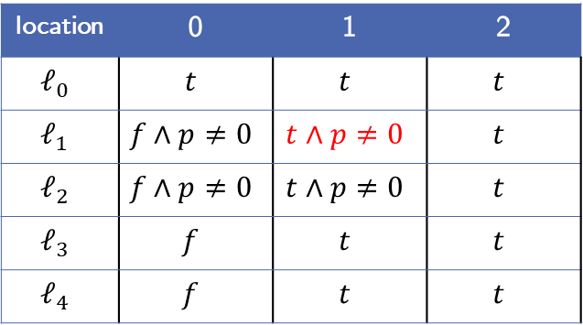

Example:
location | 0 | 1 | 2
$$ℓ_{0}$$ | $$t$$ | $$t$$ | $$t$$
$$ℓ_{1}$$ | $$f∧p≠0$$ | $$t∧p≠0$$ | $$t$$
$$ℓ_{2}$$ | $$f∧p≠0$$ | $$t∧p≠0$$ | $$t$$
$$ℓ_{3}$$ | $$f$$ | $$t$$ | $$t$$
$$ℓ_{4}$$ | $$f$$ | $$t$$ | $$t$$
$$ℓ_{0}$$
$$p ≠0$$
$$ℓ_{1}$$
$$n<0$$
$$ℓ_{5}$$
$$n≥0$$
7. Step: Level 2 Blocking-Phase:
Try to block$(p=0,ℓ_{2}, 2)$ again
Predecessor $ℓ_{1}$:
$t∧p≠0∧n≥0∧ p^{′}=0$
Proof-Obligations:
$(p=0,ℓ_{2}, 2)$
$n^{′}=n−1$
$$ℓ_{2}$$
$$p=0$$
$$ℓ_{E}$$
$$n≠0$$
$$n=0$$
$$ℓ_{3}$$
$$ℓ_{4}$$
$$p^{′}=0$$

Slide 37
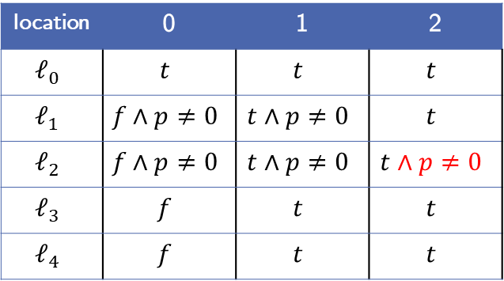

Example:
location | 0 | 1 | 2
$$ℓ_{0}$$ | $$t$$ | $$t$$ | $$t$$
$$ℓ_{1}$$ | $$f∧p≠0$$ | $$t∧p≠0$$ | $$t$$
$$ℓ_{2}$$ | $$f∧p≠0$$ | $$t∧p≠0$$ | $$t∧p≠0$$
$$ℓ_{3}$$ | $$f$$ | $$t$$ | $$t$$
$$ℓ_{4}$$ | $$f$$ | $$t$$ | $$t$$
$$ℓ_{0}$$
$$p ≠0$$
$$ℓ_{1}$$
$$n<0$$
$$ℓ_{5}$$
$$n≥0$$
7. Step: Level 2 Blocking-Phase:
Try to block$(p=0,ℓ_{2}, 2)$ again
Predecessor $ℓ_{1}$:
$t∧p≠0∧n≥0∧ p^{′}=0$
Unsatisfiable!
Strengthen frames $F_{2,ℓ_{2}}$
Proof-Obligations:
$∅$
$n^{′}=n−1$
$$ℓ_{2}$$
$$p=0$$
$$ℓ_{E}$$
$$n≠0$$
$$n=0$$
$$ℓ_{3}$$
$$ℓ_{4}$$
$$p^{′}=0$$

Slide 38
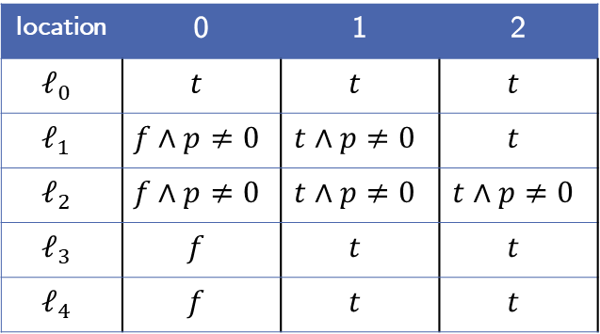
Example:
location | 0 | 1 | 2
$$ℓ_{0}$$ | $$t$$ | $$t$$ | $$t$$
$$ℓ_{1}$$ | $$f∧p≠0$$ | $$t∧p≠0$$ | $$t$$
$$ℓ_{2}$$ | $$f∧p≠0$$ | $$t∧p≠0$$ | $$t∧p≠0$$
$$ℓ_{3}$$ | $$f$$ | $$t$$ | $$t$$
$$ℓ_{4}$$ | $$f$$ | $$t$$ | $$t$$
$$ℓ_{0}$$
$$p ≠0$$
$$ℓ_{1}$$
$$n<0$$
$$ℓ_{5}$$
$$n≥0$$
8. Step: Level 2 Propagation-Phase:
Is there a global fixpoint?
➔ No, continue with level 3
Proof-Obligations:
$∅$
$n^{′}=n−1$
$$ℓ_{2}$$
$$p=0$$
$$ℓ_{E}$$
$$n≠0$$
$$n=0$$
$$ℓ_{3}$$
$$ℓ_{4}$$
$$p^{′}=0$$

Slide 39
Example:
location | 0 | 1 | 2
$$ℓ_{0}$$ | $$t$$ | $$t$$ | $$t$$
$$ℓ_{1}$$ | $$f∧p≠0$$ | $$t∧p≠0$$ | $$t$$
$$ℓ_{2}$$ | $$f∧p≠0$$ | $$t∧p≠0$$ | $$t∧p≠0$$
$$ℓ_{3}$$ | $$f$$ | $$t$$ | $$t$$
$$ℓ_{4}$$ | $$f$$ | $$t$$ | $$t$$
$$ℓ_{0}$$
$$p ≠0$$
$$ℓ_{1}$$
$$n<0$$
$$ℓ_{5}$$
$$n≥0$$
9. Step: Level 3
Initzialize new frames
Get initial proof-obligations
Proof-Obligations:
$∅$
$n^{′}=n−1$
$$ℓ_{2}$$
$$p=0$$
$$ℓ_{E}$$
$$n≠0$$
$$n=0$$
$$ℓ_{3}$$
$$ℓ_{4}$$
$$p^{′}=0$$

Slide 40
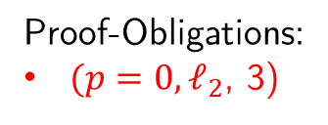
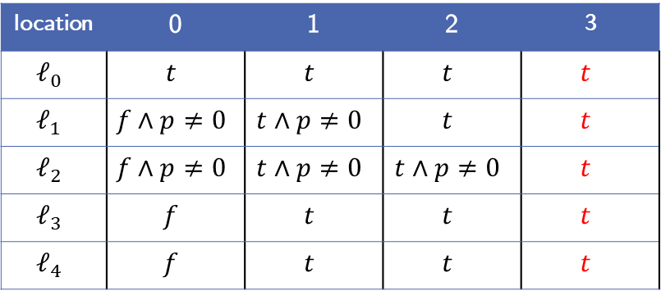
Example:
location | 0 | 1 | 2 | 3
$$ℓ_{0}$$ | $$t$$ | $$t$$ | $$t$$ | $$t$$
$$ℓ_{1}$$ | $$f∧p≠0$$ | $$t∧p≠0$$ | $$t$$ | $$t$$
$$ℓ_{2}$$ | $$f∧p≠0$$ | $$t∧p≠0$$ | $$t∧p≠0$$ | $$t$$
$$ℓ_{3}$$ | $$f$$ | $$t$$ | $$t$$ | $$t$$
$$ℓ_{4}$$ | $$f$$ | $$t$$ | $$t$$ | $$t$$
$$ℓ_{0}$$
$$p ≠0$$
$$ℓ_{1}$$
$$n<0$$
$$ℓ_{5}$$
$$n≥0$$
9. Step: Level 3
Initialize new frames
Get initial proof-obligations
Proof-Obligations:
$(p=0, ℓ_{2}$, 3)
$n^{′}=n−1$
$$ℓ_{2}$$
$$p=0$$
$$ℓ_{E}$$
$$n≠0$$
$$n=0$$
$$ℓ_{3}$$
$$ℓ_{4}$$
$$p^{′}=0$$

Slide 41
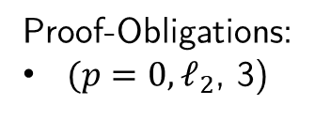


Example:
location | 0 | 1 | 2 | 3
$$ℓ_{0}$$ | $$t$$ | $$t$$ | $$t$$ | $$t$$
$$ℓ_{1}$$ | $$f∧p≠0$$ | $$t∧p≠0$$ | $$t$$ | $$t$$
$$ℓ_{2}$$ | $$f∧p≠0$$ | $$t∧p≠0$$ | $$t∧p≠0$$ | $$t$$
$$ℓ_{3}$$ | $$f$$ | $$t$$ | $$t$$ | $$t$$
$$ℓ_{4}$$ | $$f$$ | $$t$$ | $$t$$ | $$t$$
$$ℓ_{0}$$
$$p ≠0$$
$$ℓ_{1}$$
$$n<0$$
$$ℓ_{5}$$
$$n≥0$$
10. Step: Level 3 Blocking-Phase
Try to block $(p=0, ℓ_{2}$, 3)
Predecessor $ℓ_{1}$:
$t∧n≥0∧ p^{′}=0$
Like the level before this is satisfiable
Proof-Obligations:
$(p=0, ℓ_{2}$, 3)
$n^{′}=n−1$
$$ℓ_{2}$$
$$p=0$$
$$ℓ_{E}$$
$$n≠0$$
$$n=0$$
$$ℓ_{3}$$
$$ℓ_{4}$$
$$p^{′}=0$$

Slide 42

Example:
location | 0 | 1 | 2 | 3
$$ℓ_{0}$$ | $$t$$ | $$t$$ | $$t$$ | $$t$$
$$ℓ_{1}$$ | $$f∧p≠0$$ | $$t∧p≠0$$ | $$t$$ | $$t$$
$$ℓ_{2}$$ | $$f∧p≠0$$ | $$t∧p≠0$$ | $$t∧p≠0$$ | $$t$$
$$ℓ_{3}$$ | $$f$$ | $$t$$ | $$t$$ | $$t$$
$$ℓ_{4}$$ | $$f$$ | $$t$$ | $$t$$ | $$t$$
$$ℓ_{0}$$
$$p ≠0$$
$$ℓ_{1}$$
$$n<0$$
$$ℓ_{5}$$
$$n≥0$$
10. Step: Level 3 Blocking-Phase
Try to block $(p=0, ℓ_{2}$, 3)
Predecessor $ℓ_{1}$:
$t∧n≥0∧ p^{′}=0$
Like the level before, get the same new proof-obligation but on level 2
$(p=0,ℓ_{1},2)$
Proof-Obligations:
$(p=0, ℓ_{2}$, 3)
$n^{′}=n−1$
$$ℓ_{2}$$
$$p=0$$
$$ℓ_{E}$$
$$n≠0$$
$$n=0$$
$$ℓ_{3}$$
$$ℓ_{4}$$
$$p^{′}=0$$

Slide 43


Example:
location | 0 | 1 | 2 | 3
$$ℓ_{0}$$ | $$t$$ | $$t$$ | $$t$$ | $$t$$
$$ℓ_{1}$$ | $$f∧p≠0$$ | $$t∧p≠0$$ | $$t$$ | $$t$$
$$ℓ_{2}$$ | $$f∧p≠0$$ | $$t∧p≠0$$ | $$t∧p≠0$$ | $$t$$
$$ℓ_{3}$$ | $$f$$ | $$t$$ | $$t$$ | $$t$$
$$ℓ_{4}$$ | $$f$$ | $$t$$ | $$t$$ | $$t$$
$$ℓ_{0}$$
$$p ≠0$$
$$ℓ_{1}$$
$$n<0$$
$$ℓ_{5}$$
$$n≥0$$
10. Step: Level 3 Blocking-Phase
Try to block $(p=0, ℓ_{2}$, 3)
Predecessor $ℓ_{1}$:
$t∧n≥0∧ p^{′}=0$
Like the level before, get the same new proof-obligation but on level 2
$(p=0,ℓ_{1},2)$
Proof-Obligations:
$(p=0, ℓ_{2}$, 3)
$(p=0,ℓ_{1},2)$
$n^{′}=n−1$
$$ℓ_{2}$$
$$p=0$$
$$ℓ_{E}$$
$$n≠0$$
$$n=0$$
$$ℓ_{3}$$
$$ℓ_{4}$$
$$p^{′}=0$$

Slide 44

Example:
location | 0 | 1 | 2 | 3
$$ℓ_{0}$$ | $$t$$ | $$t$$ | $$t$$ | $$t$$
$$ℓ_{1}$$ | $$f∧p≠0$$ | $$t∧p≠0$$ | $$t$$ | $$t$$
$$ℓ_{2}$$ | $$f∧p≠0$$ | $$t∧p≠0$$ | $$t∧p≠0$$ | $$t$$
$$ℓ_{3}$$ | $$f$$ | $$t$$ | $$t$$ | $$t$$
$$ℓ_{4}$$ | $$f$$ | $$t$$ | $$t$$ | $$t$$
$$ℓ_{0}$$
$$p ≠0$$
$$ℓ_{1}$$
$$n<0$$
$$ℓ_{5}$$
$$n≥0$$
10. Step: Level 3 Blocking-Phase
There are a lot of repetitions
Proof-Obligations:
$(p=0, ℓ_{2}$, 3)
$(p=0,ℓ_{1},2)$
$n^{′}=n−1$
$$ℓ_{2}$$
$$p=0$$
$$ℓ_{E}$$
$$n≠0$$
$$n=0$$
$$ℓ_{3}$$
$$ℓ_{4}$$
$$p^{′}=0$$

Slide 45

Example:
location | 0 | 1 | 2 | 3
$$ℓ_{0}$$ | $$t$$ | $$t$$ | $$t$$ | $$t$$
$$ℓ_{1}$$ | $$f∧p≠0$$ | $$t∧p≠0$$ | $$t∧p≠0$$ | $$t$$
$$ℓ_{2}$$ | $$f∧p≠0$$ | $$t∧p≠0$$ | $$t∧p≠0$$ | $$t∧p≠0$$
$$ℓ_{3}$$ | $$f$$ | $$t$$ | $$t$$ | $$t$$
$$ℓ_{4}$$ | $$f∧p≠0$$ | $$t∧p≠0$$ | $$t$$ | $$t$$
$$ℓ_{0}$$
$$p ≠0$$
$$ℓ_{1}$$
$$n<0$$
$$ℓ_{5}$$
$$n≥0$$
11. Step: Level 3 Done
$n^{′}=n−1$
$$ℓ_{2}$$
$$p=0$$
$$ℓ_{E}$$
$$n≠0$$
$$n=0$$
$$ℓ_{3}$$
$$ℓ_{4}$$
$$p^{′}=0$$

Slide 46

Example:
location | 0 | 1 | 2 | 3
$$ℓ_{0}$$ | $$t$$ | $$t$$ | $$t$$ | $$t$$
$$ℓ_{1}$$ | $$f∧p≠0$$ | $$t∧p≠0$$ | $$t∧p≠0$$ | $$t$$
$$ℓ_{2}$$ | $$f∧p≠0$$ | $$t∧p≠0$$ | $$t∧p≠0$$ | $$t∧p≠0$$
$$ℓ_{3}$$ | $$f$$ | $$t$$ | $$t$$ | $$t$$
$$ℓ_{4}$$ | $$f∧p≠0$$ | $$t∧p≠0$$ | $$t$$ | $$t$$
$$ℓ_{0}$$
$$p ≠0$$
$$ℓ_{1}$$
$$n<0$$
$$ℓ_{5}$$
$$n≥0$$
11. Step: Level 4
$n^{′}=n−1$
$$ℓ_{2}$$
$$p=0$$
$$ℓ_{E}$$
$$n≠0$$
$$n=0$$
$$ℓ_{3}$$
$$ℓ_{4}$$
$$p^{′}=0$$

Slide 47

Example:
location | 0 | 1 | 2 | 3 | 4
$$ℓ_{0}$$ | $$t$$ | $$t$$ | $$t$$ | $$t$$ | $$t$$
$$ℓ_{1}$$ | $$f∧p≠0$$ | $$t∧p≠0$$ | $$t∧p≠0$$ | $$t$$ | $$t$$
$$ℓ_{2}$$ | $$f∧p≠0$$ | $$t∧p≠0$$ | $$t∧p≠0$$ | $$t∧p≠0$$ | $$t$$
$$ℓ_{3}$$ | $$f$$ | $$t$$ | $$t$$ | $$t$$ | $$t$$
$$ℓ_{4}$$ | $$f∧p≠0$$ | $$t∧p≠0$$ | $$t$$ | $$t$$ | $$t$$
$$ℓ_{0}$$
$$p ≠0$$
$$ℓ_{1}$$
$$n<0$$
$$ℓ_{5}$$
$$n≥0$$
11. Step: Level 4 Initialization
$n^{′}=n−1$
$$ℓ_{2}$$
$$p=0$$
$$ℓ_{E}$$
$$n≠0$$
$$n=0$$
$$ℓ_{3}$$
$$ℓ_{4}$$
$$p^{′}=0$$

Slide 48
Example:
location | 0 | 1 | 2 | 3 | 4
$$ℓ_{0}$$ | $$t$$ | $$t$$ | $$t$$ | $$t$$ | $$t$$
$$ℓ_{1}$$ | $$f∧p≠0$$ | $$t∧p≠0$$ | $$t∧p≠0$$ | $$t$$ | $$t$$
$$ℓ_{2}$$ | $$f∧p≠0$$ | $$t∧p≠0$$ | $$t∧p≠0$$ | $$t∧p≠0$$ | $$t$$
$$ℓ_{3}$$ | $$f$$ | $$t$$ | $$t$$ | $$t$$ | $$t$$
$$ℓ_{4}$$ | $$f∧p≠0$$ | $$t∧p≠0$$ | $$t$$ | $$t$$ | $$t$$
$$ℓ_{0}$$
$$p ≠0$$
$$ℓ_{1}$$
$$n<0$$
$$ℓ_{5}$$
$$n≥0$$
TODO The new interesting proof-obligation!
$n^{′}=n−1$
$$ℓ_{2}$$
$$p=0$$
$$ℓ_{E}$$
$$n≠0$$
$$n=0$$
$$ℓ_{3}$$
$$ℓ_{4}$$
$$p^{′}=0$$

Slide 49

Example:
location | 0 | 1 | 2 | 3 | 4
$$ℓ_{0}$$ | $$t$$ | $$t$$ | $$t$$ | $$t$$ | $$t$$
$$ℓ_{1}$$ | $$f∧p≠0$$ | $$t∧p≠0$$ | $$t∧p≠0$$ | $$t∧p≠0$$ | $$t$$
$$ℓ_{2}$$ | $$f∧p≠0$$ | $$t∧p≠0$$ | $$t∧p≠0$$ | $$t∧p≠0$$ | $$t∧p≠0$$
$$ℓ_{3}$$ | $$f∧f$$ | $$t∧f$$ | $$t$$ | $$t$$ | $$t$$
$$ℓ_{4}$$ | $$f∧p≠0$$ | $$t∧p≠0$$ | $$t∧p≠0$$ | $$t$$ | $$t$$
$$ℓ_{0}$$
$$p ≠0$$
$$ℓ_{1}$$
$$n<0$$
$$ℓ_{5}$$
$$n≥0$$
TODO The Last step:
Spoiler: Error is unreachable
$n^{′}=n−1$
$$ℓ_{2}$$
$$p=0$$
$$ℓ_{E}$$
$$n≠0$$
$$n=0$$
$$ℓ_{3}$$
$$ℓ_{4}$$
$$p^{′}=0$$

Slide 50

Example:
location | 0 | 1 | 2 | 3 | 4 | 5
$$ℓ_{0}$$
$$ℓ_{1}$$
$$ℓ_{2}$$
$$ℓ_{3}$$
$$ℓ_{4}$$
$$ℓ_{0}$$
$$p ≠0$$
$$ℓ_{1}$$
$$n<0$$
$$ℓ_{5}$$
$$n≥0$$
Text
Proof-Obligations:
$n^{′}=n−1$
$$ℓ_{2}$$
$$p=0$$
$$ℓ_{E}$$
$$n≠0$$
$$n=0$$
$$ℓ_{3}$$
$$ℓ_{4}$$
$$p^{′}=0$$

Slide 51

Related Work: Other Approaches
Our Algorithm is based on the approach by Lange et al.¹
Other possible ways of using PDR on software:
Bit-Blasting²:
Encode the variables as bitvectors with new variable $pc$ representing the control-flow
Use the original bit-level PDR algorithm
➔ Not very competitive because tedious handling of $pc$ variable
Notes:
Vielleicht die anderen Approaches so Erwähnen wie in PDR_in_ICFG_Ex2, also einfach nur so oberflächlich anschneiden

Slide 52

Related Work: Other Approaches
Our Algorithm is based on the approach by Lange et al.¹
Other possible ways of using PDR on software:
Abstract Reachability Tree (ART) Unrolling³:
Transform CFG into an ART
Attach program-counter variable $pc$ and first-order formula $φ$ to locations
Block proof-obligations like in our approach
Notes:
Vielleicht die anderen Approaches so Erwähnen wie in PDR_in_ICFG_Ex2, also einfach nur so oberflächlich anschneiden

Slide 53
Implementation in Ultimate: Description Trace Abstraction with PDR
Calculate sequence of statements from initial location to error location
➔ Possible error trace
Construct a new CFG of error trace
Use PDR to show if error is reachable or not
➔ If reachable:
Error trace is feasible, program is unsafe

Slide 54
Implementation in Ultimate: Description Trace Abstraction with PDR
Calculate sequence of statements from initial location to error location
➔ Possible error trace
Construct a new CFG of error trace
Use PDR to show if error is reachable or not
➔ If unreachable:
Use formulas at the fixpoint as interpolant sequence to refute other error traces

Slide 55















Implementation in Ultimate: Trace Abstraction with PDR
$$ℓ_{0}$$
$$p ≠0$$
$$ℓ_{1}$$
$$n<0$$
$$ℓ_{5}$$
$$n≥0$$
1. Step: Get possible error trace
$n^{′}=n−1$
$$ℓ_{2}$$
$$p=0$$
$$ℓ_{E}$$
$$n≠0$$
$$n=0$$
$$ℓ_{3}$$
$$ℓ_{4}$$
$$p^{′}=0$$

Slide 56



Implementation in Ultimate: Trace Abstraction with PDR
$$ℓ_{0}$$
$$p ≠0$$
$$ℓ_{1}$$
$$n<0$$
$$ℓ_{5}$$
$$n≥0$$
1. Step: Get possible error trace
$n^{′}=n−1$
$$ℓ_{2}$$
$$p=0$$
$$ℓ_{E}$$
$$n≠0$$
$$n=0$$
$$ℓ_{3}$$
$$ℓ_{4}$$
$$p^{′}=0$$

Slide 57
Implementation in Ultimate: Trace Abstraction with PDR
$$ℓ_{0}$$
$$p ≠0$$
$$ℓ_{1}$$
$$n<0$$
$$ℓ_{5}$$
$$n≥0$$
2. Step: Construct new CFG
$n^{′}=n−1$
$$ℓ_{2}$$
$$p=0$$
$$ℓ_{E}$$
$$n≠0$$
$$n=0$$
$$ℓ_{3}$$
$$ℓ_{4}$$
$$p^{′}=0$$

Slide 58


Implementation in Ultimate: Trace Abstraction with PDR
$$ℓ_{0}$$
$$p ≠0$$
$$ℓ_{1}$$
$$n≥0$$
2. Step: Construct new CFG
$$ℓ_{2}$$
$$p=0$$
$$ℓ_{E}$$

Slide 59
Implementation in Ultimate: Trace Abstraction with PDR
$$ℓ_{0}$$
$$p ≠0$$
$$ℓ_{1}$$
$$n≥0$$
3. Step: Use PDR
$$ℓ_{2}$$
$$p=0$$
$$ℓ_{E}$$

Slide 60

Implementation in Ultimate: Trace Abstraction with PDR
location | 0 | 1 | 2 | 3
$$ℓ_{0}$$
$$ℓ_{1}$$
$$ℓ_{2}$$
$$ℓ_{0}$$
$$p ≠0$$
$$ℓ_{1}$$
$$n≥0$$
3. Step: Use PDR
$$ℓ_{2}$$
$$p=0$$
$$ℓ_{E}$$

Slide 61

Implementation in Ultimate: Trace Abstraction with PDR
location | 0 | 1 | 2 | 3
$$ℓ_{0}$$ | $$t$$ | $$t$$ | $$t$$ | $$t$$
$$ℓ_{1}$$ | $$f∧p≠0$$ | $$t∧p≠0$$ | $$t∧p≠0$$ | $$t$$
$$ℓ_{2}$$ | $$f∧p≠0$$ | $$t∧p≠0$$ | $$t∧p≠0$$ | $$t∧p≠0$$
$$ℓ_{0}$$
$$p ≠0$$
$$ℓ_{1}$$
$$n≥0$$
3. Step: Use PDR
$$ℓ_{2}$$
$$p=0$$
$$ℓ_{E}$$

Slide 62

Implementation in Ultimate: Trace Abstraction with PDR
location | 0 | 1 | 2 | 3
$$ℓ_{0}$$ | $$t$$ | $$t$$ | $$t$$ | $$t$$
$$ℓ_{1}$$ | $$f∧p≠0$$ | $$t∧p≠0$$ | $$t∧p≠0$$ | $$t$$
$$ℓ_{2}$$ | $$f∧p≠0$$ | $$t∧p≠0$$ | $$t∧p≠0$$ | $$t∧p≠0$$
$$ℓ_{0}$$
$$p ≠0$$
$$ℓ_{1}$$
$$n≥0$$
4. Step: Use fixpoint invariants as
interpolant sequence
$$ℓ_{2}$$
$$p=0$$
$$ℓ_{E}$$

Slide 63

Implementation in Ultimate: Trace Abstraction with PDR
location | 0 | 1 | 2 | 3
$$ℓ_{0}$$ | $$t$$ | $$t$$ | $$t$$ | $$t$$
$$ℓ_{1}$$ | $$f∧p≠0$$ | $$t∧p≠0$$ | $$t∧p≠0$$ | $$t$$
$$ℓ_{2}$$ | $$f∧p≠0$$ | $$t∧p≠0$$ | $$t∧p≠0$$ | $$t∧p≠0$$
$$ℓ_{0}$$
$$p ≠0$$
$$ℓ_{1}$$
$$n≥0$$
4. Step: Use fixpoint invariants as
interpolant sequence
$$ℓ_{2}$$
$$p=0$$
$$ℓ_{E}$$

Slide 64

Implementation in Ultimate: Implemented Improvements
Caching proof-obligations:
Save the proof-obligation queue
Start every new level with the
latest blocked proof-obligation
➔ Only proof-obligation that differs
from level before

Slide 65
Implementation in Ultimate: Implemented Improvements
Skipping already blocked proof-obligations:
Save unsatisfiable queues to SMT-solver
➔ If a saved queue is seen again, do not call SMT-solver again, strengthen frames right away

Slide 66
Evaluation: Data Comparison
We benchmarked PDR
Notes:
Hier vielleicht beide Graphen und dann was dazu sagen.

Slide 67


Evaluation: Data Comparison
CPU Time Consumption
Memory Consumption
Notes:
Hier vielleicht beide Graphen und dann was dazu sagen.

Slide 68
Evaluation: Discussion

Slide 69
Future Work: Implementing Further Improvements
Using Interpolation:
Our algorithm is inefficient when dealing with loops
Idea:
Instead of strengthening frames with negated proof-obligation, calculate Interpolant for transition and proof-obligation and add that
Notes:
Nichts Ausführliches

Slide 70
Future Work: Implementing Further Improvements
Dealing with procedures:
C programs often contain procedures with which PDR cannot deal
Idea:
Use a non-linear approach of PDR
Calculate a procedure summary and add that to the CFG, removing the procedure altogether
Notes:
Nichts Ausführliches

Slide 71
Conclusion

