Slide 2
Motivation

Slide 3
Contents
1. Introduction
2. Background: PDR on Hardware
3. PDR on Software
4. Implementation in Ultimate
5. Evaluation
6. Related Work
7. Future Work
8. Conclusion

Slide 4
Overview
1. Introduction
2. Background: PDR on Hardware
3. PDR on Software
4. Implementation in Ultimate
5. Evaluation
6. Related Work
7. Future Work
8. Conclusion

Slide 5
1. Introduction

Slide 6
Overview
1. Introduction
2. Background: PDR on Hardware
3. PDR on Software
4. Implementation in Ultimate
5. Evaluation
6. Related Work
7. Future Work
8. Conclusion

Slide 7
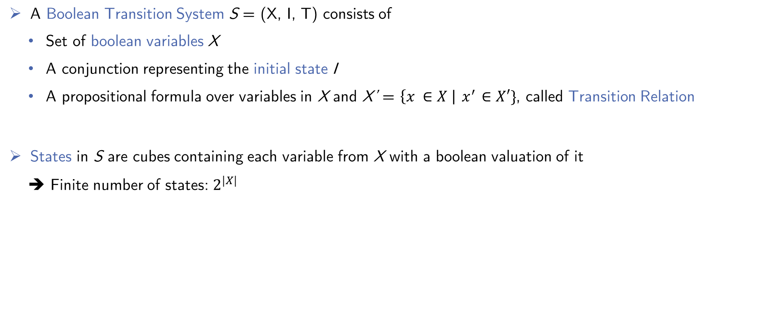
2.1 Preliminaries
A Boolean Transition System S = (X, I, T) consists of
Set of boolean variables X
A conjunction representing the initial state I
A propositional formula over variables in X and X’ = $\left\{x ∈X \right|{ x}^{′} ∈X′\}$, called Transition Relation
States in S are cubes containing each variable from X with a boolean valuation of it
➔ Finite number of states: $2^{|X|}$
Notes:
Folie für boolean Transition System

Slide 8
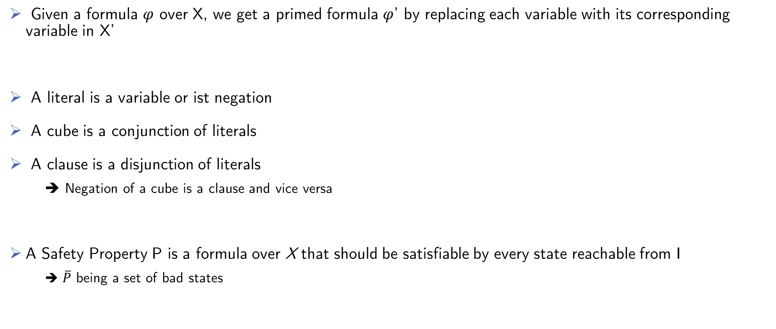
2.1 Preliminaries
Given a formula $φ$ over X, we get a primed formula $φ$’ by replacing each variable with its corresponding variable in X’
A literal is a variable or ist negation
A cube is a conjunction of literals
A clause is a disjunction of literals
➔ Negation of a cube is a clause and vice versa
A Safety Property P is a formula over X that should be satisfiable by every state reachable from I
➔ $\overline{P}$ being a set of bad states

Slide 9
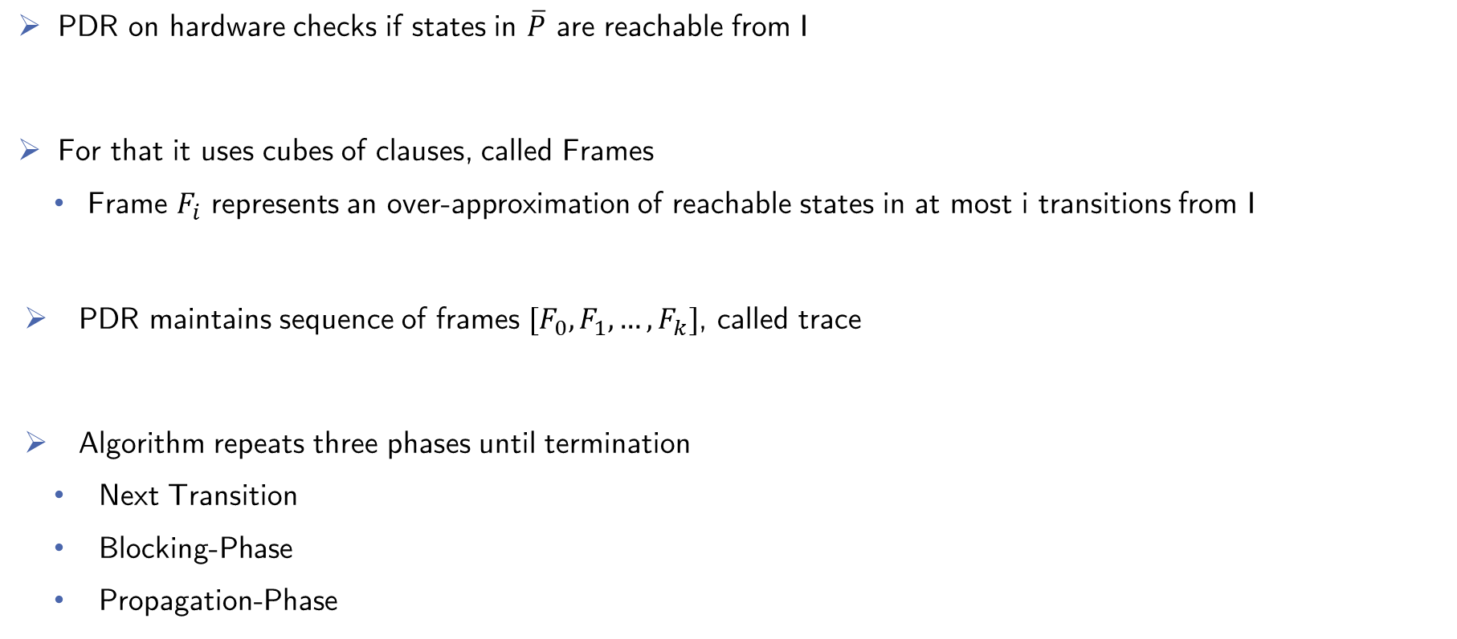
2.2 Algorithm
PDR on hardware checks if states in $\overline{P}$ are reachable from I
For that it uses cubes of clauses, called Frames
Frame $F_{i }$represents an over-approximation of reachable states in at most i transitions from I
PDR maintains sequence of frames $[F_{0}, F_{1}, …, F_{k}]$, called trace
Algorithm repeats three phases until termination
Next Transition
Blocking-Phase
Propagation-Phase

Slide 10
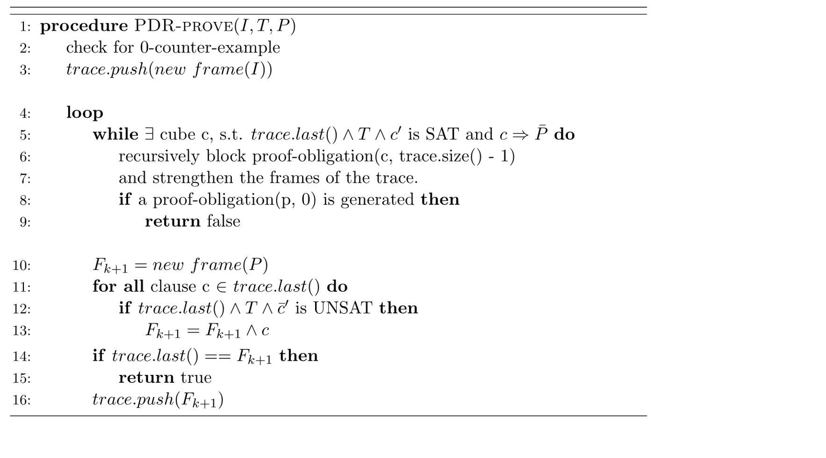
2.2 Algorithm
Notes:
Eingekreiste Codezeilen erklären. In subsequenten Folien, nur die Phasen eingezeichnet lassen die gerade Erklärt werden
Check for 0 CTI
Next Transition Phase
Blocking-Phase
Propagation-Phase

Slide 11
2.3 Example

Slide 12
2.4 Possible Improvements
Blocking one state at a time is ineffective.
➔ Generalize blocked states by removing cubes not used in the proof, delivered by Unsat-cores
Ternary simulation to generalize proof-obligations
Extend binary variables with a new unknown value and check variables for importance

Slide 13
Overview
1. Introduction
2. Background: PDR on Hardware
3. PDR on Software
4. Implementation in Ultimate
5. Evaluation
6. Related Work
7. Future Work
8. Conclusion

Slide 14
3.1 Preliminaries

Slide 15
3.2 Lifted Algorithm
Algorithm Pseudocode here
Notes:
Links soll Lifted Algorithm Pseudocode hin, wieder Zeilenabstand ist 0, Rechts ist dann wiederPlatz für Erklärungen.

Slide 16
3.3 Example
Notes:
Only one, take the one with less steps. Because time

Slide 17
3.4 Possible Improvements

Slide 18
Overview
1. Introduction
2. Background: PDR on Hardware
3. PDR on Software
4. Implementation in Ultimate
5. Evaluation
6. Related Work
7. Future Work
8. Conclusion

Slide 19
4.1 Implementation

Slide 20
4.2 Implemented Improvements

Slide 21
Overview
1. Introduction
2. Background: PDR on Hardware
3. PDR on Software
4. Implementation in Ultimate
5. Evaluation
6. Related Work
7. Future Work
8. Conclusion

Slide 22
5.1 Data Comparison
Notes:
Hier vielleicht beide Graphen und dann was dazu sagen.

Slide 23
5.2 Discussion

Slide 24
Overview
1. Introduction
2. Background: PDR on Hardware
3. PDR on Software
4. Implementation in Ultimate
5. Evaluation
6. Related Work
7. Future Work
8. Conclusion

Slide 25
6. Related Work
Notes:
Vielleicht die anderen Approaches so Erwähnen wie in PDR_in_ICFG_Ex2, also einfach nur so oberflächlich anschneiden

Slide 26
Overview
1. Introduction
2. Background: PDR on Hardware
3. PDR on Software
4. Implementation in Ultimate
5. Evaluation
6. Related Work
7. Future Work
8. Conclusion

Slide 27
7.1 Further Improvements
Notes:
Nichts Ausführliches

Slide 28
Overview
1. Introduction
2. Background: PDR on Hardware
3. PDR on Software
4. Implementation in Ultimate
5. Evaluation
6. Related Work
7. Future Work
8. Conclusion

Slide 29
8. Conclusion

