Slide 2
Motivation

Slide 3
Overview
Introduction
Background: PDR on Hardware
PDR on Software
Implementation in Ultimate
Evaluation
Related Work
Future Work
Conclusion

Slide 4
Overview
Introduction
Background: PDR on Hardware
PDR on Software
Implementation in Ultimate
Evaluation
Related Work
Future Work
Conclusion

Slide 5
1. Introduction

Slide 6
Overview
Introduction
Background: PDR on Hardware
PDR on Software
Implementation in Ultimate
Evaluation
Related Work
Future Work
Conclusion

Slide 7
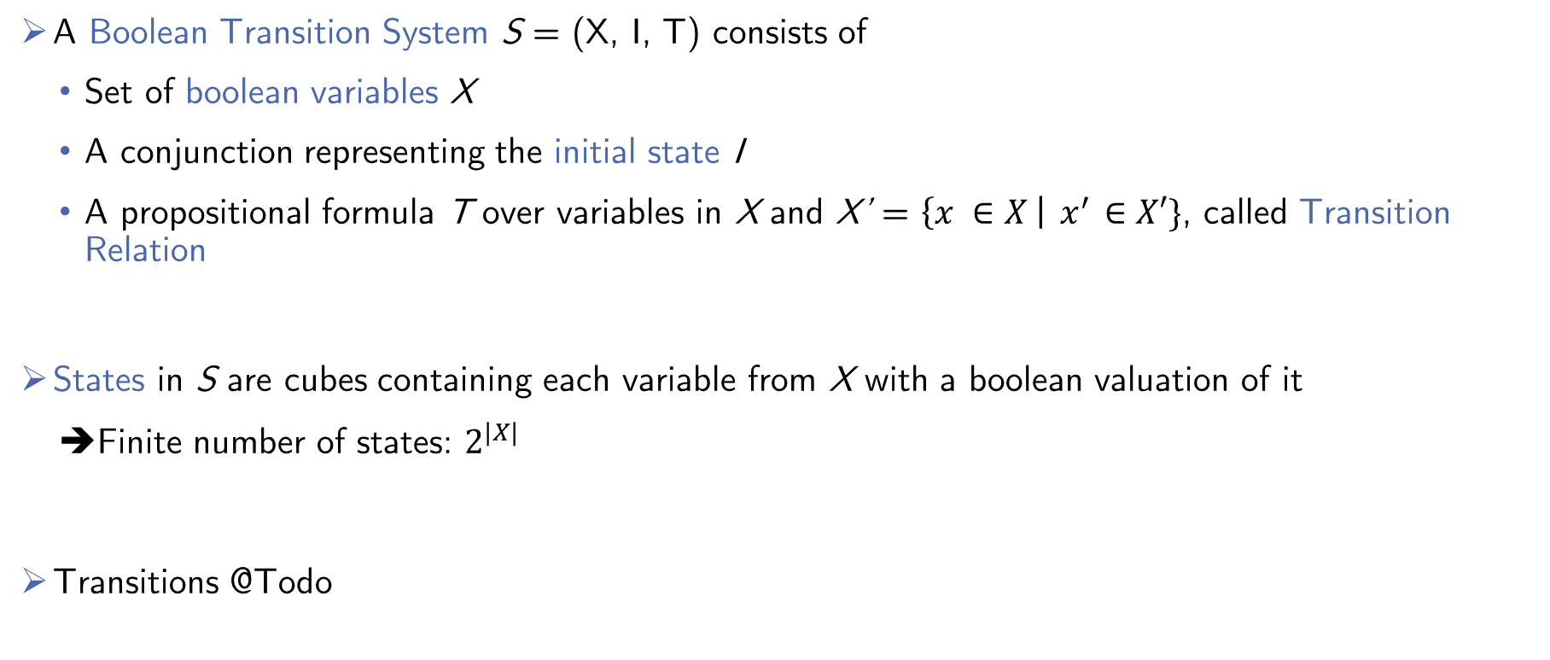
2.1 Preliminaries
A Boolean Transition System S = (X, I, T) consists of
Set of boolean variables X
A conjunction representing the initial state I
A propositional formula T over variables in X and X’ = $\left\{x ∈X \right|{ x}^{′} ∈X′\}$, called Transition Relation
States in S are cubes containing each variable from X with a boolean valuation of it
➔Finite number of states: $2^{|X|}$
Transitions @Todo
Notes:
Folie für boolean Transition System

Slide 8
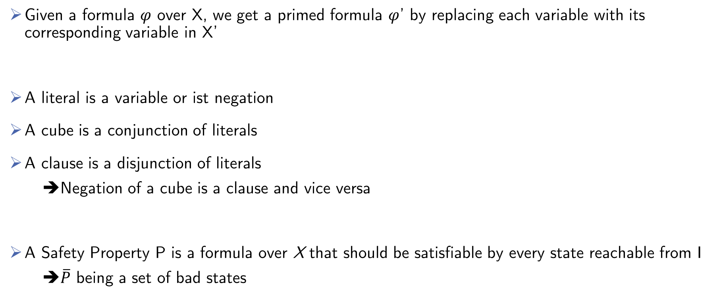
2.1 Preliminaries
Given a formula $φ$ over X, we get a primed formula $φ$’ by replacing each variable with its corresponding variable in X’
A literal is a variable or ist negation
A cube is a conjunction of literals
A clause is a disjunction of literals
➔Negation of a cube is a clause and vice versa
A Safety Property P is a formula over X that should be satisfiable by every state reachable from I
➔$\overline{P}$ being a set of bad states

Slide 9

2.2 Algorithm
PDR on hardware checks if states in $\overline{P}$ are reachable from I
For that it uses cubes of clauses, called Frames
Frame $F_{i }$represents an over-approximation of reachable states in at most i transitions from I
PDR maintains sequence of frames $[F_{0}, F_{1}, …, F_{k}]$, called trace

Slide 10
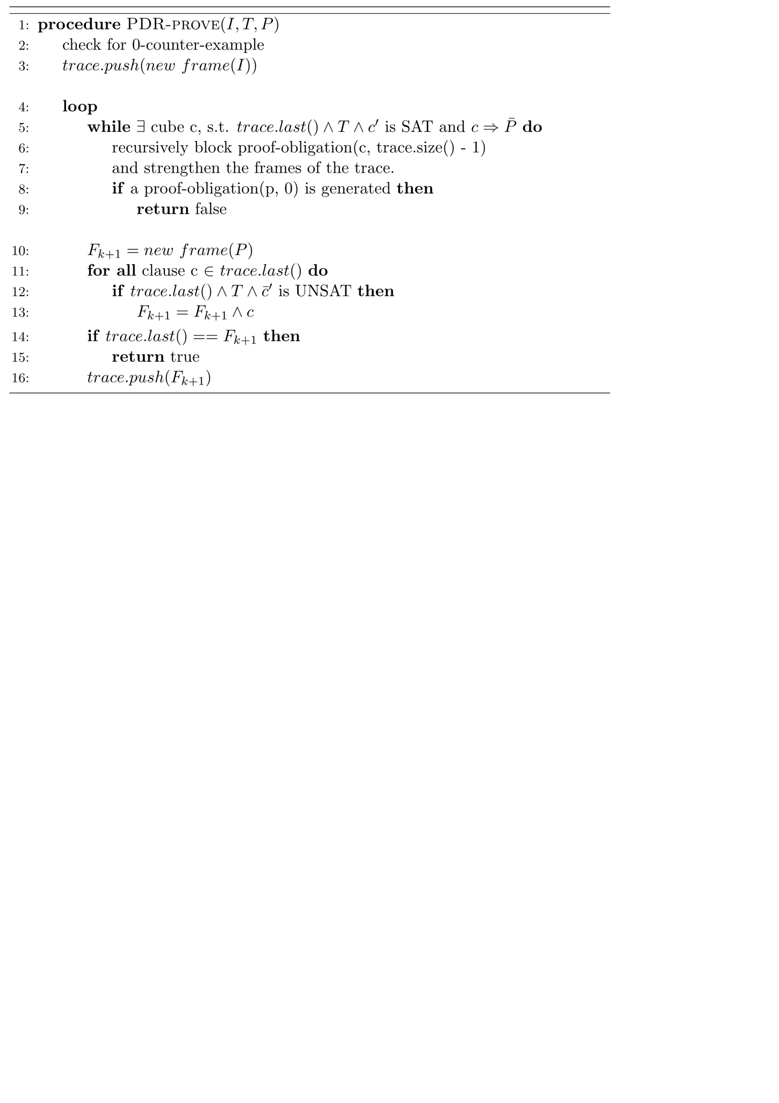
2.2 Algorithm: Pseudo-Code
Notes:
Next Transition Phase

Slide 11
2.2 Algorithm: Pseudo-Code
Notes:
Eingekreiste Codezeilen erklären. In subsequenten Folien, nur die Phasen eingezeichnet lassen die gerade Erklärt werden
Check for 0 CTI
Next Transition Phase
Blocking-Phase
Propagation-Phase

Slide 12
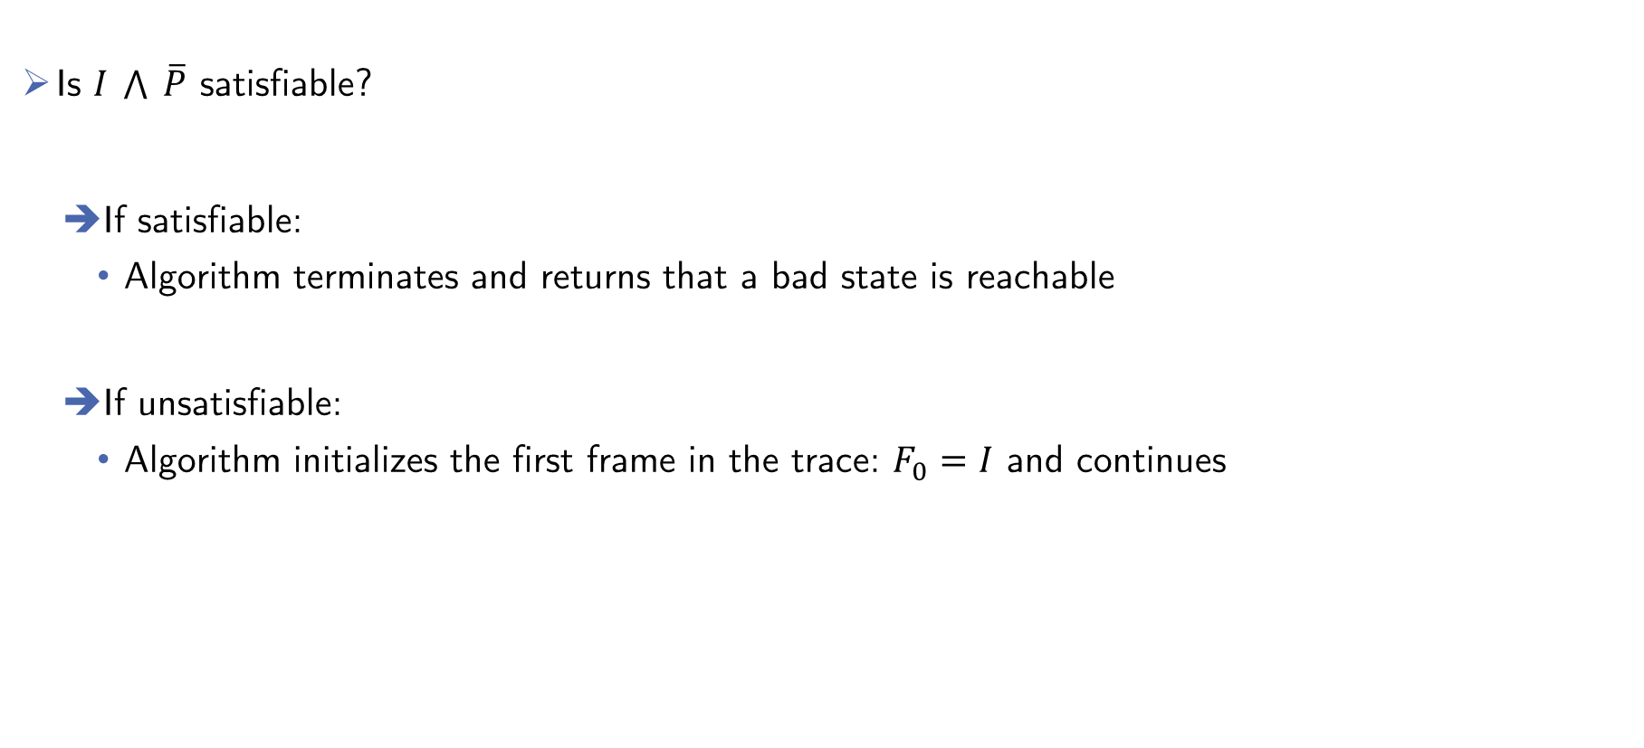
2.2 Algorithm: Checking for 0-counter-example
Is $I \bigwedge{ \overline{P}}$ satisfiable?
If satisfiable:
Algorithm terminates and returns that a bad state is reachable
If unsatisfiable:
Algorithm initializes the first frame in the trace: $F_{0}=I$ and continues

Slide 13
2.2 Algorithm: Pseudo-Code
Next Transition Phase
Notes:
Next Transition Phase

Slide 14

2.2 Algorithm: Next Transition Phase:
Checking if the next state is a good state:
Let $[F_{0}, F_{1}, …, F_{k}]$ be the current trace
Is $F_{k} \bigwedge{ T\bigwedge{\overline{ P^{′}}}}$ satisfiable?
➔If unsatisfiable:
Continue with the next phase

Slide 15

2.2 Algorithm: Next Transition Phase:
Checking if the next state is a good state
Let $[F_{0}, F_{1}, …, F_{k}]$ be the current trace
Is $F_{k} \bigwedge{ T\bigwedge{\overline{ P^{′}}}}$ satisfiable?
➔If satisfiable:
Take satisfying assignment $\vec{x}=\left\{x_{1},x_{2}, …,x_{\left|X\right|},x_{1}^{′},x_{2}^{′}, …,x_{\left|X^{′}\right|}^{′}\right\}$
The algorithm gets new bad state: $b=x_{1} \bigwedge{ x_{2}} \bigwedge{… \bigwedge{{ x}_{\left|X\right|} }}$
Construct the tuple $t=(b, k)$, called proof-obligation

Slide 16
2.2 Algorithm: Pseudo-Code
Blocking-Phase
Notes:
Blocking Phase

Slide 17
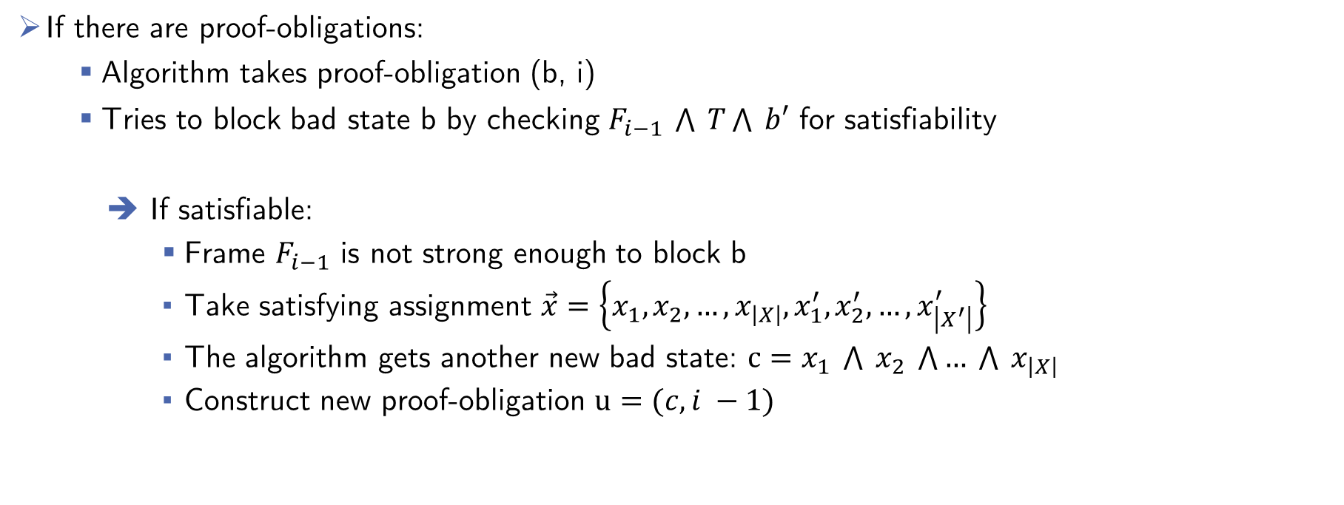
2.2 Algorithm: Blocking-Phase
Proving that new bad states are not reachable
If there are proof-obligations:
Algorithm takes proof-obligation (b, i)
Tries to block bad state b by checking $F_{i−1} \bigwedge{ T}\bigwedge{ b′}$ for satisfiability
If satisfiable:
Frame $F_{i−1}$ is not strong enough to block b
Take satisfying assignment $\vec{x}=\left\{x_{1},x_{2}, …,x_{\left|X\right|},x_{1}^{′},x_{2}^{′}, …,x_{\left|X^{′}\right|}^{′}\right\}$
The algorithm gets another new bad state: $c=x_{1} \bigwedge{ x_{2}} \bigwedge{… \bigwedge{{ x}_{\left|X\right|} }}$
Construct new proof-obligation $u=(c, i −1)$
Notes:
Vielleicht Code Snippet auf die Folie?

Slide 18

2.2 Algorithm: Blocking-Phase
Proving that new bad states are not reachable
If there are proof-obligations:
Algorithm takes proof-obligation (b, i)
Tries to block bad state b by checking $F_{i−1} \bigwedge{ T}\bigwedge{ b′}$ for satisfiability
If unsatisfiable:
Algorithm strenghthens $F_{i}$ with $\overline{b}$
➔ $F_{i }=F_{i} \bigwedge{ \overline{b}}$
Blocking bad state b at $F_{i }$
Notes:
Vielleicht Code Snippet auf die Folie?

Slide 19
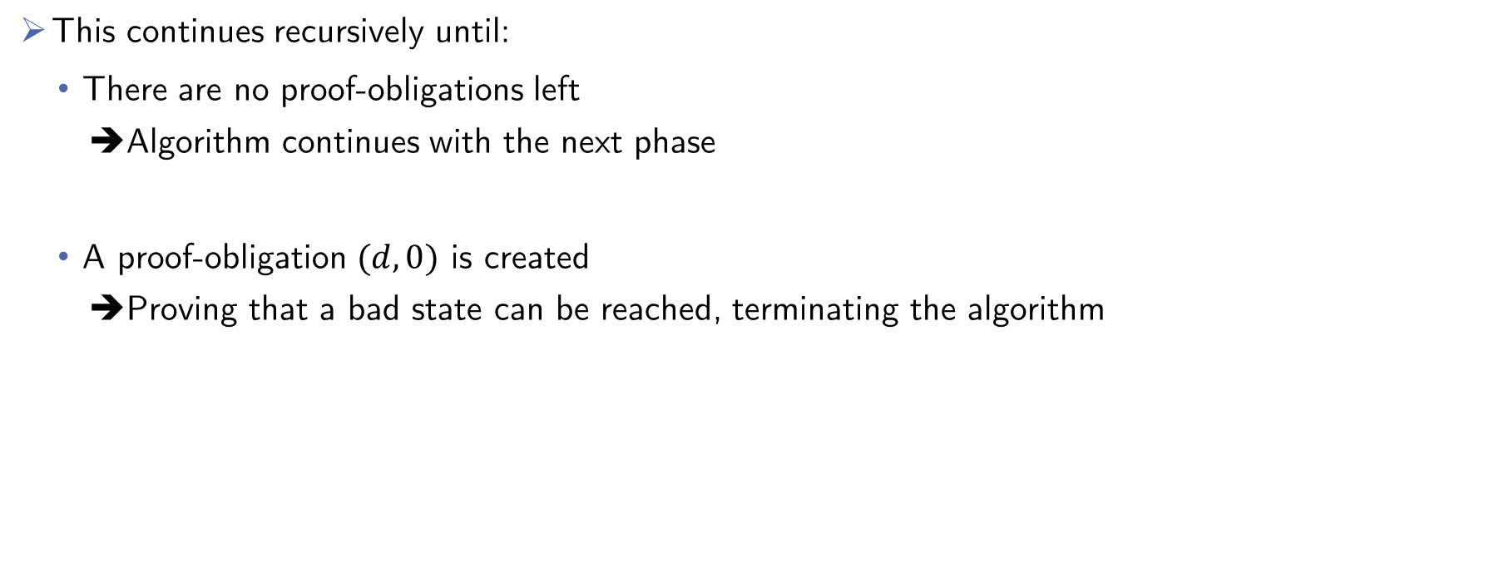
2.2 Algorithm: Blocking-Phase
This continues recursively until:
There are no proof-obligations left
➔Algorithm continues with the next phase
A proof-obligation $(d, 0)$ is created
➔Proving that a bad state can be reached, terminating the algorithm
Notes:
Vielleicht Code Snippet auf die Folie?

Slide 20
2.2 Algorithm: Pseudo-Code
Propagation-Phase
Notes:
Propagation Phase

Slide 21
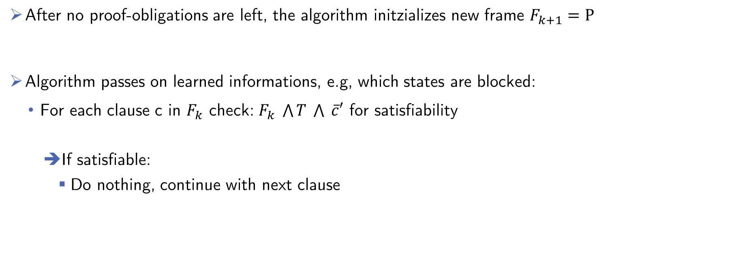
2.2 Algorithm: Propagation-Phase
Propagating learned information
After no proof-obligations are left, the algorithm initzializes new frame $F_{k+1}=P$
Algorithm passes on learned informations, e.g, which states are blocked:
For each clause c in $F_{k}$ check: $F_{k} \bigwedge{T} \bigwedge{ \overline{c}′}$ for satisfiability
If satisfiable:
Do nothing, continue with next clause

Slide 22
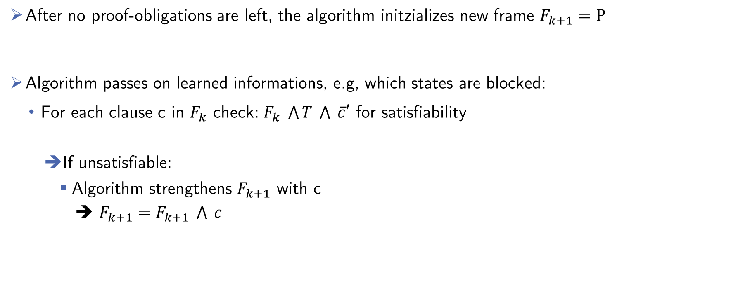
2.2 Algorithm: Propagation-Phase
Propagating learned information
After no proof-obligations are left, the algorithm initzializes new frame $F_{k+1}=P$
Algorithm passes on learned informations, e.g, which states are blocked:
For each clause c in $F_{k}$ check: $F_{k} \bigwedge{T} \bigwedge{ \overline{c}′}$ for satisfiability
If unsatisfiable:
Algorithm strengthens $F_{k+1}$ with c
➔ $F_{k+1}=F_{k+1} \bigwedge{ c}$

Slide 23

2.2 Algorithm: Propagation-Phase
Check for termination
After all clauses have been tested, algorithm checks if $F_{k} ≡ F_{k+1}$
If so, the algorithm has found a fixpoint and terminates
➔No states of $\overline{P}$ are reachable
If not, the algorithm continues with a new Next Transition Phase

Slide 24
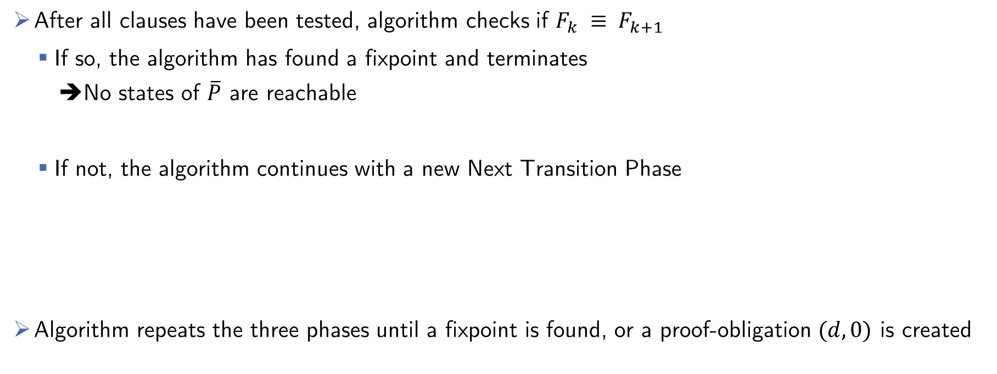
2.2 Algorithm: Propagation-Phase
Check for termination
After all clauses have been tested, algorithm checks if $F_{k} ≡ F_{k+1}$
If so, the algorithm has found a fixpoint and terminates
➔No states of $\overline{P}$ are reachable
If not, the algorithm continues with a new Next Transition Phase
Algorithm repeats the three phases until a fixpoint is found, or a proof-obligation $(d, 0)$ is created

Slide 25
2.2 Algorithm: Pseudo-Code TEMPLATE
Notes:
Eingekreiste Codezeilen erklären. In subsequenten Folien, nur die Phasen eingezeichnet lassen die gerade Erklärt werden
Check for 0 CTI
Next Transition Phase
Blocking-Phase
Propagation-Phase

Slide 26
2.3 Example

Slide 27
2.4 Possible Improvements
Blocking one state at a time is ineffective:
Generalize blocked states
➔ Eliminate insignificant cubes from states, that are not used by UNSAT-cores
Ternary Simulation to reduce proof-obligations:
Extend binary variables with a new value: unknown
Check state variables of proof-obligations for importance
➔ Eliminate unimportant state variables

Slide 28
Overview
Introduction
Background: PDR on Hardware
PDR on Software
Implementation in Ultimate
Evaluation
Related Work
Future Work
Conclusion

Slide 29
3.1 Preliminaries

Slide 30
3.2 Lifted Algorithm
Algorithm Pseudocode here
Notes:
Links soll Lifted Algorithm Pseudocode hin, wieder Zeilenabstand ist 0, Rechts ist dann wiederPlatz für Erklärungen.

Slide 31
3.3 Example
Notes:
Only one, take the one with less steps. Because time

Slide 32
3.4 Possible Improvements

Slide 33
Overview
Introduction
Background: PDR on Hardware
PDR on Software
Implementation in Ultimate
Evaluation
Related Work
Future Work
Conclusion

Slide 34
4.1 Implementation

Slide 35
4.2 Implemented Improvements

Slide 36
Overview
Introduction
Background: PDR on Hardware
PDR on Software
Implementation in Ultimate
Evaluation
Related Work
Future Work
Conclusion

Slide 37
5.1 Data Comparison
Notes:
Hier vielleicht beide Graphen und dann was dazu sagen.

Slide 38
5.2 Discussion

Slide 39
Overview
Introduction
Background: PDR on Hardware
PDR on Software
Implementation in Ultimate
Evaluation
Related Work
Future Work
Conclusion

Slide 40
6. Related Work
Notes:
Vielleicht die anderen Approaches so Erwähnen wie in PDR_in_ICFG_Ex2, also einfach nur so oberflächlich anschneiden

Slide 41
Overview
Introduction
Background: PDR on Hardware
PDR on Software
Implementation in Ultimate
Evaluation
Related Work
Future Work
Conclusion

Slide 42
7.1 Further Improvements
Notes:
Nichts Ausführliches

Slide 43
Overview
Introduction
Background: PDR on Hardware
PDR on Software
Implementation in Ultimate
Evaluation
Related Work
Future Work
Conclusion

Slide 44
8. Conclusion

