Slide 2
Introduction: Motivation
Property Directed Reachability (PDR) was first devised as hardware verification technique in 2010 by Aaron Bradley¹

Slide 3
Introduction: Motivation
Property Directed Reachability (PDR) was first devised as hardware verification technique in 2010 by Aaron Bradley¹
➔ Surprisingly won 3rd place at CAV 2010 hardware checking competition²

Slide 4
Introduction: Motivation
Property Directed Reachability (PDR) was first devised as hardware verification technique in 2010 by Aaron Bradley¹
➔ Surprisingly won 3rd place at CAV 2010 hardware checking competition²
“This new method appears to be the most important contribution to bit-level formal verification in almost a decade” ³
3: Niklas Een, Alan Mishchenko, and Robert Brayton. 2011. Efficient implementation of property directed reachability. In Proceedings of the International Conference on Formal Methods in Computer-Aided Design (FMCAD '11). FMCAD Inc, Austin, TX, 125-134.

Slide 5
Introduction: Motivation
Property Directed Reachability (PDR) was first devised as hardware verification technique in 2010 by Aaron Bradley¹
➔ Surprisingly won 3rd place at CAV 2010 hardware checking competition²
“This new method appears to be the most important contribution to bit-level formal verification in almost a decade” ³
Using PDR on software may have similar performance!
3: Niklas Een, Alan Mishchenko, and Robert Brayton. 2011. Efficient implementation of property directed reachability. In Proceedings of the International Conference on Formal Methods in Computer-Aided Design (FMCAD '11). FMCAD Inc, Austin, TX, 125-134.

Slide 6
Introduction: Motivation
Our Goals:
Use PDR on software in the verification framework Ultimate¹
➔ Combining Trace Abstraction and PDR
Comparison to existing techniques

Slide 7
Overview
How does our PDR algorithm work?
Preliminaries
Running Example
Related Work
How do we use PDR in Ultimate?
Combination of Trace Abstraction and our PDR algorithm
Implemented Improvements

Slide 8
Overview
Evaluation:
Comparison of Trace Abstraction using PDR and Trace Abstraction using Nested Interpolants
What can be done in the future?
Implementing more Improvements

Slide 9

PDR Algorithm: Preliminaries
Control flow graph (CFG) $A=(X, L, E, ℓ_{0}, ℓ_{E})$ is a graph consisting of
Finite set of first-order variables $X$
Finite set of locations $L$
Finite set of transitions E$⊆L ×FO ×L$
$FO$is a quantifier free first-order logic formula over variables in $X$ and $X^{′}=\left\{x ∈X \right|x^{′}∈ X′\}$
Initial location $ℓ_{0} ∈L$
Error location $ℓ_{E} ∈L$

Slide 10

PDR Algorithm: Datastructures
Frame $F_{i, ℓ}$:
Represents a first-order formula
$ℓ$ is the corresponding location
$i$ is the corresponding iteration
Each location has multiple assigned frames
Proof-Obligation $(p,ℓ,i)$:
$p$ is a first-order formula
$ℓ$ is the corresponding location
$i$ is the corresponding iteration
➔ Need to be blocked

Slide 11
PDR Algorithm: Description
Starts with checking for a 0-Counter-Example
Global Initialization
Repeats three phases until termination:
1. Next Iteration Initialization
2. Blocking-Phase
3. Propagation-Phase

Slide 12















Example: Running Example
$$ℓ_{0}$$
$$p ≠0$$
$$ℓ_{1}$$
$$n<0$$
$$ℓ_{5}$$
$$n≥0$$
$n^{′}=n−1$
$$ℓ_{2}$$
$$p=0$$
$$ℓ_{E}$$
$$n≠0$$
$$n=0$$
$$ℓ_{3}$$
$$ℓ_{4}$$
$$p^{′}=0$$

Slide 13
Example:
$$ℓ_{0}$$
$$p ≠0$$
$$ℓ_{1}$$
$$n<0$$
$$ℓ_{5}$$
$$n≥0$$
1. Step: Check for 0-Counter-Example
$n^{′}=n−1$
$$ℓ_{2}$$
$$p=0$$
$$ℓ_{E}$$
$$n≠0$$
$$n=0$$
$$ℓ_{3}$$
$$ℓ_{4}$$
$$p^{′}=0$$

Slide 14
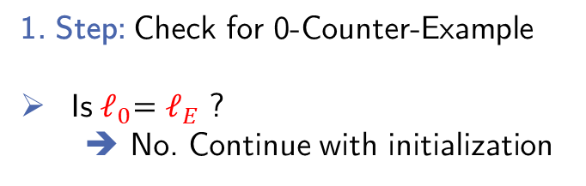


Example:
$$ℓ_{0}$$
$$p ≠0$$
$$ℓ_{1}$$
$$n<0$$
$$ℓ_{5}$$
$$n≥0$$
1. Step: Check for 0-Counter-Example
Is${ ℓ}_{0}=ℓ_{E}$ ?
➔ No. Continue with initialization
$n^{′}=n−1$
$$ℓ_{2}$$
$$p=0$$
$$ℓ_{E}$$
$$n≠0$$
$$n=0$$
$$ℓ_{3}$$
$$ℓ_{4}$$
$$p^{′}=0$$

Slide 15
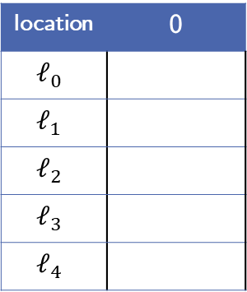

Example:
location | 0
$$ℓ_{0}$$
$$ℓ_{1}$$
$$ℓ_{2}$$
$$ℓ_{3}$$
$$ℓ_{4}$$
$$ℓ_{0}$$
$$p ≠0$$
$$ℓ_{1}$$
$$n<0$$
$$ℓ_{5}$$
$$n≥0$$
2. Step: Global Initialization
$F_{0, ℓ}=\left\{\begin{matrix}\text{true}, & ℓ= ℓ_{0} \\ \text{false}, & otherwise\end{matrix}\right.$
$n^{′}=n−1$
$$ℓ_{2}$$
$$p=0$$
$$ℓ_{E}$$
$$n≠0$$
$$n=0$$
$$ℓ_{3}$$
$$ℓ_{4}$$
$$p^{′}=0$$

Slide 16
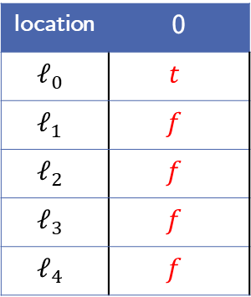
Example:
location | 0
$$ℓ_{0}$$ | $$t$$
$$ℓ_{1}$$ | $$f$$
$$ℓ_{2}$$ | $$f$$
$$ℓ_{3}$$ | $$f$$
$$ℓ_{4}$$ | $$f$$
$$ℓ_{0}$$
$$p ≠0$$
$$ℓ_{1}$$
$$n<0$$
$$ℓ_{5}$$
$$n≥0$$
2. Step: Global Initialization
$F_{0, ℓ}=\left\{\begin{matrix}\text{true}, & ℓ= ℓ_{0} \\ \text{false}, & otherwise\end{matrix}\right.$
$n^{′}=n−1$
$$ℓ_{2}$$
$$p=0$$
$$ℓ_{E}$$
$$n≠0$$
$$n=0$$
$$ℓ_{3}$$
$$ℓ_{4}$$
$$p^{′}=0$$

Slide 17
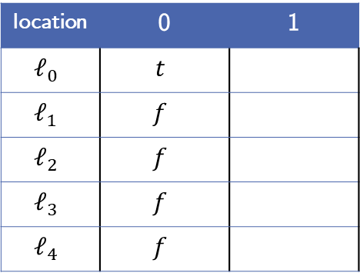
Example:
location | 0 | 1
$$ℓ_{0}$$ | $$t$$
$$ℓ_{1}$$ | $$f$$
$$ℓ_{2}$$ | $$f$$
$$ℓ_{3}$$ | $$f$$
$$ℓ_{4}$$ | $$f$$
$$ℓ_{0}$$
$$p ≠0$$
$$ℓ_{1}$$
$$n<0$$
$$ℓ_{5}$$
$$n≥0$$
3. Step: Iteration 1 Initialization
Initialize iteration 1 frames as true
$n^{′}=n−1$
$$ℓ_{2}$$
$$p=0$$
$$ℓ_{E}$$
$$n≠0$$
$$n=0$$
$$ℓ_{3}$$
$$ℓ_{4}$$
$$p^{′}=0$$

Slide 18
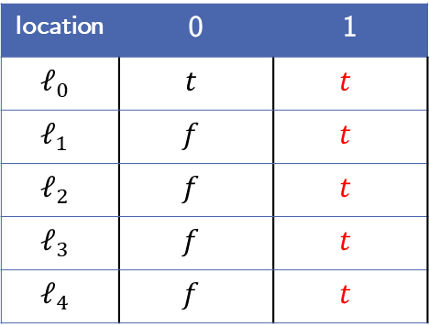
Example:
location | 0 | 1
$$ℓ_{0}$$ | $$t$$ | $$t$$
$$ℓ_{1}$$ | $$f$$ | $$t$$
$$ℓ_{2}$$ | $$f$$ | $$t$$
$$ℓ_{3}$$ | $$f$$ | $$t$$
$$ℓ_{4}$$ | $$f$$ | $$t$$
$$ℓ_{0}$$
$$p ≠0$$
$$ℓ_{1}$$
$$n<0$$
$$ℓ_{5}$$
$$n≥0$$
3. Step: Iteration 1 Initialization
Initialize iteration 1 frames as true
$n^{′}=n−1$
$$ℓ_{2}$$
$$p=0$$
$$ℓ_{E}$$
$$n≠0$$
$$n=0$$
$$ℓ_{3}$$
$$ℓ_{4}$$
$$p^{′}=0$$

Slide 19





Example:
location | 0 | 1
$$ℓ_{0}$$ | $$t$$ | $$t$$
$$ℓ_{1}$$ | $$f$$ | $$t$$
$$ℓ_{2}$$ | $$f$$ | $$t$$
$$ℓ_{3}$$ | $$f$$ | $$t$$
$$ℓ_{4}$$ | $$f$$ | $$t$$
$$ℓ_{0}$$
$$p ≠0$$
$$ℓ_{1}$$
$$n<0$$
$$ℓ_{5}$$
$$n≥0$$
3. Step: Iteration 1 Initialization
Get initial proof-obligation:
➔ $(p=0,ℓ_{2}, 1)$
Proof-Obligations:
$(p=0,ℓ_{2}, 1)$
$n^{′}=n−1$
$$ℓ_{2}$$
$$p=0$$
$$ℓ_{E}$$
$$n≠0$$
$$n=0$$
$$ℓ_{3}$$
$$ℓ_{4}$$
$$p^{′}=0$$

Slide 20
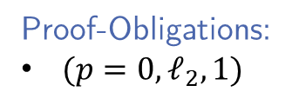
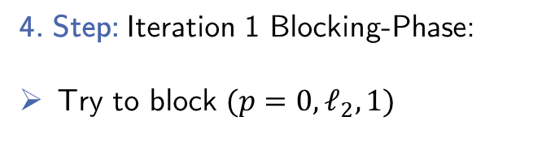
Example:
location | 0 | 1
$$ℓ_{0}$$ | $$t$$ | $$t$$
$$ℓ_{1}$$ | $$f$$ | $$t$$
$$ℓ_{2}$$ | $$f$$ | $$t$$
$$ℓ_{3}$$ | $$f$$ | $$t$$
$$ℓ_{4}$$ | $$f$$ | $$t$$
$$ℓ_{0}$$
$$p ≠0$$
$$ℓ_{1}$$
$$n<0$$
$$ℓ_{5}$$
$$n≥0$$
4. Step: Iteration 1 Blocking-Phase:
Try to block $(p=0,ℓ_{2}, 1)$
Proof-Obligations:
$(p=0,ℓ_{2}, 1)$
$n^{′}=n−1$
$$ℓ_{2}$$
$$p=0$$
$$ℓ_{E}$$
$$n≠0$$
$$n=0$$
$$ℓ_{3}$$
$$ℓ_{4}$$
$$p^{′}=0$$

Slide 21


Example:
location | 0 | 1
$$ℓ_{0}$$ | $$t$$ | $$t$$
$$ℓ_{1}$$ | $$f$$ | $$t$$
$$ℓ_{2}$$ | $$f$$ | $$t$$
$$ℓ_{3}$$ | $$f$$ | $$t$$
$$ℓ_{4}$$ | $$f$$ | $$t$$
$$ℓ_{0}$$
$$p ≠0$$
$$ℓ_{1}$$
$$n<0$$
$$ℓ_{5}$$
$$n≥0$$
4. Step: Iteration 1 Blocking-Phase:
Try to block $(p=0,ℓ_{2}, 1)$
Predecessor $ℓ_{1}$:
$$F_{0,ℓ_{1}} ∧ T_{ℓ_{1} →ℓ_{2}} ∧obligation′$$
Proof-Obligations:
$(p=0,ℓ_{2}, 1)$
$n^{′}=n−1$
$$ℓ_{2}$$
$$p=0$$
$$ℓ_{E}$$
$$n≠0$$
$$n=0$$
$$ℓ_{3}$$
$$ℓ_{4}$$
$$p^{′}=0$$

Slide 22
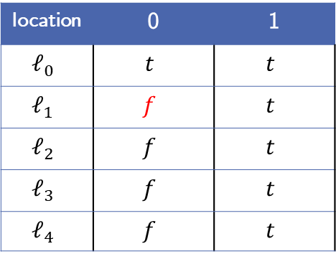


Example:
location | 0 | 1
$$ℓ_{0}$$ | $$t$$ | $$t$$
$$ℓ_{1}$$ | $$f$$ | $$t$$
$$ℓ_{2}$$ | $$f$$ | $$t$$
$$ℓ_{3}$$ | $$f$$ | $$t$$
$$ℓ_{4}$$ | $$f$$ | $$t$$
$$ℓ_{0}$$
$$p ≠0$$
$$ℓ_{1}$$
$$n<0$$
$$ℓ_{5}$$
$$n≥0$$
4. Step: Iteration 1 Blocking-Phase:
Try to block $(p=0,ℓ_{2}, 1)$
Predecessor $ℓ_{1}$:
$$f_{ } ∧ n≥0 ∧ p^{′}=0$$
Proof-Obligations:
$(p=0,ℓ_{2}, 1)$
$n^{′}=n−1$
$$ℓ_{2}$$
$$p=0$$
$$ℓ_{E}$$
$$n≠0$$
$$n=0$$
$$ℓ_{3}$$
$$ℓ_{4}$$
$$p^{′}=0$$

Slide 23
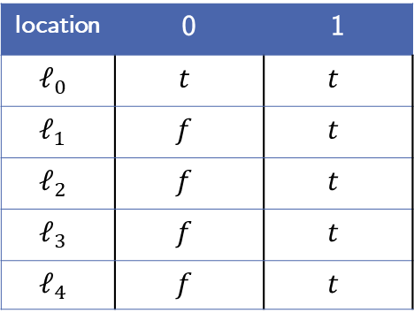
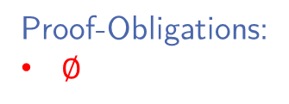
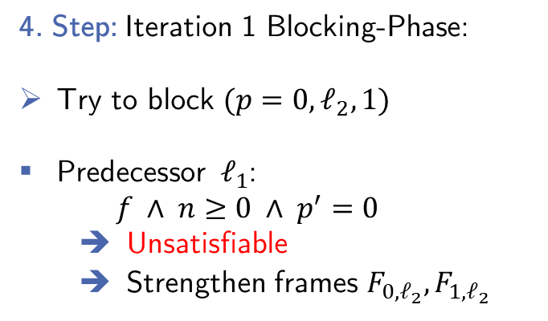
Example:
location | 0 | 1
$$ℓ_{0}$$ | $$t$$ | $$t$$
$$ℓ_{1}$$ | $$f$$ | $$t$$
$$ℓ_{2}$$ | $$f$$ | $$t$$
$$ℓ_{3}$$ | $$f$$ | $$t$$
$$ℓ_{4}$$ | $$f$$ | $$t$$
$$ℓ_{0}$$
$$p ≠0$$
$$ℓ_{1}$$
$$n<0$$
$$ℓ_{5}$$
$$n≥0$$
4. Step: Iteration 1 Blocking-Phase:
Try to block $(p=0,ℓ_{2}, 1)$
Predecessor $ℓ_{1}$:
$$f_{ } ∧ n≥0 ∧ p^{′}=0$$
Unsatisfiable
Strengthen frames $F_{0,ℓ_{2}},F_{1,ℓ_{2}}$
Proof-Obligations:
$∅$
$n^{′}=n−1$
$$ℓ_{2}$$
$$p=0$$
$$ℓ_{E}$$
$$n≠0$$
$$n=0$$
$$ℓ_{3}$$
$$ℓ_{4}$$
$$p^{′}=0$$

Slide 24
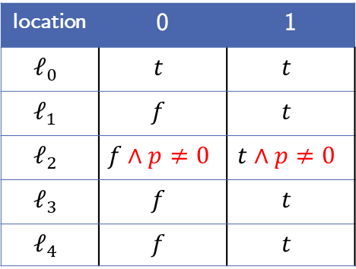
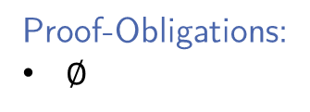
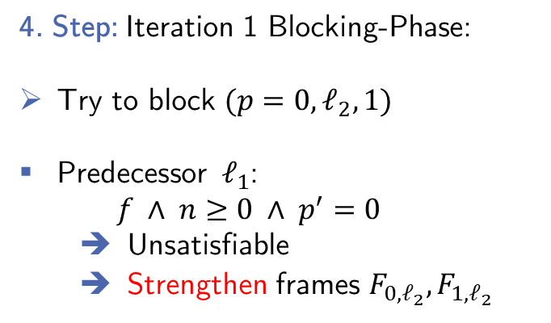
Example:
location | 0 | 1
$$ℓ_{0}$$ | $$t$$ | $$t$$
$$ℓ_{1}$$ | $$f$$ | $$t$$
$$ℓ_{2}$$ | $$f∧p≠0$$ | $$t∧p≠0$$
$$ℓ_{3}$$ | $$f$$ | $$t$$
$$ℓ_{4}$$ | $$f$$ | $$t$$
$$ℓ_{0}$$
$$p ≠0$$
$$ℓ_{1}$$
$$n<0$$
$$ℓ_{5}$$
$$n≥0$$
4. Step: Iteration 1 Blocking-Phase:
Try to block $(p=0,ℓ_{2}, 1)$
Predecessor $ℓ_{1}$:
$$f_{ } ∧ n≥0 ∧ p^{′}=0$$
Unsatisfiable
Strengthen frames $F_{0,ℓ_{2}},F_{1,ℓ_{2}}$
Proof-Obligations:
$∅$
$n^{′}=n−1$
$$ℓ_{2}$$
$$p=0$$
$$ℓ_{E}$$
$$n≠0$$
$$n=0$$
$$ℓ_{3}$$
$$ℓ_{4}$$
$$p^{′}=0$$

Slide 25
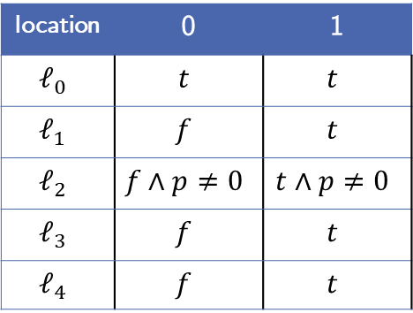
Example:
location | 0 | 1
$$ℓ_{0}$$ | $$t$$ | $$t$$
$$ℓ_{1}$$ | $$f$$ | $$t$$
$$ℓ_{2}$$ | $$f∧p≠0$$ | $$t∧p≠0$$
$$ℓ_{3}$$ | $$f$$ | $$t$$
$$ℓ_{4}$$ | $$f$$ | $$t$$
$$ℓ_{0}$$
$$p ≠0$$
$$ℓ_{1}$$
$$n<0$$
$$ℓ_{5}$$
$$n≥0$$
5. Step: Iteration 1 Propagation-Phase
Is there a global fixpoint?
Proof-Obligations:
$∅$
$n^{′}=n−1$
$$ℓ_{2}$$
$$p=0$$
$$ℓ_{E}$$
$$n≠0$$
$$n=0$$
$$ℓ_{3}$$
$$ℓ_{4}$$
$$p^{′}=0$$

Slide 26

Example:
location | 0 | 1
$$ℓ_{0}$$ | $$t$$ | $$t$$
$$ℓ_{1}$$ | $$f$$ | $$t$$
$$ℓ_{2}$$ | $$f∧p≠0$$ | $$t∧p≠0$$
$$ℓ_{3}$$ | $$f$$ | $$t$$
$$ℓ_{4}$$ | $$f$$ | $$t$$
$$ℓ_{0}$$
$$p ≠0$$
$$ℓ_{1}$$
$$n<0$$
$$ℓ_{5}$$
$$n≥0$$
5. Step: Iteration 1 Propagation-Phase
Is there an $i$ where
$F_{i−1, ℓ}=F_{i, ℓ}$ for$ℓ∈L∖\{ℓ_{E}\}$ ?
Proof-Obligations:
$∅$
$n^{′}=n−1$
$$ℓ_{2}$$
$$p=0$$
$$ℓ_{E}$$
$$n≠0$$
$$n=0$$
$$ℓ_{3}$$
$$ℓ_{4}$$
$$p^{′}=0$$

Slide 27
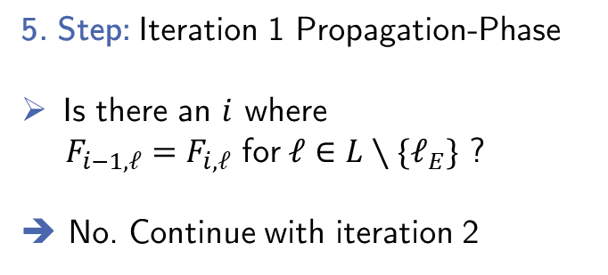
Example:
location | 0 | 1
$$ℓ_{0}$$ | $$t$$ | $$t$$
$$ℓ_{1}$$ | $$f$$ | $$t$$
$$ℓ_{2}$$ | $$f∧p≠0$$ | $$t∧p≠0$$
$$ℓ_{3}$$ | $$f$$ | $$t$$
$$ℓ_{4}$$ | $$f$$ | $$t$$
$$ℓ_{0}$$
$$p ≠0$$
$$ℓ_{1}$$
$$n<0$$
$$ℓ_{5}$$
$$n≥0$$
5. Step: Iteration 1 Propagation-Phase
Is there an $i$ where
$F_{i−1, ℓ}=F_{i, ℓ}$ for$ℓ∈L∖\{ℓ_{E}\}$ ?
➔ No. Continue with iteration 2
Proof-Obligations:
$∅$
$n^{′}=n−1$
$$ℓ_{2}$$
$$p=0$$
$$ℓ_{E}$$
$$n≠0$$
$$n=0$$
$$ℓ_{3}$$
$$ℓ_{4}$$
$$p^{′}=0$$

Slide 28

Example:
location | 0 | 1
$$ℓ_{0}$$ | $$t$$ | $$t$$
$$ℓ_{1}$$ | $$f$$ | $$t$$
$$ℓ_{2}$$ | $$f∧p≠0$$ | $$t∧p≠0$$
$$ℓ_{3}$$ | $$f$$ | $$t$$
$$ℓ_{4}$$ | $$f$$ | $$t$$
$$ℓ_{0}$$
$$p ≠0$$
$$ℓ_{1}$$
$$n<0$$
$$ℓ_{5}$$
$$n≥0$$
6. Step: Iteration 2 Initialization
Initialize new frames
Add initial proof-obligation
$(p=0,ℓ_{2}, 2)$
Proof-Obligations:
$∅$
$n^{′}=n−1$
$$ℓ_{2}$$
$$p=0$$
$$ℓ_{E}$$
$$n≠0$$
$$n=0$$
$$ℓ_{3}$$
$$ℓ_{4}$$
$$p^{′}=0$$

Slide 29
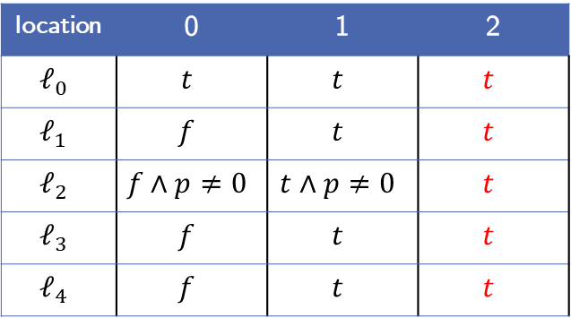

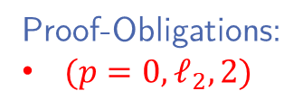
Example:
location | 0 | 1 | 2
$$ℓ_{0}$$ | $$t$$ | $$t$$ | $$t$$
$$ℓ_{1}$$ | $$f$$ | $$t$$ | $$t$$
$$ℓ_{2}$$ | $$f∧p≠0$$ | $$t∧p≠0$$ | $$t$$
$$ℓ_{3}$$ | $$f$$ | $$t$$ | $$t$$
$$ℓ_{4}$$ | $$f$$ | $$t$$ | $$t$$
$$ℓ_{0}$$
$$p ≠0$$
$$ℓ_{1}$$
$$n<0$$
$$ℓ_{5}$$
$$n≥0$$
6. Step: Iteration 2 Initialization
Initialize new frames
Add initial proof-obligation
$(p=0,ℓ_{2}, 2)$
Proof-Obligations:
$(p=0,ℓ_{2}, 2)$
$n^{′}=n−1$
$$ℓ_{2}$$
$$p=0$$
$$ℓ_{E}$$
$$n≠0$$
$$n=0$$
$$ℓ_{3}$$
$$ℓ_{4}$$
$$p^{′}=0$$

Slide 30
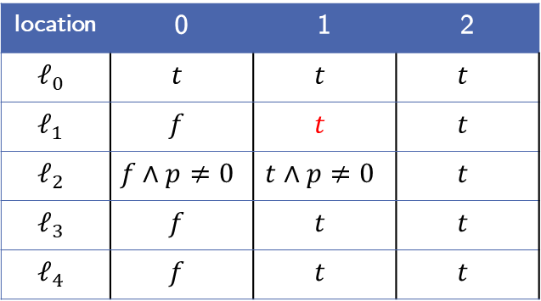

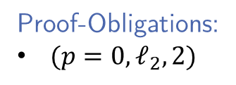
Example:
location | 0 | 1 | 2
$$ℓ_{0}$$ | $$t$$ | $$t$$ | $$t$$
$$ℓ_{1}$$ | $$f$$ | $$t$$ | $$t$$
$$ℓ_{2}$$ | $$f∧p≠0$$ | $$t∧p≠0$$ | $$t$$
$$ℓ_{3}$$ | $$f$$ | $$t$$ | $$t$$
$$ℓ_{4}$$ | $$f$$ | $$t$$ | $$t$$
$$ℓ_{0}$$
$$p ≠0$$
$$ℓ_{1}$$
$$n<0$$
$$ℓ_{5}$$
$$n≥0$$
7. Step: Iteration 2 Blocking-Phase:
Try to block $(p=0,ℓ_{2}, 2)$
Predecessor $ℓ_{1}$:
$$t ∧ n≥0 ∧ p^{′}=0$$
Proof-Obligations:
$(p=0,ℓ_{2}, 2)$
$n^{′}=n−1$
$$ℓ_{2}$$
$$p=0$$
$$ℓ_{E}$$
$$n≠0$$
$$n=0$$
$$ℓ_{3}$$
$$ℓ_{4}$$
$$p^{′}=0$$

Slide 31
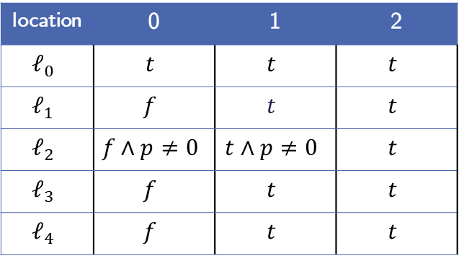
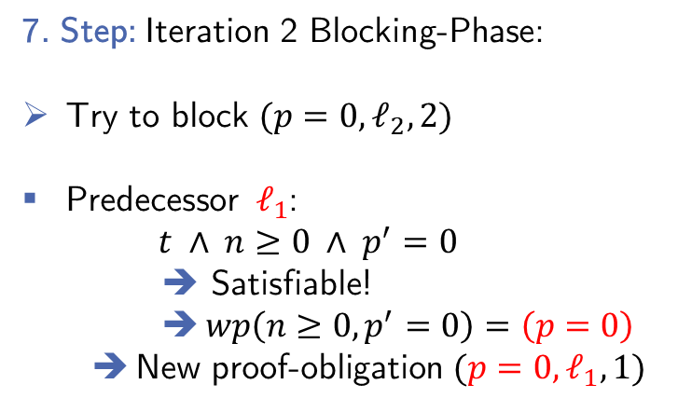
Example:
location | 0 | 1 | 2
$$ℓ_{0}$$ | $$t$$ | $$t$$ | $$t$$
$$ℓ_{1}$$ | $$f$$ | $$t$$ | $$t$$
$$ℓ_{2}$$ | $$f∧p≠0$$ | $$t∧p≠0$$ | $$t$$
$$ℓ_{3}$$ | $$f$$ | $$t$$ | $$t$$
$$ℓ_{4}$$ | $$f$$ | $$t$$ | $$t$$
$$ℓ_{0}$$
$$p ≠0$$
$$ℓ_{1}$$
$$n<0$$
$$ℓ_{5}$$
$$n≥0$$
7. Step: Iteration 2 Blocking-Phase:
Try to block $(p=0,ℓ_{2}, 2)$
Predecessor $ℓ_{1}$:
$$t ∧ n≥0 ∧ p^{′}=0$$
➔ Satisfiable!
$wp\left(n≥0, p^{′}=0\right)=\left(p=0\right)$
New proof-obligation $(p=0,ℓ_{1},1)$
Proof-Obligations:
$(p=0,ℓ_{2}, 2)$
$n^{′}=n−1$
$$ℓ_{2}$$
$$p=0$$
$$ℓ_{E}$$
$$n≠0$$
$$n=0$$
$$ℓ_{3}$$
$$ℓ_{4}$$
$$p^{′}=0$$

Slide 32
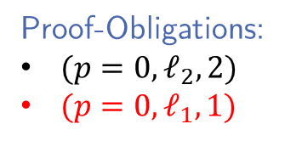
Example:
location | 0 | 1 | 2
$$ℓ_{0}$$ | $$t$$ | $$t$$ | $$t$$
$$ℓ_{1}$$ | $$f$$ | $$t$$ | $$t$$
$$ℓ_{2}$$ | $$f∧p≠0$$ | $$t∧p≠0$$ | $$t$$
$$ℓ_{3}$$ | $$f$$ | $$t$$ | $$t$$
$$ℓ_{4}$$ | $$f$$ | $$t$$ | $$t$$
$$ℓ_{0}$$
$$p ≠0$$
$$ℓ_{1}$$
$$n<0$$
$$ℓ_{5}$$
$$n≥0$$
7. Step: Iteration 2 Blocking-Phase:
Try to block $(p=0,ℓ_{2}, 2)$
Predecessor $ℓ_{1}$:
$$t ∧ n≥0 ∧ p^{′}=0$$
➔ Satisfiable!
$wp\left(n≥0, p^{′}=0\right)=\left(p=0\right)$
New proof-obligation $(p=0,ℓ_{1},1)$
Proof-Obligations:
$(p=0,ℓ_{2}, 2)$
$(p=0,ℓ_{1},1)$
$n^{′}=n−1$
$$ℓ_{2}$$
$$p=0$$
$$ℓ_{E}$$
$$n≠0$$
$$n=0$$
$$ℓ_{3}$$
$$ℓ_{4}$$
$$p^{′}=0$$

Slide 33

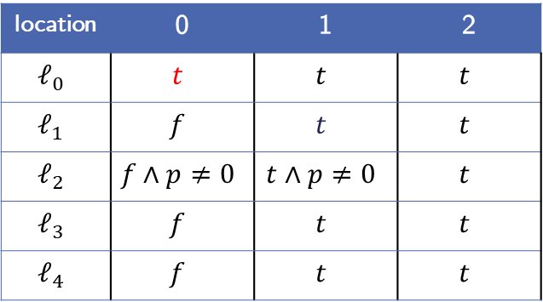

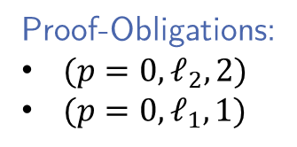
Example:
location | 0 | 1 | 2
$$ℓ_{0}$$ | $$t$$ | $$t$$ | $$t$$
$$ℓ_{1}$$ | $$f$$ | $$t$$ | $$t$$
$$ℓ_{2}$$ | $$f∧p≠0$$ | $$t∧p≠0$$ | $$t$$
$$ℓ_{3}$$ | $$f$$ | $$t$$ | $$t$$
$$ℓ_{4}$$ | $$f$$ | $$t$$ | $$t$$
$$ℓ_{0}$$
$$p ≠0$$
$$ℓ_{1}$$
$$n<0$$
$$ℓ_{5}$$
$$n≥0$$
7. Step: Iteration 2 Blocking-Phase:
Try to block $(p=0,ℓ_{1},1)$
Predecessor $ℓ_{0}$:
$$t ∧p ≠0 ∧ p^{′}=0$$
Proof-Obligations:
$(p=0,ℓ_{2}, 2)$
$(p=0,ℓ_{1},1)$
$n^{′}=n−1$
$$ℓ_{2}$$
$$p=0$$
$$ℓ_{E}$$
$$n≠0$$
$$n=0$$
$$ℓ_{3}$$
$$ℓ_{4}$$
$$p^{′}=0$$

Slide 34
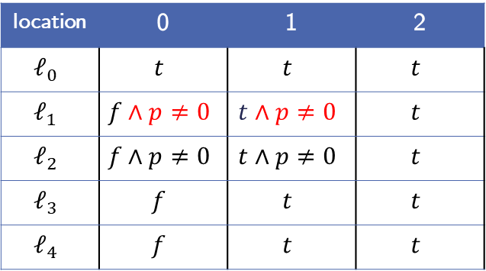

Example:
location | 0 | 1 | 2
$$ℓ_{0}$$ | $$t$$ | $$t$$ | $$t$$
$$ℓ_{1}$$ | $$f∧p≠0$$ | $$t∧p≠0$$ | $$t$$
$$ℓ_{2}$$ | $$f∧p≠0$$ | $$t∧p≠0$$ | $$t$$
$$ℓ_{3}$$ | $$f$$ | $$t$$ | $$t$$
$$ℓ_{4}$$ | $$f$$ | $$t$$ | $$t$$
$$ℓ_{0}$$
$$p ≠0$$
$$ℓ_{1}$$
$$n<0$$
$$ℓ_{5}$$
$$n≥0$$
7. Step: Iteration 2 Blocking-Phase:
Try to block $(p=0,ℓ_{1},1)$
Predecessor $ℓ_{0}$:
$$t ∧p ≠0 ∧ p^{′}=0$$
Unsatisfiable!
Strengthen frames $F_{0,ℓ_{1}},F_{1,ℓ_{1}}$
Proof-Obligations:
$(p=0,ℓ_{2}, 2)$
$(p=0,ℓ_{1},1)$
$n^{′}=n−1$
$$ℓ_{2}$$
$$p=0$$
$$ℓ_{E}$$
$$n≠0$$
$$n=0$$
$$ℓ_{3}$$
$$ℓ_{4}$$
$$p^{′}=0$$

Slide 35
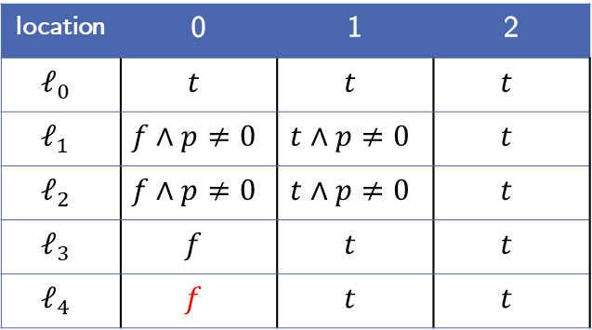



Example:
location | 0 | 1 | 2
$$ℓ_{0}$$ | $$t$$ | $$t$$ | $$t$$
$$ℓ_{1}$$ | $$f∧p≠0$$ | $$t∧p≠0$$ | $$t$$
$$ℓ_{2}$$ | $$f∧p≠0$$ | $$t∧p≠0$$ | $$t$$
$$ℓ_{3}$$ | $$f$$ | $$t$$ | $$t$$
$$ℓ_{4}$$ | $$f$$ | $$t$$ | $$t$$
$$ℓ_{0}$$
$$p ≠0$$
$$ℓ_{1}$$
$$n<0$$
$$ℓ_{5}$$
$$n≥0$$
7. Step: Iteration 2 Blocking-Phase:
Try to block $(p=0,ℓ_{1},1)$
Predecessor $ℓ_{4}$:
$$f∧n^{′}=n−1∧ p^{′}=0$$
Proof-Obligations:
$(p=0,ℓ_{2}, 2)$
$(p=0,ℓ_{1},1)$
$n^{′}=n−1$
$$ℓ_{2}$$
$$p=0$$
$$ℓ_{E}$$
$$n≠0$$
$$n=0$$
$$ℓ_{3}$$
$$ℓ_{4}$$
$$p^{′}=0$$

Slide 36
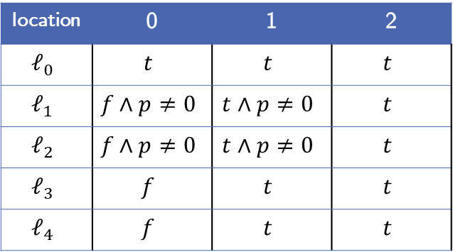

Example:
location | 0 | 1 | 2
$$ℓ_{0}$$ | $$t$$ | $$t$$ | $$t$$
$$ℓ_{1}$$ | $$f∧p≠0$$ | $$t∧p≠0$$ | $$t$$
$$ℓ_{2}$$ | $$f∧p≠0$$ | $$t∧p≠0$$ | $$t$$
$$ℓ_{3}$$ | $$f$$ | $$t$$ | $$t$$
$$ℓ_{4}$$ | $$f$$ | $$t$$ | $$t$$
$$ℓ_{0}$$
$$p ≠0$$
$$ℓ_{1}$$
$$n<0$$
$$ℓ_{5}$$
$$n≥0$$
7. Step: Iteration 2 Blocking-Phase:
Try to block $(p=0,ℓ_{1},1)$
Predecessor $ℓ_{4}$:
$$f∧n^{′}=n−1∧ p^{′}=0$$
➔ Unsatisfiable!
Proof-Obligations:
$(p=0,ℓ_{2}, 2)$
$(p=0,ℓ_{1},1)$
$n^{′}=n−1$
$$ℓ_{2}$$
$$p=0$$
$$ℓ_{E}$$
$$n≠0$$
$$n=0$$
$$ℓ_{3}$$
$$ℓ_{4}$$
$$p^{′}=0$$

Slide 37
Example:
location | 0 | 1 | 2
$$ℓ_{0}$$ | $$t$$ | $$t$$ | $$t$$
$$ℓ_{1}$$ | $$f∧p≠0$$ | $$t∧p≠0$$ | $$t$$
$$ℓ_{2}$$ | $$f∧p≠0$$ | $$t∧p≠0$$ | $$t$$
$$ℓ_{3}$$ | $$f$$ | $$t$$ | $$t$$
$$ℓ_{4}$$ | $$f$$ | $$t$$ | $$t$$
$$ℓ_{0}$$
$$p ≠0$$
$$ℓ_{1}$$
$$n<0$$
$$ℓ_{5}$$
$$n≥0$$
7. Step: Iteration 2 Blocking-Phase:
Try to block $(p=0,ℓ_{1},1)$
Predecessor $ℓ_{4}$:
$$f∧n^{′}=n−1∧ p^{′}=0$$
➔ Unsatisfiable!
Proof-Obligations:
$(p=0,ℓ_{2}, 2)$
$n^{′}=n−1$
$$ℓ_{2}$$
$$p=0$$
$$ℓ_{E}$$
$$n≠0$$
$$n=0$$
$$ℓ_{3}$$
$$ℓ_{4}$$
$$p^{′}=0$$

Slide 38
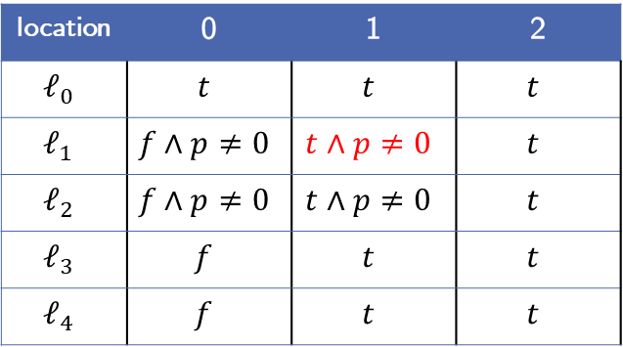

Example:
location | 0 | 1 | 2
$$ℓ_{0}$$ | $$t$$ | $$t$$ | $$t$$
$$ℓ_{1}$$ | $$f∧p≠0$$ | $$t∧p≠0$$ | $$t$$
$$ℓ_{2}$$ | $$f∧p≠0$$ | $$t∧p≠0$$ | $$t$$
$$ℓ_{3}$$ | $$f$$ | $$t$$ | $$t$$
$$ℓ_{4}$$ | $$f$$ | $$t$$ | $$t$$
$$ℓ_{0}$$
$$p ≠0$$
$$ℓ_{1}$$
$$n<0$$
$$ℓ_{5}$$
$$n≥0$$
7. Step: Iteration 2 Blocking-Phase:
Try to block $(p=0,ℓ_{2}, 2)$ again
Predecessor $ℓ_{1}$:
$$t∧p≠0∧n≥0∧ p^{′}=0$$
Proof-Obligations:
$(p=0,ℓ_{2}, 2)$
$n^{′}=n−1$
$$ℓ_{2}$$
$$p=0$$
$$ℓ_{E}$$
$$n≠0$$
$$n=0$$
$$ℓ_{3}$$
$$ℓ_{4}$$
$$p^{′}=0$$

Slide 39
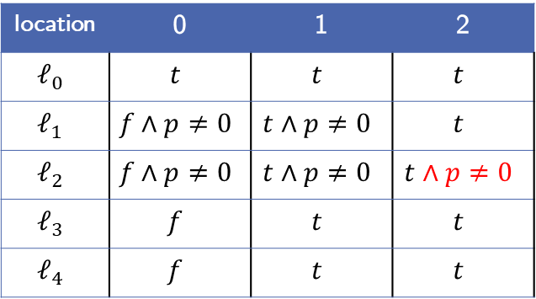

Example:
location | 0 | 1 | 2
$$ℓ_{0}$$ | $$t$$ | $$t$$ | $$t$$
$$ℓ_{1}$$ | $$f∧p≠0$$ | $$t∧p≠0$$ | $$t$$
$$ℓ_{2}$$ | $$f∧p≠0$$ | $$t∧p≠0$$ | $$t∧p≠0$$
$$ℓ_{3}$$ | $$f$$ | $$t$$ | $$t$$
$$ℓ_{4}$$ | $$f$$ | $$t$$ | $$t$$
$$ℓ_{0}$$
$$p ≠0$$
$$ℓ_{1}$$
$$n<0$$
$$ℓ_{5}$$
$$n≥0$$
7. Step: Iteration 2 Blocking-Phase:
Try to block $(p=0,ℓ_{2}, 2)$ again
Predecessor $ℓ_{1}$:
$$t∧p≠0∧n≥0∧ p^{′}=0$$
Unsatisfiable!
Strengthen frames $F_{2,ℓ_{2}}$
Proof-Obligations:
$∅$
$n^{′}=n−1$
$$ℓ_{2}$$
$$p=0$$
$$ℓ_{E}$$
$$n≠0$$
$$n=0$$
$$ℓ_{3}$$
$$ℓ_{4}$$
$$p^{′}=0$$

Slide 40
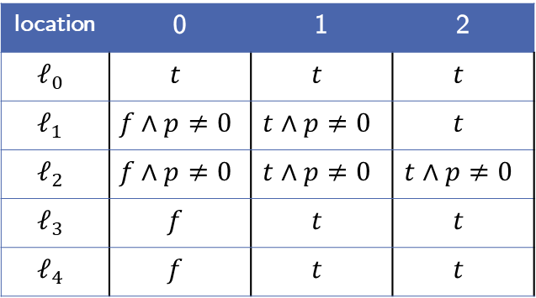
Example:
location | 0 | 1 | 2
$$ℓ_{0}$$ | $$t$$ | $$t$$ | $$t$$
$$ℓ_{1}$$ | $$f∧p≠0$$ | $$t∧p≠0$$ | $$t$$
$$ℓ_{2}$$ | $$f∧p≠0$$ | $$t∧p≠0$$ | $$t∧p≠0$$
$$ℓ_{3}$$ | $$f$$ | $$t$$ | $$t$$
$$ℓ_{4}$$ | $$f$$ | $$t$$ | $$t$$
$$ℓ_{0}$$
$$p ≠0$$
$$ℓ_{1}$$
$$n<0$$
$$ℓ_{5}$$
$$n≥0$$
8. Step: Iteration 2 Propagation-Phase:
Is there a global fixpoint?
➔ No. Continue with Iteration 3
Proof-Obligations:
$∅$
$n^{′}=n−1$
$$ℓ_{2}$$
$$p=0$$
$$ℓ_{E}$$
$$n≠0$$
$$n=0$$
$$ℓ_{3}$$
$$ℓ_{4}$$
$$p^{′}=0$$

Slide 41
Example:
location | 0 | 1 | 2
$$ℓ_{0}$$ | $$t$$ | $$t$$ | $$t$$
$$ℓ_{1}$$ | $$f∧p≠0$$ | $$t∧p≠0$$ | $$t$$
$$ℓ_{2}$$ | $$f∧p≠0$$ | $$t∧p≠0$$ | $$t∧p≠0$$
$$ℓ_{3}$$ | $$f$$ | $$t$$ | $$t$$
$$ℓ_{4}$$ | $$f$$ | $$t$$ | $$t$$
$$ℓ_{0}$$
$$p ≠0$$
$$ℓ_{1}$$
$$n<0$$
$$ℓ_{5}$$
$$n≥0$$
9. Step: Iteration 3 Initialization
Initialize new frames
Get initial proof-obligations
Proof-Obligations:
$∅$
$n^{′}=n−1$
$$ℓ_{2}$$
$$p=0$$
$$ℓ_{E}$$
$$n≠0$$
$$n=0$$
$$ℓ_{3}$$
$$ℓ_{4}$$
$$p^{′}=0$$

Slide 42
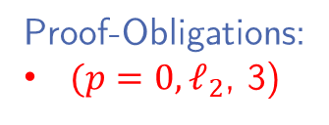
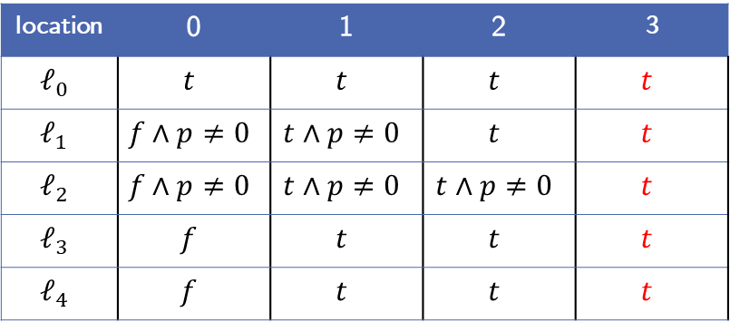
Example:
location | 0 | 1 | 2 | 3
$$ℓ_{0}$$ | $$t$$ | $$t$$ | $$t$$ | $$t$$
$$ℓ_{1}$$ | $$f∧p≠0$$ | $$t∧p≠0$$ | $$t$$ | $$t$$
$$ℓ_{2}$$ | $$f∧p≠0$$ | $$t∧p≠0$$ | $$t∧p≠0$$ | $$t$$
$$ℓ_{3}$$ | $$f$$ | $$t$$ | $$t$$ | $$t$$
$$ℓ_{4}$$ | $$f$$ | $$t$$ | $$t$$ | $$t$$
$$ℓ_{0}$$
$$p ≠0$$
$$ℓ_{1}$$
$$n<0$$
$$ℓ_{5}$$
$$n≥0$$
9. Step: Iteration 3 Initialization
Initialize new frames
Get initial proof-obligations
Proof-Obligations:
$(p=0, ℓ_{2}$, 3)
$n^{′}=n−1$
$$ℓ_{2}$$
$$p=0$$
$$ℓ_{E}$$
$$n≠0$$
$$n=0$$
$$ℓ_{3}$$
$$ℓ_{4}$$
$$p^{′}=0$$

Slide 43



Example:
location | 0 | 1 | 2 | 3
$$ℓ_{0}$$ | $$t$$ | $$t$$ | $$t$$ | $$t$$
$$ℓ_{1}$$ | $$f∧p≠0$$ | $$t∧p≠0$$ | $$t$$ | $$t$$
$$ℓ_{2}$$ | $$f∧p≠0$$ | $$t∧p≠0$$ | $$t∧p≠0$$ | $$t$$
$$ℓ_{3}$$ | $$f$$ | $$t$$ | $$t$$ | $$t$$
$$ℓ_{4}$$ | $$f$$ | $$t$$ | $$t$$ | $$t$$
$$ℓ_{0}$$
$$p ≠0$$
$$ℓ_{1}$$
$$n<0$$
$$ℓ_{5}$$
$$n≥0$$
10. Step: Iteration 3 Blocking-Phase
Try to block $(p=0, ℓ_{2}$, 3)
Predecessor $ℓ_{1}$:
$$t∧n≥0∧ p^{′}=0$$
Like the Iteration before this is satisfiable
Proof-Obligations:
$(p=0, ℓ_{2}$, 3)
$n^{′}=n−1$
$$ℓ_{2}$$
$$p=0$$
$$ℓ_{E}$$
$$n≠0$$
$$n=0$$
$$ℓ_{3}$$
$$ℓ_{4}$$
$$p^{′}=0$$

Slide 44


Example:
location | 0 | 1 | 2 | 3
$$ℓ_{0}$$ | $$t$$ | $$t$$ | $$t$$ | $$t$$
$$ℓ_{1}$$ | $$f∧p≠0$$ | $$t∧p≠0$$ | $$t$$ | $$t$$
$$ℓ_{2}$$ | $$f∧p≠0$$ | $$t∧p≠0$$ | $$t∧p≠0$$ | $$t$$
$$ℓ_{3}$$ | $$f$$ | $$t$$ | $$t$$ | $$t$$
$$ℓ_{4}$$ | $$f$$ | $$t$$ | $$t$$ | $$t$$
$$ℓ_{0}$$
$$p ≠0$$
$$ℓ_{1}$$
$$n<0$$
$$ℓ_{5}$$
$$n≥0$$
10. Step: Iteration 3 Blocking-Phase
Try to block $(p=0, ℓ_{2}$, 3)
Predecessor $ℓ_{1}$:
$$t∧n≥0∧ p^{′}=0$$
Get same proof-obligation as before but on Iteration 2
$(p=0,ℓ_{1},2)$
Proof-Obligations:
$(p=0, ℓ_{2}, 3)$
$n^{′}=n−1$
$$ℓ_{2}$$
$$p=0$$
$$ℓ_{E}$$
$$n≠0$$
$$n=0$$
$$ℓ_{3}$$
$$ℓ_{4}$$
$$p^{′}=0$$

Slide 45


Example:
location | 0 | 1 | 2 | 3
$$ℓ_{0}$$ | $$t$$ | $$t$$ | $$t$$ | $$t$$
$$ℓ_{1}$$ | $$f∧p≠0$$ | $$t∧p≠0$$ | $$t$$ | $$t$$
$$ℓ_{2}$$ | $$f∧p≠0$$ | $$t∧p≠0$$ | $$t∧p≠0$$ | $$t$$
$$ℓ_{3}$$ | $$f$$ | $$t$$ | $$t$$ | $$t$$
$$ℓ_{4}$$ | $$f$$ | $$t$$ | $$t$$ | $$t$$
$$ℓ_{0}$$
$$p ≠0$$
$$ℓ_{1}$$
$$n<0$$
$$ℓ_{5}$$
$$n≥0$$
10. Step: Iteration 3 Blocking-Phase
Try to block $(p=0, ℓ_{2}$, 3)
Predecessor $ℓ_{1}$:
$$t∧n≥0∧ p^{′}=0$$
Get same proof-obligation as before but on Iteration 2
$(p=0,ℓ_{1},2)$
Proof-Obligations:
$(p=0, ℓ_{2}, 3)$
$(p=0,ℓ_{1},2)$
$n^{′}=n−1$
$$ℓ_{2}$$
$$p=0$$
$$ℓ_{E}$$
$$n≠0$$
$$n=0$$
$$ℓ_{3}$$
$$ℓ_{4}$$
$$p^{′}=0$$

Slide 46

Example:
location | 0 | 1 | 2 | 3
$$ℓ_{0}$$ | $$t$$ | $$t$$ | $$t$$ | $$t$$
$$ℓ_{1}$$ | $$f∧p≠0$$ | $$t∧p≠0$$ | $$t$$ | $$t$$
$$ℓ_{2}$$ | $$f∧p≠0$$ | $$t∧p≠0$$ | $$t∧p≠0$$ | $$t$$
$$ℓ_{3}$$ | $$f$$ | $$t$$ | $$t$$ | $$t$$
$$ℓ_{4}$$ | $$f$$ | $$t$$ | $$t$$ | $$t$$
$$ℓ_{0}$$
$$p ≠0$$
$$ℓ_{1}$$
$$n<0$$
$$ℓ_{5}$$
$$n≥0$$
10. Step: Iteration 3 Blocking-Phase
There are a lot of repetitions
➔ Duplicate proof-obligations
Proof-Obligations:
$(p=0, ℓ_{2}$, 3)
$(p=0, ℓ_{1}, 2)$
$n^{′}=n−1$
$$ℓ_{2}$$
$$p=0$$
$$ℓ_{E}$$
$$n≠0$$
$$n=0$$
$$ℓ_{3}$$
$$ℓ_{4}$$
$$p^{′}=0$$

Slide 47


Example:
location | 0 | 1 | 2 | 3
$$ℓ_{0}$$ | $$t$$ | $$t$$ | $$t$$ | $$t$$
$$ℓ_{1}$$ | $$f∧p≠0$$ | $$t∧p≠0$$ | $$t∧p≠0$$ | $$t$$
$$ℓ_{2}$$ | $$f∧p≠0$$ | $$t∧p≠0$$ | $$t∧p≠0$$ | $$t∧p≠0$$
$$ℓ_{3}$$ | $$f$$ | $$t$$ | $$t$$ | $$t$$
$$ℓ_{4}$$ | $$f∧p≠0$$ | $$t∧p≠0$$ | $$t$$ | $$t$$
$$ℓ_{0}$$
$$p ≠0$$
$$ℓ_{1}$$
$$n<0$$
$$ℓ_{5}$$
$$n≥0$$
10. Step: Iteration 3 Blocking-Phase
There are a lot of repetitions
➔ Duplicate proof-obligations
Proof-Obligations:
$∅$
$n^{′}=n−1$
$$ℓ_{2}$$
$$p=0$$
$$ℓ_{E}$$
$$n≠0$$
$$n=0$$
$$ℓ_{3}$$
$$ℓ_{4}$$
$$p^{′}=0$$
23.09.2018

Slide 48

Example:
location | 0 | 1 | 2 | 3
$$ℓ_{0}$$ | $$t$$ | $$t$$ | $$t$$ | $$t$$
$$ℓ_{1}$$ | $$f∧p≠0$$ | $$t∧p≠0$$ | $$t∧p≠0$$ | $$t$$
$$ℓ_{2}$$ | $$f∧p≠0$$ | $$t∧p≠0$$ | $$t∧p≠0$$ | $$t∧p≠0$$
$$ℓ_{3}$$ | $$f$$ | $$t$$ | $$t$$ | $$t$$
$$ℓ_{4}$$ | $$f∧p≠0$$ | $$t∧p≠0$$ | $$t$$ | $$t$$
$$ℓ_{0}$$
$$p ≠0$$
$$ℓ_{1}$$
$$n<0$$
$$ℓ_{5}$$
$$n≥0$$
11. Step: Iteration 3 Propagation-Phase
Is there a global fixpoint?
➔ No. Continue with Iteration 4
Proof-Obligations:
$∅$
$n^{′}=n−1$
$$ℓ_{2}$$
$$p=0$$
$$ℓ_{E}$$
$$n≠0$$
$$n=0$$
$$ℓ_{3}$$
$$ℓ_{4}$$
$$p^{′}=0$$

Slide 49

Example:
location | 0 | 1 | 2 | 3 | 4
$$ℓ_{0}$$ | $$t$$ | $$t$$ | $$t$$ | $$t$$ | $$t$$
$$ℓ_{1}$$ | $$f∧p≠0$$ | $$t∧p≠0$$ | $$t∧p≠0$$ | $$t$$ | $$t$$
$$ℓ_{2}$$ | $$f∧p≠0$$ | $$t∧p≠0$$ | $$t∧p≠0$$ | $$t∧p≠0$$ | $$t$$
$$ℓ_{3}$$ | $$f$$ | $$t$$ | $$t$$ | $$t$$ | $$t$$
$$ℓ_{4}$$ | $$f∧p≠0$$ | $$t∧p≠0$$ | $$t$$ | $$t$$ | $$t$$
$$ℓ_{0}$$
$$p ≠0$$
$$ℓ_{1}$$
$$n<0$$
$$ℓ_{5}$$
$$n≥0$$
11. Step: Iteration 4 Initialization
$n^{′}=n−1$
$$ℓ_{2}$$
$$p=0$$
$$ℓ_{E}$$
$$n≠0$$
$$n=0$$
$$ℓ_{3}$$
$$ℓ_{4}$$
$$p^{′}=0$$

Slide 50

Example:
location | 0 | 1 | 2 | 3 | 4
$$ℓ_{0}$$ | $$t$$ | $$t$$ | $$t$$ | $$t$$ | $$t$$
$$ℓ_{1}$$ | $$f∧p≠0$$ | $$t∧p≠0$$ | $$t∧p≠0$$ | $$t$$ | $$t$$
$$ℓ_{2}$$ | $$f∧p≠0$$ | $$t∧p≠0$$ | $$t∧p≠0$$ | $$t∧p≠0$$ | $$t$$
$$ℓ_{3}$$ | $$f$$ | $$t$$ | $$t$$ | $$t$$ | $$t$$
$$ℓ_{4}$$ | $$f∧p≠0$$ | $$t∧p≠0$$ | $$t$$ | $$t$$ | $$t$$
$$ℓ_{0}$$
$$p ≠0$$
$$ℓ_{1}$$
$$n<0$$
$$ℓ_{5}$$
$$n≥0$$
12. Step: Iteration 4 Blocking-Phase
$n^{′}=n−1$
$$ℓ_{2}$$
$$p=0$$
$$ℓ_{E}$$
$$n≠0$$
$$n=0$$
$$ℓ_{3}$$
$$ℓ_{4}$$
$$p^{′}=0$$

Slide 51

Example:
location | 0 | 1 | 2 | 3 | 4
$$ℓ_{0}$$ | $$t$$ | $$t$$ | $$t$$ | $$t$$ | $$t$$
$$ℓ_{1}$$ | $$f∧p≠0$$ | $$t∧p≠0$$ | $$t∧p≠0$$ | $$t∧p≠0$$ | $$t$$
$$ℓ_{2}$$ | $$f∧p≠0$$ | $$t∧p≠0$$ | $$t∧p≠0$$ | $$t∧p≠0$$ | $$t∧p≠0$$
$$ℓ_{3}$$ | $$f∧f$$ | $$t∧f$$ | $$t$$ | $$t$$ | $$t$$
$$ℓ_{4}$$ | $$f∧p≠0$$ | $$t∧p≠0$$ | $$t∧p≠0$$ | $$t$$ | $$t$$
$$ℓ_{0}$$
$$p ≠0$$
$$ℓ_{1}$$
$$n<0$$
$$ℓ_{5}$$
$$n≥0$$
12. Step: Iteration 4 Blocking-Phase
$n^{′}=n−1$
$$ℓ_{2}$$
$$p=0$$
$$ℓ_{E}$$
$$n≠0$$
$$n=0$$
$$ℓ_{3}$$
$$ℓ_{4}$$
$$p^{′}=0$$

Slide 52

Example:
location | 0 | 1 | 2 | 3 | 4
$$ℓ_{0}$$ | $$t$$ | $$t$$ | $$t$$ | $$t$$ | $$t$$
$$ℓ_{1}$$ | $$f∧p≠0$$ | $$t∧p≠0$$ | $$t∧p≠0$$ | $$t∧p≠0$$ | $$t$$
$$ℓ_{2}$$ | $$f∧p≠0$$ | $$t∧p≠0$$ | $$t∧p≠0$$ | $$t∧p≠0$$ | $$t∧p≠0$$
$$ℓ_{3}$$ | $$f∧f$$ | $$t∧f$$ | $$t$$ | $$t$$ | $$t$$
$$ℓ_{4}$$ | $$f∧p≠0$$ | $$t∧p≠0$$ | $$t∧p≠0$$ | $$t$$ | $$t$$
$$ℓ_{0}$$
$$p ≠0$$
$$ℓ_{1}$$
$$n<0$$
$$ℓ_{5}$$
$$n≥0$$
13. Step: Iteration 4 Propagation-Phase
Is there a global fixpoint?
➔ No. Continue with Iteration 5
$n^{′}=n−1$
$$ℓ_{2}$$
$$p=0$$
$$ℓ_{E}$$
$$n≠0$$
$$n=0$$
$$ℓ_{3}$$
$$ℓ_{4}$$
$$p^{′}=0$$

Slide 53

Example:
location | 0 | 1 | 2 | 3 | 4 | 5
$$ℓ_{0}$$ | $$t$$ | $$t$$ | $$t$$ | $$t$$ | $$t$$ | $$t$$
$$ℓ_{1}$$ | $$f∧p≠0$$ | $$t∧p≠0$$ | $$t∧p≠0$$ | $$t∧p≠0$$ | $$t$$ | $$t$$
$$ℓ_{2}$$ | $$f∧p≠0$$ | $$t∧p≠0$$ | $$t∧p≠0$$ | $$t∧p≠0$$ | $$t∧p≠0$$ | $$t$$
$$ℓ_{3}$$ | $$f∧f$$ | $$t∧f$$ | $$t$$ | $$t$$ | $$t$$ | $$t$$
$$ℓ_{4}$$ | $$f∧p≠0$$ | $$t∧p≠0$$ | $$t∧p≠0$$ | $$t$$ | $$t$$ | $$t$$
$$ℓ_{0}$$
$$p ≠0$$
$$ℓ_{1}$$
$$n<0$$
$$ℓ_{5}$$
$$n≥0$$
14. Step: Iteration 5 Initialization
$n^{′}=n−1$
$$ℓ_{2}$$
$$p=0$$
$$ℓ_{E}$$
$$n≠0$$
$$n=0$$
$$ℓ_{3}$$
$$ℓ_{4}$$
$$p^{′}=0$$

Slide 54

Example:
location | 0 | 1 | 2 | 3 | 4 | 5
$$ℓ_{0}$$ | $$t$$ | $$t$$ | $$t$$ | $$t$$ | $$t$$ | $$t$$
$$ℓ_{1}$$ | $$f∧p≠0$$ | $$t∧p≠0$$ | $$t∧p≠0$$ | $$t∧p≠0$$ | $$t$$ | $$t$$
$$ℓ_{2}$$ | $$f∧p≠0$$ | $$t∧p≠0$$ | $$t∧p≠0$$ | $$t∧p≠0$$ | $$t∧p≠0$$ | $$t$$
$$ℓ_{3}$$ | $$f∧f$$ | $$t∧f$$ | $$t$$ | $$t$$ | $$t$$ | $$t$$
$$ℓ_{4}$$ | $$f∧p≠0$$ | $$t∧p≠0$$ | $$t∧p≠0$$ | $$t$$ | $$t$$ | $$t$$
$$ℓ_{0}$$
$$p ≠0$$
$$ℓ_{1}$$
$$n<0$$
$$ℓ_{5}$$
$$n≥0$$
15. Step: Iteration 5 Blocking-Phase
$n^{′}=n−1$
$$ℓ_{2}$$
$$p=0$$
$$ℓ_{E}$$
$$n≠0$$
$$n=0$$
$$ℓ_{3}$$
$$ℓ_{4}$$
$$p^{′}=0$$

Slide 55

Example:
location | 0 | 1 | 2 | 3 | 4 | 5
$$ℓ_{0}$$ | $$t$$ | $$t$$ | $$t$$ | $$t$$ | $$t$$ | $$t$$
$$ℓ_{1}$$ | $$f∧p≠0$$ | $$t∧p≠0$$ | $$t∧p≠0$$ | $$t∧p≠0$$ | $$t∧p≠0$$ | $$t$$
$$ℓ_{2}$$ | $$f∧p≠0$$ | $$t∧p≠0$$ | $$t∧p≠0$$ | $$t∧p≠0$$ | $$t∧p≠0$$ | $$t∧p≠0$$
$$ℓ_{3}$$ | $$f∧f$$ | $$t∧f$$ | $$t∧f$$ | $$t$$ | $$t$$ | $$t$$
$$ℓ_{4}$$ | $$f∧p≠0$$ | $$t∧p≠0$$ | $$t∧p≠0$$ | $t$ $∧p≠0$ | $$t$$ | $$t$$
$$ℓ_{0}$$
$$p ≠0$$
$$ℓ_{1}$$
$$n<0$$
$$ℓ_{5}$$
$$n≥0$$
15. Step: Iteration 5 Blocking-Phase
$n^{′}=n−1$
$$ℓ_{2}$$
$$p=0$$
$$ℓ_{E}$$
$$n≠0$$
$$n=0$$
$$ℓ_{3}$$
$$ℓ_{4}$$
$$p^{′}=0$$

Slide 56

Example:
location | 0 | 1 | 2 | 3 | 4 | 5
$$ℓ_{0}$$ | $$t$$ | $$t$$ | $$t$$ | $$t$$ | $$t$$ | $$t$$
$$ℓ_{1}$$ | $$f∧p≠0$$ | $$t∧p≠0$$ | $$t∧p≠0$$ | $$t∧p≠0$$ | $$t∧p≠0$$ | $$t$$
$$ℓ_{2}$$ | $$f∧p≠0$$ | $$t∧p≠0$$ | $$t∧p≠0$$ | $$t∧p≠0$$ | $$t∧p≠0$$ | $$t∧p≠0$$
$$ℓ_{3}$$ | $$f∧f$$ | $$t∧f$$ | $$t∧f$$ | $$t$$ | $$t$$ | $$t$$
$$ℓ_{4}$$ | $$f∧p≠0$$ | $$t∧p≠0$$ | $$t∧p≠0$$ | $t$ $∧p≠0$ | $$t$$ | $$t$$
$$ℓ_{0}$$
$$p ≠0$$
$$ℓ_{1}$$
$$n<0$$
$$ℓ_{5}$$
$$n≥0$$
16. Step: Iteration 5 Propagation-Phase
Is there a global fixpoint?
$n^{′}=n−1$
$$ℓ_{2}$$
$$p=0$$
$$ℓ_{E}$$
$$n≠0$$
$$n=0$$
$$ℓ_{3}$$
$$ℓ_{4}$$
$$p^{′}=0$$

Slide 57

Example:
location | 0 | 1 | 2 | 3 | 4 | 5
$$ℓ_{0}$$ | $$t$$ | $$t$$ | $$t$$ | $$t$$ | $$t$$ | $$t$$
$$ℓ_{1}$$ | $$f∧p≠0$$ | $$t∧p≠0$$ | $$t∧p≠0$$ | $$t∧p≠0$$ | $$t∧p≠0$$ | $$t$$
$$ℓ_{2}$$ | $$f∧p≠0$$ | $$t∧p≠0$$ | $$t∧p≠0$$ | $$t∧p≠0$$ | $$t∧p≠0$$ | $$t∧p≠0$$
$$ℓ_{3}$$ | $$f∧f$$ | $$t∧f$$ | $$t∧f$$ | $$t$$ | $$t$$ | $$t$$
$$ℓ_{4}$$ | $$f∧p≠0$$ | $$t∧p≠0$$ | $$t∧p≠0$$ | $t$ $∧p≠0$ | $$t$$ | $$t$$
$$ℓ_{0}$$
$$p ≠0$$
$$ℓ_{1}$$
$$n<0$$
$$ℓ_{5}$$
$$n≥0$$
16. Step: Iteration 5 Propagation-Phase
Is there a global fixpoint?
Yes!
Algorithm termintes returning that error location is not reachable
$n^{′}=n−1$
$$ℓ_{2}$$
$$p=0$$
$$ℓ_{E}$$
$$n≠0$$
$$n=0$$
$$ℓ_{3}$$
$$ℓ_{4}$$
$$p^{′}=0$$

Slide 58

PDR Algorithm: Termination
Error location is reachable, if a proof-obligation $(p, ℓ, 0)$ is generated

Slide 59

Related Work: Other Approaches
Our Algorithm is based on the approach by Lange et al.¹
Other possible ways of using PDR on software:
Bit-Blasting²:
Encode the variables as bitvectors with new variable $pc$ representing the control-flow
Use original bit-level PDR algorithm
➔ Not very competitive because tedious handling of $pc$ variable
Notes:
Vielleicht die anderen Approaches so Erwähnen wie in PDR_in_ICFG_Ex2, also einfach nur so oberflächlich anschneiden

Slide 60

Related Work: Other Approaches
Our Algorithm is based on the approach by Lange et al.¹
Other possible ways of using PDR on software:
Abstract Reachability Tree (ART) Unrolling³:
Transform CFG into an ART
Attach program-counter variable $pc$ and first-order formula $φ$ to locations
Block proof-obligations like in our approach
Notes:
Vielleicht die anderen Approaches so Erwähnen wie in PDR_in_ICFG_Ex2, also einfach nur so oberflächlich anschneiden

Slide 61
Implementation in Ultimate: Description Trace Abstraction with PDR
Calculate sequence of statements from initial location to error location
➔ Possible error trace
Construct a path program of error trace, by projecting given program to the transitions found in trace
Use PDR to show if error is reachable or not
➔ If reachable:
Error trace is feasible, program is unsafe

Slide 62
Implementation in Ultimate: Description Trace Abstraction with PDR
Calculate sequence of statements from initial location to error location
➔ Possible error trace
Construct a path program of error trace, by projecting given program to the transitions found in trace
Use PDR to show if error is reachable or not
➔ If unreachable:
Use formulas at the fixpoint as interpolant sequence to refute other error traces

Slide 63















Implementation in Ultimate: Trace Abstraction with PDR
$$ℓ_{0}$$
$$p ≠0$$
$$ℓ_{1}$$
$$n<0$$
$$ℓ_{5}$$
$$n≥0$$
1. Step: Get possible error trace
$n^{′}=n−1$
$$ℓ_{2}$$
$$p=0$$
$$ℓ_{E}$$
$$n≠0$$
$$n=0$$
$$ℓ_{3}$$
$$ℓ_{4}$$
$$p^{′}=0$$

Slide 64
Implementation in Ultimate: Trace Abstraction with PDR
$$ℓ_{0}$$
$$p ≠0$$
$$ℓ_{1}$$
$$n<0$$
$$ℓ_{5}$$
$$n≥0$$
1. Step: Get possible error trace
$n^{′}=n−1$
$$ℓ_{2}$$
$$p=0$$
$$ℓ_{E}$$
$$n≠0$$
$$n=0$$
$$ℓ_{3}$$
$$ℓ_{4}$$
$$p^{′}=0$$

Slide 65
Implementation in Ultimate: Trace Abstraction with PDR
$$ℓ_{0}$$
$$p ≠0$$
$$ℓ_{1}$$
$$n<0$$
$$ℓ_{5}$$
$$n≥0$$
2. Step: Construct Path Program
$n^{′}=n−1$
$$ℓ_{2}$$
$$p=0$$
$$ℓ_{E}$$
$$n≠0$$
$$n=0$$
$$ℓ_{3}$$
$$ℓ_{4}$$
$$p^{′}=0$$

Slide 66


Implementation in Ultimate: Trace Abstraction with PDR
$$ℓ_{0}$$
$$p ≠0$$
$$p ≠0$$
$$ℓ_{1}$$
$$n≥0$$
2. Step: Construct Path Program
$$n≥0$$
$$ℓ_{2}$$
$$p=0$$
$$ℓ_{E}$$

Slide 67

Implementation in Ultimate: Trace Abstraction with PDR
$$ℓ_{0}$$
$$p ≠0$$
$$ℓ_{1}$$
$$n≥0$$
3. Step: Use PDR
$$ℓ_{2}$$
$$p=0$$
$$ℓ_{E}$$

Slide 68

Implementation in Ultimate: Trace Abstraction with PDR
location | 0 | 1 | 2 | 3
$$ℓ_{0}$$
$$ℓ_{1}$$
$$ℓ_{2}$$
$$ℓ_{0}$$
$$p ≠0$$
$$ℓ_{1}$$
$$n≥0$$
3. Step: Use PDR
$$ℓ_{2}$$
$$p=0$$
$$ℓ_{E}$$

Slide 69

Implementation in Ultimate: Trace Abstraction with PDR
location | 0 | 1 | 2 | 3
$$ℓ_{0}$$ | $$t$$ | $$t$$ | $$t$$ | $$t$$
$$ℓ_{1}$$ | $$f∧p≠0$$ | $$t∧p≠0$$ | $$t∧p≠0$$ | $$t$$
$$ℓ_{2}$$ | $$f∧p≠0$$ | $$t∧p≠0$$ | $$t∧p≠0$$ | $$t∧p≠0$$
$$ℓ_{0}$$
$$p ≠0$$
$$ℓ_{1}$$
$$n≥0$$
3. Step: Use PDR
$$ℓ_{2}$$
$$p=0$$
$$ℓ_{E}$$

Slide 70

Implementation in Ultimate: Trace Abstraction with PDR
location | 0 | 1 | 2 | 3
$$ℓ_{0}$$ | $$t$$ | $$t$$ | $$t$$ | $$t$$
$$ℓ_{1}$$ | $$f∧p≠0$$ | $$t∧p≠0$$ | $$t∧p≠0$$ | $$t$$
$$ℓ_{2}$$ | $$f∧p≠0$$ | $$t∧p≠0$$ | $$t∧p≠0$$ | $$t∧p≠0$$
$$ℓ_{0}$$
$$p ≠0$$
$$ℓ_{1}$$
$$n≥0$$
4. Step: Use fixpoint invariants as
interpolant sequence
$$ℓ_{2}$$
$$p=0$$
$$ℓ_{E}$$

Slide 71

Implementation in Ultimate: Trace Abstraction with PDR
location | 0 | 1 | 2 | 3
$$ℓ_{0}$$ | $$t$$ | $$t$$ | $$t$$ | $$t$$
$$ℓ_{1}$$ | $$f∧p≠0$$ | $$t∧p≠0$$ | $$t∧p≠0$$ | $$t$$
$$ℓ_{2}$$ | $$f∧p≠0$$ | $$t∧p≠0$$ | $$t∧p≠0$$ | $$t∧p≠0$$
$$ℓ_{0}$$
$$p ≠0$$
$$ℓ_{1}$$
$$n≥0$$
4. Step: Use fixpoint invariants as
interpolant sequence
$$ℓ_{2}$$
$$p=0$$
$$ℓ_{E}$$

Slide 72

Implementation in Ultimate: Implemented Improvements
Caching proof-obligations:
Cache the proof-obligation queue
Start every new Iteration with the latest blocked proof-obligation
➔ Only proof-obligation that differs
from Iteration before

Slide 73
Implementation in Ultimate: Implemented Improvements
Skipping already blocked proof-obligations:
Cache unsatisfiable queries to SMT-solver
➔ When a query to the SMT-solver is proven unsatisfiable, cache it
➔ If a cached query is seen again, do not call SMT-solver again, strengthen frames right away

Slide 74
Evaluation: Introduction
We compared Trace Abstraction using PDR with Trace Abstraction using Nested Interpolants
Tested on Ultimate version 0.1.23-e6fd87c, time limit: 300s, memory limit: 8000MB
Notes:
Hier vielleicht beide Graphen und dann was dazu sagen.

Slide 75
Evaluation: Introduction
We compared Trace Abstraction using PDR with Trace Abstraction using Nested Interpolants
Tested on Ultimate version 0.1.23-e6fd87c, time limit: 300s, memory limit: 8000MB
Benchmarkset contained 250 Boogie¹ Programs
31 real-life code
40 programs without disjunctions
134 difficult programs that could not be solved in three iterations
37 programs with difficult loop invariants
8 non-linear arithmetic
Notes:
Hier vielleicht beide Graphen und dann was dazu sagen.

Slide 76


Evaluation: Data Comparison
CPU Time Consumption in Seconds
Memory Consumption in Bit
Notes:
Hier vielleicht beide Graphen und dann was dazu sagen.

Slide 77


Slide 78
Evaluation: Discussion
PDR with SMTInterpol:
90 Timeouts, mostly due to loops
111 Exceptions:
➔ 16 Syntax Exceptions
➔ 95 Exceptions due to exist quantifier

Slide 79
Evaluation: Discussion
PDR with z3:
131 Timeouts, mostly due to loops
55 Exceptions:
➔ 48 Solver returned unknown
2 overapproximation Exceptions
2 Unsupported Operation Exception
1 z3-Internal Exception
1 Procedure Exception

Slide 80

Evaluation: Discussion

Slide 81
Evaluation: Discussion
13 programs were exclusively solved by PDR
Timed out with Nested Interpolants
PDR solved them in 2 iterations each

Slide 82
Future Work: Implementing Further Improvements
Using Interpolation:
Our algorithm is inefficient when dealing with loops
Idea:
Instead of strengthening frames with negated proof-obligation, calculate Interpolant for transition and proof-obligation and add that
Notes:
Nichts Ausführliches

Slide 83
Future Work: Implementing Further Improvements
Dealing with procedures:
C programs often contain procedures with which PDR cannot deal
Ideas:
1. Use a non-linear approach of PDR
2. Calculate a procedure summary, add that to the CFG, removing the procedure altogether
Notes:
Nichts Ausführliches

Slide 84
Conclusion
We have seen:
How PDR works on software
How we combined Trace Abstraction and PDR
How the combination compared to Trace Abstraction with Nested Interpolants
What can be done to make it more efficient

Slide 85
Bibliography
Aaron R. Bradley. Sat-based model checking without unrolling. In VMCAI, volume 6538 of Lecture Notes in Computer Science, pages 70–87. Springer, 2011.
Hwmcc10 results. https://fmv.jku.at/hwmcc10/results.html. Accessed: 2018-07-20
Niklas Een, Alan Mishchenko, and Robert Brayton. 2011. Efficient implementation of property directed reachability. In Proceedings of the International Conference on Formal Methods in Computer-Aided Design (FMCAD '11). FMCAD Inc, Austin, TX, 125-134.
Tim Lange, Martin R. Neuhäußer, and Thomas Noll. IC3 software model checking on control flow automata. In FMCAD, pages 97–104. IEEE, 2015.
Tobias Welp and Andreas Kuehlmann. QF BV model checking with property directed reachability. In DATE, pages 791–796. EDA Consortium San Jose, CA, USA / ACM DL, 2013.
Alessandro Cimatti and Alberto Griggio. Software model checking via IC3. In CAV, volume 7358 of Lecture Notes in Computer Science, pages 277–293. Springer, 2012.
Ultimate. https://ultimate.informatik.uni-freiburg.de. Accessed: 2018-07-20.
https://www.microsoft.com/en-us/research/project/boogie-an-intermediate-verification-language/

