Slide 2
Introduction: Motivation

Slide 3
PDR Algorithm: Preliminaries

Slide 4
PDR Algorithm: Basic Notions

Slide 5
PDR Algorithm: Description
Starts with checking for a 0-Counter-Example
Repeats three phases until termination:
1. Next Level Initialization Phase
2. Blocking-Phase
3. Propagation-Phase

Slide 6















Example: CFA
$$ℓ_{0}$$
$$p ≠0$$
$$ℓ_{1}$$
$$n<0$$
$$ℓ_{5}$$
$$n≥0$$
$n^{′}=n−1$
$$ℓ_{2}$$
$$p=0$$
$$ℓ_{E}$$
$$n≠0$$
$$n=0$$
$$ℓ_{3}$$
$$ℓ_{4}$$
$$p^{′}=0$$

Slide 7
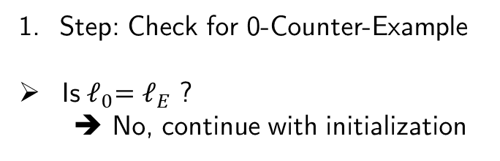


Example:
$$ℓ_{0}$$
$$p ≠0$$
$$ℓ_{1}$$
$$n<0$$
$$ℓ_{5}$$
$$n≥0$$
Step: Check for 0-Counter-Example
Is${ ℓ}_{0}=ℓ_{E}$ ?
➔ No, continue with initialization
$n^{′}=n−1$
$$ℓ_{2}$$
$$p=0$$
$$ℓ_{E}$$
$$n≠0$$
$$n=0$$
$$ℓ_{3}$$
$$ℓ_{4}$$
$$p^{′}=0$$

Slide 8
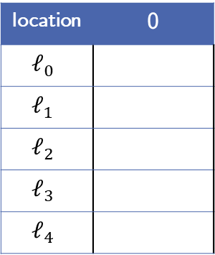

Example:
location | 0
$$ℓ_{0}$$
$$ℓ_{1}$$
$$ℓ_{2}$$
$$ℓ_{3}$$
$$ℓ_{4}$$
$$ℓ_{0}$$
$$p ≠0$$
$$ℓ_{1}$$
$$n<0$$
$$ℓ_{5}$$
$$n≥0$$
2. Step: Initialization of level 0
$F_{0, ℓ}=\left\{\begin{matrix}\text{T}, & ℓ= ℓ_{0} \\ \text{F}, & otherwise\end{matrix}\right.$
$n^{′}=n−1$
$$ℓ_{2}$$
$$p=0$$
$$ℓ_{E}$$
$$n≠0$$
$$n=0$$
$$ℓ_{3}$$
$$ℓ_{4}$$
$$p^{′}=0$$

Slide 9
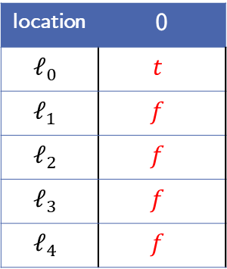
Example:
location | 0
$$ℓ_{0}$$ | $$t$$
$$ℓ_{1}$$ | $$f$$
$$ℓ_{2}$$ | $$f$$
$$ℓ_{3}$$ | $$f$$
$$ℓ_{4}$$ | $$f$$
$$ℓ_{0}$$
$$p ≠0$$
$$ℓ_{1}$$
$$n<0$$
$$ℓ_{5}$$
$$n≥0$$
2. Step: Initialization of level 0
$F_{0, ℓ}=\left\{\begin{matrix}\text{T}, & ℓ= ℓ_{0} \\ \text{F}, & otherwise\end{matrix}\right.$
$n^{′}=n−1$
$$ℓ_{2}$$
$$p=0$$
$$ℓ_{E}$$
$$n≠0$$
$$n=0$$
$$ℓ_{3}$$
$$ℓ_{4}$$
$$p^{′}=0$$

Slide 10
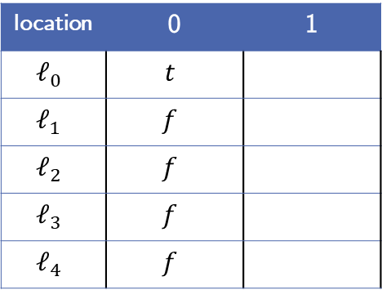
Example:
location | 0 | 1
$$ℓ_{0}$$ | $$t$$
$$ℓ_{1}$$ | $$f$$
$$ℓ_{2}$$ | $$f$$
$$ℓ_{3}$$ | $$f$$
$$ℓ_{4}$$ | $$f$$
$$ℓ_{0}$$
$$p ≠0$$
$$ℓ_{1}$$
$$n<0$$
$$ℓ_{5}$$
$$n≥0$$
3. Step: Level 1
Initialize level 1 frames as true
$n^{′}=n−1$
$$ℓ_{2}$$
$$p=0$$
$$ℓ_{E}$$
$$n≠0$$
$$n=0$$
$$ℓ_{3}$$
$$ℓ_{4}$$
$$p^{′}=0$$

Slide 11
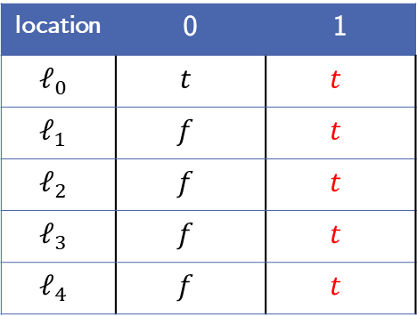
Example:
location | 0 | 1
$$ℓ_{0}$$ | $$t$$ | $$t$$
$$ℓ_{1}$$ | $$f$$ | $$t$$
$$ℓ_{2}$$ | $$f$$ | $$t$$
$$ℓ_{3}$$ | $$f$$ | $$t$$
$$ℓ_{4}$$ | $$f$$ | $$t$$
$$ℓ_{0}$$
$$p ≠0$$
$$ℓ_{1}$$
$$n<0$$
$$ℓ_{5}$$
$$n≥0$$
3. Step: Level 1
Initialize level 1 frames as true
$n^{′}=n−1$
$$ℓ_{2}$$
$$p=0$$
$$ℓ_{E}$$
$$n≠0$$
$$n=0$$
$$ℓ_{3}$$
$$ℓ_{4}$$
$$p^{′}=0$$

Slide 12



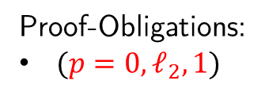
Example:
location | 0 | 1
$$ℓ_{0}$$ | $$t$$ | $$t$$
$$ℓ_{1}$$ | $$f$$ | $$t$$
$$ℓ_{2}$$ | $$f$$ | $$t$$
$$ℓ_{3}$$ | $$f$$ | $$t$$
$$ℓ_{4}$$ | $$f$$ | $$t$$
$$ℓ_{0}$$
$$p ≠0$$
$$ℓ_{1}$$
$$n<0$$
$$ℓ_{5}$$
$$n≥0$$
3. Step: Level 1
Get initial proof-obligation
Proof-Obligations:
$(p=0,ℓ_{2}, 1)$
$n^{′}=n−1$
$$ℓ_{2}$$
$$p=0$$
$$ℓ_{E}$$
$$n≠0$$
$$n=0$$
$$ℓ_{3}$$
$$ℓ_{4}$$
$$p^{′}=0$$

Slide 13
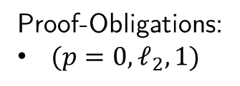
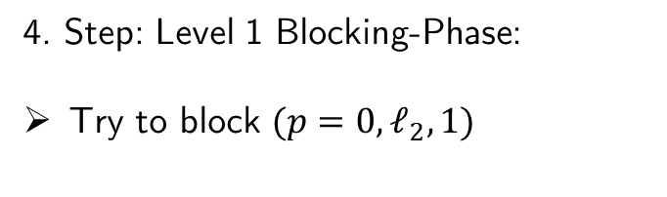
Example:
location | 0 | 1
$$ℓ_{0}$$ | $$t$$ | $$t$$
$$ℓ_{1}$$ | $$f$$ | $$t$$
$$ℓ_{2}$$ | $$f$$ | $$t$$
$$ℓ_{3}$$ | $$f$$ | $$t$$
$$ℓ_{4}$$ | $$f$$ | $$t$$
$$ℓ_{0}$$
$$p ≠0$$
$$ℓ_{1}$$
$$n<0$$
$$ℓ_{5}$$
$$n≥0$$
4. Step: Level 1 Blocking-Phase:
Try to block $(p=0,ℓ_{2}, 1)$
Proof-Obligations:
$(p=0,ℓ_{2}, 1)$
$n^{′}=n−1$
$$ℓ_{2}$$
$$p=0$$
$$ℓ_{E}$$
$$n≠0$$
$$n=0$$
$$ℓ_{3}$$
$$ℓ_{4}$$
$$p^{′}=0$$

Slide 14


Example:
location | 0 | 1
$$ℓ_{0}$$ | $$t$$ | $$t$$
$$ℓ_{1}$$ | $$f$$ | $$t$$
$$ℓ_{2}$$ | $$f$$ | $$t$$
$$ℓ_{3}$$ | $$f$$ | $$t$$
$$ℓ_{4}$$ | $$f$$ | $$t$$
$$ℓ_{0}$$
$$p ≠0$$
$$ℓ_{1}$$
$$n<0$$
$$ℓ_{5}$$
$$n≥0$$
4. Step: Level 1 Blocking-Phase:
Try to block $(p=0,ℓ_{2}, 1)$
Predecessor $ℓ_{1}$:
$F_{0,ℓ_{1}} ∧ T_{ℓ_{1} →ℓ_{2}} ∧ p^{′}=0$
Proof-Obligations:
$(p=0,ℓ_{2}, 1)$
$n^{′}=n−1$
$$ℓ_{2}$$
$$p=0$$
$$ℓ_{E}$$
$$n≠0$$
$$n=0$$
$$ℓ_{3}$$
$$ℓ_{4}$$
$$p^{′}=0$$

Slide 15
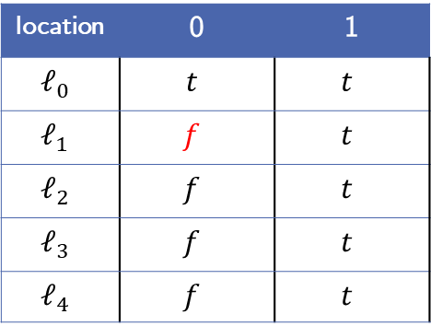


Example:
location | 0 | 1
$$ℓ_{0}$$ | $$t$$ | $$t$$
$$ℓ_{1}$$ | $$f$$ | $$t$$
$$ℓ_{2}$$ | $$f$$ | $$t$$
$$ℓ_{3}$$ | $$f$$ | $$t$$
$$ℓ_{4}$$ | $$f$$ | $$t$$
$$ℓ_{0}$$
$$p ≠0$$
$$ℓ_{1}$$
$$n<0$$
$$ℓ_{5}$$
$$n≥0$$
4. Step: Level 1 Blocking-Phase:
Try to block $(p=0,ℓ_{2}, 1)$
Predecessor $ℓ_{1}$:
$f_{ } ∧ n≥0 ∧ p^{′}=0$
Proof-Obligations:
$(p=0,ℓ_{2}, 1)$
$n^{′}=n−1$
$$ℓ_{2}$$
$$p=0$$
$$ℓ_{E}$$
$$n≠0$$
$$n=0$$
$$ℓ_{3}$$
$$ℓ_{4}$$
$$p^{′}=0$$

Slide 16
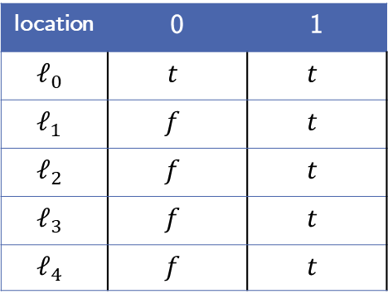
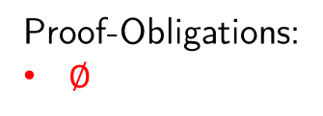
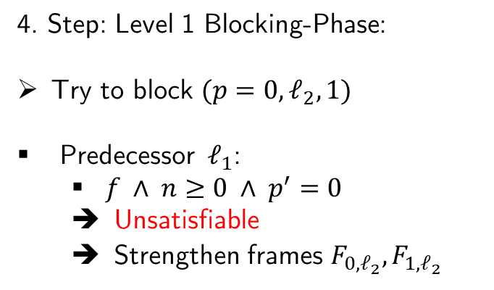
Example:
location | 0 | 1
$$ℓ_{0}$$ | $$t$$ | $$t$$
$$ℓ_{1}$$ | $$f$$ | $$t$$
$$ℓ_{2}$$ | $$f$$ | $$t$$
$$ℓ_{3}$$ | $$f$$ | $$t$$
$$ℓ_{4}$$ | $$f$$ | $$t$$
$$ℓ_{0}$$
$$p ≠0$$
$$ℓ_{1}$$
$$n<0$$
$$ℓ_{5}$$
$$n≥0$$
4. Step: Level 1 Blocking-Phase:
Try to block $(p=0,ℓ_{2}, 1)$
Predecessor $ℓ_{1}$:
$f_{ } ∧ n≥0 ∧ p^{′}=0$
Unsatisfiable
Strengthen frames $F_{0,ℓ_{2}},F_{1,ℓ_{2}}$
Proof-Obligations:
$∅$
$n^{′}=n−1$
$$ℓ_{2}$$
$$p=0$$
$$ℓ_{E}$$
$$n≠0$$
$$n=0$$
$$ℓ_{3}$$
$$ℓ_{4}$$
$$p^{′}=0$$

Slide 17
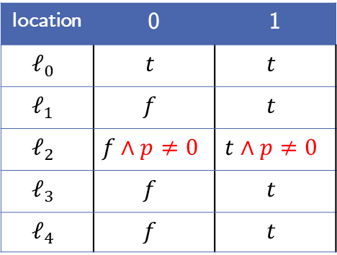
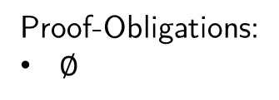
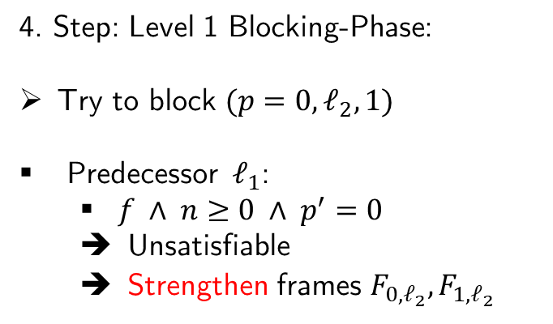
Example:
location | 0 | 1
$$ℓ_{0}$$ | $$t$$ | $$t$$
$$ℓ_{1}$$ | $$f$$ | $$t$$
$$ℓ_{2}$$ | $$f∧p≠0$$ | $$t∧p≠0$$
$$ℓ_{3}$$ | $$f$$ | $$t$$
$$ℓ_{4}$$ | $$f$$ | $$t$$
$$ℓ_{0}$$
$$p ≠0$$
$$ℓ_{1}$$
$$n<0$$
$$ℓ_{5}$$
$$n≥0$$
4. Step: Level 1 Blocking-Phase:
Try to block $(p=0,ℓ_{2}, 1)$
Predecessor $ℓ_{1}$:
$f_{ } ∧ n≥0 ∧ p^{′}=0$
Unsatisfiable
Strengthen frames $F_{0,ℓ_{2}},F_{1,ℓ_{2}}$
Proof-Obligations:
$∅$
$n^{′}=n−1$
$$ℓ_{2}$$
$$p=0$$
$$ℓ_{E}$$
$$n≠0$$
$$n=0$$
$$ℓ_{3}$$
$$ℓ_{4}$$
$$p^{′}=0$$

Slide 18
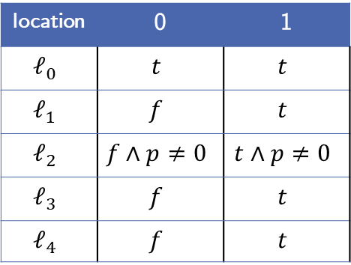
Example:
location | 0 | 1
$$ℓ_{0}$$ | $$t$$ | $$t$$
$$ℓ_{1}$$ | $$f$$ | $$t$$
$$ℓ_{2}$$ | $$f∧p≠0$$ | $$t∧p≠0$$
$$ℓ_{3}$$ | $$f$$ | $$t$$
$$ℓ_{4}$$ | $$f$$ | $$t$$
$$ℓ_{0}$$
$$p ≠0$$
$$ℓ_{1}$$
$$n<0$$
$$ℓ_{5}$$
$$n≥0$$
5. Step: Level 1 Propagation-Phase
Is there a global fixpoint?
Proof-Obligations:
$∅$
$n^{′}=n−1$
$$ℓ_{2}$$
$$p=0$$
$$ℓ_{E}$$
$$n≠0$$
$$n=0$$
$$ℓ_{3}$$
$$ℓ_{4}$$
$$p^{′}=0$$

Slide 19

Example:
location | 0 | 1
$$ℓ_{0}$$ | $$t$$ | $$t$$
$$ℓ_{1}$$ | $$f$$ | $$t$$
$$ℓ_{2}$$ | $$f∧p≠0$$ | $$t∧p≠0$$
$$ℓ_{3}$$ | $$f$$ | $$t$$
$$ℓ_{4}$$ | $$f$$ | $$t$$
$$ℓ_{0}$$
$$p ≠0$$
$$ℓ_{1}$$
$$n<0$$
$$ℓ_{5}$$
$$n≥0$$
5. Step: Level 1 Propagation-Phase
Is there an $i$ where $F_{i−1, ℓ}=F_{i, ℓ}$ for $ℓ∈L∖\{ℓ_{E}\}$ ?
Proof-Obligations:
$∅$
$n^{′}=n−1$
$$ℓ_{2}$$
$$p=0$$
$$ℓ_{E}$$
$$n≠0$$
$$n=0$$
$$ℓ_{3}$$
$$ℓ_{4}$$
$$p^{′}=0$$

Slide 20
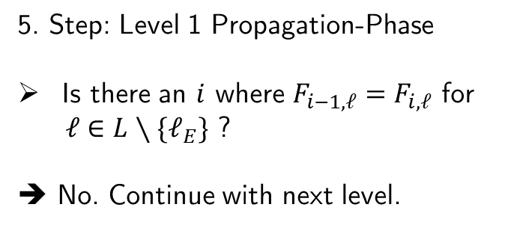
Example:
location | 0 | 1
$$ℓ_{0}$$ | $$t$$ | $$t$$
$$ℓ_{1}$$ | $$f$$ | $$t$$
$$ℓ_{2}$$ | $$f∧p≠0$$ | $$t∧p≠0$$
$$ℓ_{3}$$ | $$f$$ | $$t$$
$$ℓ_{4}$$ | $$f$$ | $$t$$
$$ℓ_{0}$$
$$p ≠0$$
$$ℓ_{1}$$
$$n<0$$
$$ℓ_{5}$$
$$n≥0$$
5. Step: Level 1 Propagation-Phase
Is there an $i$ where $F_{i−1, ℓ}=F_{i, ℓ}$ for $ℓ∈L∖\{ℓ_{E}\}$ ?
➔ No. Continue with next level.
Proof-Obligations:
$∅$
$n^{′}=n−1$
$$ℓ_{2}$$
$$p=0$$
$$ℓ_{E}$$
$$n≠0$$
$$n=0$$
$$ℓ_{3}$$
$$ℓ_{4}$$
$$p^{′}=0$$

Slide 21

Example:
location | 0 | 1
$$ℓ_{0}$$ | $$t$$ | $$t$$
$$ℓ_{1}$$ | $$f$$ | $$t$$
$$ℓ_{2}$$ | $$f∧p≠0$$ | $$t∧p≠0$$
$$ℓ_{3}$$ | $$f$$ | $$t$$
$$ℓ_{4}$$ | $$f$$ | $$t$$
$$ℓ_{0}$$
$$p ≠0$$
$$ℓ_{1}$$
$$n<0$$
$$ℓ_{5}$$
$$n≥0$$
6. Step: Level 2
Initzialize new frames
Add initial proof-obligation
$(p=0,ℓ_{2}, 2)$
Proof-Obligations:
$∅$
$n^{′}=n−1$
$$ℓ_{2}$$
$$p=0$$
$$ℓ_{E}$$
$$n≠0$$
$$n=0$$
$$ℓ_{3}$$
$$ℓ_{4}$$
$$p^{′}=0$$

Slide 22
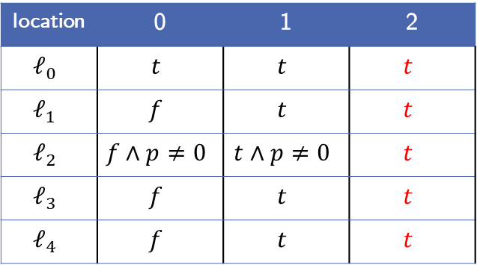

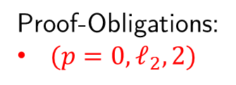
Example:
location | 0 | 1 | 2
$$ℓ_{0}$$ | $$t$$ | $$t$$ | $$t$$
$$ℓ_{1}$$ | $$f$$ | $$t$$ | $$t$$
$$ℓ_{2}$$ | $$f∧p≠0$$ | $$t∧p≠0$$ | $$t$$
$$ℓ_{3}$$ | $$f$$ | $$t$$ | $$t$$
$$ℓ_{4}$$ | $$f$$ | $$t$$ | $$t$$
$$ℓ_{0}$$
$$p ≠0$$
$$ℓ_{1}$$
$$n<0$$
$$ℓ_{5}$$
$$n≥0$$
6. Step: Level 2
Initzialize new frames
Add initial proof-obligation
$(p=0,ℓ_{2}, 2)$
Proof-Obligations:
$(p=0,ℓ_{2}, 2)$
$n^{′}=n−1$
$$ℓ_{2}$$
$$p=0$$
$$ℓ_{E}$$
$$n≠0$$
$$n=0$$
$$ℓ_{3}$$
$$ℓ_{4}$$
$$p^{′}=0$$

Slide 23
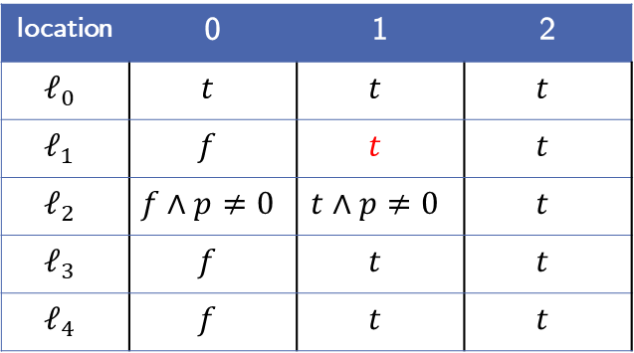

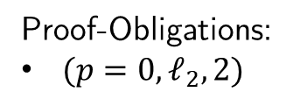
Example:
location | 0 | 1 | 2
$$ℓ_{0}$$ | $$t$$ | $$t$$ | $$t$$
$$ℓ_{1}$$ | $$f$$ | $$t$$ | $$t$$
$$ℓ_{2}$$ | $$f∧p≠0$$ | $$t∧p≠0$$ | $$t$$
$$ℓ_{3}$$ | $$f$$ | $$t$$ | $$t$$
$$ℓ_{4}$$ | $$f$$ | $$t$$ | $$t$$
$$ℓ_{0}$$
$$p ≠0$$
$$ℓ_{1}$$
$$n<0$$
$$ℓ_{5}$$
$$n≥0$$
7. Step: Level 2 Blocking-Phase:
Try to block $(p=0,ℓ_{2}, 2)$
Predecessor $ℓ_{1}$:
$t ∧ n≥0 ∧ p^{′}=0$
Proof-Obligations:
$(p=0,ℓ_{2}, 2)$
$n^{′}=n−1$
$$ℓ_{2}$$
$$p=0$$
$$ℓ_{E}$$
$$n≠0$$
$$n=0$$
$$ℓ_{3}$$
$$ℓ_{4}$$
$$p^{′}=0$$

Slide 24
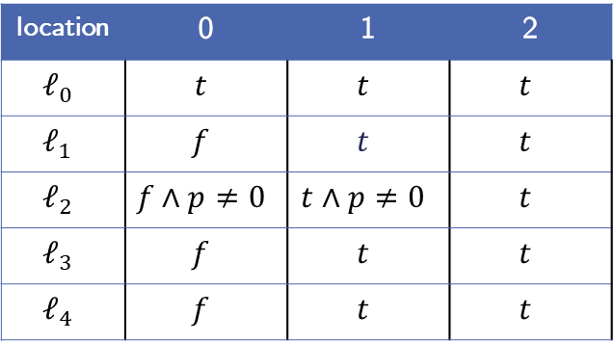
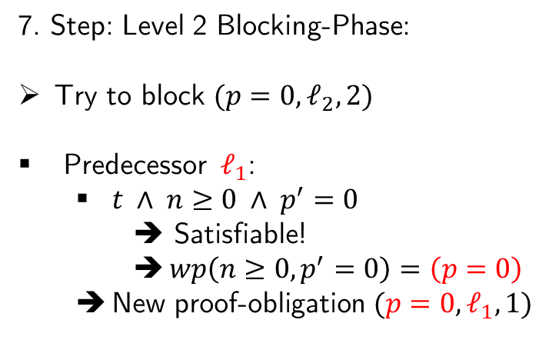
Example:
location | 0 | 1 | 2
$$ℓ_{0}$$ | $$t$$ | $$t$$ | $$t$$
$$ℓ_{1}$$ | $$f$$ | $$t$$ | $$t$$
$$ℓ_{2}$$ | $$f∧p≠0$$ | $$t∧p≠0$$ | $$t$$
$$ℓ_{3}$$ | $$f$$ | $$t$$ | $$t$$
$$ℓ_{4}$$ | $$f$$ | $$t$$ | $$t$$
$$ℓ_{0}$$
$$p ≠0$$
$$ℓ_{1}$$
$$n<0$$
$$ℓ_{5}$$
$$n≥0$$
7. Step: Level 2 Blocking-Phase:
Try to block $(p=0,ℓ_{2}, 2)$
Predecessor $ℓ_{1}$:
$t ∧ n≥0 ∧ p^{′}=0$
➔ Satisfiable!
$wp\left(n≥0, p^{′}=0\right)=\left(p=0\right)$
New proof-obligation $(p=0,ℓ_{1},1)$
Proof-Obligations:
$(p=0,ℓ_{2}, 2)$
$n^{′}=n−1$
$$ℓ_{2}$$
$$p=0$$
$$ℓ_{E}$$
$$n≠0$$
$$n=0$$
$$ℓ_{3}$$
$$ℓ_{4}$$
$$p^{′}=0$$

Slide 25
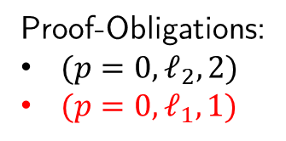
Example:
location | 0 | 1 | 2
$$ℓ_{0}$$ | $$t$$ | $$t$$ | $$t$$
$$ℓ_{1}$$ | $$f$$ | $$t$$ | $$t$$
$$ℓ_{2}$$ | $$f∧p≠0$$ | $$t∧p≠0$$ | $$t$$
$$ℓ_{3}$$ | $$f$$ | $$t$$ | $$t$$
$$ℓ_{4}$$ | $$f$$ | $$t$$ | $$t$$
$$ℓ_{0}$$
$$p ≠0$$
$$ℓ_{1}$$
$$n<0$$
$$ℓ_{5}$$
$$n≥0$$
7. Step: Level 2 Blocking-Phase:
Try to block $(p=0,ℓ_{2}, 2)$
Predecessor $ℓ_{1}$:
$t ∧ n≥0 ∧ p^{′}=0$
➔ Satisfiable!
$wp\left(n≥0, p^{′}=0\right)=\left(p=0\right)$
New proof-obligation $(p=0,ℓ_{1},1)$
Proof-Obligations:
$(p=0,ℓ_{2}, 2)$
$(p=0,ℓ_{1},1)$
$n^{′}=n−1$
$$ℓ_{2}$$
$$p=0$$
$$ℓ_{E}$$
$$n≠0$$
$$n=0$$
$$ℓ_{3}$$
$$ℓ_{4}$$
$$p^{′}=0$$

Slide 26

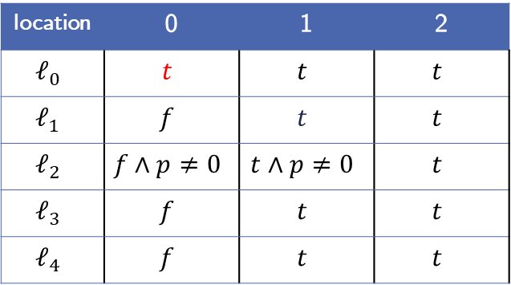

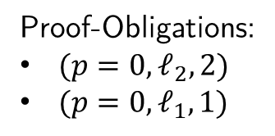
Example:
location | 0 | 1 | 2
$$ℓ_{0}$$ | $$t$$ | $$t$$ | $$t$$
$$ℓ_{1}$$ | $$f$$ | $$t$$ | $$t$$
$$ℓ_{2}$$ | $$f∧p≠0$$ | $$t∧p≠0$$ | $$t$$
$$ℓ_{3}$$ | $$f$$ | $$t$$ | $$t$$
$$ℓ_{4}$$ | $$f$$ | $$t$$ | $$t$$
$$ℓ_{0}$$
$$p ≠0$$
$$ℓ_{1}$$
$$n<0$$
$$ℓ_{5}$$
$$n≥0$$
7. Step: Level 2 Blocking-Phase:
Try to block $(p=0,ℓ_{1},1)$
Predecessor $ℓ_{0}$:
$t ∧p ≠0 ∧ p^{′}=0$
Proof-Obligations:
$(p=0,ℓ_{2}, 2)$
$(p=0,ℓ_{1},1)$
$n^{′}=n−1$
$$ℓ_{2}$$
$$p=0$$
$$ℓ_{E}$$
$$n≠0$$
$$n=0$$
$$ℓ_{3}$$
$$ℓ_{4}$$
$$p^{′}=0$$

Slide 27
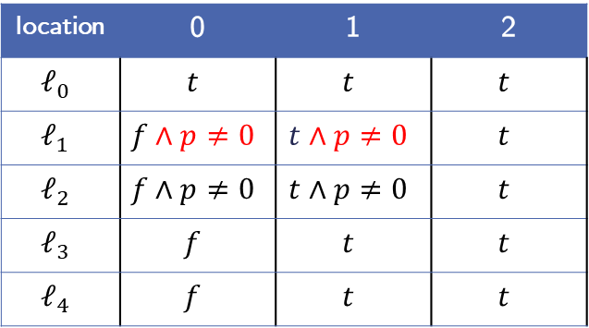

Example:
location | 0 | 1 | 2
$$ℓ_{0}$$ | $$t$$ | $$t$$ | $$t$$
$$ℓ_{1}$$ | $$f∧p≠0$$ | $$t∧p≠0$$ | $$t$$
$$ℓ_{2}$$ | $$f∧p≠0$$ | $$t∧p≠0$$ | $$t$$
$$ℓ_{3}$$ | $$f$$ | $$t$$ | $$t$$
$$ℓ_{4}$$ | $$f$$ | $$t$$ | $$t$$
$$ℓ_{0}$$
$$p ≠0$$
$$ℓ_{1}$$
$$n<0$$
$$ℓ_{5}$$
$$n≥0$$
7. Step: Level 2 Blocking-Phase:
Try to block $(p=0,ℓ_{1},1)$
Predecessor $ℓ_{0}$:
$t ∧p ≠0 ∧ p^{′}=0$
Unsatisfiable!
Strengthen frames $F_{0,ℓ_{1}},F_{1,ℓ_{1}}$
Proof-Obligations:
$(p=0,ℓ_{2}, 2)$
$(p=0,ℓ_{1},1)$
$n^{′}=n−1$
$$ℓ_{2}$$
$$p=0$$
$$ℓ_{E}$$
$$n≠0$$
$$n=0$$
$$ℓ_{3}$$
$$ℓ_{4}$$
$$p^{′}=0$$

Slide 28
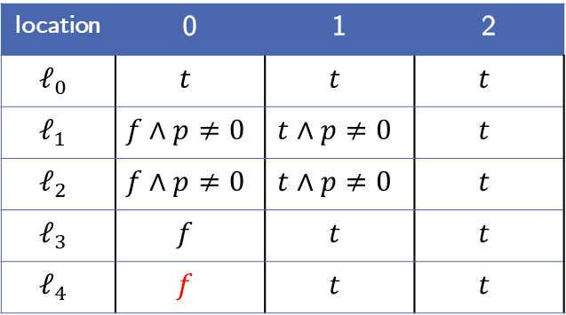



Example:
location | 0 | 1 | 2
$$ℓ_{0}$$ | $$t$$ | $$t$$ | $$t$$
$$ℓ_{1}$$ | $$f∧p≠0$$ | $$t∧p≠0$$ | $$t$$
$$ℓ_{2}$$ | $$f∧p≠0$$ | $$t∧p≠0$$ | $$t$$
$$ℓ_{3}$$ | $$f$$ | $$t$$ | $$t$$
$$ℓ_{4}$$ | $$f$$ | $$t$$ | $$t$$
$$ℓ_{0}$$
$$p ≠0$$
$$ℓ_{1}$$
$$n<0$$
$$ℓ_{5}$$
$$n≥0$$
7. Step: Level 2 Blocking-Phase:
Try to block $(p=0,ℓ_{1},1)$
Predecessor $ℓ_{4}$:
$f∧n^{′}=n−1∧ p^{′}=0$
Proof-Obligations:
$(p=0,ℓ_{2}, 2)$
$(p=0,ℓ_{1},1)$
$n^{′}=n−1$
$$ℓ_{2}$$
$$p=0$$
$$ℓ_{E}$$
$$n≠0$$
$$n=0$$
$$ℓ_{3}$$
$$ℓ_{4}$$
$$p^{′}=0$$

Slide 29
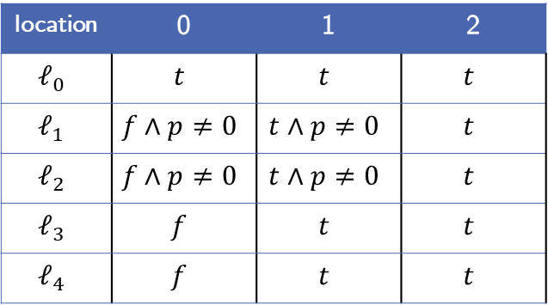

Example:
location | 0 | 1 | 2
$$ℓ_{0}$$ | $$t$$ | $$t$$ | $$t$$
$$ℓ_{1}$$ | $$f∧p≠0$$ | $$t∧p≠0$$ | $$t$$
$$ℓ_{2}$$ | $$f∧p≠0$$ | $$t∧p≠0$$ | $$t$$
$$ℓ_{3}$$ | $$f$$ | $$t$$ | $$t$$
$$ℓ_{4}$$ | $$f$$ | $$t$$ | $$t$$
$$ℓ_{0}$$
$$p ≠0$$
$$ℓ_{1}$$
$$n<0$$
$$ℓ_{5}$$
$$n≥0$$
7. Step: Level 2 Blocking-Phase:
Try to block $(p=0,ℓ_{1},1)$
Predecessor $ℓ_{4}$:
$f∧n^{′}=n−1∧ p^{′}=0$
➔ Unsatisfiable!
Proof-Obligations:
$(p=0,ℓ_{2}, 2)$
$(p=0,ℓ_{1},1)$
$n^{′}=n−1$
$$ℓ_{2}$$
$$p=0$$
$$ℓ_{E}$$
$$n≠0$$
$$n=0$$
$$ℓ_{3}$$
$$ℓ_{4}$$
$$p^{′}=0$$

Slide 30
Example:
location | 0 | 1 | 2
$$ℓ_{0}$$ | $$t$$ | $$t$$ | $$t$$
$$ℓ_{1}$$ | $$f∧p≠0$$ | $$t∧p≠0$$ | $$t$$
$$ℓ_{2}$$ | $$f∧p≠0$$ | $$t∧p≠0$$ | $$t$$
$$ℓ_{3}$$ | $$f$$ | $$t$$ | $$t$$
$$ℓ_{4}$$ | $$f$$ | $$t$$ | $$t$$
$$ℓ_{0}$$
$$p ≠0$$
$$ℓ_{1}$$
$$n<0$$
$$ℓ_{5}$$
$$n≥0$$
7. Step: Level 2 Blocking-Phase:
Try to block $(p=0,ℓ_{1},1)$
Predecessor $ℓ_{4}$:
$f∧n^{′}=n−1∧ p^{′}=0$
➔ Unsatisfiable!
Proof-Obligations:
$(p=0,ℓ_{2}, 2)$
$n^{′}=n−1$
$$ℓ_{2}$$
$$p=0$$
$$ℓ_{E}$$
$$n≠0$$
$$n=0$$
$$ℓ_{3}$$
$$ℓ_{4}$$
$$p^{′}=0$$

Slide 31
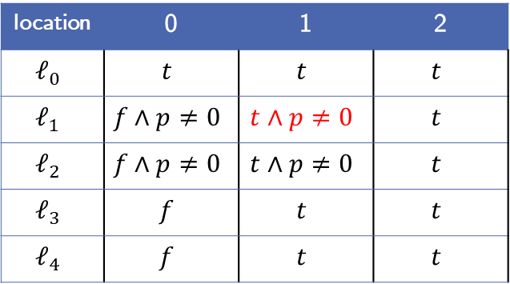

Example:
location | 0 | 1 | 2
$$ℓ_{0}$$ | $$t$$ | $$t$$ | $$t$$
$$ℓ_{1}$$ | $$f∧p≠0$$ | $$t∧p≠0$$ | $$t$$
$$ℓ_{2}$$ | $$f∧p≠0$$ | $$t∧p≠0$$ | $$t$$
$$ℓ_{3}$$ | $$f$$ | $$t$$ | $$t$$
$$ℓ_{4}$$ | $$f$$ | $$t$$ | $$t$$
$$ℓ_{0}$$
$$p ≠0$$
$$ℓ_{1}$$
$$n<0$$
$$ℓ_{5}$$
$$n≥0$$
7. Step: Level 2 Blocking-Phase:
Try to block$(p=0,ℓ_{2}, 2)$ again
Predecessor $ℓ_{1}$:
$t∧p≠0∧n≥0∧ p^{′}=0$
Proof-Obligations:
$(p=0,ℓ_{2}, 2)$
$n^{′}=n−1$
$$ℓ_{2}$$
$$p=0$$
$$ℓ_{E}$$
$$n≠0$$
$$n=0$$
$$ℓ_{3}$$
$$ℓ_{4}$$
$$p^{′}=0$$

Slide 32
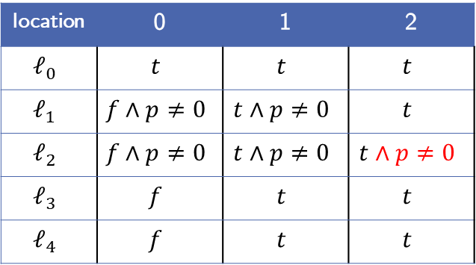

Example:
location | 0 | 1 | 2
$$ℓ_{0}$$ | $$t$$ | $$t$$ | $$t$$
$$ℓ_{1}$$ | $$f∧p≠0$$ | $$t∧p≠0$$ | $$t$$
$$ℓ_{2}$$ | $$f∧p≠0$$ | $$t∧p≠0$$ | $$t∧p≠0$$
$$ℓ_{3}$$ | $$f$$ | $$t$$ | $$t$$
$$ℓ_{4}$$ | $$f$$ | $$t$$ | $$t$$
$$ℓ_{0}$$
$$p ≠0$$
$$ℓ_{1}$$
$$n<0$$
$$ℓ_{5}$$
$$n≥0$$
7. Step: Level 2 Blocking-Phase:
Try to block$(p=0,ℓ_{2}, 2)$ again
Predecessor $ℓ_{1}$:
$t∧p≠0∧n≥0∧ p^{′}=0$
Unsatisfiable!
Strengthen frames $F_{2,ℓ_{2}}$
Proof-Obligations:
$∅$
$n^{′}=n−1$
$$ℓ_{2}$$
$$p=0$$
$$ℓ_{E}$$
$$n≠0$$
$$n=0$$
$$ℓ_{3}$$
$$ℓ_{4}$$
$$p^{′}=0$$

Slide 33
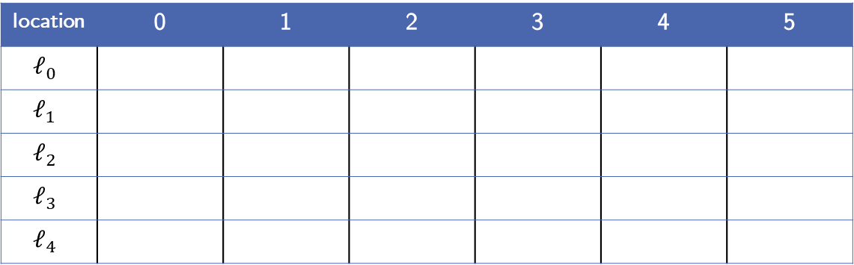
Example:
location | 0 | 1 | 2 | 3 | 4 | 5
$$ℓ_{0}$$
$$ℓ_{1}$$
$$ℓ_{2}$$
$$ℓ_{3}$$
$$ℓ_{4}$$
$$ℓ_{0}$$
$$p ≠0$$
$$ℓ_{1}$$
$$n<0$$
$$ℓ_{5}$$
$$n≥0$$
Text
Proof-Obligations:
$n^{′}=n−1$
$$ℓ_{2}$$
$$p=0$$
$$ℓ_{E}$$
$$n≠0$$
$$n=0$$
$$ℓ_{3}$$
$$ℓ_{4}$$
$$p^{′}=0$$

Slide 34
6. Related Work
Notes:
Vielleicht die anderen Approaches so Erwähnen wie in PDR_in_ICFG_Ex2, also einfach nur so oberflächlich anschneiden

Slide 35
Implementation in Ultimate: Traceabstraction with PDR

Slide 36
Implemented Improvements

Slide 37
Evaluation: Data Comparison
Notes:
Hier vielleicht beide Graphen und dann was dazu sagen.

Slide 38
Evaluation: Discussion

Slide 39
Future Work: Implementing Further Improvements
Notes:
Nichts Ausführliches

Slide 40
Conclusion

