Slide 1
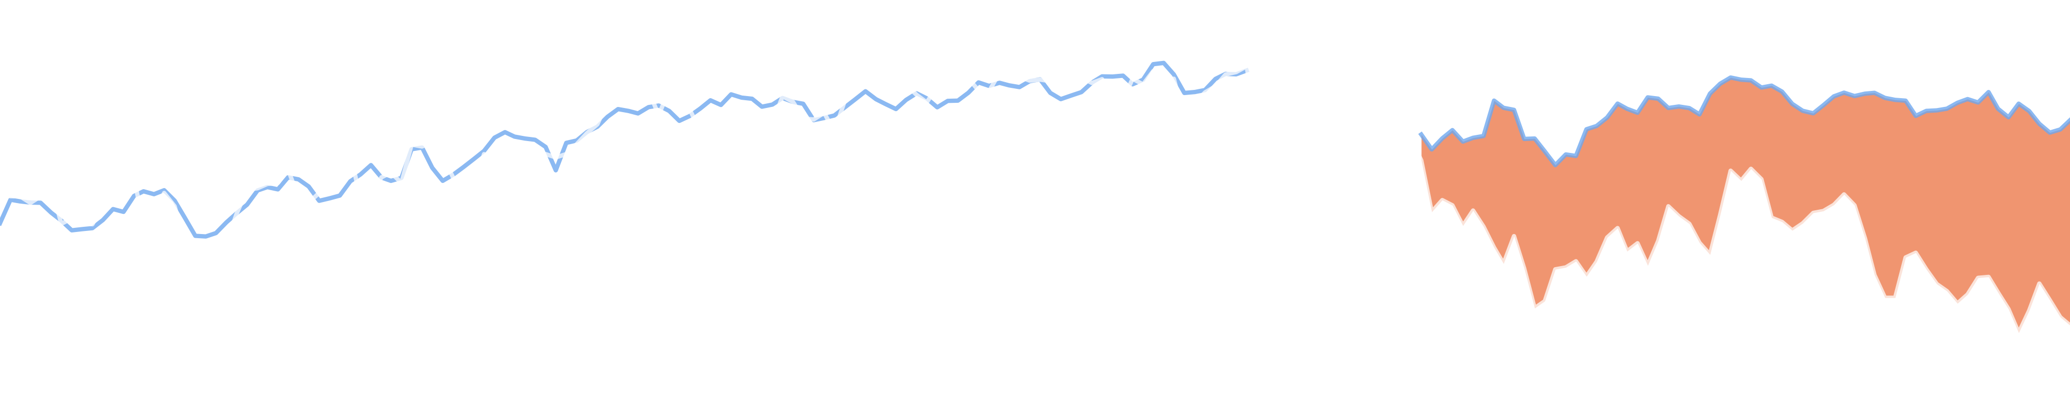
AI APPLICATIONS IN FINANCE · FINAL PROJECT
Unexplained Pessimism
Economic fundamentals, media narratives and U.S. consumer sentiment before the 2026 midterms
Jonas Wu · Data through October 16, 2026
Notes:
≈ 11 s · 23 words · 0 clicks
Hi, I’m Jonas. Americans feel much worse about the economy than the numbers suggest. Is the news to blame? Our answer: mostly no.
—— 中文对照 ——
大家好，我是 Jonas。美国人对经济的感受比数据显示的差得多。这要怪新闻吗？我们的答案是：基本不是。

Slide 2
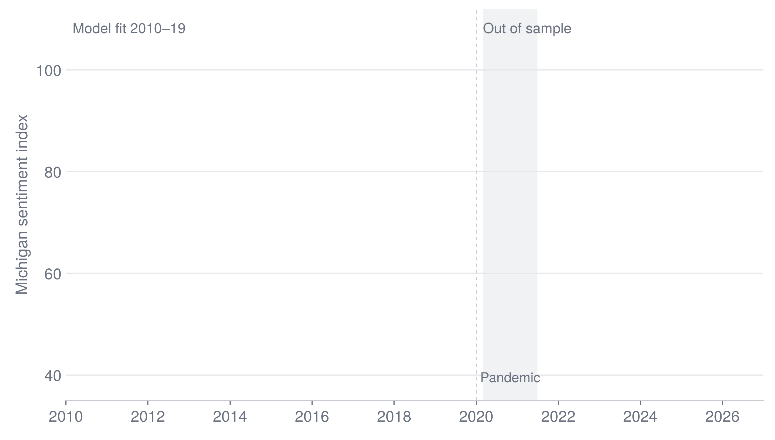
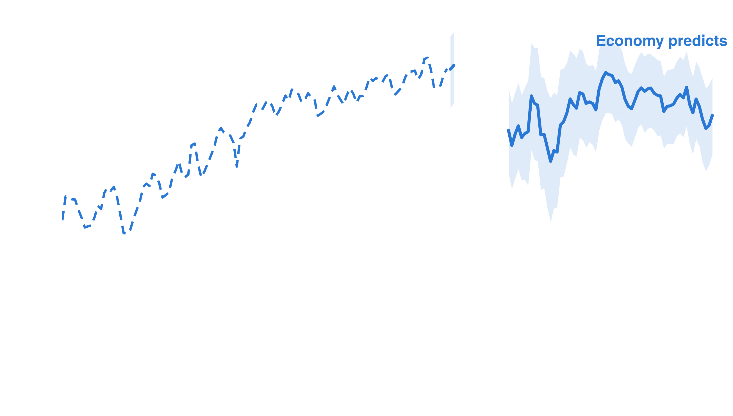
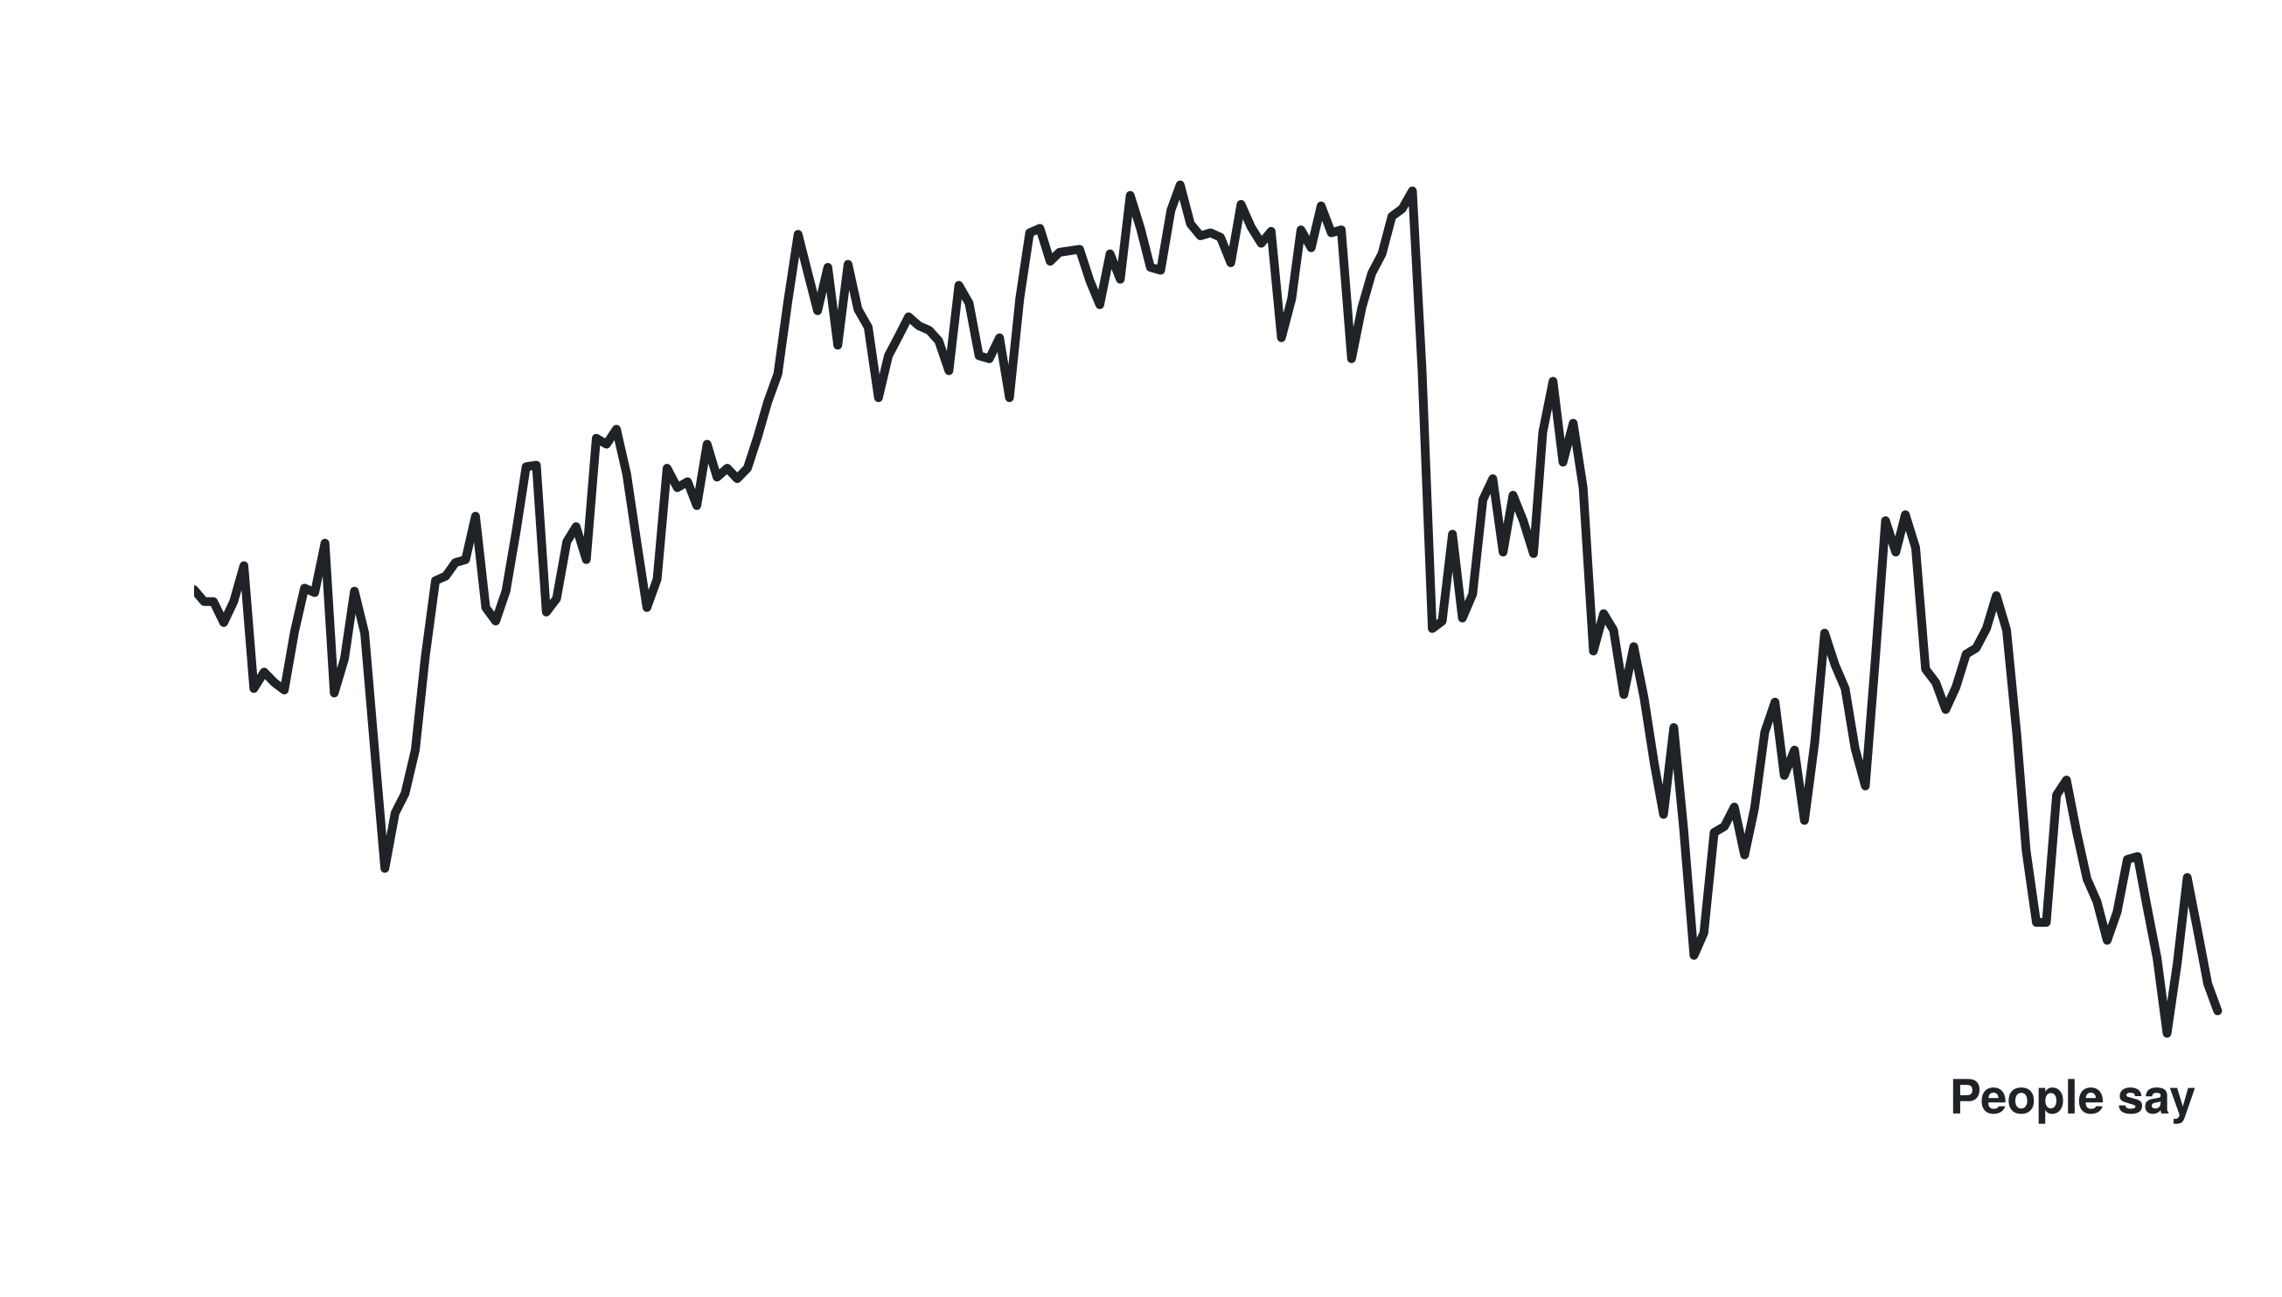
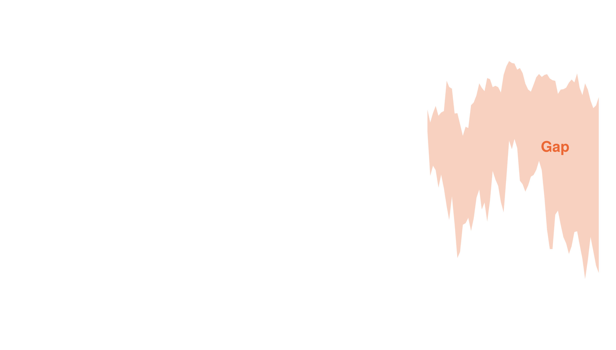
THE PUZZLE
Sentiment is ~40 points below the economy’s prediction
−35.8
points, 2025 average gap
−39.8
points, 2026 average gap
7–11%
of the fall since 2019 that the economy explains
Model: real-time unemployment, PCE inflation and GDP growth (ALFRED vintages), fit 2010–19. Band: 95% prediction interval. Pandemic months not modelled.
2
Notes:
≈ 27 s · 54 words · 3 clicks
First, the gap. We predict the Michigan index from unemployment, inflation and GDP growth, using only data known at the time. [CLICK] Blue is the prediction. [CLICK] Black is what people say. [CLICK] The gap is about 36 points in 2025 and 40 in 2026. The economy explains only about a tenth of the drop since 2019.
—— 中文对照 ——
先看缺口。我们用失业率、通胀和 GDP 增长来预测密歇根消费者信心指数，而且只用当时已知的数据。[点击] 蓝线是预测值。[点击] 黑线是人们实际的回答。[点击] 缺口在 2025 年约 36 点，2026 年约 40 点。2019 年以来的下降，经济数据只能解释大约十分之一。

Slide 3
THREE EXPLANATIONS
Three ways to explain the gap
H1
Real pressures
High prices and rates the headline numbers miss
H2
Media
Selection, framing or bias in coverage
H3
Measurement
Survey method, timing or the model
?
?
?
● All tests fixed before estimation ● 150 specifications registered ● 8 pre-set tests against the media story
3
Notes:
≈ 20 s · 41 words · 1 clicks
Three explanations are possible: real pressures the headline numbers miss, like high prices; the media; or a problem with the survey or the model. [CLICK] We fixed all our tests in advance, including eight results that would count against the media story.
—— 中文对照 ——
可能的解释有三种：一是头条数据没有反映的真实压力，比如物价太高；二是媒体；三是调查或模型本身的问题。[点击] 所有检验都是事先定好的，其中包括八条一旦出现就不利于媒体解释的结果。

Slide 4
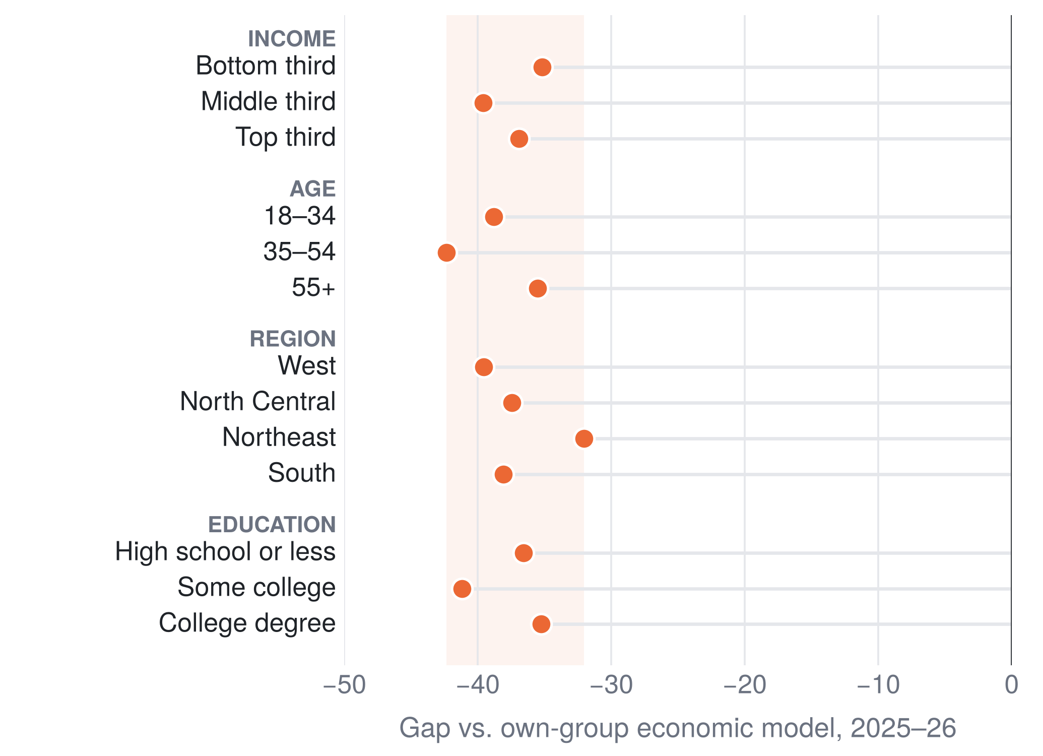
H3 · MEASUREMENT
H1
H2
H3
Not the survey, not party mix, not the campaign
−23 → −39
Gap kept widening after the survey moved online (late 2024 → 2026)
≤ 2.7 pts
Largest plausible effect of the party mix of respondents
−38.8 → −40.4
Gap in Jan–Apr vs. May–Oct 2026: already there before the campaign
Group gaps: each group’s own economic model, fit 2010–19; mean 2025-01 to 2026-08. Party-mix bound: Republican share 2–6 points lower.
4
Notes:
≈ 23 s · 45 words · 3 clicks
Start with measurement. The gap is similar in every income, age, region and education group. [CLICK] The survey moved online in 2024, but the gap kept growing after that. [CLICK] Party mix moves it by less than 3 points. [CLICK] And it was this large before the campaign.
—— 中文对照 ——
先看测量问题。各个收入、年龄、地区和学历组的缺口都差不多。[点击] 2024 年调查改成了线上，但之后缺口还在扩大。[点击] 党派构成的变化最多只带来不到 3 点。[点击] 而且竞选开始之前缺口就已经这么大了。

Slide 5
H2 · MEASURING THE MEDIA
H1
H2
H3
An AI coder that nearly matches human agreement
167,418
news items, posts and comments
→
11,431
coded by an LLM
→
360
labeled by two people, independently
Agreement with the human labels on tone (Cohen’s κ, test set)
Human vs. human
0.79
✓
Name and source swaps
0 of 39 tests show bias
LLM
0.73
TF-IDF classifier
0.39
Finance dictionary
0.35
VADER
0.27
Gold standard: 360 items, two annotators, adjudicated; LLM prompt frozen on 100 development items and scored once on 260 test items.
5
Notes:
≈ 29 s · 59 words · 2 clicks
Now the media. We collected about 167,000 news items, posts and comments. An LLM coded over 11,000, and two people labeled 360 by hand to check it. [CLICK] On tone, the LLM agrees with humans almost as well as they agree with each other, and about twice as well as word lists. [CLICK] Swapping political names showed no sign of bias.
—— 中文对照 ——
再看媒体。我们收集了约 16.7 万条新闻、帖子和评论，用大语言模型编码了其中一万一千多条，并请两个人独立手工标注了 360 条来检验。[点击] 在语气上，模型和人的一致程度几乎和两个人之间一样高，大约是词典法的两倍。[点击] 把政治人物的名字互换之后，也没有发现偏差。

Slide 6
H2 · WHAT COVERAGE SHOWS
H1
H2
H3
Even-handed tone, but more blame on the White House
Share of economic news items blaming the White House
✓ Good and bad news treated alike
40%
✓ Rising and easing prices treated alike
19%
✓ 2 of 68 checkable numbers wrong
6%
3%
Obama
Trump I
Biden
Trump II
Blame is not proof of bias: tariffs are the president’s own decisions
National news (NYT, Guardian), LLM-coded. Factual check against the official data available on the publication date.
6
Notes:
≈ 22 s · 45 words · 2 clicks
Coverage treats good and bad news alike, and only 2 of 68 checkable numbers were wrong. [CLICK] What changed is blame: under Trump’s second term, 40 percent of items blame the White House. [CLICK] But tariffs are his own decisions, so blame is not proof of bias.
—— 中文对照 ——
报道对好消息和坏消息的处理差不多，能核对的 68 个数字里只有 2 个是错的。[点击] 变化最大的是归咎：特朗普第二任期内，40% 的报道把问题归咎于白宫。[点击] 但关税本来就是总统自己的决定，所以归咎不能证明有偏差。

Slide 7
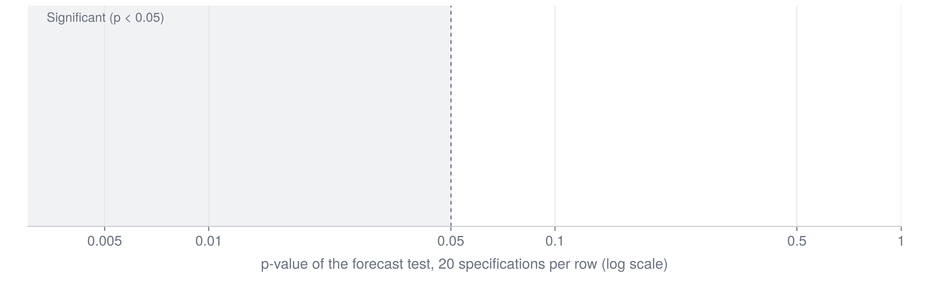
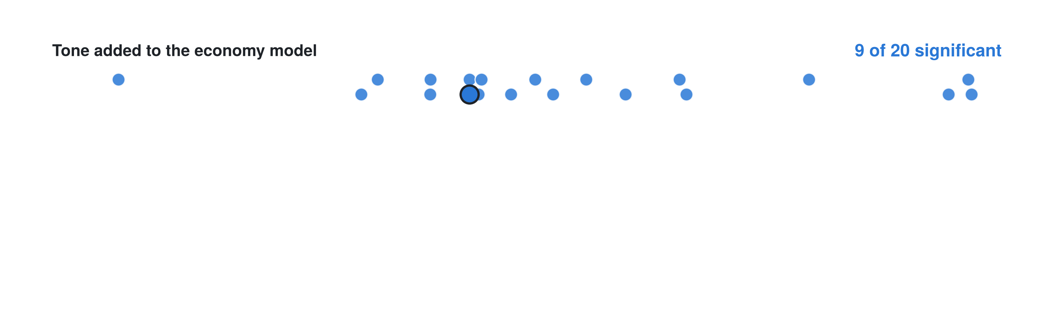
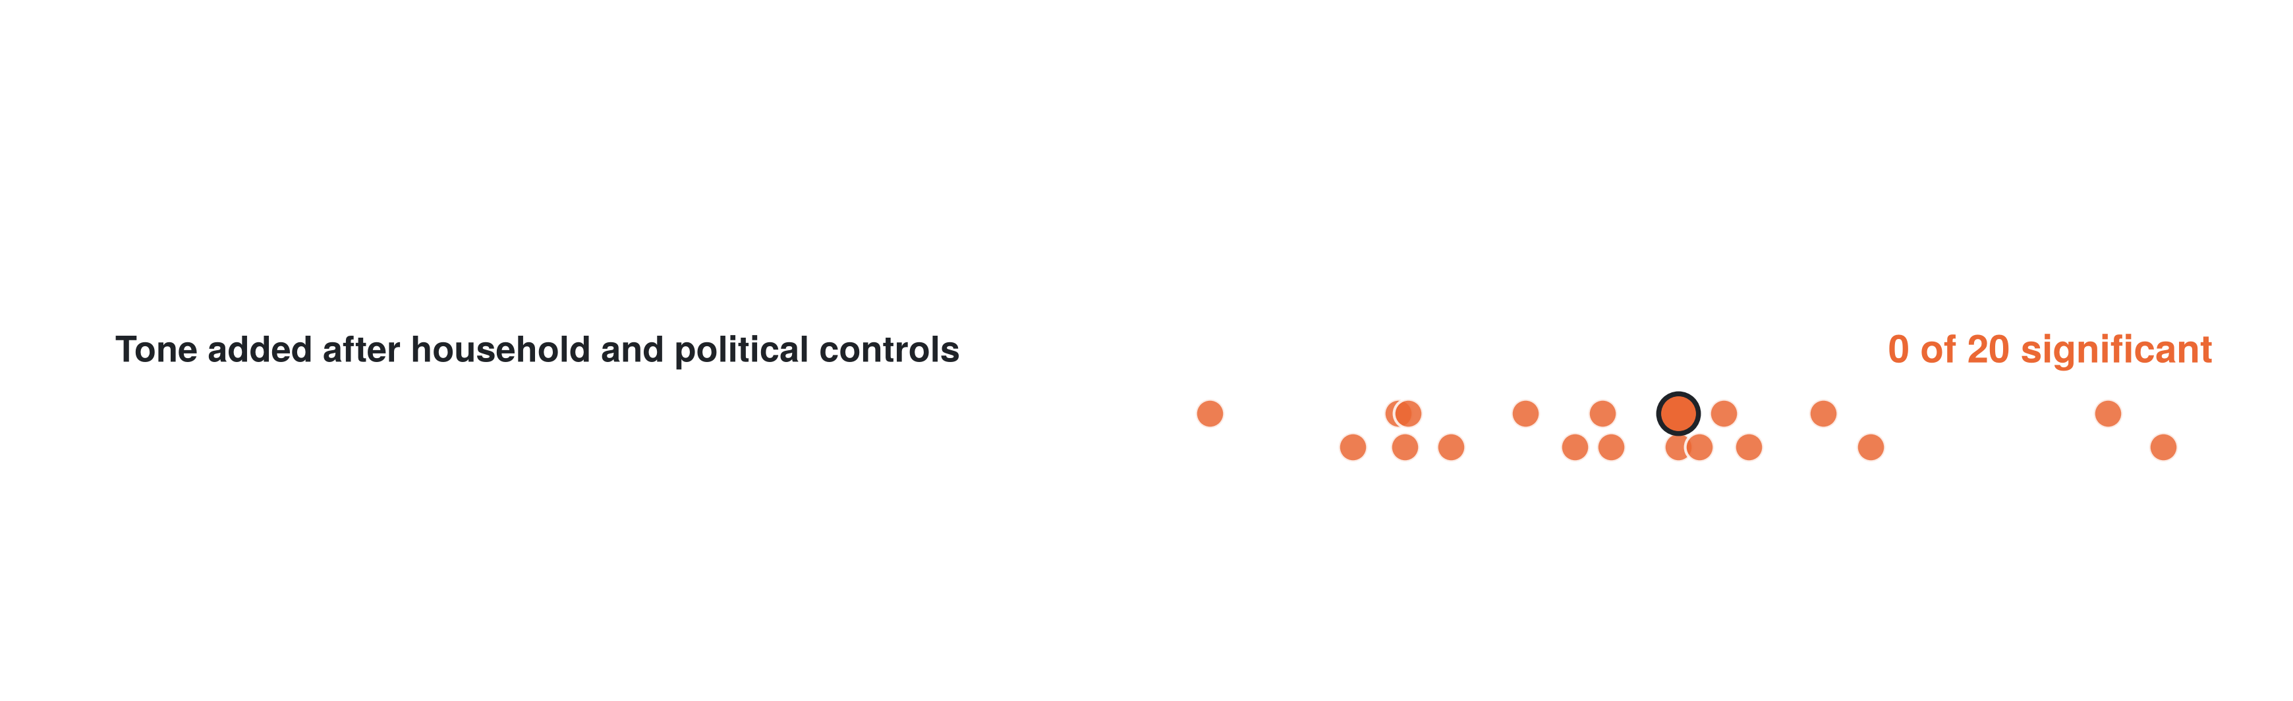
H2 · THE FORECAST TEST
H1
H2
H3
Tone stops helping forecasts once controls are in
≤ 5%
of the 2025–26 gap is linked to news tone, at most
One-step-ahead forecasts 2017–26, Clark–West test. Outlined dot = main specification. Controls: household pressures, governing party, pre-election month.
7
Notes:
≈ 25 s · 49 words · 3 clicks
The key test: does news tone help forecast sentiment? Each dot is one version of the test. [CLICK] Added to the economy model, tone helps a little. [CLICK] But with household costs and politics included, none of 20 versions is significant. [CLICK] At most, tone explains about 5 percent of the gap.
—— 中文对照 ——
关键检验：新闻语气能不能帮助预测消费者信心？每个点是检验的一个版本。[点击] 只加在经济模型上时，语气有一点帮助。[点击] 但加入家庭成本和政治因素之后，20 个版本没有一个显著。[点击] 语气最多只能解释缺口的约 5%。

Slide 8
VERDICT
Media bias is not the main explanation
H1
Real pressures
High prices and rates the headline numbers miss
H2
Media
Selection, framing or bias in coverage
H3
Measurement
Survey method, timing or the model
OPEN
WEAK
RULED OUT
Plausible, but the 2010–19 data cannot size it
≤ 5% of the gap; 2 of 8 tests go against it
Not survey mode, party mix or timing
Limits observational data; two national outlets, about 26 items a month
Next a randomized framing experiment to test cause
8
Notes:
≈ 22 s · 42 words · 3 clicks
Back to our three explanations. [CLICK] Measurement is ruled out. [CLICK] The media story is weak: two of our eight tests go against it. [CLICK] Real pressures stay open: high prices may matter, but our data cannot size them. Next, an experiment could test cause.
—— 中文对照 ——
回到三种解释。[点击] 测量问题被排除了。[点击] 媒体解释很弱：八条预设检验中有两条与它相反。[点击] 真实压力还没有定论：高物价可能有影响，但我们的数据无法量化。下一步可以用实验来检验因果。

Slide 9
IMPLICATION FOR FORECASTING AND RISK
Treat the gap as persistent, not as noise
Michigan index, 2026 average
1
Don’t use pre-2020 mappings
They would read today as a deep downturn
Economy predicts
91
2
Track the gap and its error band
Next to price levels and mortgage rates
People say
51
3
Skip news-tone signals here
No forecast gain once those are included
Lowest reading before 2020: 51.7
(May 1980; series since 1952)
Prediction: economy-only model (real-time data, fit 2010–19), January–October 2026. The dashboard tracks the gap and its band each month.
9
Notes:
≈ 30 s · 60 words · 3 clicks
What does this mean for finance? [CLICK] In 2026 the index averages about 51; the economy points to 91. [CLICK] That is below any reading before 2020, so old models would see a deep downturn. [CLICK] So treat the gap as lasting, not noise. Track it with its error band, next to prices and rates. News tone will not fix it. Thank you.
—— 中文对照 ——
这对金融意味着什么？[点击] 2026 年这个指数平均约 51，经济数据指向 91。[点击] 这比 2020 年以前的任何读数都低，按旧规律建的模型会把它看成深度衰退。[点击] 所以要把缺口当成持续的状态，而不是噪音；连同误差带一起跟踪它，同时看物价和利率。新闻语气修正不了它。谢谢大家。

