Slide 1
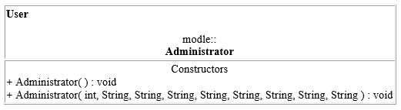
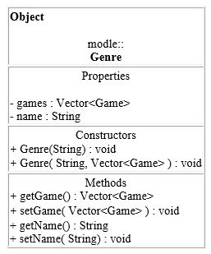
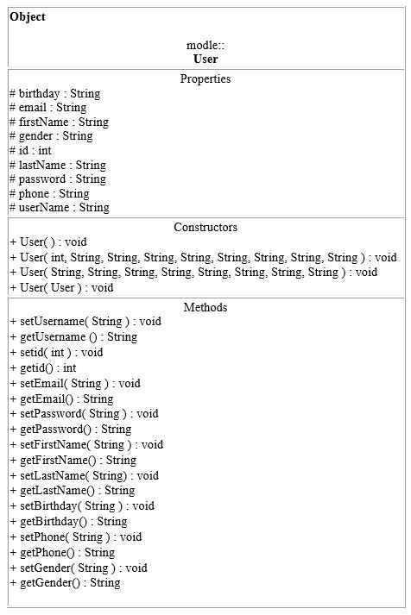
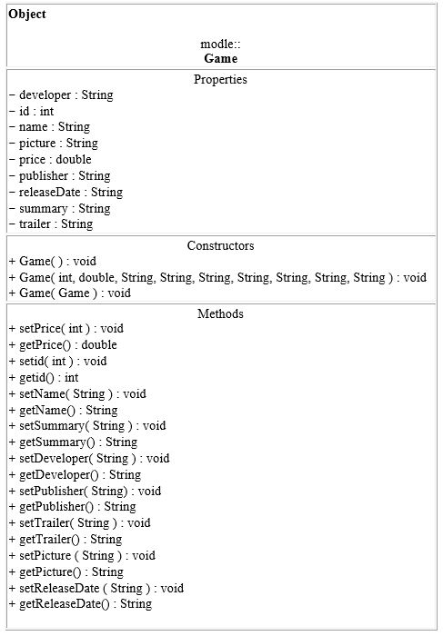
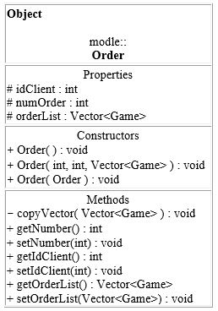
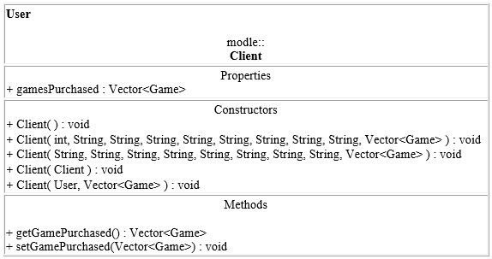
UML Class Diagram Game Warrior
יונה זרביב 340941301
אור כהן 307852681
Package: modle
1…*
0…*
0…*
1…*
0…*
1
0…*
0…*
Private: -
Protected: #
Public: +

Slide 2
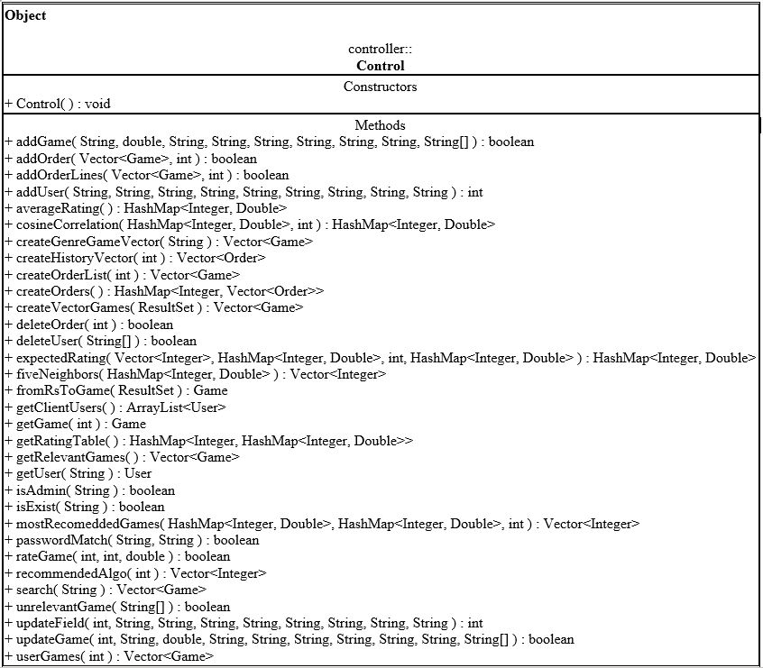
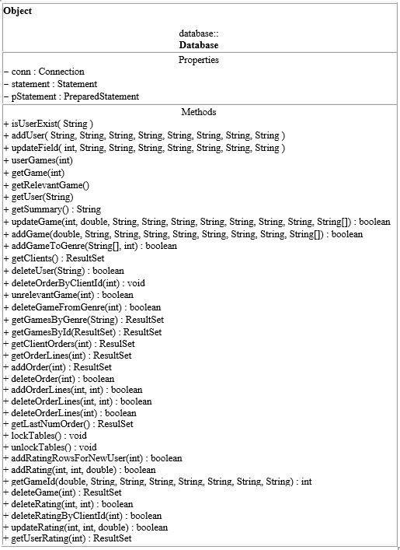
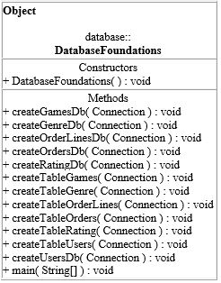
Package: controller
Package: database

Slide 3
Connections between packages
modle
view
controller
database

