Slide 1
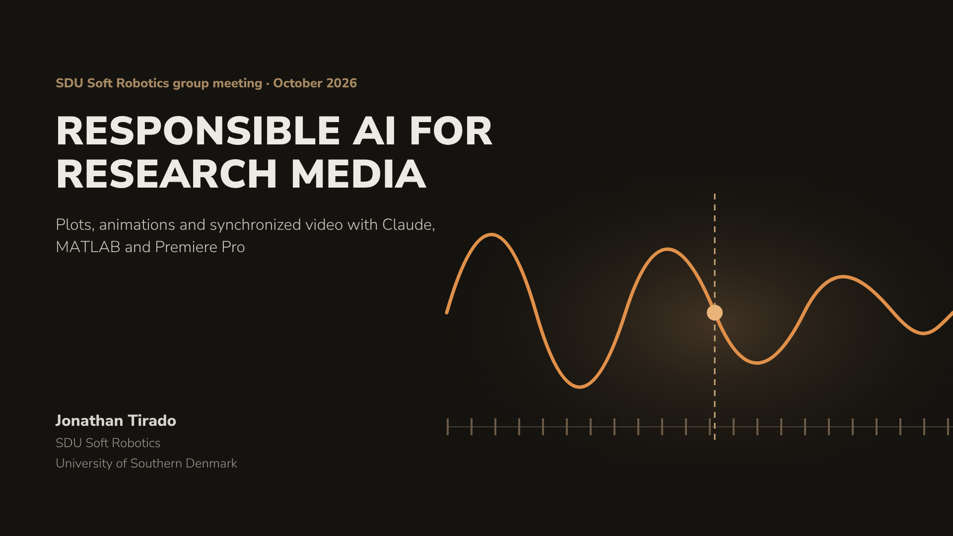
Notes:
Welcome. Today has two goals that belong together: show how much AI assistants can speed up the media side of experimental research, and agree on how to use them responsibly. We start with principles, then tour Claude’s tools, then three hands-on areas: MATLAB plots and animations, synchronizing video with sensor data, and driving Premiere Pro. The orange line is the whole talk in one picture: a measured signal, video frame ticks, and the sync event that ties them together.

Slide 2
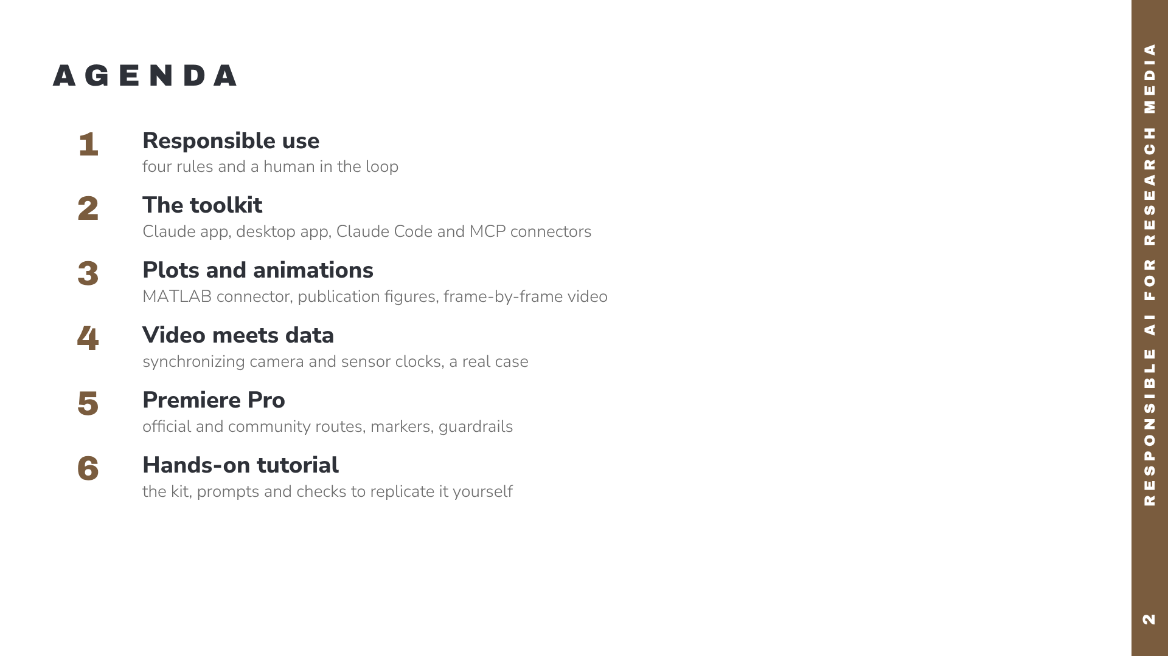
Notes:
Five parts. Responsibility comes first on purpose: every demo afterwards applies those rules.

Slide 3
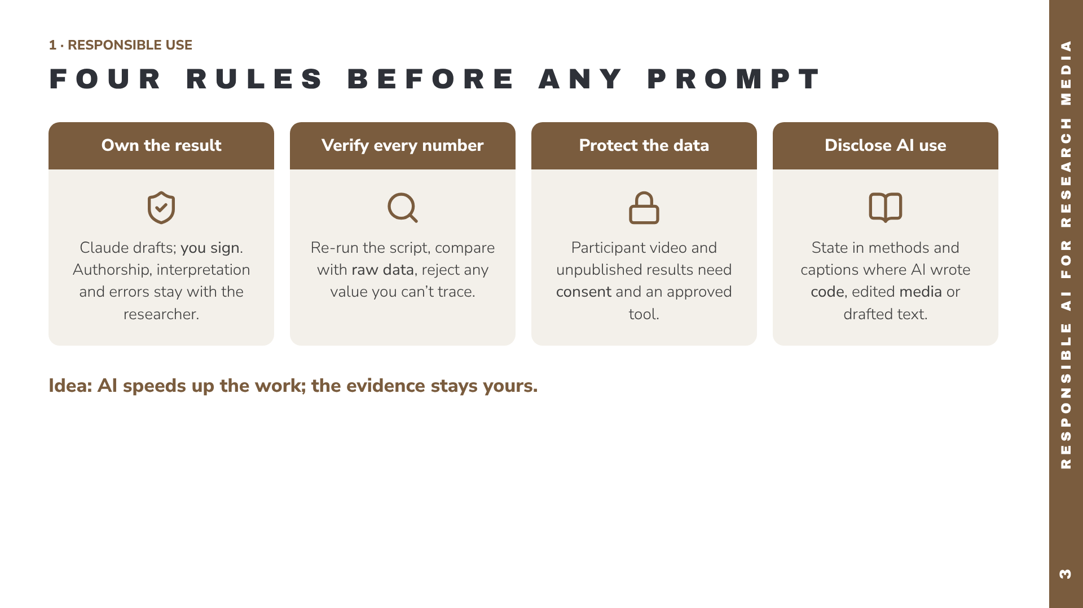
Notes:
These four rules frame everything that follows. Ownership: the AI is a tool, like MATLAB itself; you remain the author and are accountable for errors. Verification: language models can produce plausible but wrong code or numbers, so every figure must trace back to raw data through a script you have run and read. Data protection: check your institution’s policy and ethics approval before uploading identifiable participant video or confidential data to any cloud service. Disclosure: many journals and funders now require stating how AI was used; keep notes as you go.

Slide 4
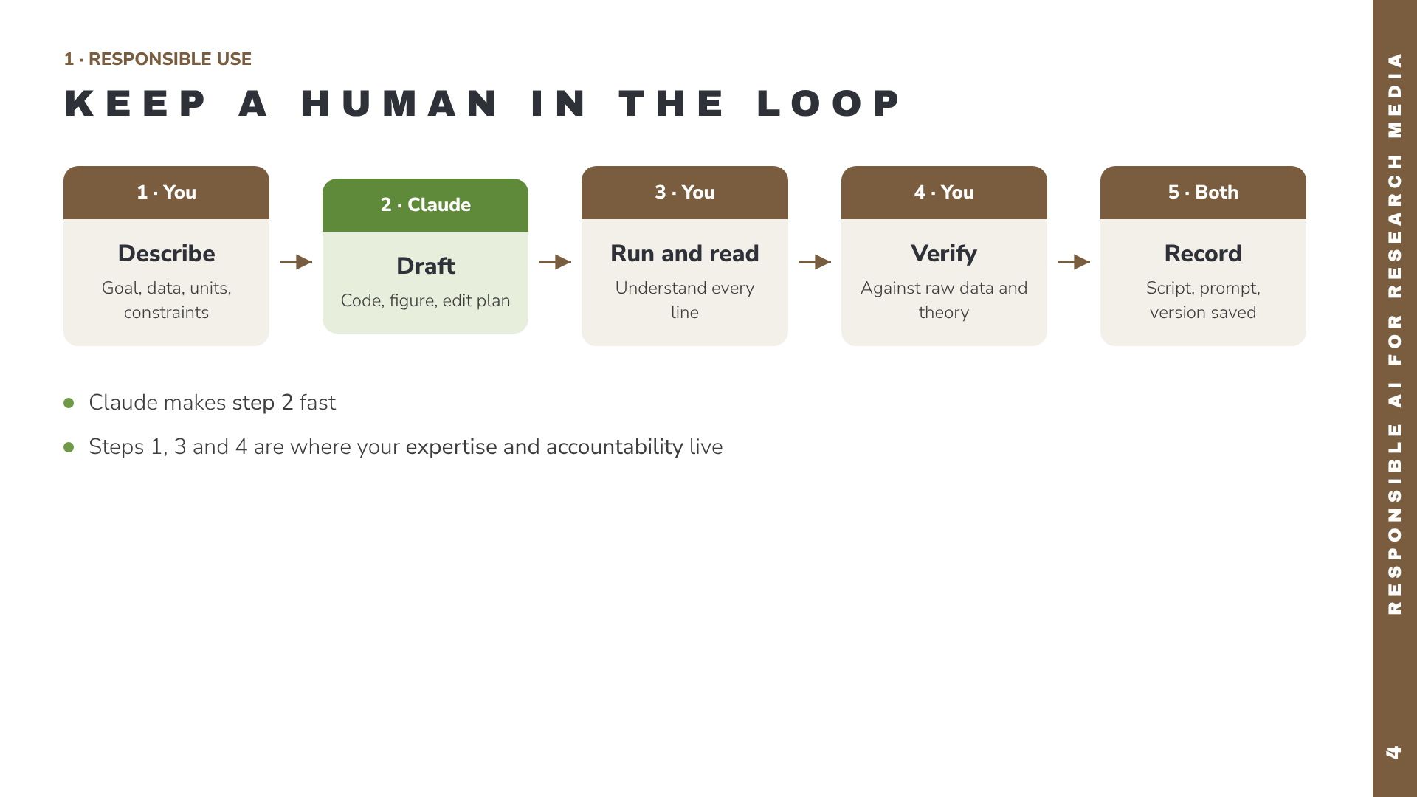
Notes:
This loop is the working pattern for every demo today. You describe the task precisely, including units and data location. Claude drafts. You run it and read it: if you can’t explain a line, ask Claude to explain it before using it. Then verify against raw data or a quick hand calculation. Finally record: keep the script, the prompt and the software versions with the dataset.

Slide 5
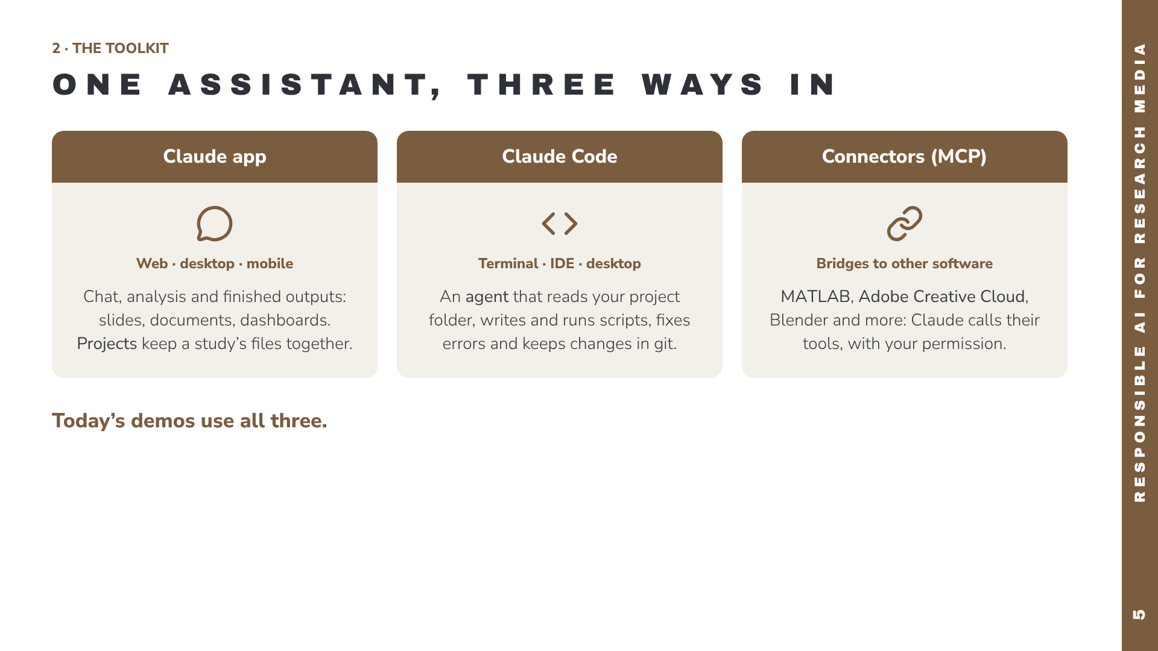
Notes:
Three entry points, same underlying model. The Claude app is where most people start: chat, upload files, and get finished outputs. Claude Code is for when the work lives in a folder of scripts and data: it acts as an agent that can read, edit and run things. Connectors use the Model Context Protocol, MCP, to let Claude use other applications’ tools.

Slide 6
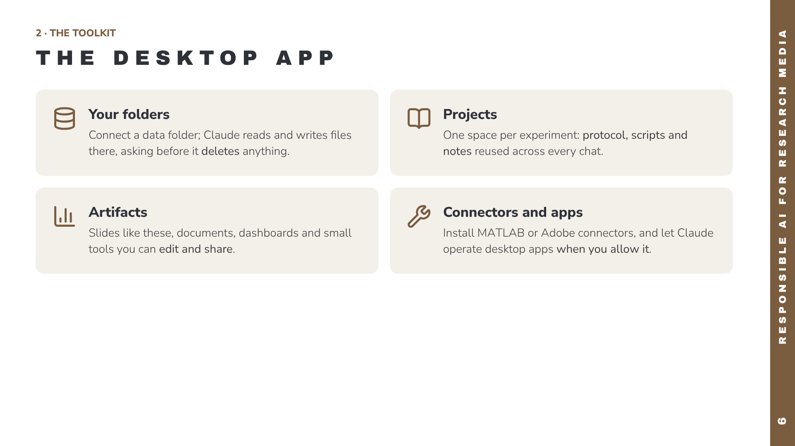
Notes:
The desktop app is where the research-media workflow becomes practical. You can connect a folder on your own computer so Claude works directly with your recordings and scripts. Projects hold the context for one experiment. Artifacts are finished outputs like this deck. Connectors and computer use extend Claude into other software. Every one of these is a permission you grant: grant the minimum, per project.

Slide 7
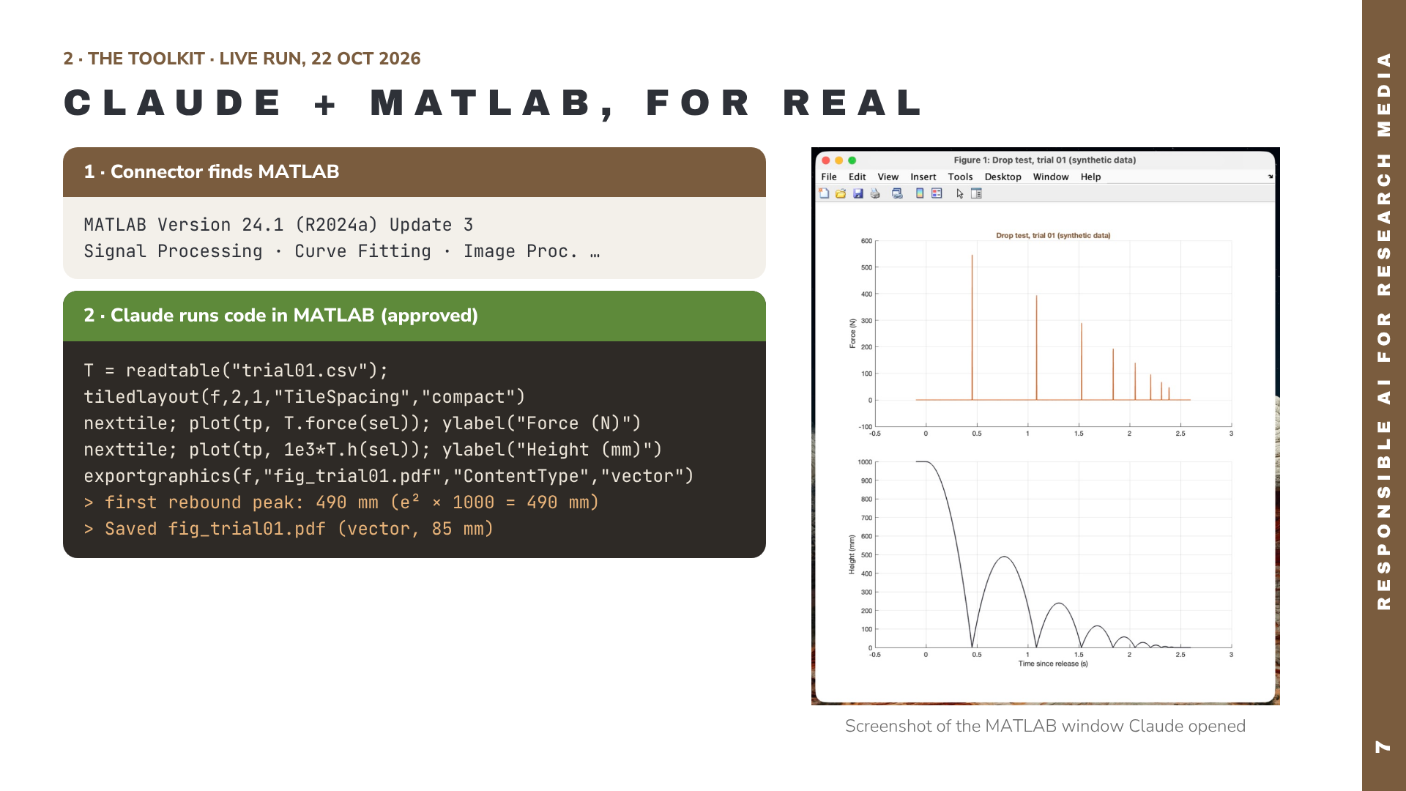
Notes:
This is a real run, done live through the official MathWorks MATLAB connector in the Claude desktop app on 22 October 2026. Step 1: the connector reports the MATLAB installation and toolboxes it found. Step 2: Claude wrote and ran the plotting code in MATLAB after approval; the output lines are MATLAB’s actual console output. The image on the right is a real screenshot of the MATLAB figure window on the presenter’s Mac. The data are synthetic: a simulated 1 m drop test. Setup tip from doing this: on a Mac, set the MATLAB Installation Path in the extension settings (for example /Applications/MATLAB_R2024a.app) and fully restart Claude, otherwise the connector reports that no MATLAB was found.

Slide 8
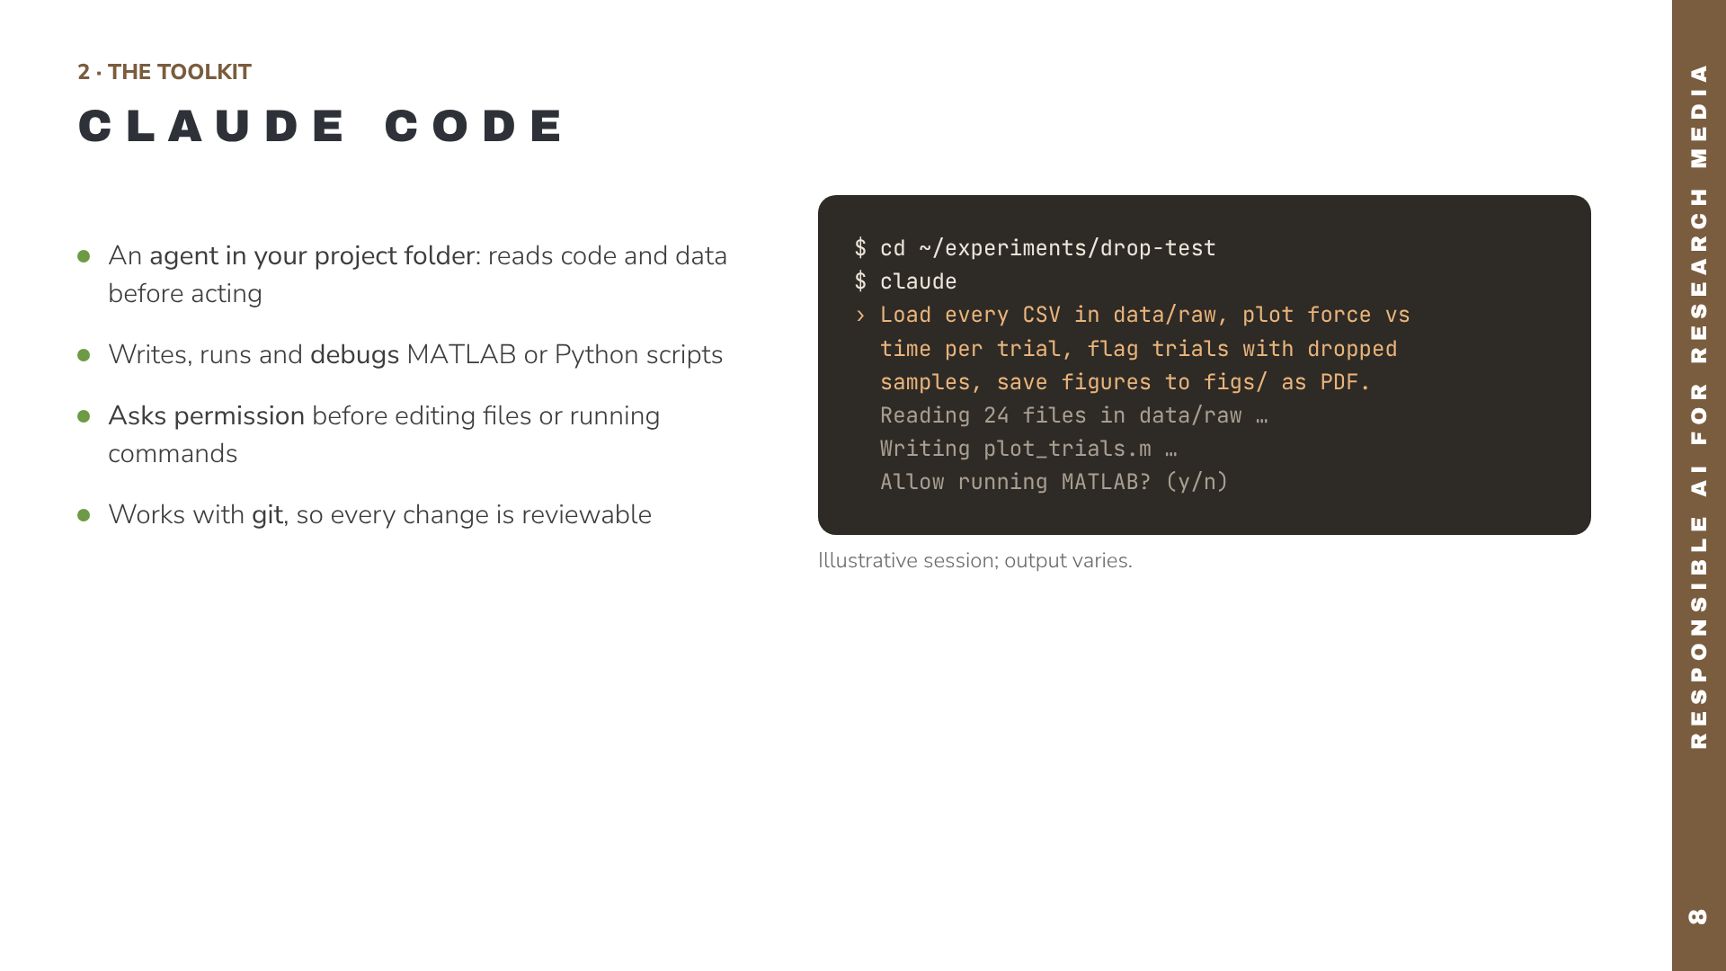
Notes:
Claude Code is the agentic side. You start it inside a project folder and give it a task in plain language. It explores the files, writes a script, asks before running commands or editing files, and iterates when something fails. Point out the permission prompt: that is a feature, not friction. Recommend initialising a git repository first so every change can be diffed and reverted.

Slide 9
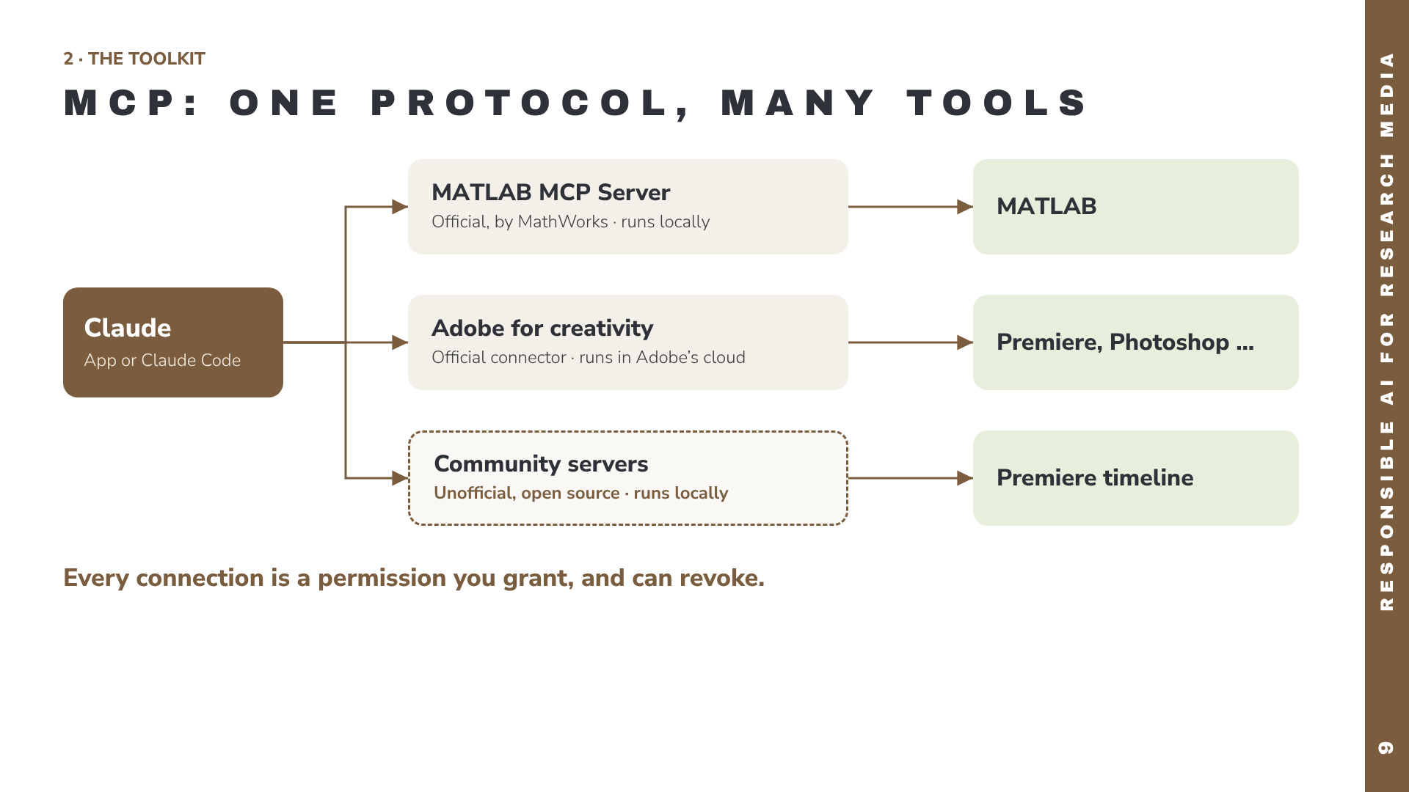
Notes:
MCP, the Model Context Protocol, is an open standard: an application exposes tools through an MCP server, and Claude can call those tools. MathWorks publishes an official MATLAB MCP Server that runs locally. Adobe launched the official “Adobe for creativity” connector on 28 April 2026, giving Claude access to more than 50 Creative Cloud tools including Premiere; that work runs in Adobe’s cloud. Several community-built, unofficial servers control a local Premiere timeline through a CEP panel and ExtendScript. The dashed border marks the unofficial route.

Slide 10
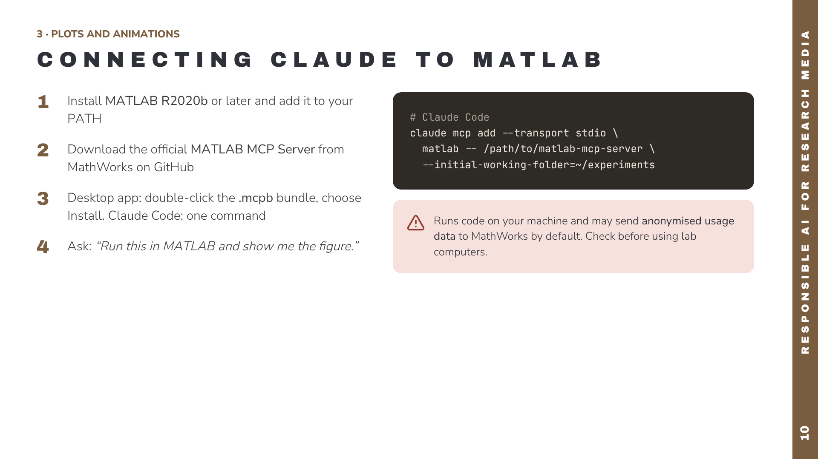
Notes:
Setup takes about ten minutes. MathWorks publishes the MATLAB MCP Server on GitHub (github.com/matlab/matlab-mcp-server; an earlier variant is the MATLAB MCP Core Server). For the Claude desktop app there is an .mcpb bundle you double-click to install. For Claude Code, register it with claude mcp add, pointing at the downloaded binary. Once connected, Claude can write MATLAB code, run it in your MATLAB session and read back results. The MathWorks README states that usage data collection is on by default. Verify the exact commands against the current README before the session.

Slide 11
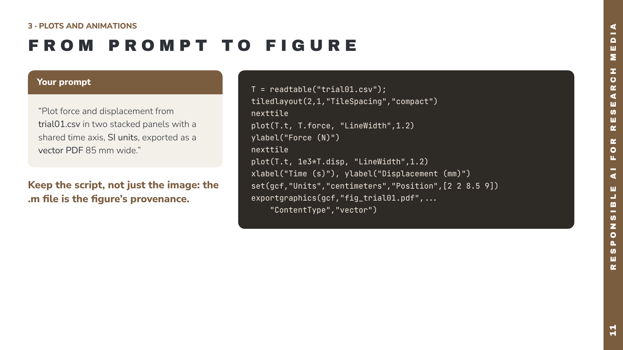
Notes:
Live demo: give this prompt to Claude with the MATLAB connector active. Name the file, the variables, the units, the layout and the export format. Claude writes code like this, runs it in MATLAB and can show you the figure. Then iterate in plain language. The column names t, force and disp are placeholders for your own data. Save the .m file next to the figure and commit both.

Slide 12
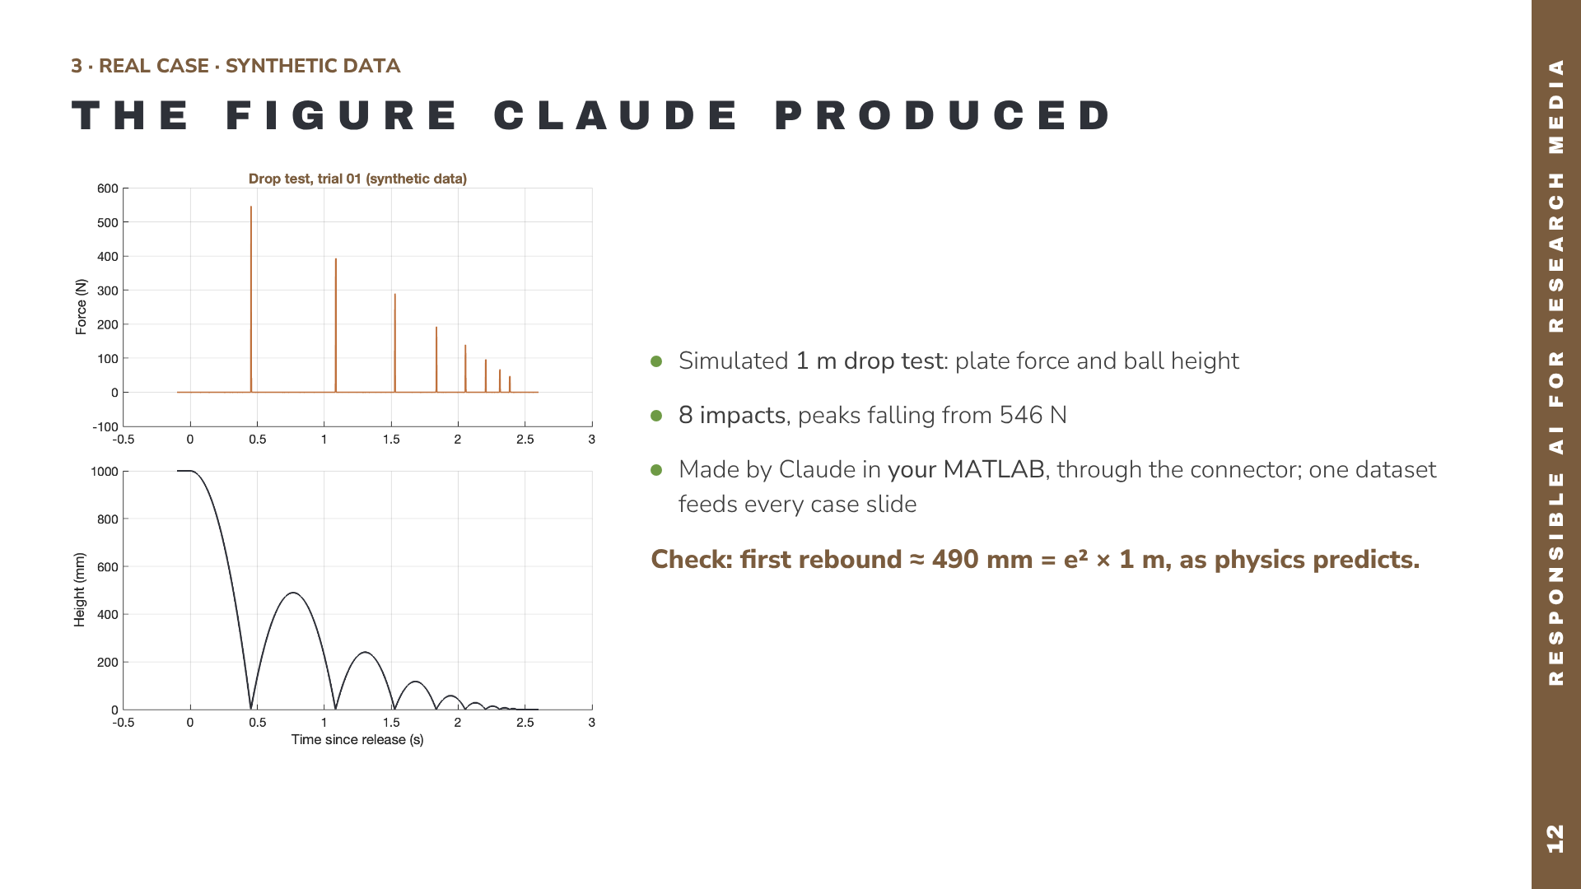
Notes:
This is a real output: Claude generated the dataset and drew this figure in MATLAB R2024a through the MathWorks connector. The same trial01.csv drives the sync, video and event-log slides that follow. The data are synthetic: a simulated 1 m drop of a 0.2 kg ball with a coefficient of restitution of 0.7, a 1 kHz load cell and a 30 fps camera. Use it to show the verification habit: the first rebound peak is about 490 mm, which is 0.7 squared times 1000 mm. That sanity check is your job, not the AI’s. These slides will be replaced with your own data later.

Slide 13
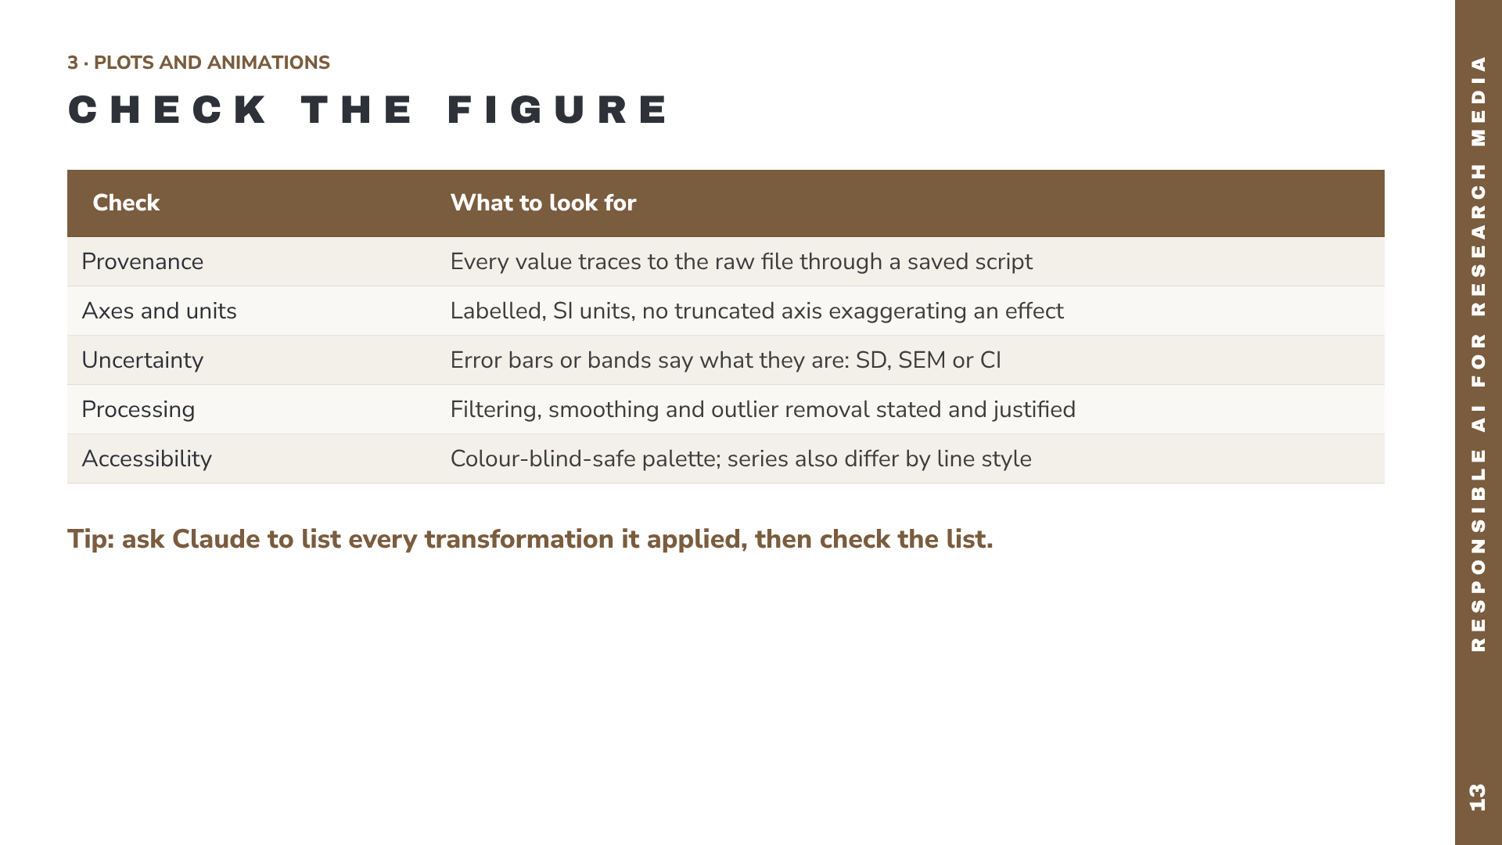
Notes:
This is the verification step from the loop, made concrete for figures. AI-generated plotting code can silently do things you didn’t ask for: drop NaNs, resample, apply default smoothing, or autoscale an axis so a small effect looks large. Read the code for each of these. Asking Claude to list every transformation applied between file and figure, then checking that list against the code yourself, is a quick and effective audit.

Slide 14
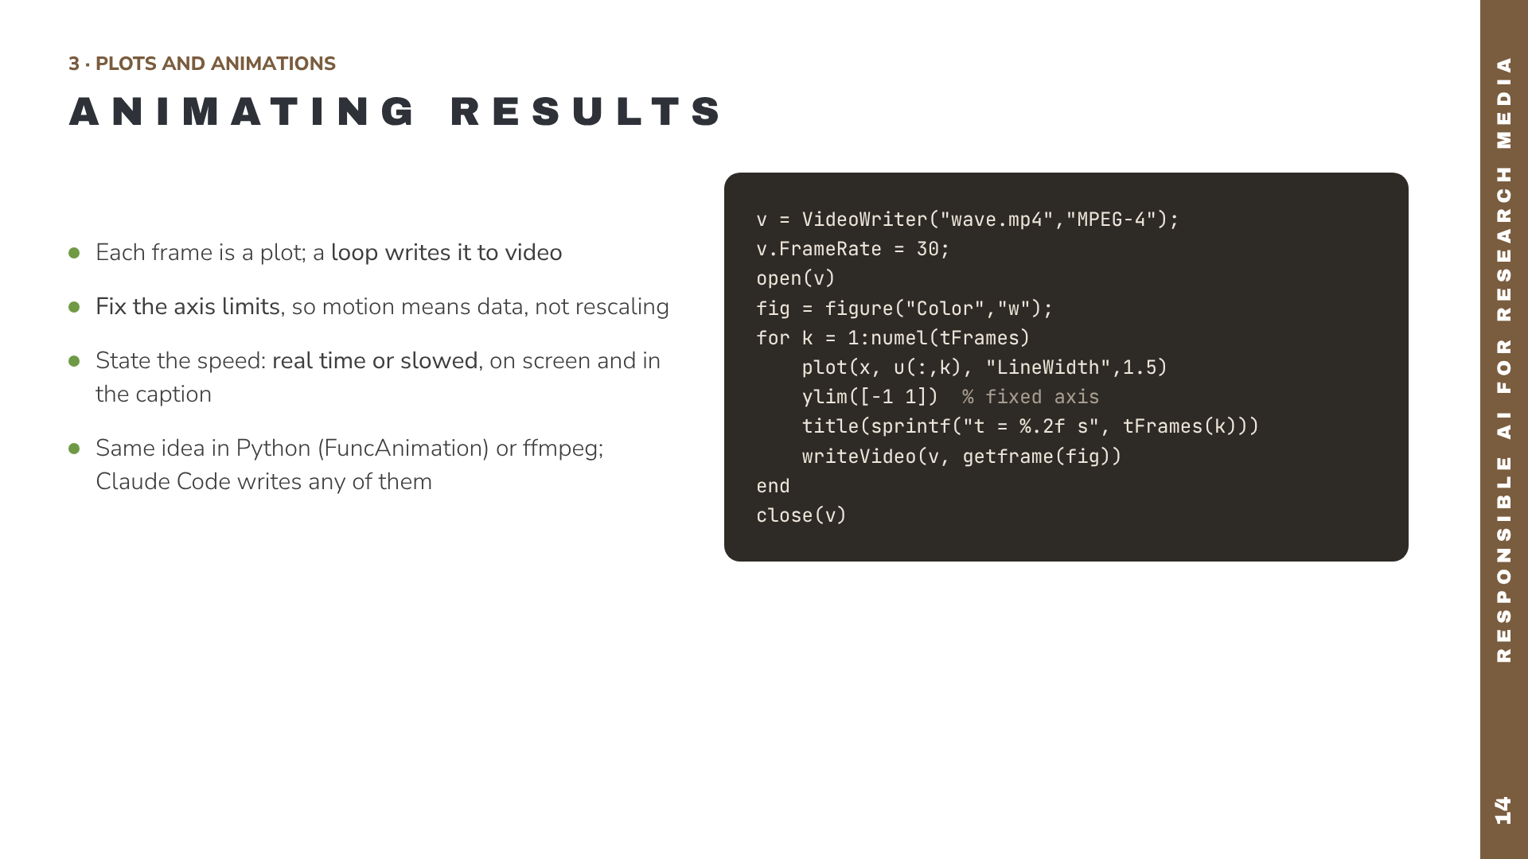
Notes:
Animations are where AI help saves the most time, because the boilerplate (VideoWriter, frame capture, codecs) is tedious and easy to get wrong. The pattern is always the same: compute or load, loop over time steps, draw, capture, write. Fix axis limits; autoscaling makes noise look like motion. Playback speed is a claim about time: if 1 second of video is 10 ms of experiment, say so on screen.

Slide 15
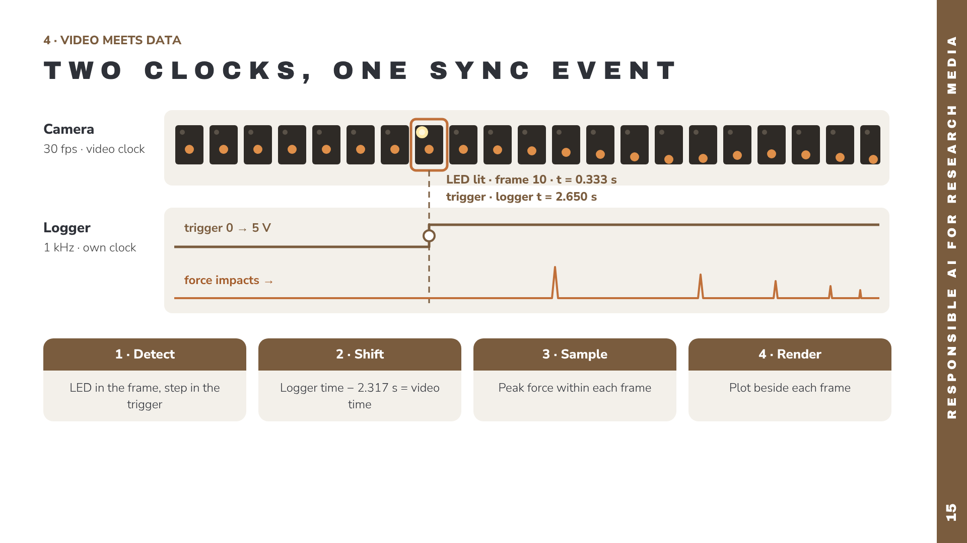
Notes:
Synchronization is the core technical problem. The camera samples at 30 frames per second on its own clock; the logger samples force at 1 kHz on another clock, and they start at different moments. The fix is a physical sync event both devices record: here an LED in the camera view wired to the logger’s trigger channel. In the camera strip, the highlighted frame is the one where the LED lights up; in the logger, the trigger steps from 0 to 5 V at the same instant. Detect both, shift the logger clock by the difference (2.317 s in our example), sample the peak force within each frame, and render. Claude writes this code well, but you confirm the detected event by eye.

Slide 16
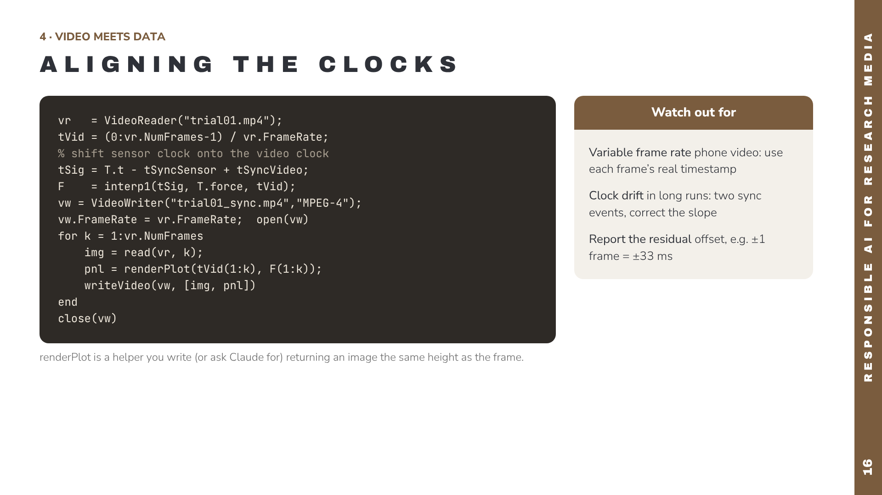
Notes:
This sketch shows the whole pipeline in about a dozen lines. tSyncSensor and tSyncVideo are the event times detected in each stream. interp1 gives one sensor value per video frame. Keep this slide in mind: the real case three slides later shows what this textbook interpolation misses. Phone cameras record variable frame rates, so read frames with readFrame and use CurrentTime. For long recordings, use a sync event at the start and the end. Always report how well the streams are aligned.

Slide 17
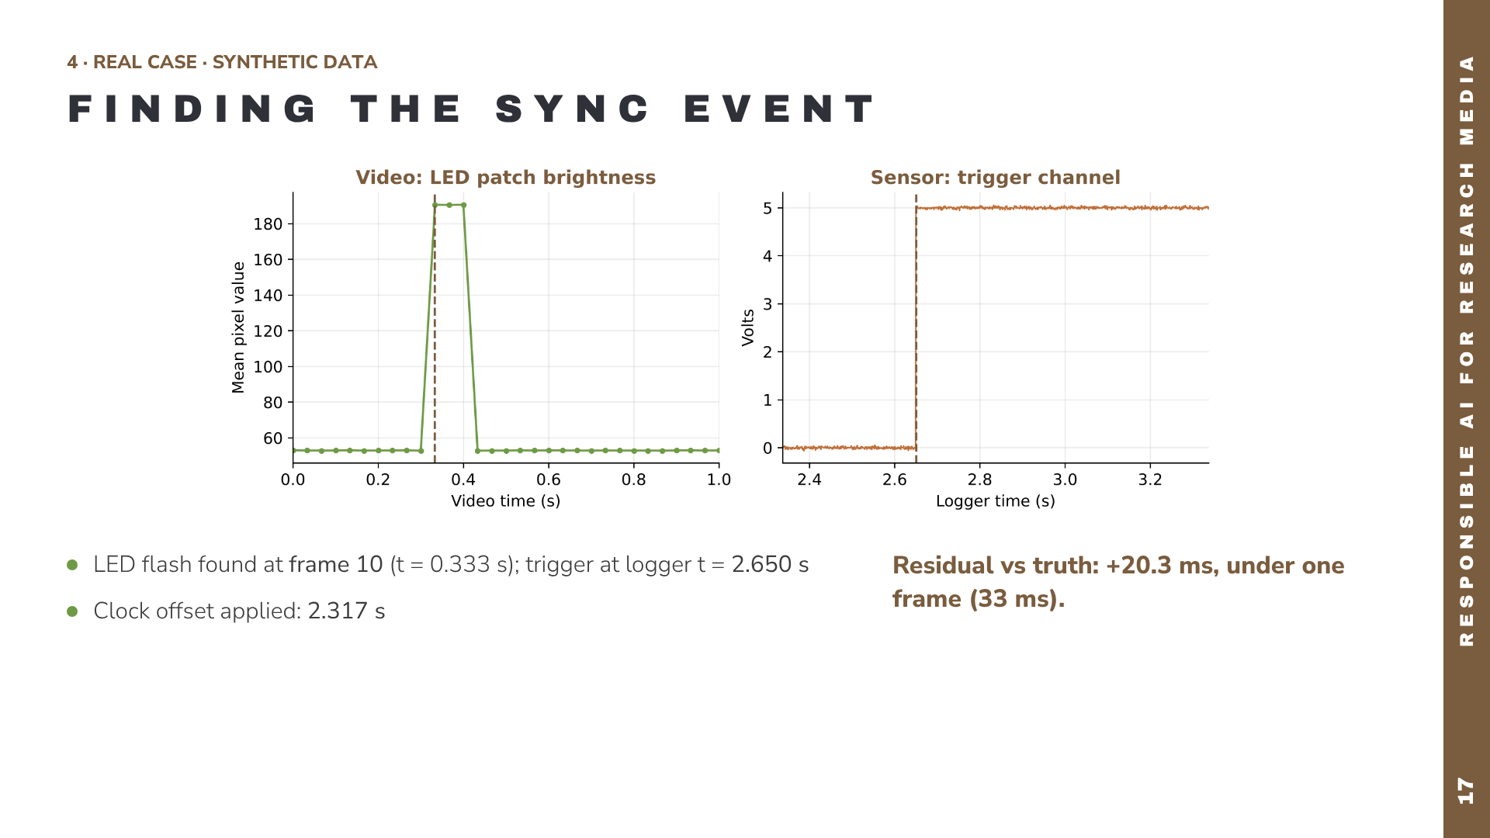
Notes:
Real output from the case-study run. The script measured the brightness of the LED region in every frame and found the flash at frame 10; it found the trigger step in the logger at 2.650 s; subtracting gives the clock offset. Because the data are synthetic, we know the truth and can measure the error: 20 ms, less than one frame at 30 fps. The camera’s frame rate sets your sync precision, and you should report it. With your own data, plot the detections like this and confirm them by eye.

Slide 18
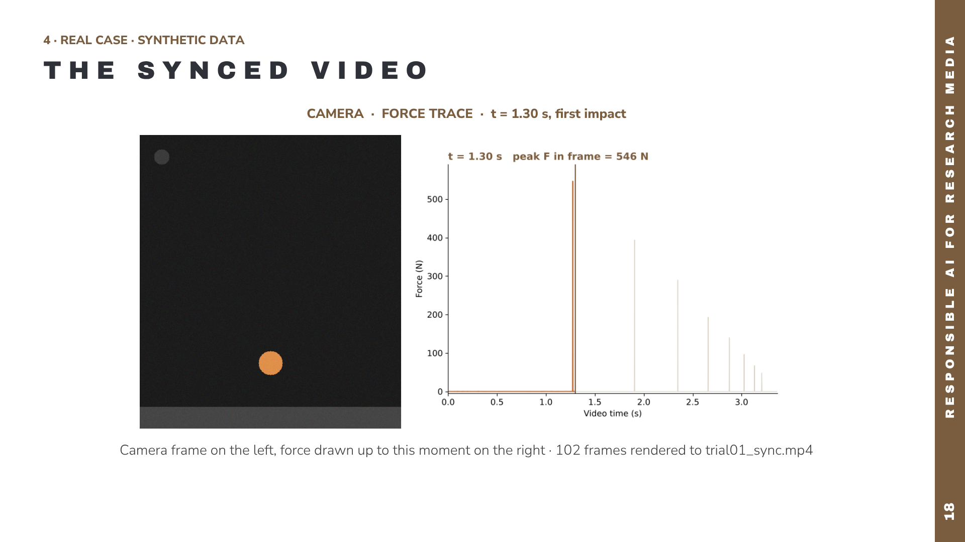
Notes:
A still from the actual synchronized video produced by the case study (play trial01_sync.mp4 here if presenting live). The ball is on the floor plate at the instant the force trace shows the first impact, which is the visual proof that the sync worked. The light trace is the full recording; the orange part is what has happened so far; the brown cursor is the current frame.

Slide 19
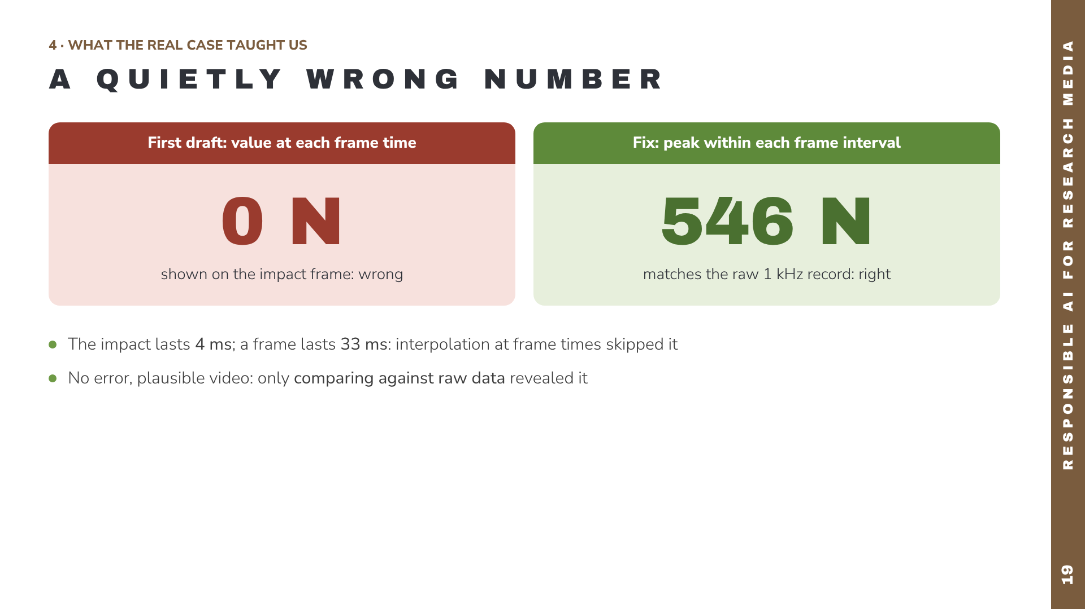
Notes:
This happened for real while preparing the case. The first version of the sync code used interpolation at each video frame time, the textbook approach shown on the code slide. It ran without errors and produced a plausible video, but on the impact frame it displayed 0 newtons, because the 4 millisecond impact fell entirely between two frames. Comparing the overlay value against the raw sensor peak exposed it. The fix was to show the peak force within each frame interval. This is the strongest argument for the verification step: the error was not a crash, it was a quietly wrong number.

Slide 20
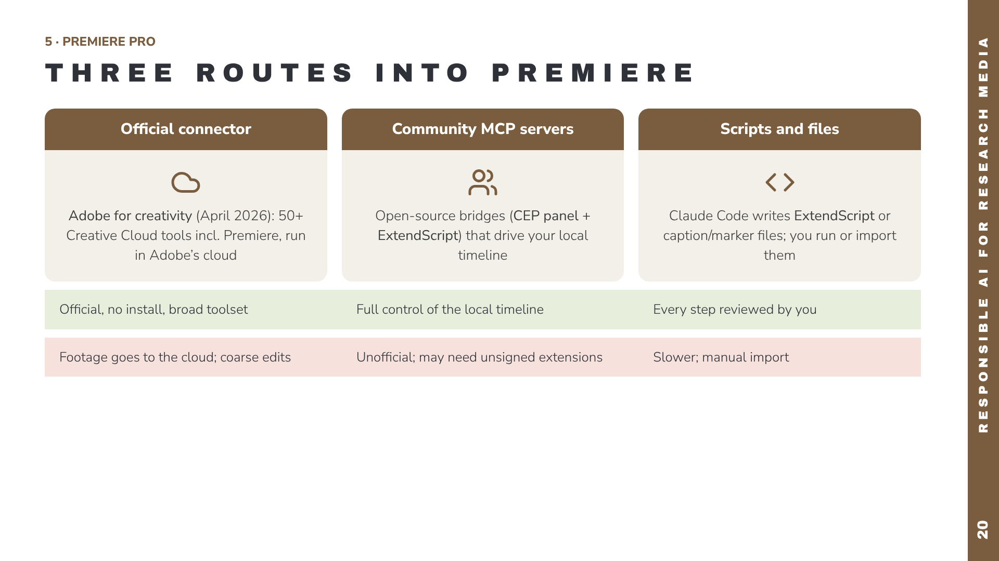
Notes:
Three practical routes. The official Adobe for creativity connector, launched by Adobe and Anthropic on 28 April 2026, is added from Claude’s connector library; it orchestrates more than 50 Creative Cloud tools in Adobe’s cloud, so it suits reformatting and quick edits rather than fine timeline work, and your footage goes to Adobe’s cloud. Community MCP servers on GitHub control your local Premiere through a CEP panel and ExtendScript; capable, but unofficial. The most conservative route: Claude Code writes scripts or caption files from your event log, and you run or import them yourself. Green row: strengths. Red row: risks.

Slide 21
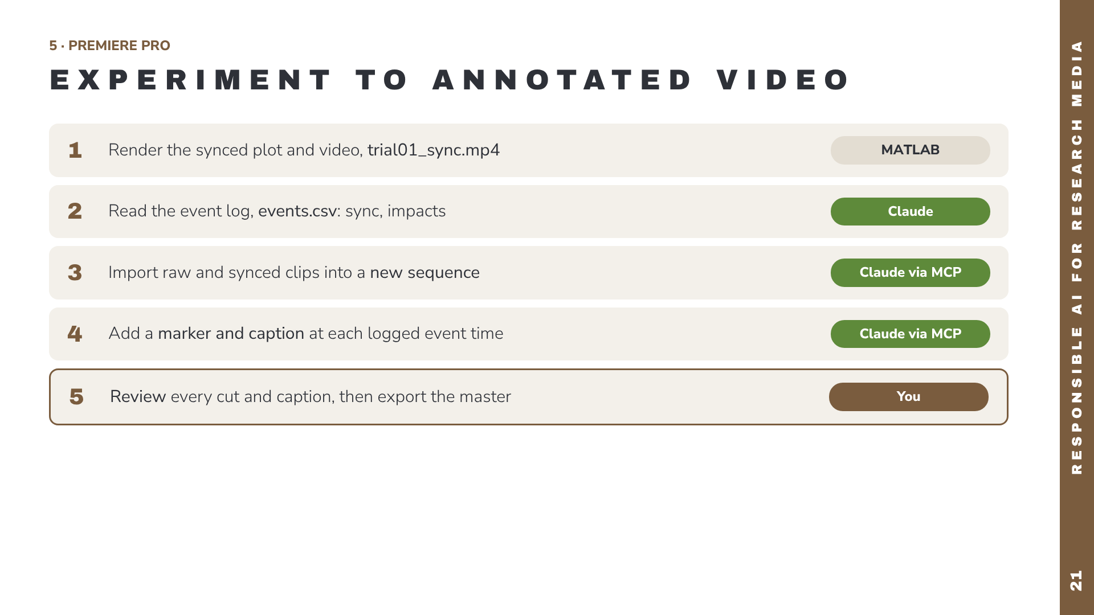
Notes:
The end-to-end example tying the talk together. MATLAB produces the synchronized video from Part 4. Claude reads the experiment’s event log. Through a Premiere MCP connection, Claude creates a sequence, imports the clips, and places a marker and caption at every logged event time, which is tedious by hand when there are dozens of trials. The final step is deliberately yours: watch the result, check each marker against the footage, and only then export.

Slide 22
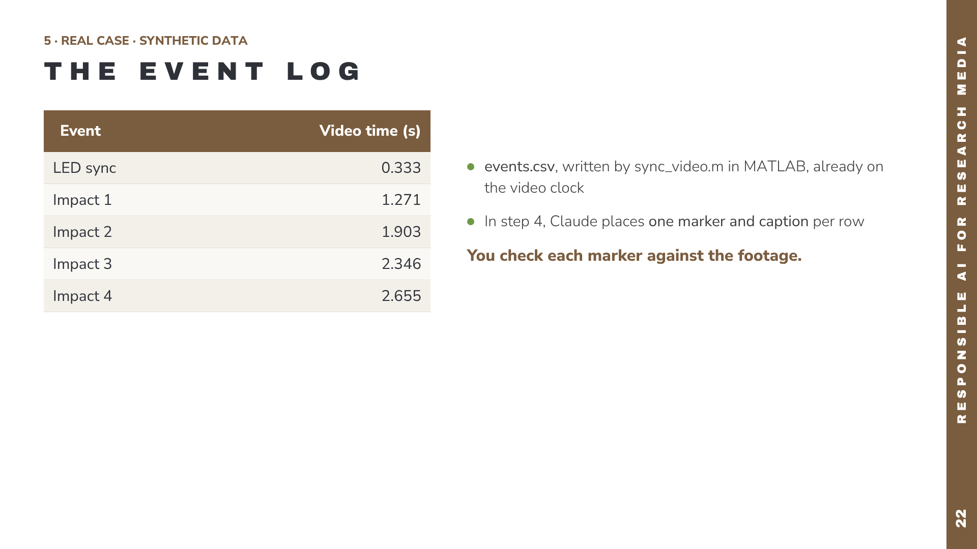
Notes:
This is the real events.csv produced by the case-study script. Because the times are already on the video clock, they can go straight onto the Premiere timeline as markers, either through a Premiere MCP connection or by Claude writing a marker or caption file you import. Before presenting, replace the next slide’s placeholder with a screenshot of these markers in your own Premiere project.

Slide 23
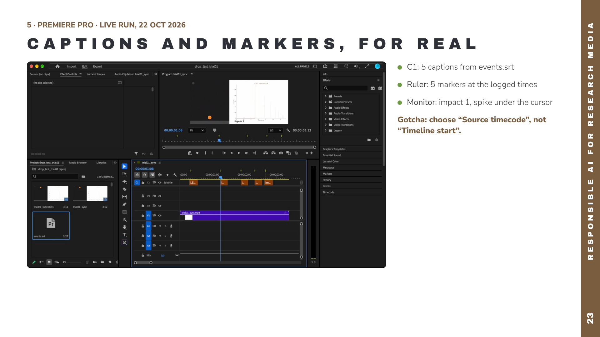
Notes:
A real screenshot from Premiere Pro 2026 on the presenter’s Mac, made by following the tutorial’s Route A. The subtitle track C1 holds the five captions imported from events.srt, the ruler holds five markers at the timecodes in markers_list.txt, and the program monitor is parked on the impact 1 frame: the force spike sits under the cursor and the ball is just above the floor. At 30 frames per second no frame catches the exact 4 ms contact. Two things we learned doing it: the caption file must be dragged onto the timeline, and in the dialog you must choose Source timecode; Timeline start moved the first caption to zero and shifted everything 0.333 s early.

Slide 24
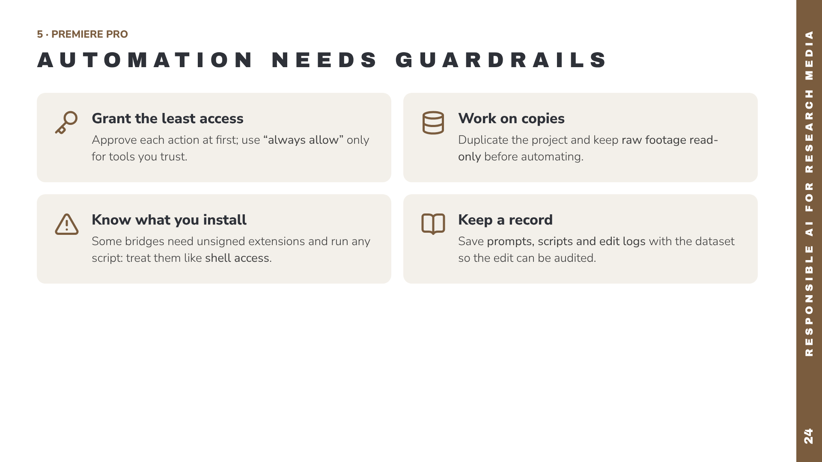
Notes:
When Claude can operate software directly, mistakes have side effects, so apply the same caution you would to a new student with admin rights. Approve actions individually until you trust a workflow. Work on a duplicated Premiere project and protect the raw footage. One community Premiere installer enables unsigned CEP extensions in debug mode, and one README notes that its execute-script tool amounts to shell access. Fine on a personal workstation, not on a shared lab machine without IT approval. Keep a record so an edited research video can be audited later.

Slide 25
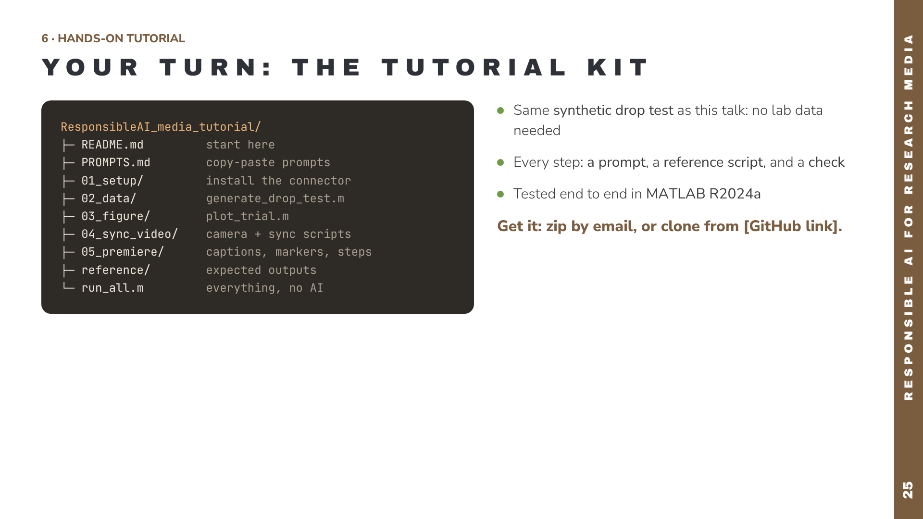
Notes:
This section turns the talk into something colleagues can repeat. The kit is a single folder, about 3.6 MB zipped, so it can be emailed, and it is set up as a Git repository (README, licence, .gitignore) so it can live on GitHub. Each step has three things: a prompt to paste into Claude with the MATLAB connector, a reference script that does the same thing so you can compare, and a check so you verify the result instead of trusting it. run_all.m reproduces everything without AI, which is also a good installation test. Replace [GitHub link] once the repository is published.

Slide 26
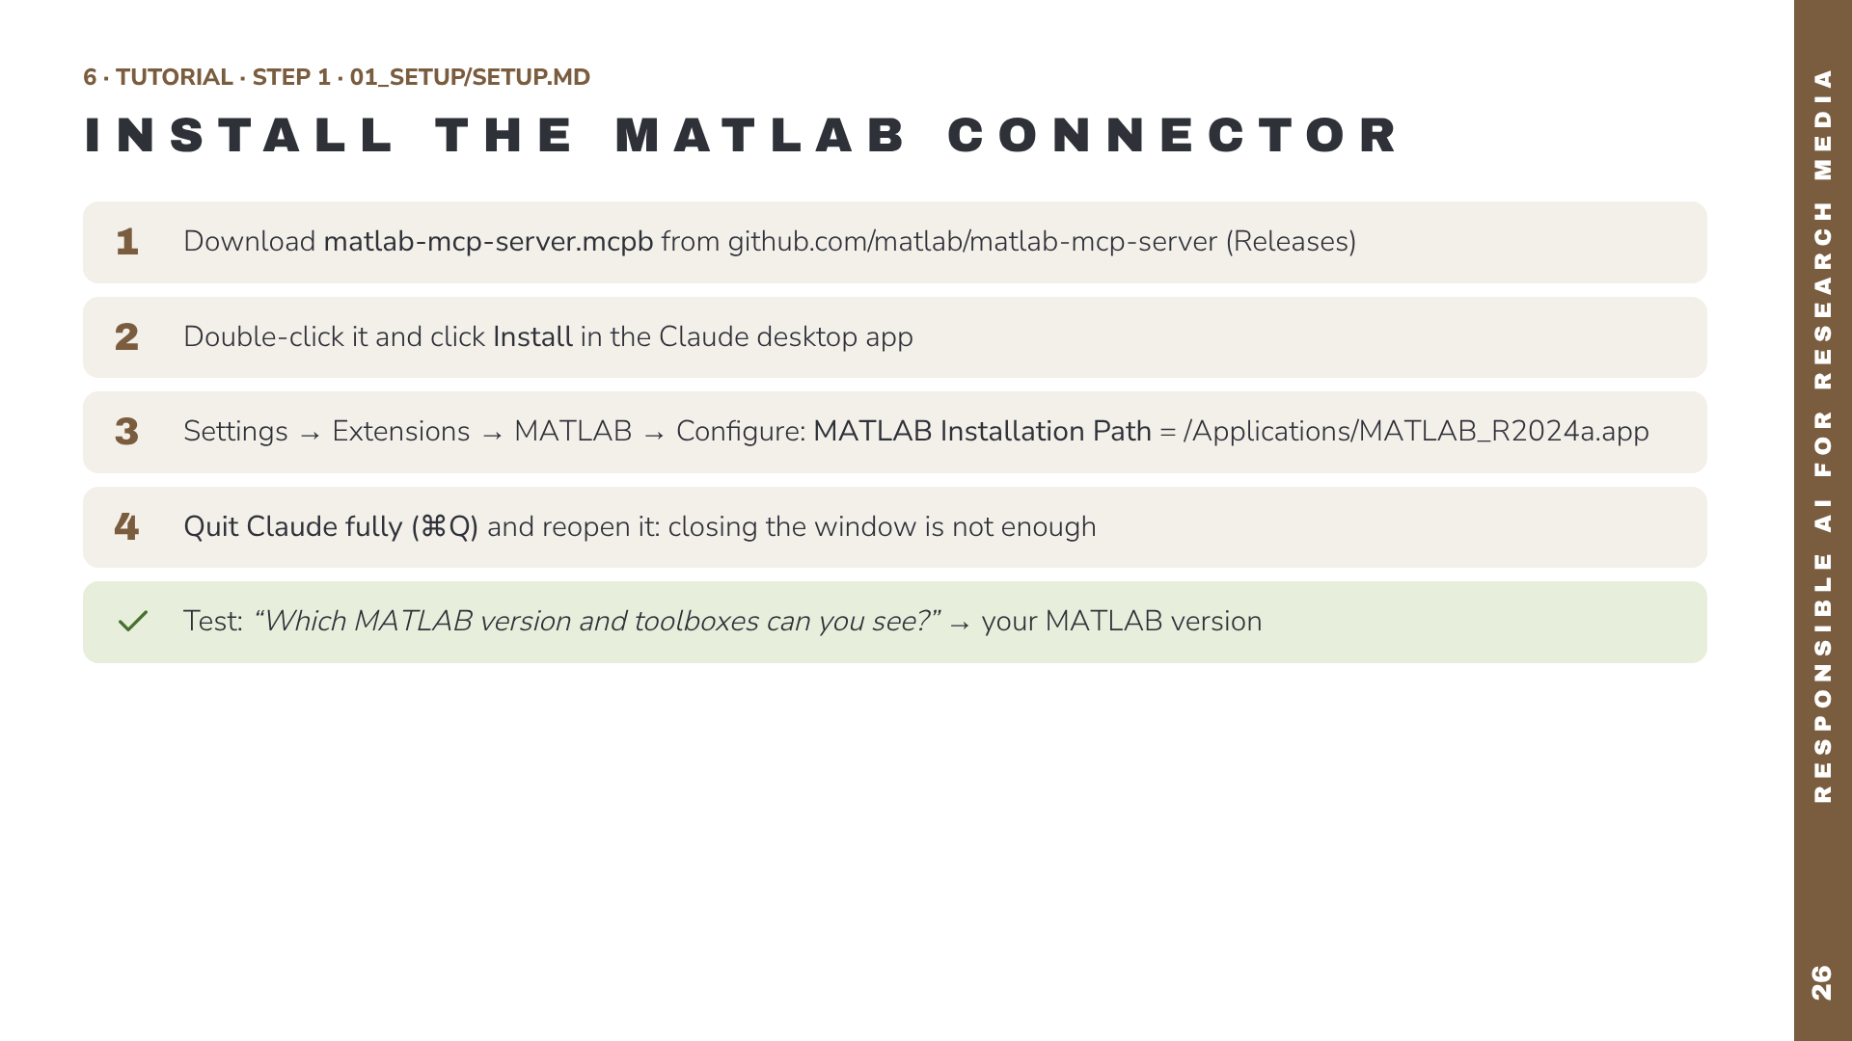
Notes:
This is exactly the sequence that worked when preparing the talk. The two traps: on a Mac, MATLAB is not on the system path, so the connector reports “no valid MATLAB environments found” until you set the installation path; and the setting only takes effect after quitting Claude completely. On Windows the path looks like C:\Program Files\MATLAB\R2024a. Optional: switch on Disable Telemetry, and set the Initial Working Folder to the kit folder.

Slide 27
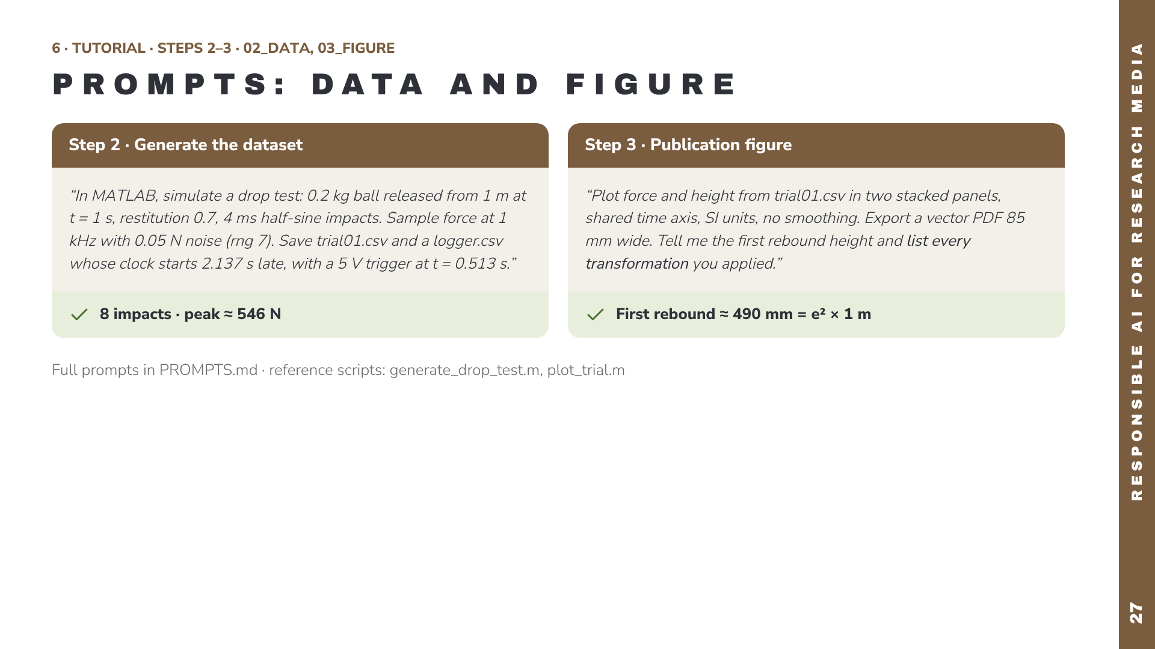
Notes:
Paste each prompt into Claude with the MATLAB connector on, approve the code after reading it, then do the check. Claude’s script will differ from the reference script, which is fine; the numbers should not. Asking Claude to list every transformation it applied is a cheap, effective audit.

Slide 28
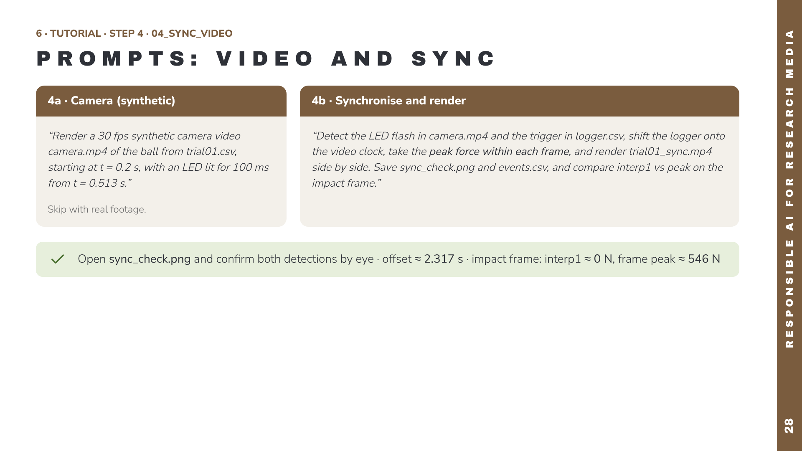
Notes:
This is the step where the real lesson of the talk lives. If someone writes the prompt without asking for the peak within each frame, Claude will usually use interp1 at the frame times, and the impact frame will show zero force. Encourage colleagues to try both and see it for themselves. The sync_check figure is the human-in-the-loop moment: never trust a detected sync event you have not looked at.

Slide 29
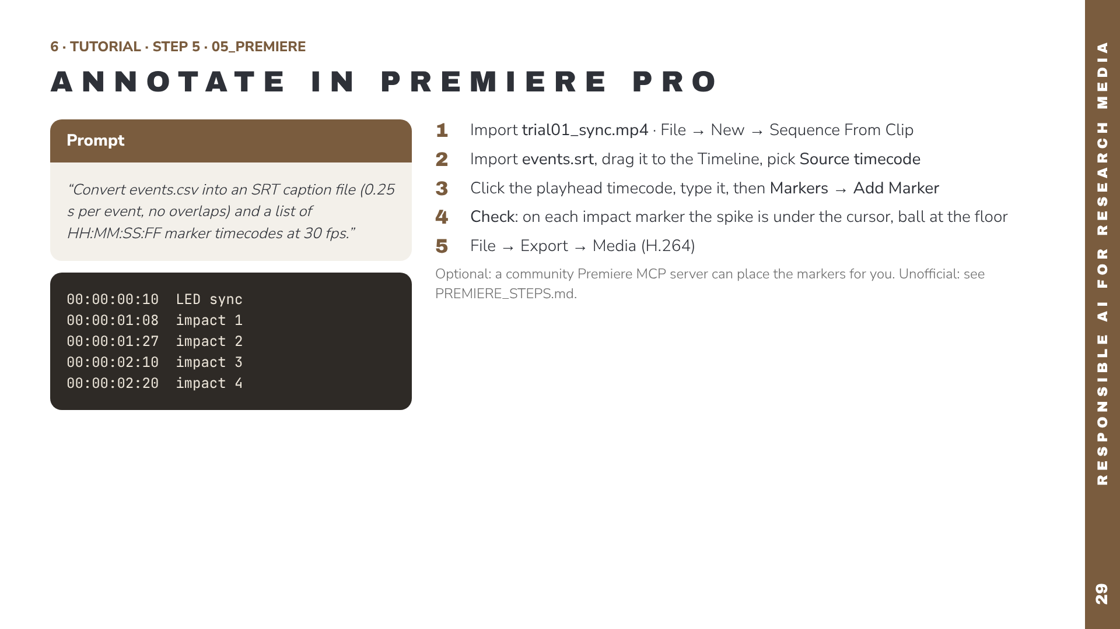
Notes:
For the tutorial we recommend Route A: Claude prepares the files, you place them. It needs no extra software and nothing runs unattended in your editor. The timecodes on the left are the real output of make_premiere_files.m. Route B, a community Premiere MCP server, can do steps 2–3 for you, but is unofficial and can run scripts on your machine; Route C, Adobe’s official connector, works in Adobe’s cloud and suits reformatting rather than frame-accurate markers. Both are described in PREMIERE_STEPS.md.

Slide 30
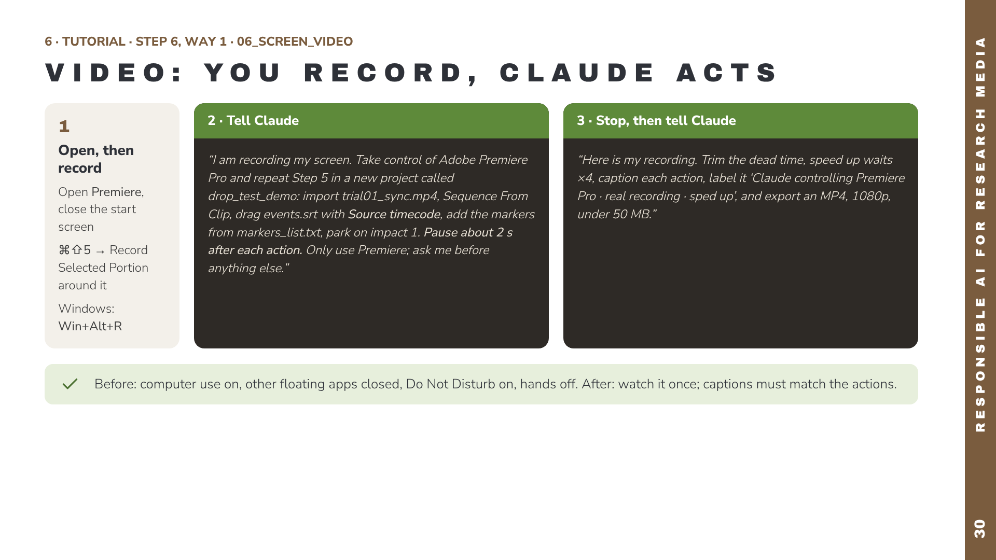
Notes:
Way 1 gives real motion, the most convincing demo. You start the macOS screen recorder, paste the first prompt, and keep your hands off the computer while Claude works; it asks you to approve control of Premiere first, so approve only Premiere. The 2-second pauses make the actions readable in the recording. When Claude says it’s done, stop the recording and give Claude the file with the second prompt to edit it into a labelled, sped-up presentation clip. Full prompts in 06_screen_video/VIDEO_PROMPTS.md. A practical lesson from preparing this talk: a floating ChatGPT window blocked Claude’s clicks until it was closed.

Slide 31
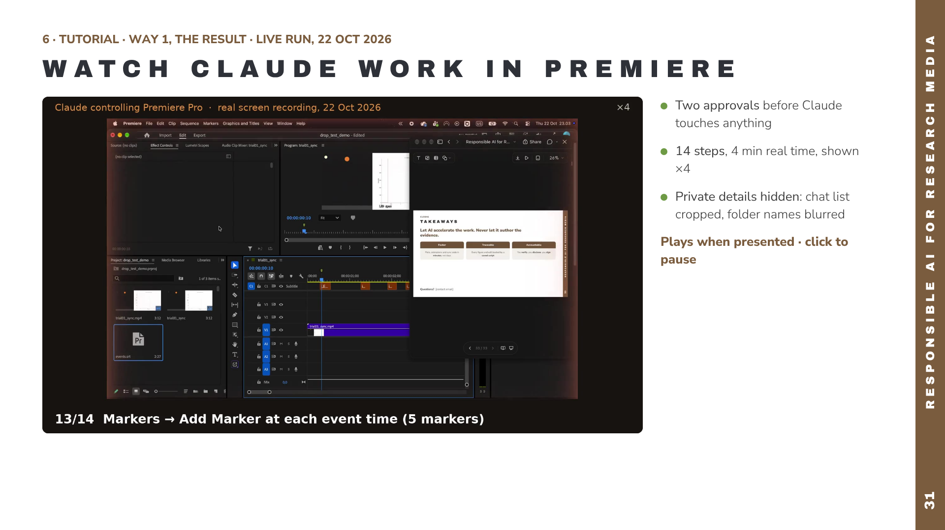
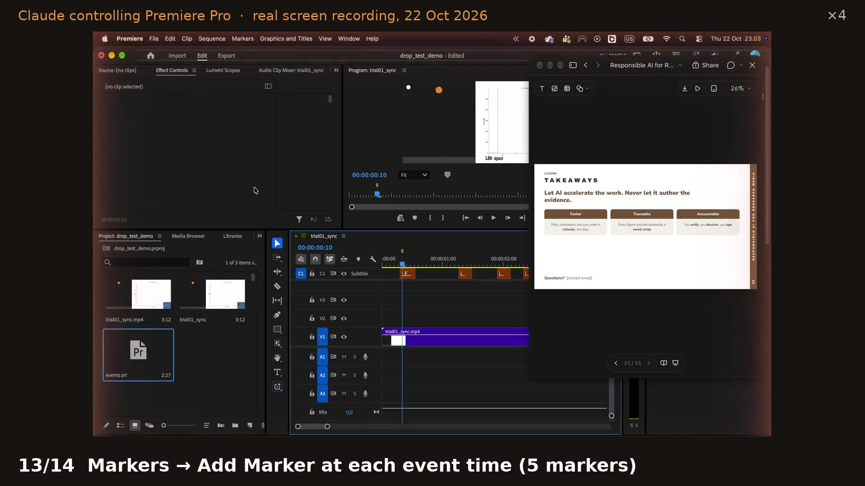
Notes:
This is the real recording made with Way 1 on 22 October 2026, edited by Claude into a 63-second clip. It starts in the Claude app: the presenter asks for the demo, Claude asks for permission to control Premiere Pro and then for full control of the screen, and the presenter clicks Allow once. Then Premiere, sped up four times: new project, import the synced video, sequence from clip, import the captions, Source timecode, five markers, park on impact 1, save. Every step is captioned, the speed-up is shown in the corner, the chat history sidebar was cropped out, and the folder names in the file dialog were blurred. The deck window you see floating on the right is this presentation, open in the Claude app during the recording.

Slide 32
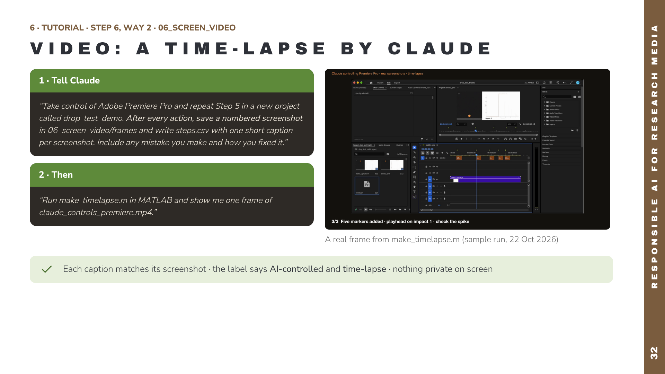
Notes:
Way 2 needs nothing from you except the two prompts. Claude repeats the Premiere step, saves a screenshot after every action with a one-line caption, and the MATLAB script make_timelapse.m turns them into a captioned MP4: 1.5 seconds per screenshot, 1920 by 1080, with an “AI-controlled, time-lapse” label. It uses only base MATLAB. The frame on the right is a real output of the script, made from three screenshots of today’s run, which are included in the kit so colleagues can test the script immediately. Asking Claude to include its own mistakes keeps the video honest and makes the point about human review.

Slide 33
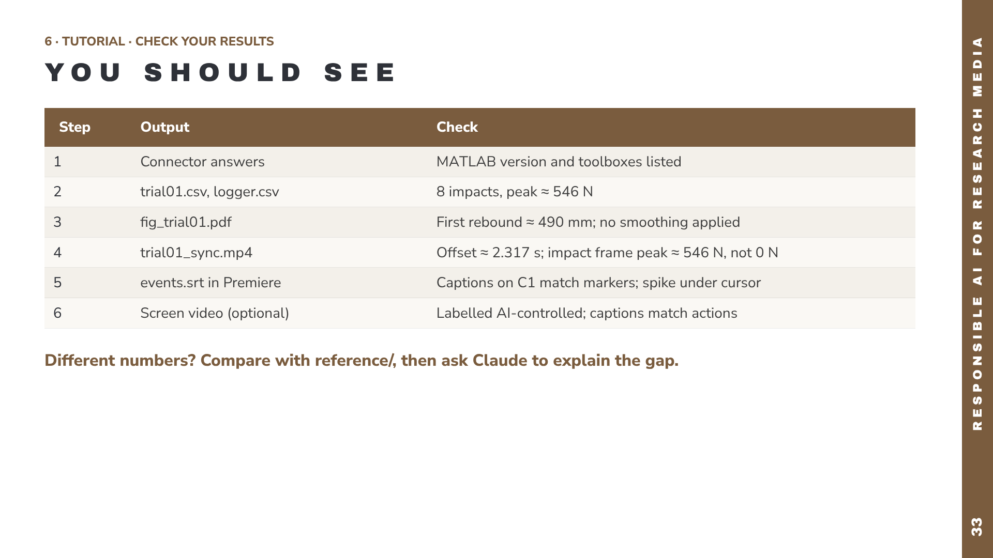
Notes:
All values come from running the kit in MATLAB R2024a. Small differences in the last digit are fine; anything bigger is a reason to investigate, which is the habit we want to build. The reference folder contains every expected output, including the synced video, for direct comparison.

Slide 34
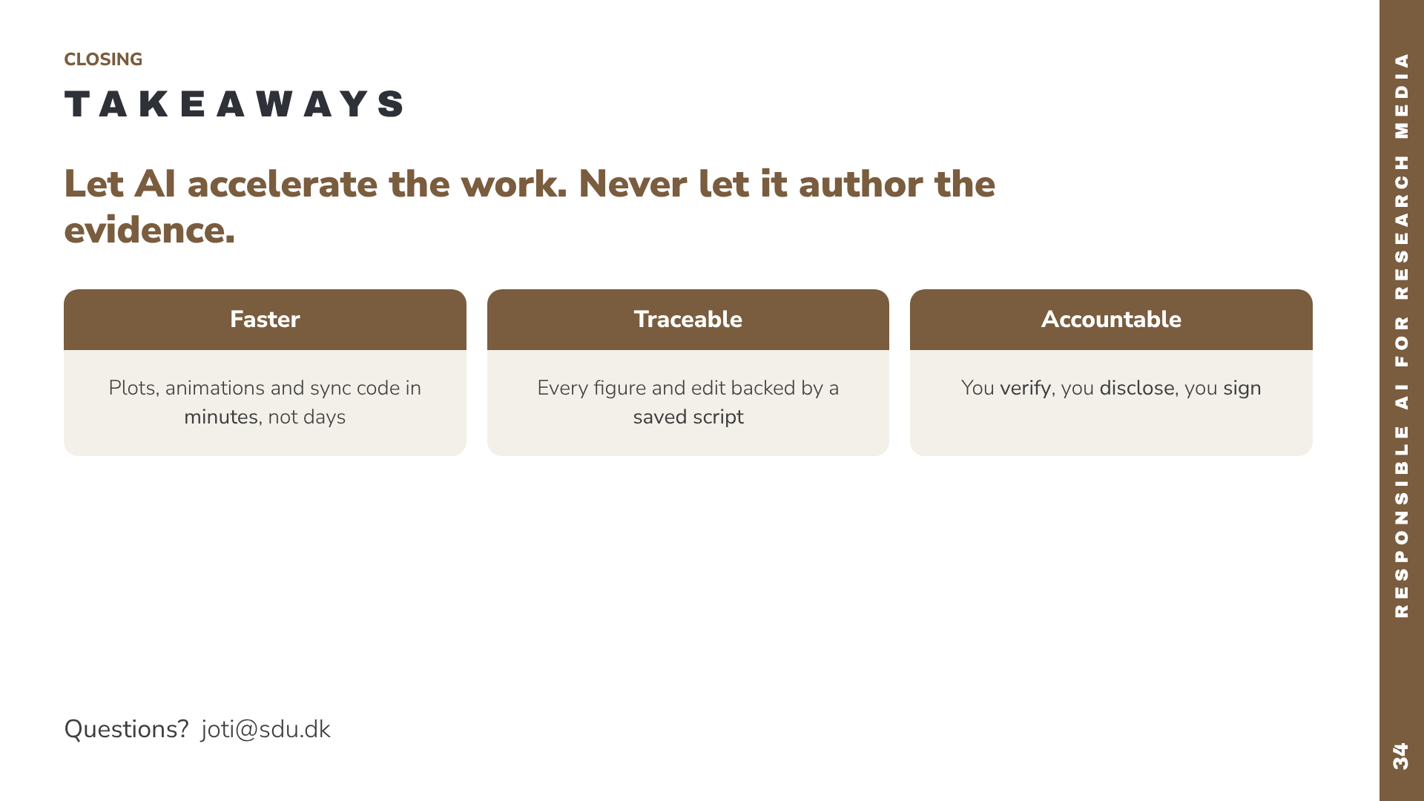
Notes:
Close on the single idea: AI is an accelerator for the media and code around research, not a substitute for the researcher’s judgement. Recap the three words: faster, traceable, accountable. Invite questions, and offer to share the setup instructions and the example scripts after the session.

