Slide 1
Introduction to Soft Robotics Autumn 2022 Instructors: Ahmad Rafsanjani, Jonas Jørgensen
5 September 2022

Slide 2
Part 1: Arduino 101
5 September 2022

Slide 3
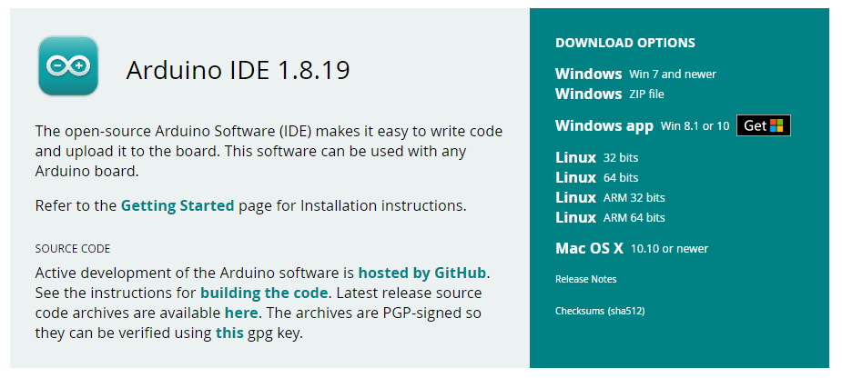
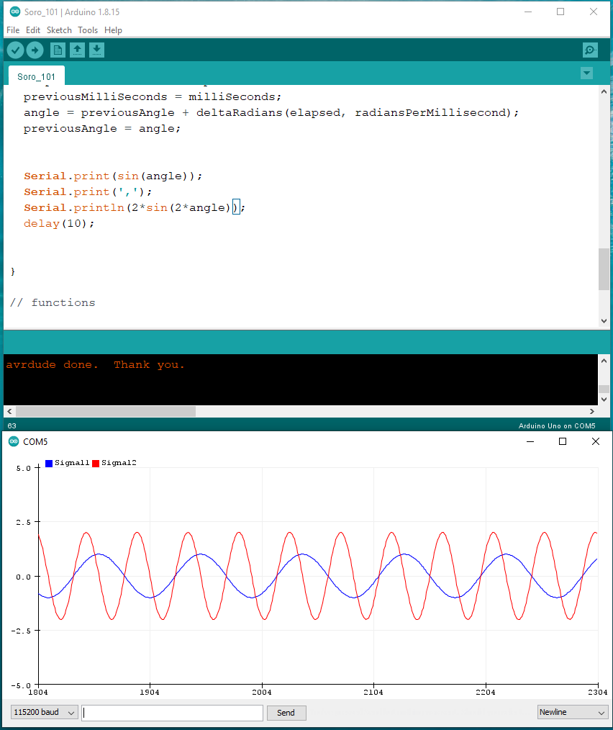
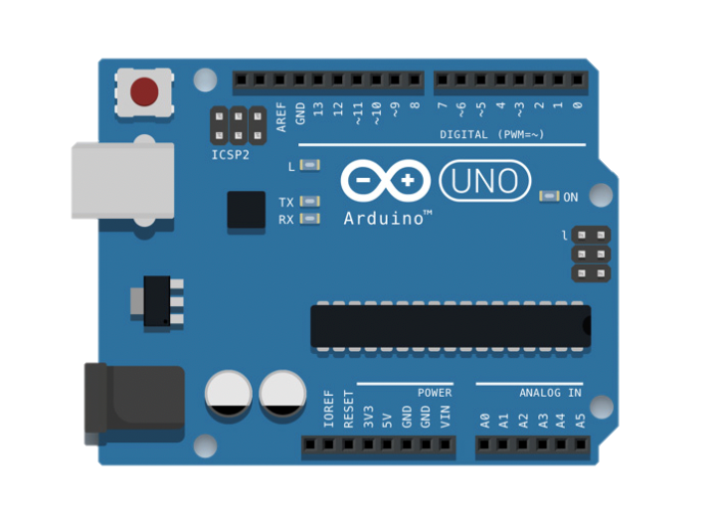




Arduino Uno and Serial communication
SoRo_101 QR code
GitHub Link
5 September 2022

Slide 4
Part 2: MPX5100 Integrated Silicon Pressure Sensor
5 September 2022

Slide 5
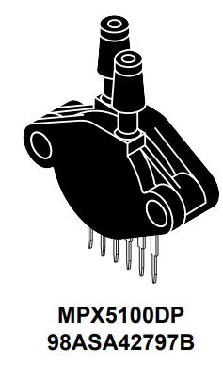
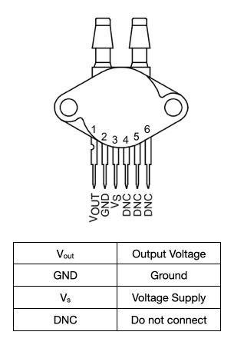
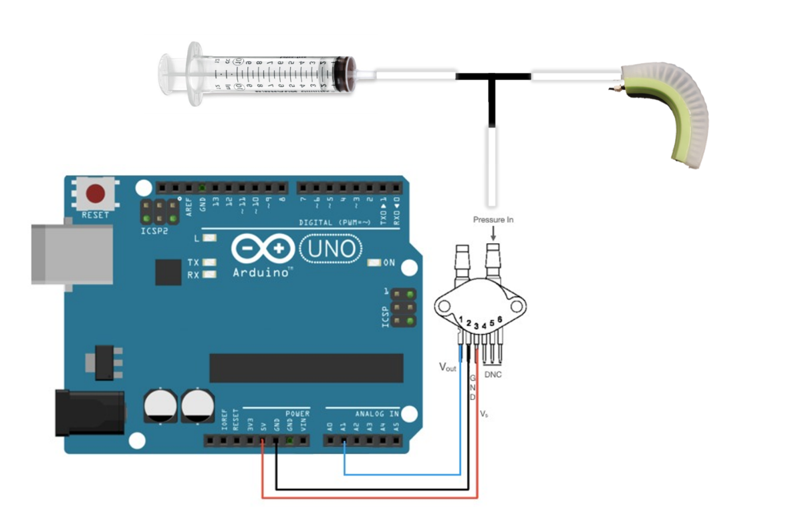
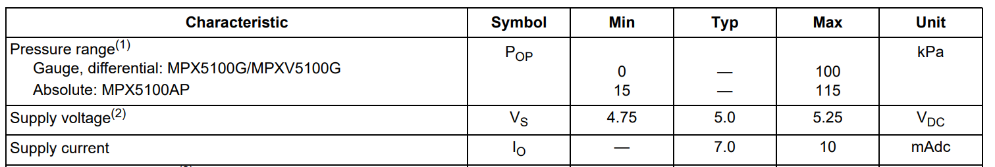
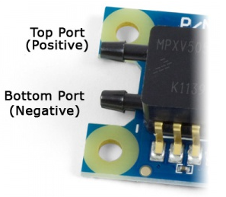
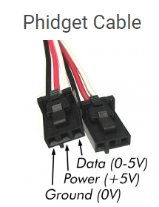
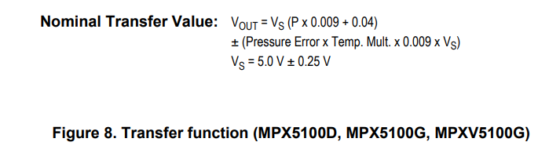
MPX5100, 0 to 100 kPa, Differential, Gauge, and Absolute, Integrated, Pressure Sensor
Figure 1. MPX5100DP Pinout (top view), Pin functions, and mechanical and electrical specifications
Figure 2. MPX5100DP – Arduino connection diagram
5 September 2022

Slide 6

Code Information
Arduino libraries
Download ads Arduino driver at GitHub Link
Copy folder ads_driver into Arduino/Libraries folder
Open the ads.h file located at ads_driver folder
Change the command ADS_DFU_CHECK(1) to ADS_DFU_CHECK(0)
Save the changes
Download SoRo_Tutorial_1 sketch at GitHub Link
Arduino Calibration
Compile and Upload SoRo_Tutorial_1 sketch at Arduino Uno Device
Open the serial monitor
Put the Bendlabs sensor in the 0° position
Type 0 and press Enter
Put the Bendlabs sensor in the 90° position
Type 9 and press Enter
Ads_driver QR code
SoRo_Tutorial_1 QR code
5 September 2022

Slide 7
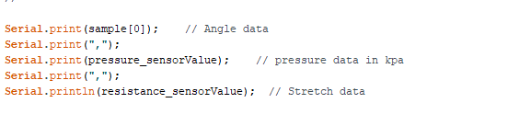
Code Information
Arduino Calibration and plotting
5 September 2022

Slide 8
Part 3: Conductive Rubber Cord Sensor
5 September 2022

Slide 9

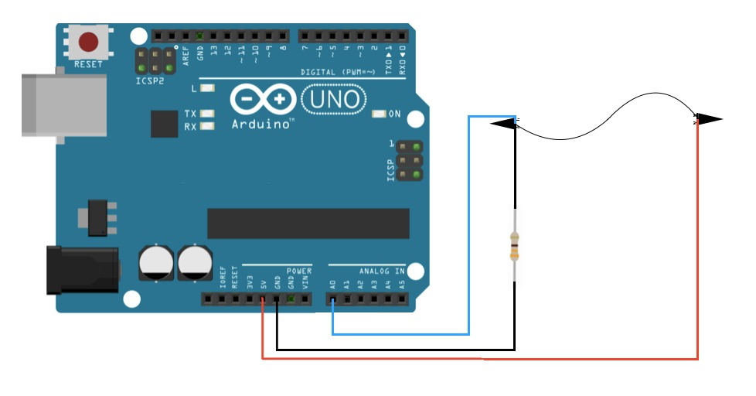
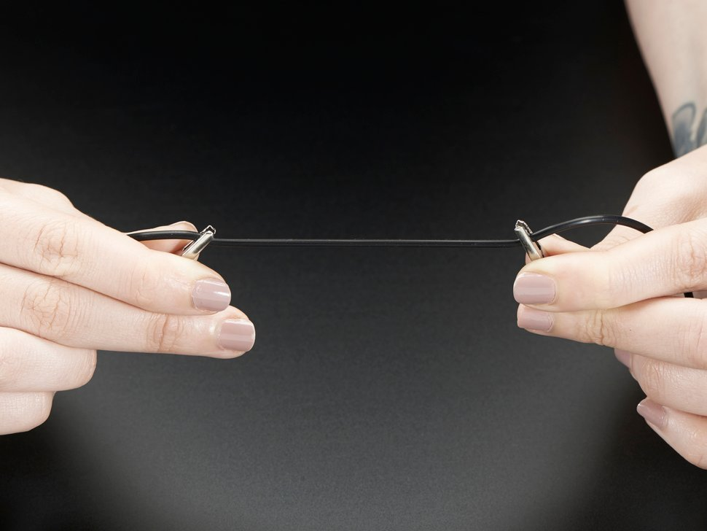
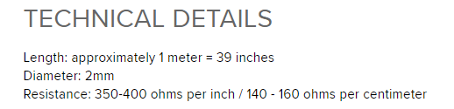
Figure 1. Conductive Rubber Cord Sensor – Arduino connection diagram
5 September 2022

Slide 10
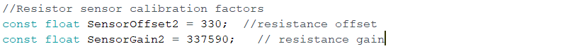
Code Information
Arduino Calibration and plotting
5 September 2022

Slide 11
Part 4: Bendlabs sensor
5 September 2022

Slide 12
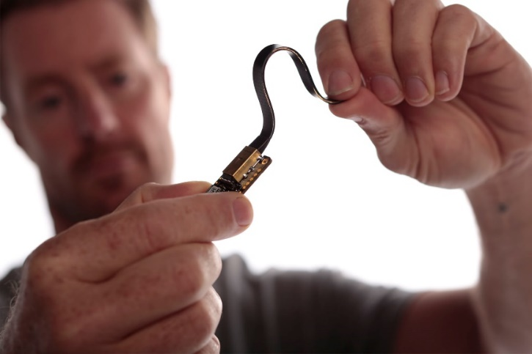


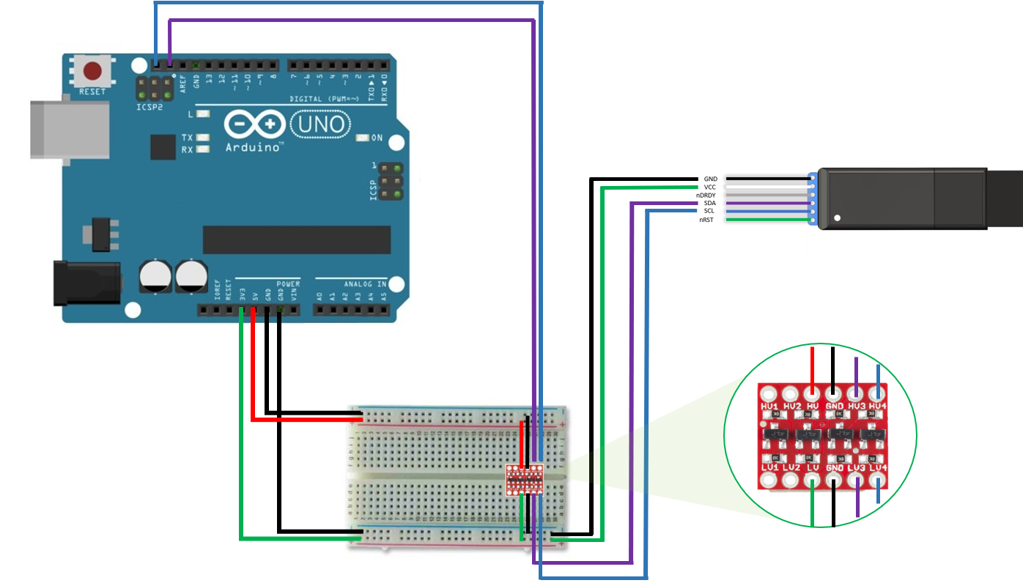
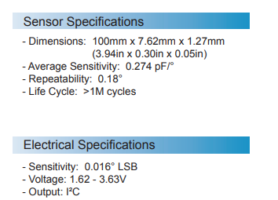
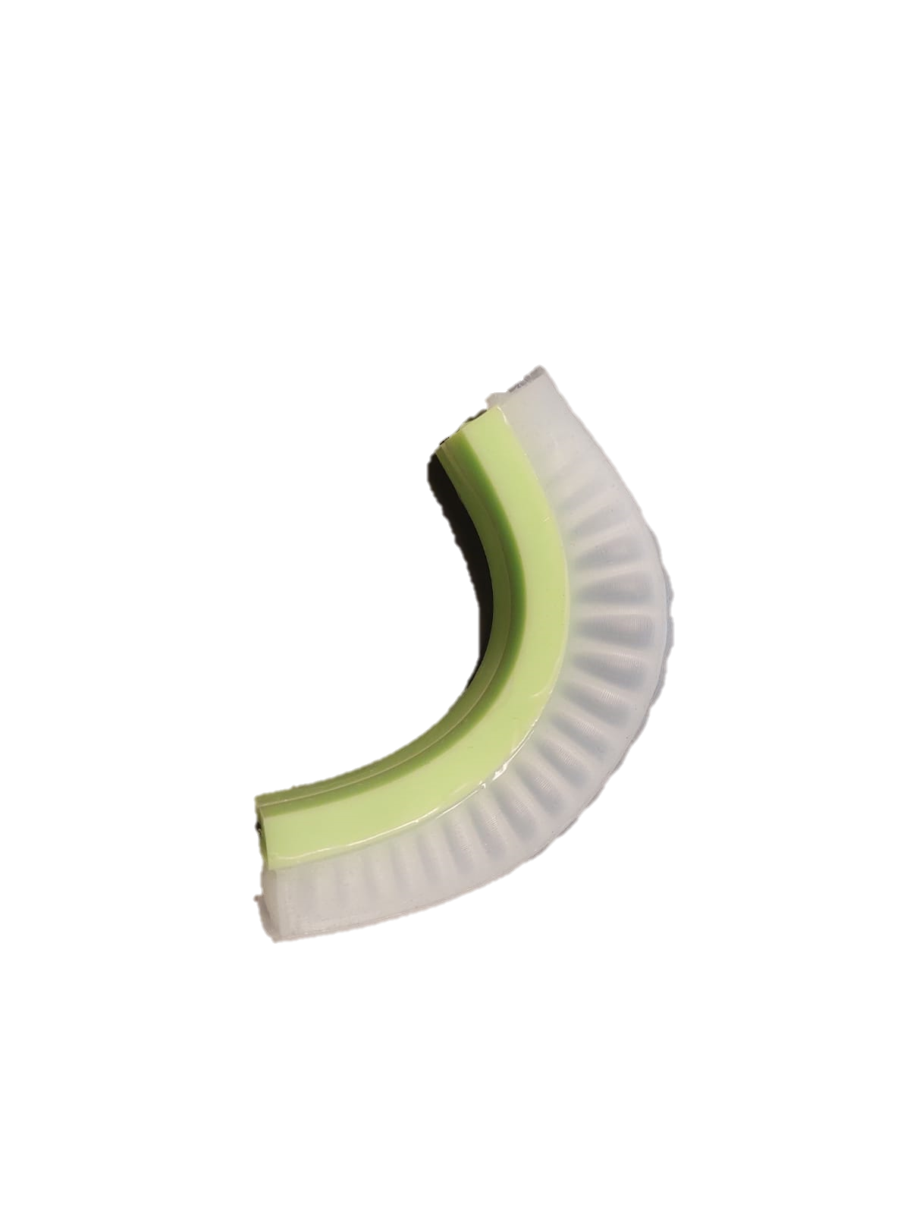
∆ꝋ
4-channel Logic Level Converter
Figure 1. Bendlabs sensor – Logic Level Converter – Arduino connection diagram
5 September 2022

Slide 13
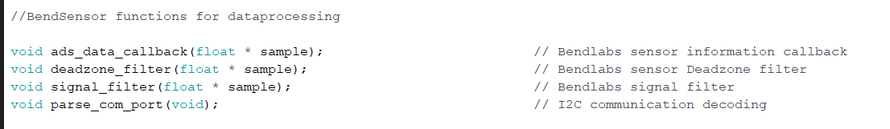
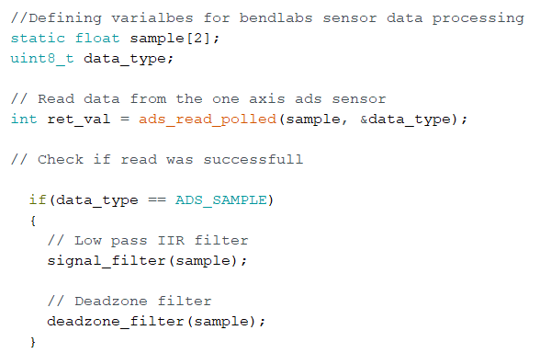
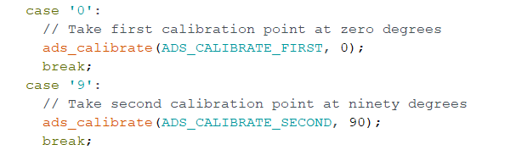
Code Information
Arduino Calibration and plotting
5 September 2022

Slide 14
Part 5: System integration
5 September 2022

Slide 15
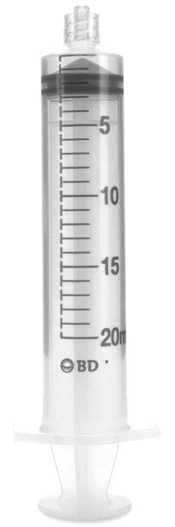
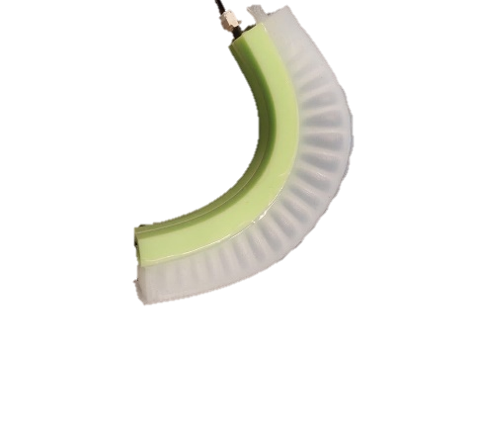
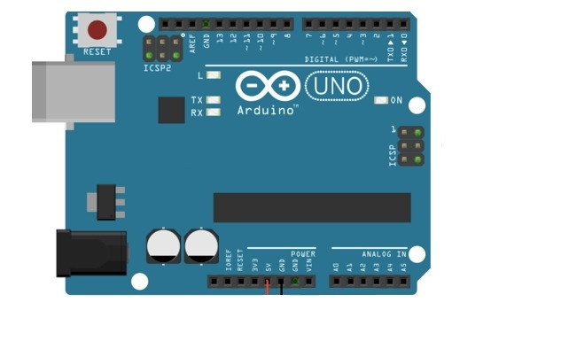
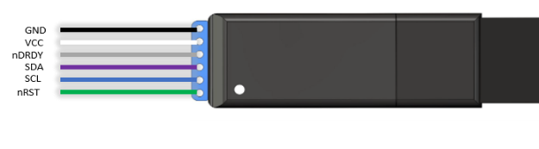
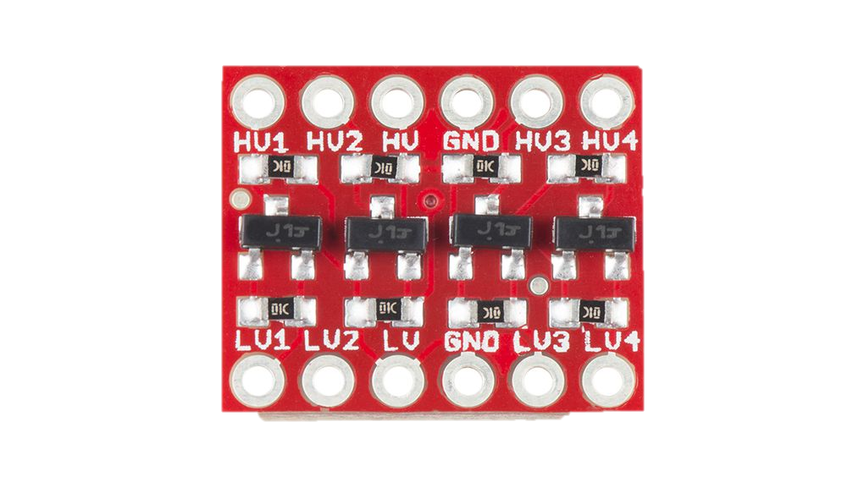
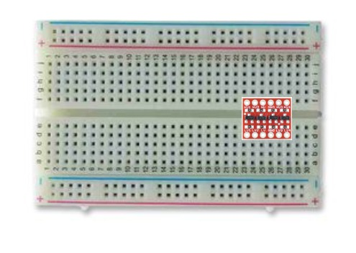
Figure 1. Connection Scheme for a Bendlabs and MPX5100 pressure sensor for Arduino Uno
5 September 2022

