Slide 1
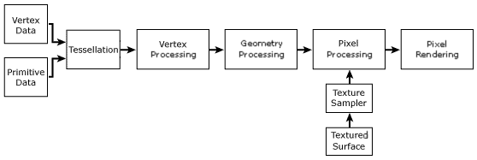
Pipeline Component | Description | Related Topics
Vertex Data | Untransformed model vertices are stored in vertex memory buffers. | Vertex Buffers (Direct3D 9), IDirect3DVertexBuffer9
Primitive Data | Geometric primitives, including points, lines, triangles, and polygons, are referenced in the vertex data with index buffers. | Index Buffers (Direct3D 9), IDirect3DIndexBuffer9, Primitives, Higher-Order Primitives (Direct3D 9)
Tessellation | The tesselator unit converts higher-order primitives, displacement maps, and mesh patches to vertex locations and stores those locations in vertex buffers. | Tessellation (Direct3D 9)
Vertex Processing | Direct3D transformations are applied to vertices stored in the vertex buffer. | Vertex Pipeline (Direct3D 9)
Geometry Processing | Clipping, back face culling, attribute evaluation, and rasterization are applied to the transformed vertices. | Pixel Pipeline (Direct3D 9)
Textured Surface | Texture coordinates for Direct3D surfaces are supplied to Direct3D through the IDirect3DTexture9 interface. | Direct3D Textures (Direct3D 9), IDirect3DTexture9
Texture Sampler | Texture level-of-detail filtering is applied to input texture values. | Direct3D Textures (Direct3D 9)
Pixel Processing | Pixel shader operations use geometry data to modify input vertex and texture data, yielding output pixel color values. | Pixel Pipeline (Direct3D 9)
Pixel Rendering | Final rendering processes modify pixel color values with alpha, depth, or stencil testing, or by applying alpha blending or fog. All resulting pixel values are presented to the output display. | Pixel Pipeline (Direct3D 9)

Slide 2
Eye Point, Look At, Up Vector and Rotation with Mouse
Up Vector = Y
Up Vector shows how the object should rotate
LR = The Same Angle as the Up Vector
Up Vector = Y
Up Vector = Y
Y
NA
UD = Z
Z
UD = X
Object in Object Space
Up Vector = X
The Up Vector tells what is up in Object Model Space
Up Vector = X
UD = Z
X
NA
Mouse UD Positive
UD = Y
The Look At tells where the Eyes are looking
Mouse LR Positive
Up Vector = Z
UpVector
EyePoint tells where the Eyes are placed on Object
Up Vector = Z
LookAt
EyePnt
UD = X
UD = Y
NA

Slide 3
Create
Globe
Init
TObject
Create
Base
Create
Create
Tube
Init
Create
Mesh
Tube
Init
Create

Slide 4
* Num
(Num + 1) * 2
+1
+1
X = v8.x + ia * (v6.x – v8.x)
Y = v8.y + ia * (v6.y – v8.y)
Z = v8.z + ia * (v6.z – v8.z)
+1
+1
+ (Num-1)*2
ia
V5:
X = v1.x + ia * (v2.x – v1.x)
Y = v1.y + ia * (v2.y – v1.y)
Z = v1.z + ia * (v2.z – v1.z)
objVbLen = Num * (Num+1)*2 + (Num-1)*2
objPriLen := Num * (Num * 2) + (Num-1)*4
ib
v1(x,y,z)
v2(x,y,z)
V8:
X = v1.x + ib * (v4.x – v1.x)
Y = v1.y + ib * (v4.y – v1.y)
Z = v1.z + ib * (v4.z – v1.z)
Ind A=1, Ind B=1
V6:
X = v2.x + ib * (v3.x – v2.x)
Y = v2.y + ib * (v3.y – v2.y)
Z = v2.z + ib * (v3.z – v2.z)
v4(x,y,z)
v3(x,y,z)
V7:
X = v4.x + ia * (v3.x – v4.x)
Y = v4.y + ia * (v3.y – v4.y)
Z = v4.z + ia * (v3.z – v4.z)

Slide 5
17
15
13
10,11
18,19
1
3
5
7
For each band:
  Base = (num+1)*2 vectors
  Side extras = (2*3) extra for 3 corners
On second to last Band:
  1 extra for the band before (last vector)
  1 extra for first vector
16
2
14
4
6
8,9
+2
12
+2

Slide 6
If Num = 8
Each Loop has 18 = (Num + 1) * 2 Vectors
There are Num Bands
Each Band has 2 extra Points
One in the beginning, and one at end
This is Num * 2 Vectors
The First Band and Last Band have only
One extra Point
objVbLen := Num * (Num+1)*2 + Num*2 – 2
If Num = 8 then =
objPriLen := 150
8
6
10
4
12
14
2
0
16
17

Slide 7
67.5 = 0.38 x 0.92
X = 4 – (4*0.38)
Y = 6 + (4*0.92)
A = 3*PI /4
45 = 0.71 x 0.71
X = 4 – (4*0.71)
Y = 6 + (4*0.71)
A = PI/2
22.5 = 0.92 x 0.38
X = 4 - (4*0.92)
Y = 6 + (4*0.38)
A = PI/4
X = 0
Y = 6
X = 4
Y = 6

Slide 8
Pick Ray
Trap
Vector Coordinates = 1,1
Will Be Length 1.414
Trap
Distance
Point
Point
Distance
Vector Coordinates = 1,1,1
Will Be Length 1.732 =
Depth
Depth
Circle Radie
Eye Point

Slide 9
objOrg (x,y,z)
objAng (x,y,z)
objScl (x,y,z)
objRadieM = Extent in Model Space
objRadieW = Extent in World Space
objBM = Base Matrix of Object
objWM = World Matrix of Object
Hit Test:
Test on Extent
Test on Vectors in its own Model Space
Children Object
objOrg = Its own Origo in Parent Objects Model Space
objAng = Its own Angle
objScl = Its own Scale
objRadieM = Extent on Model Space Max(x,y,z)
objRadieW = Extent of objRadieM * Scl
objBM = Parents objWM
objWM = (Scl * Ang * Org) * objBM
Hit Test:
Forward to its Children without testing Extent
Hit Test
Container Object with Childrens
objOrg = Its own origo from World Space Model
objAng = Its own Angle
objScl = its own Scale
objRadieM = Extent in Model Space = 0 (We don’t test on this)
objRadieW = Extent in World Space = 0 (We don’t test on this)
objBM = Identity Matrix
objWM = Scl * Ang * Org
Child Org & Radie
World Space
Org (0,0,0)
Ang (0,0,0)
Scl (0,0,0)
Container
Org, Ang, Scl
Object that’s not a Children
objOrg,
objAng
objScl
objRadieM = Extent on Model Space Max(x,y,z)
objRadieW = Extent of objRadieM * Scl
objBM = Identity Matrix
objWM = (Scl * Ang * Org)
Child Org & Radie
Hit Test:
Test on Extent
Test on Vectors in its own Model Space
Child Org & Radie

Slide 10
T3dfx
Base
Attributes:
Is
T3dfx
Container
Contain
T3dfxLight
Contain
T3dfx
Xxxx
T3dfx
Xxxx
Track
One object that the Lights Position in World Space is tracked to
One or more objects that is rendered as the Light visible parts

Slide 11
T3dfxBase
T3dfx
EyeView
T3dfx
PointList
T3dfx
ShockWave
T3dfx
LineList
T3dfx
TriStripe
T3dfx
Mesh
T3dfx
CompInst
T3dfx
Container
T3dfx
Galax
T3dfx
ExtentBox
T3dfx
Rect
T3dfx
MeshFile
T3dfx
FrontDoor
T3dfx
Scraps
T3dfx
ScreenLine
T3dfx
Cube
T3dfx
MeshText
T3dfx
IndoorDoor
T3dfx
Grid
T3dfx
Line
T3dfx
Tube
T3dfx
Billy
T3dfx
World
T3dfx
TriComp
T3dfx
TVTable
T3dfx
TriEdit
T3dfx
OakCubbard
T3dfx
LightBulb
T3dfx
Globe
T3dfx
Optiquest
T3dfx
Eye
T3dfx
AiLight
T3dfx
Ship
T3dfx
Bullet
T3dfx
SpotLight
T3dfx
TvPhilips
= Save not needed (no prop)
T3dfx
Rocket
= Save (has properties)
T3dfx
Tunnel
T3dfx
Sun
= Not Saved (temporary)
T3dfx
Arrow
T3dfx
OakTable
T3dfx
SmallLamp
= abstract class
T3dfx
Board
= Instantiated class

Slide 12
T3dfx
Cube
T3dfx
Extent
T3dfx
EyeView
T3dfx
Scraps
T3dfx
Tube
T3dfx
PointList
T3dfx
Galax
T3dfx
ScreenLine
T3dfx
Rocket
T3dfx
Line
T3dfx
Bullet
T3dfx
TriStripe
T3dfxBase
T3dfx
LineLIst
T3dfx
World
T3dfx
Globe
T3dfx
Arrow
T3dfx
Container
T3dfx
Mesh
T3dfx
Texture
T3dfx
ShockWave
T3dfx
Rect
T3dfx
Light
T3dfx
TubeTexture
T3dfx
Picture
T3dfx
RectSimple
T3dfx
CubeTexture
T3dfx
WallWrap
T3dfxLight
Container
T3dfx
Board
T3dfx
CubeFront
T3dfx
Cubbard
T3dfx
SpotLight
T3dfx
GlobeTexture
T3dfx
Leg
T3dfx
LightBulb
= abstract class
T3dfx
Eye
T3dfx
Earth
T3dfx
AiLight
= Instantiated class
= Save not needed (no prop)
= Save (has properties)
T3dfx
FrontDoor
T3dfx
Billy
T3dfx
TVTable
T3dfx
Ship
T3dfx
OakTable
T3dfx
TvPhilips
= Not Saved (temporary)
T3dfx
IndoorDoor
T3dfx
OakCubbard
T3dfx
Optiquest
T3dfx
Tunnel
T3dfx
SmallLamp
T3dfx
Sun

Slide 13
When an Object with a Light moves and is rotated its Light will move and rotate along with its Word position and angle.
Scaling of the object will not change its Light
Object On/Off will be propagated to the Light
LightList
ObjectList
Contained
Contained
On/Off, Move, Rotate.
T3dfx
Light
objLightObj
T3dfx
Base
objBaseObj
On/Off, Factor etc.
T3dfx
Container
T3dfx
Xxxx
T3dfx
SpotLight
T3dfx
PointLight
T3dfx
FlashLight
All Light objects have Draw Objects related to it.
It will follow the Draw object and be rotated along with it.
It cant be scaled.
Light On/Off as well as Factor etc. will be reflected on the Draw object by soften the Emissive or its Color.
Contained
T3dfx
Xxxx
T3dfx
Yyyy
A Light (armature etc.) is made of a Container, and some other Objects that make out the Lights visible parts. The objLightObj reference is placed on the Container or a Container inside that depending on circumstances not concerning Lights.

Slide 14
Properties:
Name
FileName
Lines
This is build by walking the 1:st Uses clause in Module
Properties:
Class
This is build by walking the 2:nd Uses clause in Module
Uses
TObjectList
Children
Children
TObjectList
Modules
TObjectList
Properties:
Name
Parent
TMyClass
TMyModule
Exists in
TMySymbol
Defined in
Modules
TObjectList
Used in
This is found by walking the Class Hierarchy
TMyClass
List
TMyModule
List
TMySymbol
List
Classes are registered in The Module its defined in
Symbols are registered in The Module its defined in

Slide 15
Object
Possible Views:
  Any Selected Object
  Eye Object
Look At Vector
Selected Object:
  Will change when you select a new
  Eye Object is one of them
  You can adjust object (rotation x,y,z)
  You can adjust position (x,y,z)
  You can adjust View point (rotation x,y,z)
View adjustment
Up Vector
Eye Point
Eye
Object
Eye Object:
  You can select other objects
  Selected objects are the View Center
  If no selection use last selected org
  You rotate around View Center
What we need:
Rotate around x, y and z using the up vector as reference to what is what
Move in x, y and z, also using up vector and look at vector as reference
We need to control at the same time:
  The Selected object I focus
  The Eye Object
On These we need to control
  The object angles and position in world
  The objects View point
We need to:
  Switch fast between the Eye and Selected object (a key)
  We need to switch fast between controlling the Object and the View (hold down a key)
How to do it:
Wheel Up/Down, Page Up/Down
Adjust Z Distance
Key Left/Right move object left/right
Key Up/Down move object up/Down
Mouse Up/Down
Rotate around X Vector
(object or view)
Key Z/X
Rotate around Look At Vector
Mouse Left/Right
Rotate around Up Vector (Y)
(object or view)
View TYpe | R L/R | R U/D | R R | M L/R | M Y/D | M Z
Selected | Muse(L) L/R | Mouse(L) U/D | Key Z/X | Key L/R | Key U/D | Wheel U/D
Eye | Mouse(L) Ctrl L/R | Mouse(L) Ctrl U/D | Key Ctrl Z/X | Key Ctrl L/R | Key Ctrl U/D | Wheel Ctrl U/D
Key V will toggle between Selected object view or Eye
Shift will multiply adjustment by 4 times
Alt will adjust the selected Object View instead of the object itself. (Not Eye object)

Slide 16
What we need:
Scale y
Rotate around x, y and z axis
Scale x, y and z on Origo or other Center point
Move in x, y and z direction. Possible to lock 90 degrees
Scale z
move
rotate
Scale x
rotate
rotate
Scale Y
Rot Z
Scale Xyz
Move z
Move y
Rot X
Scale X
Move x, y, z
rot y
Move x
Scale z
dist
Rotate Xyz
rot Y
Origo
Sphere of 1.0 Scale
Dist will be 1.414 at start when scaling in X direction
Scale
Get the First Hit Point, its distance to Objects Origo, and current Scale.
When moving Cursor, get new distance to Objects Origo and calculate the new scale
Hit Ray First Time

Slide 17
Hit Point Scaling x, y & z
y
Length from Hit Point to Origin
Sphere
Mouse Down:
  Initial object scale x, y & z = 1.0
  Initial distance from origin = 2 (1.4 * 1.4)
Mouse Move:
  Move double the distance in x, y & z
  New Distance = 2 * 2 = 4
  New Scale = First Scale * new Dist / First Dist =
  1.0 * 4 / 2 = 2
x
Bounding Box
z
Mouse Down:
  Initial object scale x, y & z = 1.0
  Initial distance from origin = 1.414
Mouse Move:
  Move double the distance in x, y & z
  New Distance = 2
  New Scale = First Scale * new Dist / First Dist =
  1.0 * 2 / 1 = 2
x

Slide 18
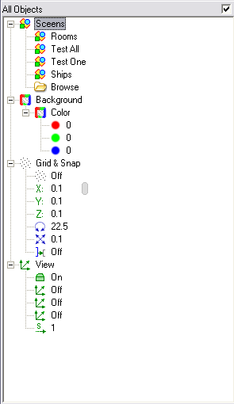
Scene Properties
Show example Scenes
Browse for (xxx.scn) and open Saved Scene
Set Scene background Color (Double Click to open Color Dialog)
Show Grid in drawing
Set Grid in x, y, and z directions
Set Angle Snap on
Set Scale Snap on
Set Object Snap on
Set Perspective Viewing on/Off
Set predefined Views (Front, Side and Back)
Set Speed from Stop to 3 times normal

Slide 19
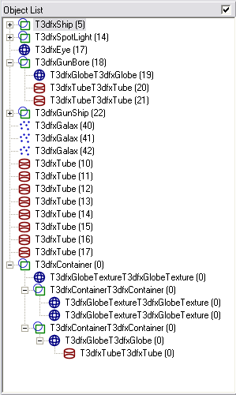
Object List
Each Object has:
  Image (Its Drawing Primitive)
  Class Name
  Unique Id
Each Object:
  Can contain other objects. These objects properties like Scale, Origin, Angles etc. are relative to its parent
A Container is a specialized object that has no own drawing primitive, it can only contain other objects.
Its not visible. Can be viewed when selected by its Bounding Box (Extent).

Slide 20
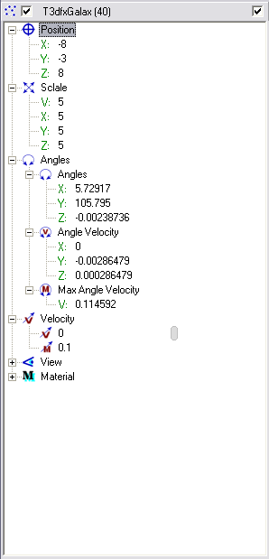
Object Properties 1
Object Position (Origin)
X, y, and z can be adjusted with slider and Snap to Grid
Object Scale
X, y, and z can be adjusted with slider and Snap to Scale Snap To
V: adjusts x, y, and z proportionally
Object Angle
X, y, and z can be adjusted with slider and Snap to Angle Snap To
DON’T WORK AT THE MOMENT
Object Angle Velocity
X, y, and z can be adjusted with slider and Snap to Angle Snap To
Double Click will set Zero angle velocity
Object Angle Velocity Max
Sets the maximal angle velocity for object
Object Velocity
Sets the velocity in View Look At vector
Object Velocity Max
Sets the maximal velocity for object

Slide 21
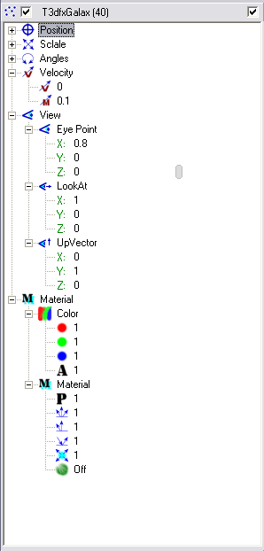
Object Properties 2
Object View
All objects can act as an Eye
Eye Position of the object
X, y, and z can be adjusted with slider and Snap to Grid
Eye Look At vector of the object
X, y, and z can be adjusted with slider and Snap to Grid
Up vector of the object
X, y, and z can be adjusted with slider and Snap to Grid
Material Color
Red, Green, and Blue can be adjusted with slider and Snap to Grid
A = Alpha does not work
Double Click will open Color Pick dialog
Material Reflection properties
Power
Ambient
Diffusion
Specular
Transparency

Slide 22
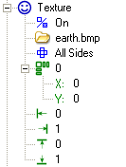
Texture
Sets Texture On/off
Browse for a Jpg or Bmp picture file.
Can have any size (256 or 512 is good)
F
Texture Style:
Front
Front & Back
All Sides
F
B
L
F
R
Multiple:
0 = Wrapping is Off
1..N = Wrapping is On
U
B
D
Wrapping Offsets in X and Y.
Only when Multiple > 0
Adjustment of start and end X/Y texture mapping.
Only when Multiple = 0

Slide 23
Cube Texture
F
U
L
F
R
F
B
B
L
F
R
D
U
B
D

Slide 24
T3dfxTriComp object and edit Vertexes
T3dfx
Rect
T3dfx
Cube
T3dfx
Tube
T3dfx
Globe
TriStripe’s Subclasses
T3dfx
TriStripe
Abstract class TriStripe
Vertex List holding all Vertexes for this object
T3dfx
TriComp
Class for managing Triangle Stripes with edited Vertexes
Can be both Normal or Textured
TVertex
TVertexList
TVertex:
Position Vertex Position
Normal Normal Position
Color Position COlor
Tu, Tv Texture Mapping
objVb
Vertex Buffer for Rendering of Type:
vbNormal (Position & Normal)
vbTexture (Position, Color, Tu, Tv)
CopyVbToDraw:
The Original (TVertexList) hold all types of Vertexes.
Depending on Vertex Buffer Type the right type of data is copied to the Drawing Vertex Buffer
Also Wrapping (Multiple X/Y) is handled when copying to Drawing Buffer
Save / Load
Component
File

Slide 25
Components
Component
A Component is Stored as a File
Properties of Instances can be changed:
  Origin
  Scale
  Center
  Angle, Angle Velocity etc.
  Velocity etc
  View etc.
Properties inside the Component cant be changed:
  Color, Material, Size, Name
  Node Numbers
  Texture and properties
  Object structure etc.
If the Properties of the Component is changed this is reflected in all its occurrences
The internal Components and their structure can not be changed
Each instance of a Component is implemented as a Read only Xxxx Object.
The Component can be opened by using an Open/Edit command. All other Instances are changed at the same time.
In Object List only the Base Object representing the Component is visible, its sub objects is not shown
When picking only the Base Object can be selected.
One can make a Copy of it.
T3dfx
Scene
T3dfx
CompInst
T3dfx
CompInst
Component
Instance
Component
Instance
Matrix Flow for
Drawing &
Picking
T3dfx
CompType
Component
Type
T3dfx
Object
T3dfx
Object

Slide 26
Render Call Chain
Move Call Chain
Identity
Matrix
T3dfx
Scene
Move:
A Move can occur on any Object level, by User or Angle Velocity, Velocity etc.
A Move must be propagated upwards and the combined Extent for each object above must be recalculated
A Move will not affect the moved object own Extent only its World Matrix.
A Matrix Change will not be propagated downwards to its Children. Only Absolute World Matrix is changed, but that is set by each rendering anyway.
Method:
The Scene will Call Move on all its Objects
These in their turn will propagate the Move call to all its children, that will…
The Move call will only Change the angle, scale etc. properties and set objRecalc to true.
The the ReCalc call is made after the Move will
Changed Vertices:
A Vertex can be changed on any Object level, by User changes some property etc.
When a Primitive’s geometry is Changed its own Extent must Change, and all objects above in the Chain must recalculate their Extents
When Rendering the Scenes World Matrix (identity) is multiplied with the World Matrix of each Object down the line before rendering its primitives
Has 1
T3dfx
Object List
Matrix is calculated on:
  Centering (x, y, z)
  Scale (x, y, z)
  Angle (Quaternion)
  Origin (x, y, z)
Any time these change its World Matrix need to be recalculated
Has N
objWM
Matrix
T3dfx
Object
Primitive
Vertex
Extent
Has 1
Vertexes are calculated on:
  Size (x, y, z)
  Texture (Offset, Mult…)
  Resolution
Each time any of these change the Extent need to be rebuild.
T3dfx
Children
The Primitives of an Object are in Model Space Vectors
Has N
objWM
Matrix
T3dfx
Object
Primitive
Vertex
Extent
Move & Rebuild dependencies

Slide 27
Finding the area of a Projected Rectangle
Points:
  pL = Point with Min X
  pR = Point with Max X
  pT = Point with Max Y
  pB = Point with Min Y
pT
pL
pR
+Y
pB
+X
Total Area =
Left Bottom occlusion area:
(pB.x – pL.x) * (pL.y-pB.y) / 2

Slide 28
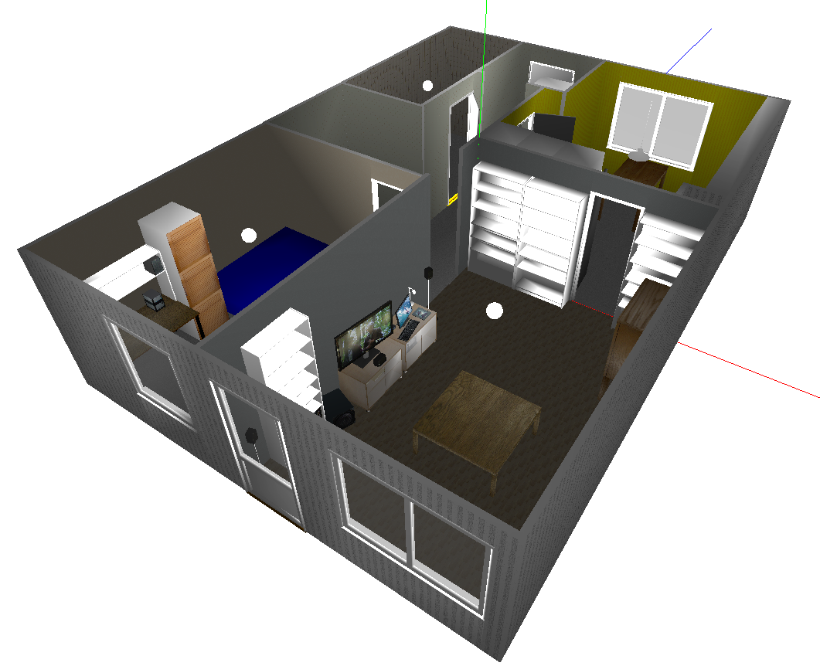

Slide 29
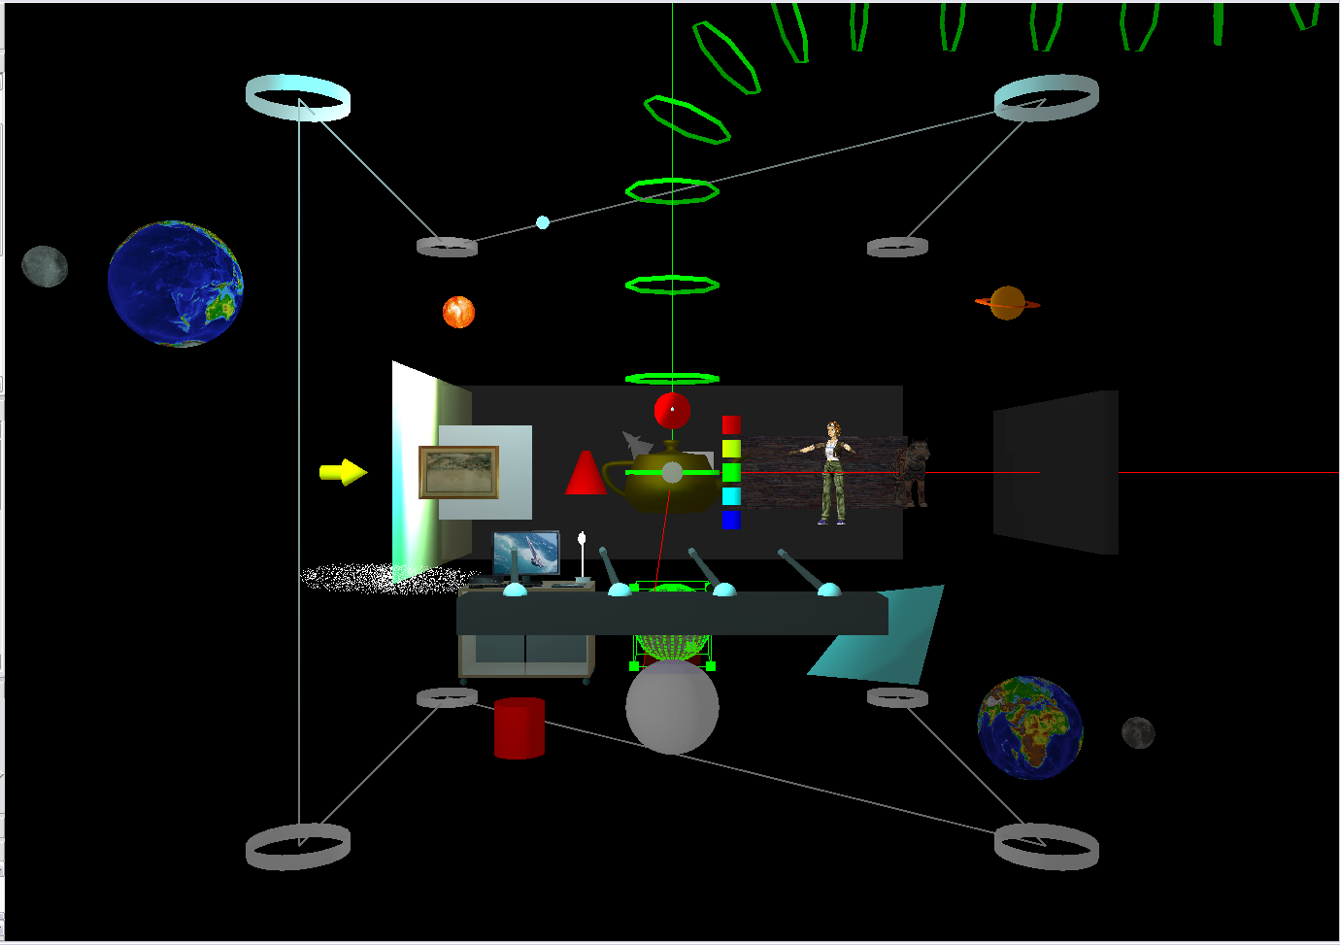

Slide 30
+X
413,364
3.71,7
0
60
78
40
20
40
60
63
34
16
91
364
111
399
273
176
263
43
82
363
406
178
60x60
160
190
62
178
228
556
60x60
34
0.34,4.06
41
0,241
98
40
60x60
135
413,34
52
71
0,194
47
88
421
12
+Z
0
171
83
0
-Z
413,-18
34
157
7x8
42
93
37,241
82
0.07,1.42
129
0.49, 5.63
171+7=178
82
86
43
136
413,-116
20
10
117
0.97,1.42
413,-143
-1.36,+2.41
-136,211
-136,+129
142
149
301
17
172
1.66, 5.63
398
1.36,-0.50
211
142
165
189
407
3.08,-0.47
308
0
3.08, 5.63
3.08,1.42
3.14,135+7+7=1.49
WallThk = 7
-X
Origo
WallHgt = 238

Slide 31
Scout Ship Actions
Action: Search For Enemy
1) Initiate Calculates how far it can travel before turning home
2) Out of Zone Sets new Random Position to go to
3) Reach Target Sets new Random Position to go to
4) Reach MaxDist Goes Home to Mother and tell her need more energy
5) Beacon Dist Drops a New Beacon with Msg 'Knows Mother'
6) Finds Enemy Goes Home to Mother and tell her Enemy was Found. Also Drops a Beacon with Msh 'Know Enemy' here
When Mother has enough Energy it will Launch a Scout Ship
(Energy > Mother Scout Energy)
M
At Beacon Interval to be used when going Home
S
First
A
Mother Ship
Drop
Msg: Knows Mother
Out of Energy
B
Beacon
Enemy Found
Update
Msg: Knows Enemy
Msg: Scout Need Energy
A
A
Action: Report No Enemy
Goes Home to Mother
Tells Mother: Scout Need Energy
Action: Report Enemy Found
Goes Home to Mother
Tops Off Beacon Energy, so Bomber can find Enemy
Adds Msg: Knows Enemy to Beacons in path
Tells Mother: Scout Found Enemy
Msg: Scout Found Enemy
Action: Go Home
This Action take a Ship Back to its Mother. Uses Track Random Base
1) If Out of Energy, it will be destroyed
2) If Mother is within Reach, it will Track to That
3) Else it finds the Beacon with Msg: ‘Knows Mother’ nearest to Mother and Track to That
4) If none is found, it will continue in the direction

Slide 32
Scout Ship Actions
Process: Search Enemy
M
Beacon Dist -1
S
Beacon Dist (3u)
S
Beacon Dist (3u)
S
S
Search Range (5u)
E
B
C
D
E
A
B
B
B
B
Enemy Known = true
Enemy Mother Dist = Cur Dist
Enemy Power = Enemy Power
Enemy Dist = 0
Beacon Dist = 1
Beacon Set = Unique Set
Top Beacon To Get Home:
Mother Known = true
Mother Dist = Cur Dist
Hit Trap (0.5 u)
Process: Go Home
Mother Dist
Enemy - Mother Dist
M
Beacon Dist -1
S
Beacon Dist (3u)
S
Beacon Dist (3u)
S
S
Search Range (5u)
E
D
C
B
A
B
B
B
B
Beacon Dist = 1
Beacon Set = Unique Set
Top Beacon To Get To Enemy:
Enemy Known = true
Enemy Dist = (Ship Enemy Mother Dist) – Beacon Mother Dist
Enemy Power = Ship Enemy Power
Top All Near Beacons within
Beacon Dist
Searching Trap for Beacons must be at least Beacon Dist + Hit Trap + Margin

Slide 33
Scout Ship Going Home
Hit Trap (0.5 u)
Process: Go Home
Mother Dist
Enemy - Mother Dist
Enemy
M
Beacon Dist -1
S
Beacon Dist (3u)
S
Beacon Dist (3u)
S
S
Search Range (5u)
E
D
C
B
A
B
B
B
B
Beacon Dist = 1
Beacon Set = Unique Set
Top Beacon To Get To Enemy:
Enemy Known = true
Enemy Dist = (Ship Enemy Mother Dist) – Beacon Mother Dist
Enemy Power = Ship Enemy Power
Drop a Beacon when Enemy was found
Searching Trap for Beacons must be at least Beacon Dist + Hit Trap + Margin

Slide 34
Scout Ship Going Home
Scout Ship finds the Beacon closest to Mother within Beacon Reach distance
Scout Ship tracking to a Beacon
Beacon Interval + Hit Dist
Energy given to Scout from Mother (200)
Beacon Next
Beacon Last
Beacon Cur
M
S
B
B
S
B
3.0
0.8
Will be killed
Mother Ship
Scout Ship to Beacon Hit Distance (0.8 U)
Beacon Interval (static) Distance (3.0)
Scout Ship to Beacon Hit Distance (0.8 U)

Slide 35
Scout Ship Distance Calculations
Action:
Calculate Max Distance
Get a Random Position in Zone
Drop Beacons at fixed Intervals
Give the Beacons Energy o they live Scout needs them to go home again
Scout was given Energy from Mother and need to calculate how far it can travel on this Energy
Max Distance travel (Forward + Back)
Energy given to Scout from Mother (200)
Scout Velocity (static) Distance / Second (2.0)
Scout Cost Per Dist (static) Energy / Dist (1.0)
Turn Home
M
S
B
B
B
Mother Ship
Beacon Interval (static) Distance (3.0)
Scout Cost Per Beacon Interval =
2 * Beacon Interval * Scout Cost Per Dist = 2 * 3 * 1 = 6 E
Beacon Cost Per Sec (static) Energy / Second (0.01)
Beacon Cost Per Beacon Interval Traveled away from it =
Beacon Cost Per Sec (0.01) * (Time for traveling 1 Beacon Interval away & back) =
0.01 * (2 * Beacon Interval (3.0) / Scout Velocity (2.0)) = 0.01* 2 * (3 / 2) = 0.03 E
Method: Iterate 1 Beacon Interval forward until Energy Cost is Higher than the Available Energy
ITER = 0
Repeat
Inc (ITER)
// Add Cost of the Scouts Traveling this Distance and back
Energy Cost = ITER * 2 * Beacon Interval (3.0) * Scout Cost Per Dist (1.0) = ITER * 6
// Add the Cost of all Beacons needed (ITER) to be added
For IND = 1 to ITER do
Energy Cost = Energy Cost + IND * Beacon Cost Per Beacon Interval Traveled away from it = IND * 0.03
Until (Energy Cost > Energy Available)
Max Distance = (ITER – 1) * Beacon Interval (3.0)

Slide 36
Scout Ship Have Found Enemy and Goes Back
Action:
It Needs to Add a Found Enemy Message and Top Off its Energy so the Bombers can use it to get back to Enemy Mother
Distance between Mother and Enemy Mother is known
Energy given to Scout from Mother (200)
Bomber Velocity (static) Distance / Second (3.0)
Bomber Cost Per Dist (static) Energy / Dist (2.0)
Turn Home when Enemy Mother is Found
Enemy Mother
M
B
b
b
b
EM
S
Beacon Interval (static) Distance (3.0)
Bomber Cost Per Beacon Interval =
2 * Beacon Interval * Bomber Cost Per Dist = 2 * 3 * 2 = 12 E
Number Of Beacons is Known
Beacon Cost Per Sec (static) Energy / Second (0.01)
Beacon Cost Per Beacon Interval Traveled away from it =
Beacon Cost Per Sec (0.01) * (Time for traveling 1 Beacon Interval away & back) =
0.01 * (2 * Beacon Interval (3.0) / Bomber Velocity (3.0)) = 0.01* 2 * (3 / 3) = 0.03 E
Calculate How Much Energy Each Beacon must have for the Bomber to Reach it before its Energy is out.
Each Beacon knows its Distance to Mother Ship. Got That when it was Dropped by a Scout)
The Time for the Bomber to Reach the Beacon is = Beacon to Mother Dist (U) / Bomber Velocity (U/S)
Energy Needed on each Beacon is = Beacon Cost Per Sec (E/S) * Beacon to Mother Dist (U) / Bomber Velocity (U/S)
If Mother cant launch a Bomber because to Low Energy we add a Margin of 10 Seconds = 10 * Beacon Cost Per Sec for all Beacons
We should really have calculated this into the formula for sending out Scout Ships

Slide 37
Bomber Going to Enemy Mother
Rocket Time Interval (2.0 S)
Distance To Enemy Mother (known from Scout)
Energy given to Bomber from Mother (350.0)
Bomber Velocity (static) Distance / Second (3.0)
Bomber Cost Per Dist (static) Energy / Dist (2.0)
Rocket Cost (static) E (10.0)
M
B
b
b
B
EM
Rocket
Enemy Mother
Beacon Interval (static) Distance (3.0)
Bomber Cost Per Beacon Interval =
2 * Beacon Interval * Scout Cost Per Dist = 2 * 3 * 1 = 6 E
When Going To Enemy Mother the existing Beacon is Topped Off to enough Energy to be able to use it going home again
Beacon Cost Per Sec (static) Energy / Second (0.01)
Beacon Cost Per Beacon Interval Traveled away from it =
Beacon Cost Per Sec (0.01) * (Time for traveling 1 Beacon Interval away & back) =
0.01 * (2 * Beacon Interval (3.0) / Scout Velocity (2.0)) = 0.01* 2 * (3 / 2) = 0.03 E
Method: Iterate 1 Beacon Interval forward until Energy Cost is Higher than the Available Energy
ITER = 0
Repeat
Inc (ITER)
// Add Cost of the Scouts Traveling this Distance and back
Energy Cost = ITER * 2 * Beacon Interval (3.0) * Scout Cost Per Dist (1.0) = ITER * 6
// Add the Cost of all Beacons needed (ITER) to be added
For IND = 1 to ITER do
Energy Cost = Energy Cost + IND * Beacon Cost Per Beacon Interval Traveled away from it = IND * 0.03
Until (Energy Cost > Energy Available)
Max Distance = (ITER – 1) * Beacon Interval (3.0)

