Slide 1

Facial emotion recognition

Slide 2
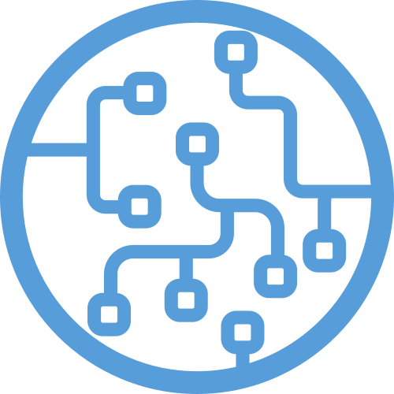
Agenda
Intro
Project
Product
Algorithms
Presentation
Conclusion

Slide 3
About Machine Learning
Find algorithms/methods to perform certain tasks independently;
Used for tasks such that any rule-based approach is unfeasable.
Data
Intelligence
ML Method
Hypothesis Space
(Model & Parameters)
Loss function
(Optimization Algorithm)
Task
Evaluation

Slide 4
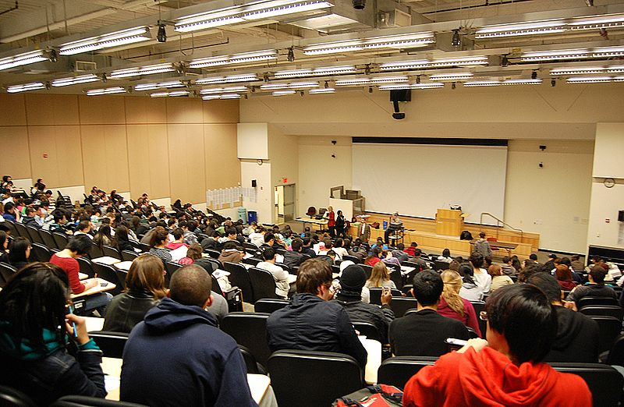

Let’s get concrete
Pandemic
How to see if your students are falling asleep?
Use machine learning for facial emotion recognition, aka Our Project!
Notes:
Timo:
Hier können wir die Story bzgl. veränderter Situation erzählen.

Slide 5
Goals
Learn to work together: management and organization + GIT.
Research different ML methods: which suits a given task best?
- Write a document in Latex about the acquired knowledge.
Implement at least one ML algorithm in Python and optimize its accuracy:
- Costumer requirement: classify emotions of faces in an input image.

Slide 6
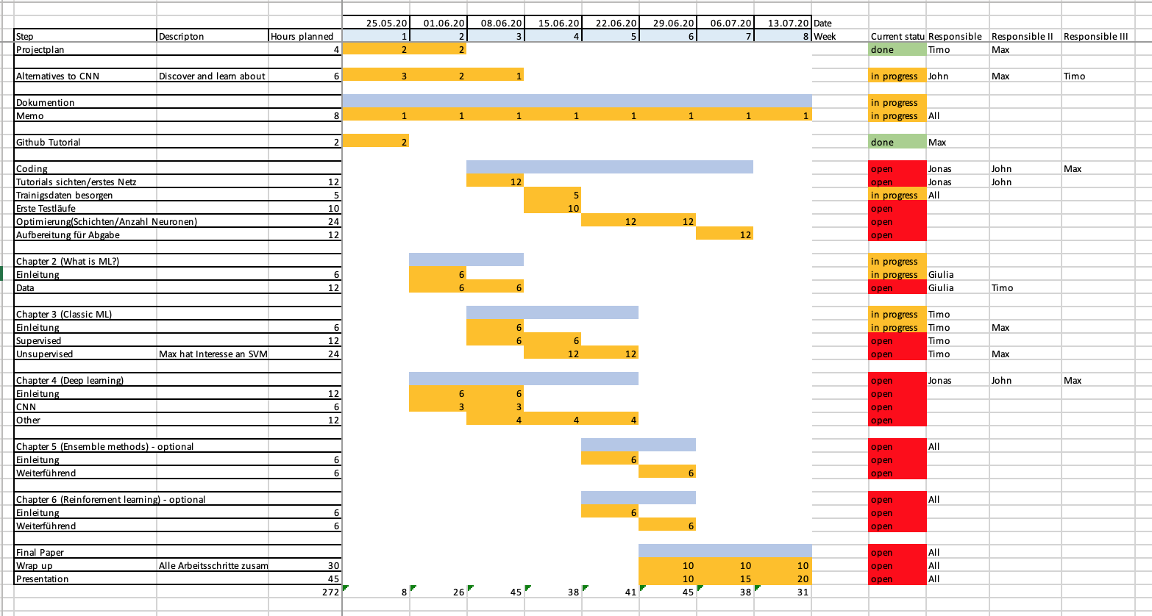
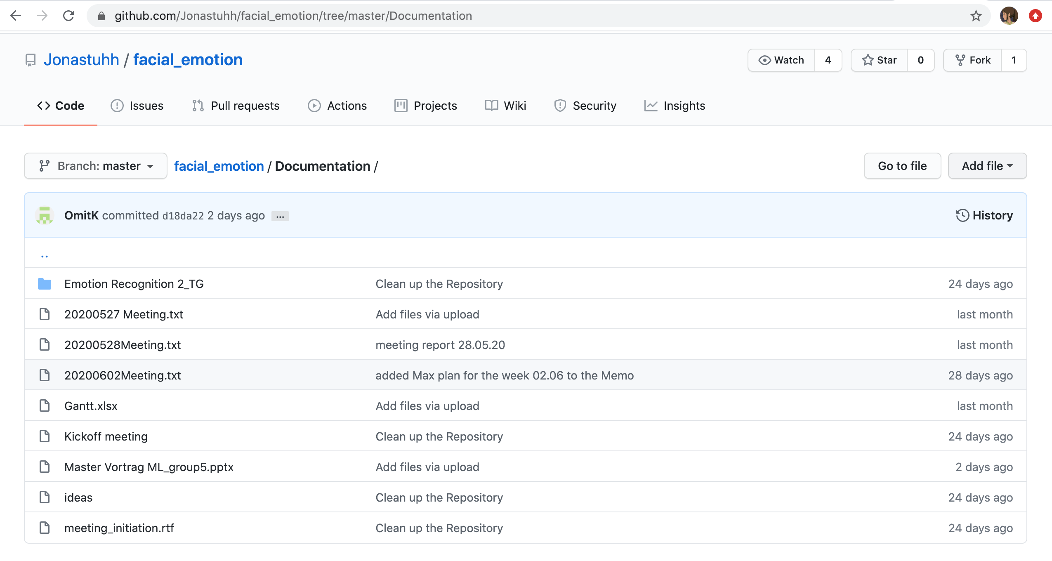
Results
Learn to work together: management and organization + GIT.
- Gantt chart, weekly meetings, communication via Whatsapp.

Slide 7
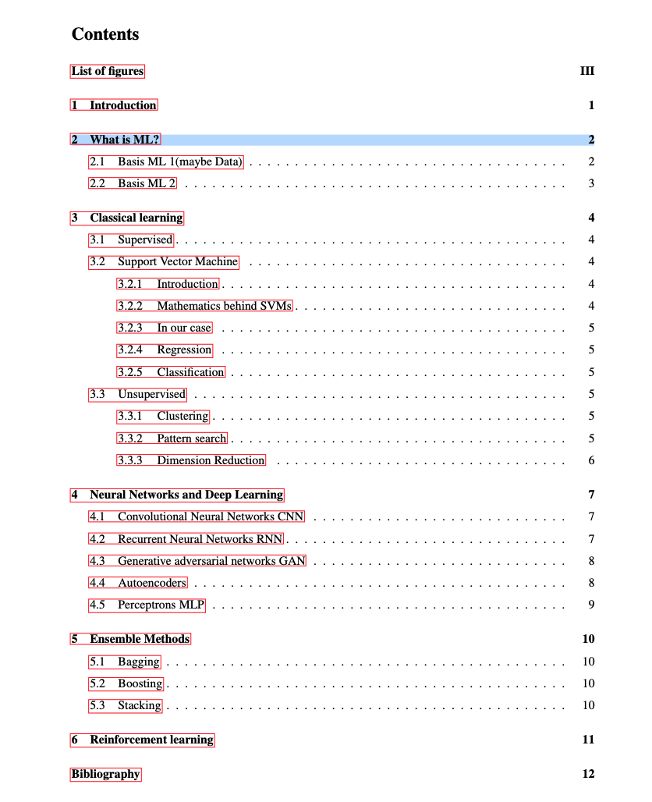
Results
Research different ML methods: which suits a given task best?
- Write a document in Latex about the acquired knowledge.

Slide 8
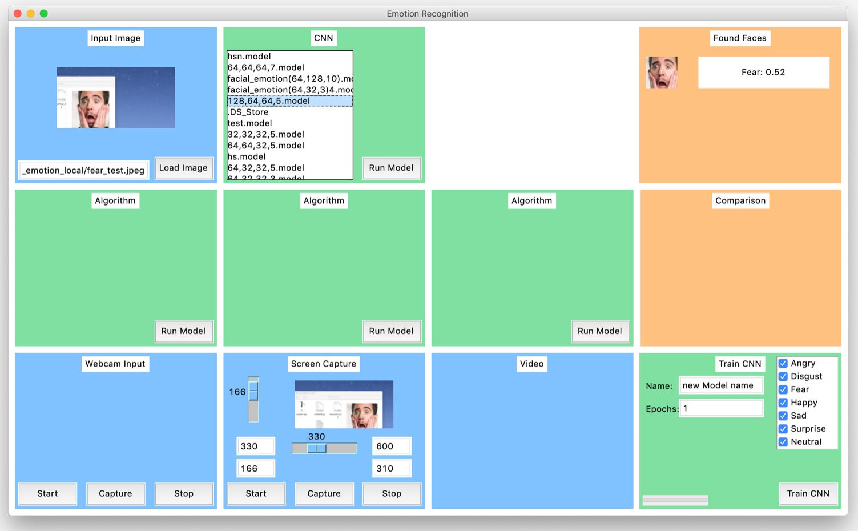
Results
Implement at least one ML algorithm in Python and optimize its accuracy:
- Costumer requirement: classify emotions of faces in an input image.
Responsible | Hyp Space
John | KNN
Jonnas | CNN
Max | SVM
Timo | Ada Boost
GUI developed by Jonnas.

Slide 9
Product

Slide 10
Algorithms Start
Here we should give an overview of our algorithms. Also we should mention that we implemented CNN because its normaly the common solution for this problem, but wanted to have some other algorithms to compare with.

Slide 11
KNN

Slide 12
Adaboost

Slide 13
SVM

Slide 14
CNN

Slide 15
Presentation
Here we should switch to Jonas Laptop and show our tool.

Slide 16
Conclusion
Here we can wrap up the project.
What did we acchieve, what was good/bad
IMO at the beginning we were a little bit lost/unstructured but managed to implement 4 different algortihms for the same problem.
At the end, we can show our idea of realtime emotion recognition

Slide 17
Quellen Bilder:
All pictures are free for non-commercial use.
Deckblatt: https://commons.wikimedia.org/wiki/File:Emotion_Recognition_Deficit.jpg
Agenda:
https://commons.wikimedia.org/wiki/File:Hey_Machine_Learning_Logo.png
Intro:
https://commons.wikimedia.org/wiki/File:5th_Floor_Lecture_Hall.jpg
https://www.pikist.com/free-photo-sobwr
Project:
Product:

