Slide 1
CNN
convolutional
SoftPlus
Leaky ReLU
What type of layers to use?
Which activation function?
fully connected
layer size
Rectified linear unit (ReLU)
batch normalization
max pooling
Exponential linear unit (ELU)
dropout
How to prevent overfitting?
early stopping
image generator
01.07.2020
Group 5 - Facial emotion recognition

Slide 2
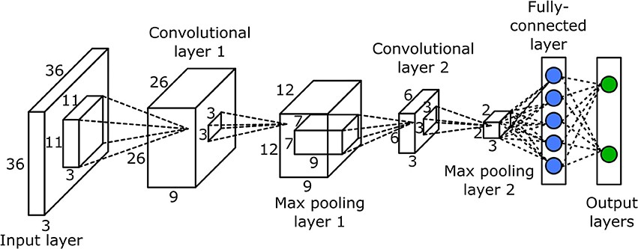
CNN architecture
Fully connected layer:
Classifies the output of the convolution and pooling process
Max pooling layer:
Reduces the complexity of a network by combining several nodes to the maximum value
Convolutional layer:
Uses convolution to find certain features in an image
01.07.2020
Group 5 - Facial emotion recognition

Slide 3
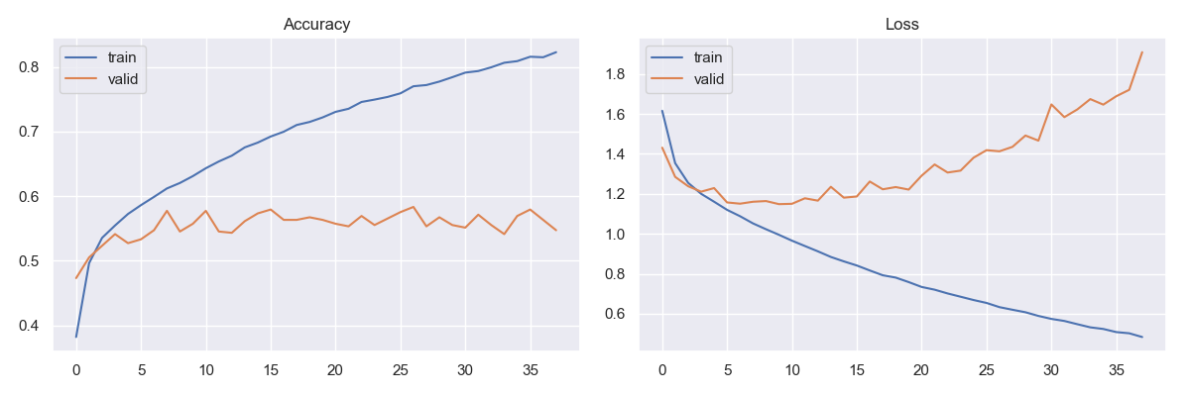
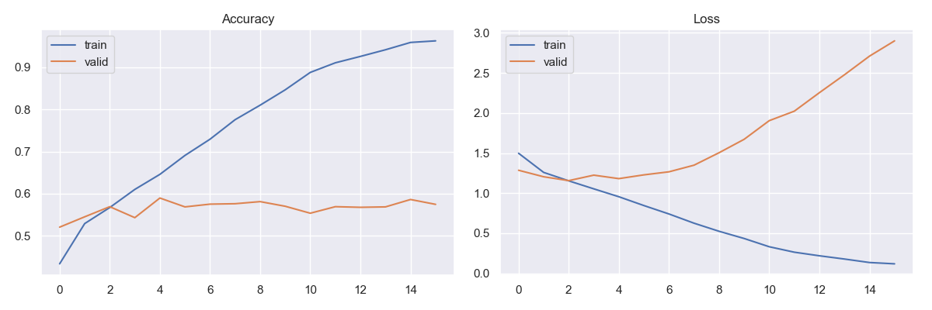
CNN
Overfitting
Training process with ELU is a lot faster
90% trainings accuracy after 10 epochs vs 80% after 30 epochs
Problem of rising validation loss function: Overfitting
ReLU
Activation function
ELU
Overfitting
01.07.2020
Group 5 - Facial emotion recognition

Slide 4
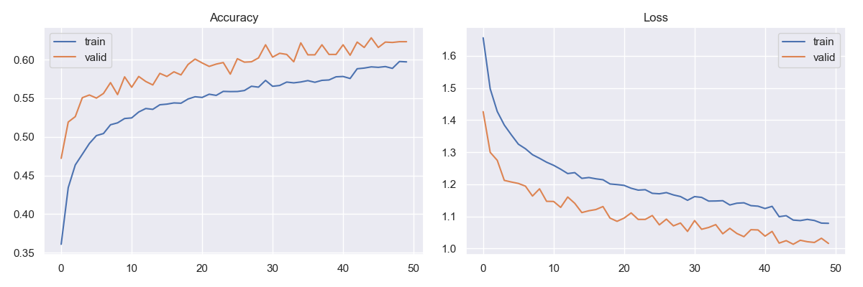

CNN
Overfitting Problem:
Image Generator
Instead of using static training data, it uses images from the trainings data that are randomly shifted, rotated, mirrored, scaled and sheared.
Early stopping and restoring weights after recognising stagnant validation accuracy / validation loss
Accuracy with Image Generator
01.07.2020
Group 5 - Facial emotion recognition

Slide 5
CNN
Overfitting Problem:
Image Generator
Instead of using static training data, it uses images from the trainings data that are randomly shifted, rotated, mirrored, scaled and sheared.
Early stopping and restoring weights after recognising stagnant validation accuracy / validation loss
Loss with Image Generator
01.07.2020
Group 5 - Facial emotion recognition

Slide 6
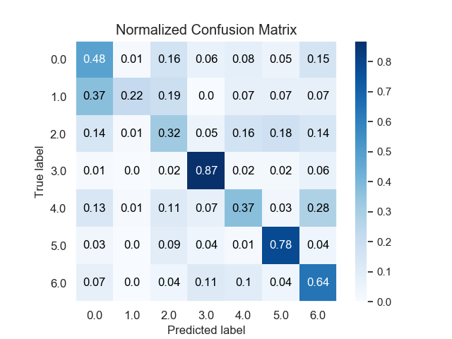
CNN
angry
disgust
62% accuracy with 7 emotions
good with happy and surprise
trouble with disgust, fear and sad
disgust is almost never predicted
least represented in data set
fear
happy
sad
surprise
neutral
01.07.2020
Group 5 - Facial emotion recognition

Slide 7
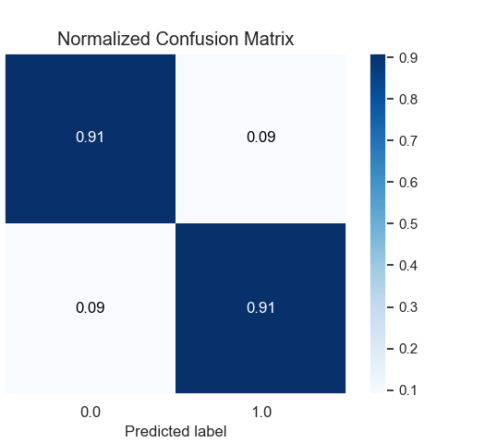
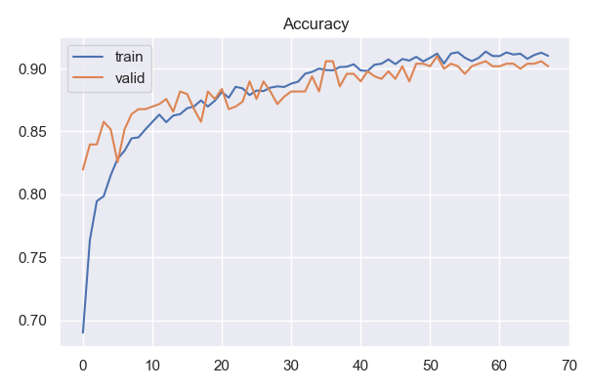
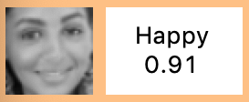
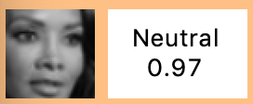
CNN
CNN trained for 2 emotions
restore weights
neutral
labeled as neutral
happy
91% accuracy with 2 emotions
many misclassifications are debatable
labeled as happy
01.07.2020
Group 5 - Facial emotion recognition

