Slide 1
The Calling: Unveiling Telemarketing Insights for Bank Long-Term Deposits
A portfolio project created by Jonatas Vieira

Slide 2
Dataset and Business problem
Data Set Information: The data pertains to the direct marketing efforts of a Portuguese bank. These campaigns relied on phone calls, sometimes necessitating multiple contacts with the same client to determine whether they would subscribe to the bank's term deposit product ('yes') or not ('no').
Problem Definition: The goal is to use all this information to predict whether someone will end up saving money with the bank. This helps the bank decide which feature to focus to get more money from the customers.

Slide 3
Data Source
This dataset describes the results of Portugal bank marketing campaigns. The campaigns primarily involved direct phone calls, where clients were offered the opportunity to place a term deposit with the bank.
If a client agreed to place a deposit after all marketing efforts, the target variable is marked as 'yes'; otherwise, it is marked as 'no'.
Records
45211
Features
17

Slide 4
Exploratory Data Analysis

Slide 5
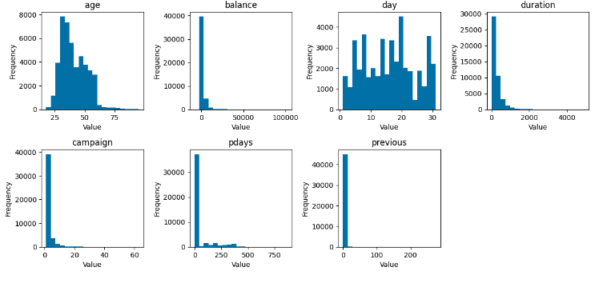
Univariate Analysis – Numerical Var.

Slide 6
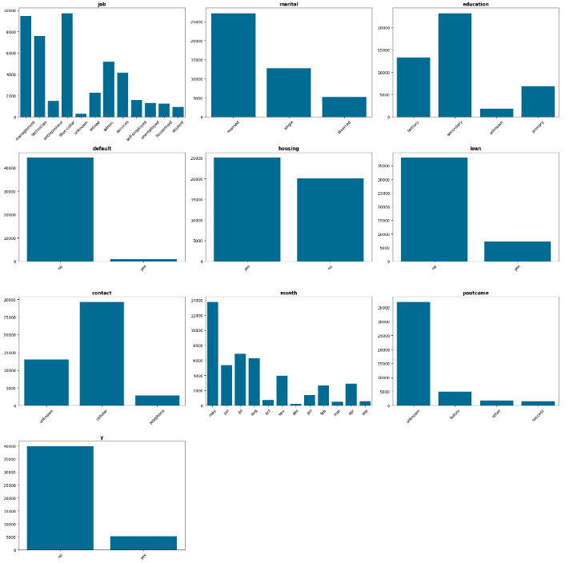
Univariate Analysis – Categorical Var.

Slide 7
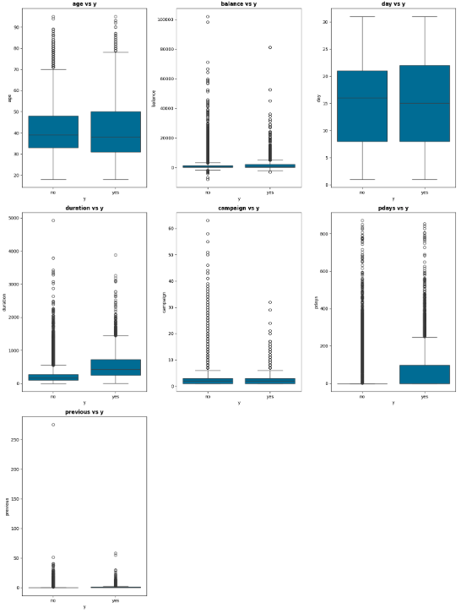
Bivariate Analysis – Numerical Var.
The longer it takes to persuade a customer, the higher the likelihood of the customer subscribing to a term deposit.
2. The younger demographic (under the age of 50-60) has a greater likelihood of subscribing to a term deposit.
Conclusions:

Slide 8
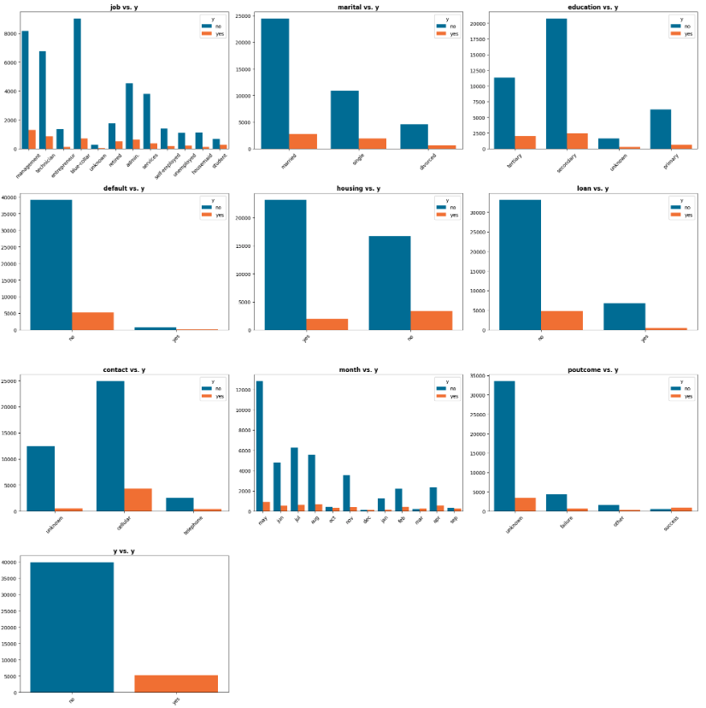
Bivariate Analysis – Categorical Var.
Cellular communication tends to be more effective in convincing customers to subscribe to a term deposit.
2. In general, managers are significantly more inclined to subscribe to a term deposit compared to individuals in other fields.
3. Single customers show a greater propensity to utilize term deposits, even though their numbers are lower than those of married customers.
Conclusions:

Slide 9
Bivariate Analysis – Categorical Var.
4. Customers without housing loans are more likely to opt for a term deposit.
5. Customers with a secondary education are significantly more inclined to utilize a term deposit.
6. Customers who have defaulted on credit payments typically do not have a term deposit subscription.
Conclusions:

Slide 10
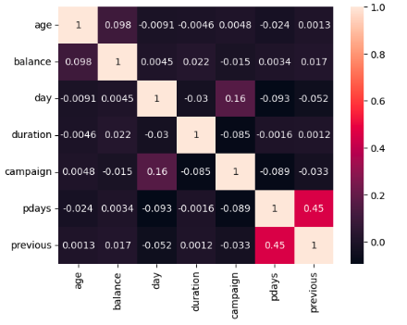
Correlation Matrix
Among numerical variables, there are no strong correlations, but pdays and previous show a moderate positive correlation of 0.45.
However, this relationship is not strong enough to indicate a direct dependency between these variables. This means that although there is some association between them, other factors may also influence their dynamics.
Conclusions:

Slide 11
Machine Learning Models

Slide 12
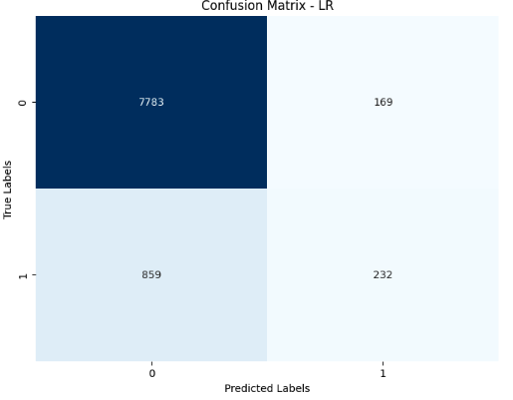
Logistic Regression – Confusion Matrix
Logistic Regression Results:
True Positive = 7783
True Negative = 232.
Also, the Logistic Regression model achieved and accuracy of 88,63%
Conclusions:

Slide 13
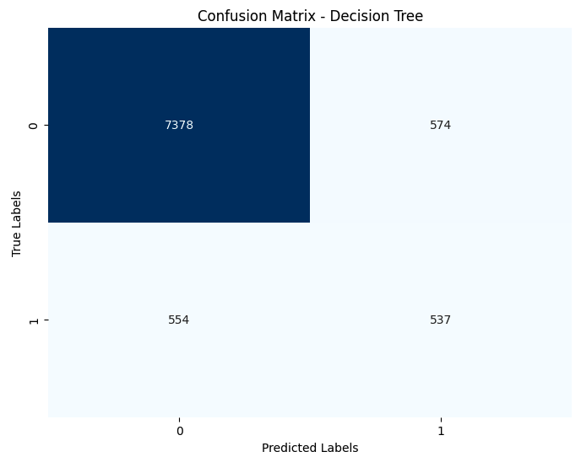
Decision Tree – Confusion Matrix
Decision Tree Results:
True Positive = 7378
True Negative = 537.
The decision Tree model scored and accuracy of 87,65%.
Conclusions:

Slide 14
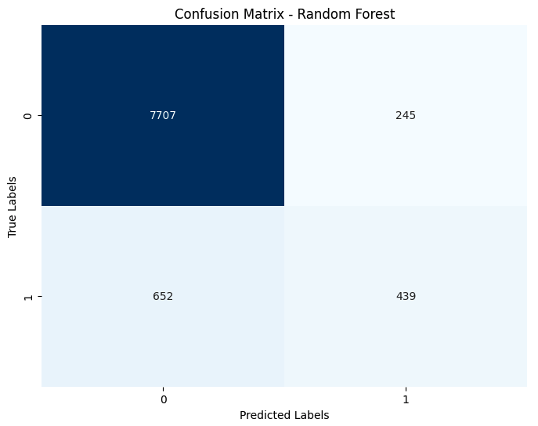
Random Forest– Confusion Matrix
Random Forest Results:
True Positive = 7707
True Negative = 439.
The Random Forest scored and accuracy of 90,15%.
Conclusions:

Slide 15
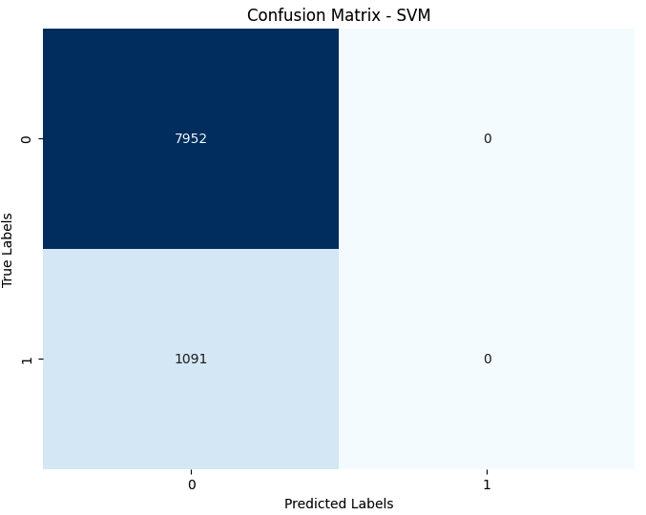
SVM (Support Vector Machine) – Confusion Matrix
Support Vector Machine Results:
True Positive = 7952
True Negative = 0.
The Support Vector Machine scored and accuracy of 87,93%.
Conclusions:

Slide 16
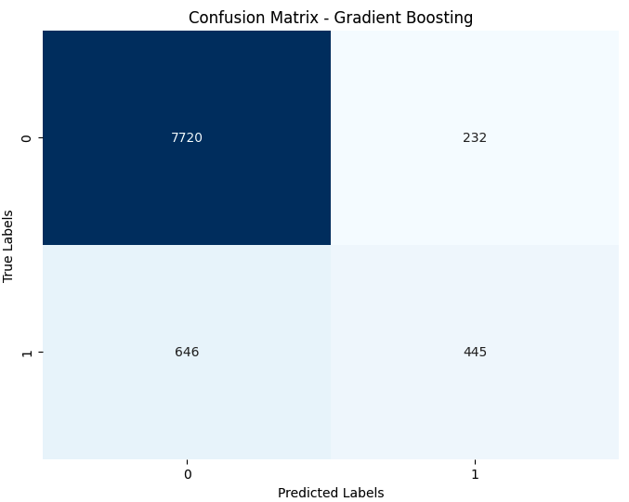
Gradient Boosting– Confusion Matrix
Gradient Boosting Results:
True Positive = 7720
True Negative = 445.
The Gradient Boosting scored an excellent accuracy of 90,29%.
Conclusions:

Slide 17
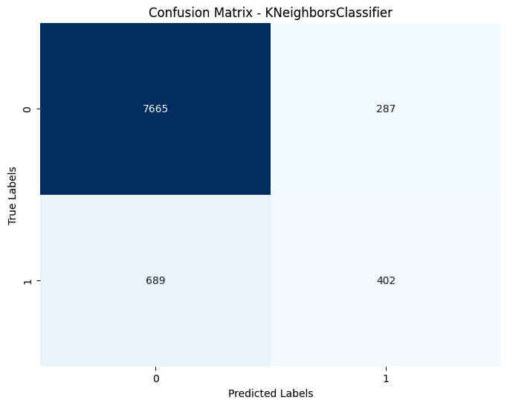
KNN (K-nearest Neighbors) – Confusion Matrix
Gradient Boosting Results:
True Positive = 7665
True Negative = 402.
The K Neighbors scored an accuracy of 89,20%.
Conclusions:

Slide 18

Naïve Bayes – Confusion Matrix
Naive Bayes Results:
True Positive = 6939
True Negative = 511.
The model scored an accuracy of 82,38%.
Conclusions:

Slide 19
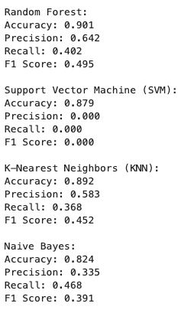
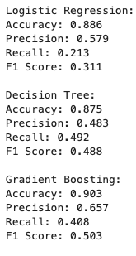
All Classifiers Report
The best models classifiers was Random Forest (acc = 0.901) and Gradient Boosting (acc = 0.903)
Conclusions:

Slide 20
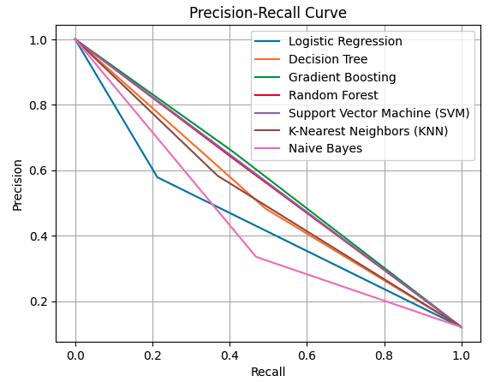
Precision-Recall Curve (All models)

Slide 21
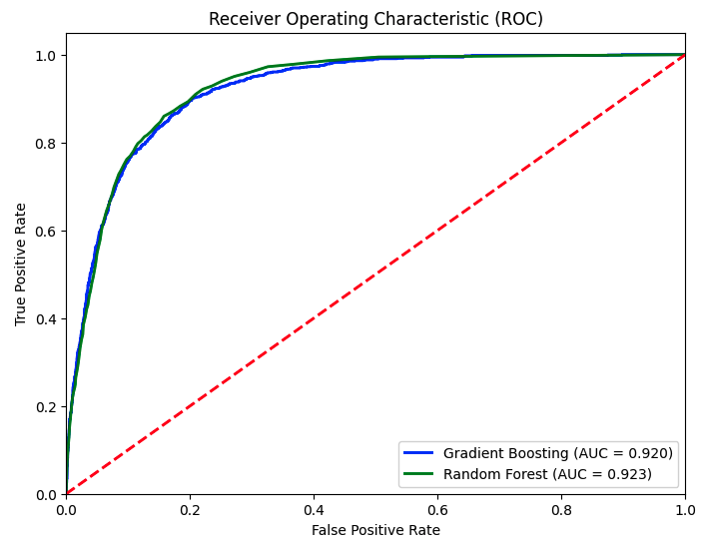
ROC Curve (Best models)

Slide 22
Feature Importance

Slide 23
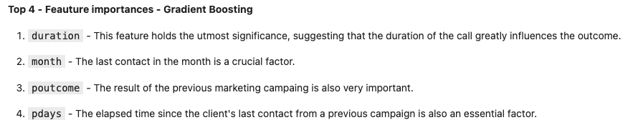
Gradient Boosting

Slide 24
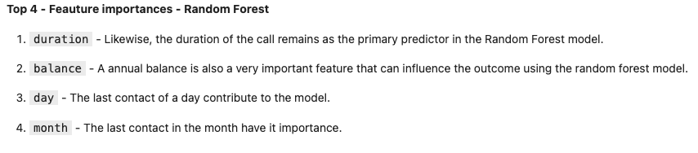
Random Forest

