Slide 1
OSTBAYE
Sci-fantasy ttRPG

Slide 2
PREMISE
PLAYERS incarnate a team sent by the Interplanetary Committee to OSTBAYE Moon
MISSION: to evaluate the moon’s potential for development as an interplanetary station

Slide 3


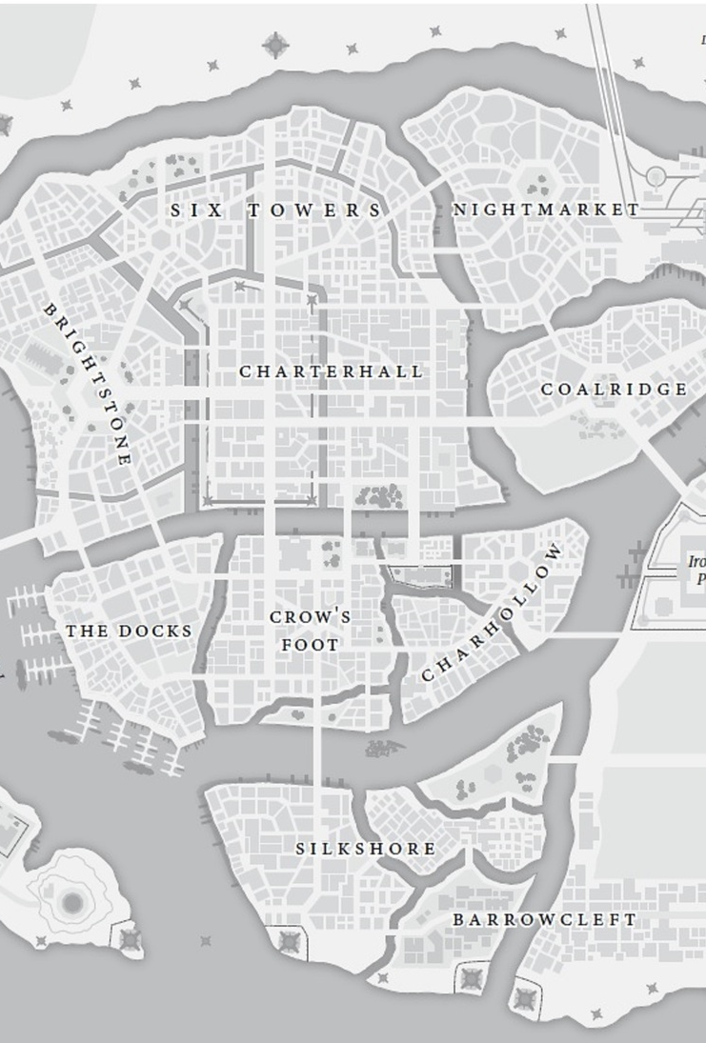
INSPIRATION BLADES IN THE DARK
Similarly, Ostbaye Moon is a set environment: it contains loosely defined elements that interact with and react to the players
Independent research teams sent by the powers behind the Interplanetary Comittee
Ostbaye fauna and flora
Other entities such as factions and powers interested in the moon.

Slide 4
IS OSTBAYE FIT FOR DEVELOPMENT
No right answer: the goal is to explore ethical and philosophical considerations
Managing the expectations of the Committee and the pressure of public opinion
Conflicts between crewmembers
The Interplanetary Committee defines sapience and prohibits the colonization of planets of planets host to sapient lifeforms. On Ostbaye, players will find lifeforms that sit in a grey zone relative to the Committee’s definition.

Slide 5
Classes
Character creation is an important step, as it decides not only the general direction you want your character to take, but also powers that may have pull on their decisions, either because of their backing or your heritage.
The classes we have made until now fill certain archetypes, and as the game we envision is quite different from blades in the dark, many of them have been geared away from combat and more towards either social or deceptive resolutions and abilities.

Slide 6
Missions
Rather than the crime based missions of blades, missions in Ostbaye are there to further the exploration of the planet, discover more about the state of the moon and further or hamper some of the faction goals present. While the goal is to be able to accomplish a lot outside of missions, the missions themselves break down as such, including the detail you will need to establish to accomplish it:
Assault: The Point of Attack
Stealth: The Entry Point
Deception:The Method
Social: The Connection
Transport: The Route
Discover: The method
Delve: The location

Slide 7
Systems
Ulitmately Ostbaye is a game and setting that revolves around balancing consequences, whether they be because of a mission or due to events that spiral out of control. On top of maintaining your character’s health and standing, the needs of the group will need to be managed within the complex web of faction ties and goals, and it may be possible that the goals of members of the team differ.

Slide 8
PLAYER CHARACTERS
OCCUPATION
Is your player a researcher, a cook, a pilot, or something else?
Most relevant during expeditions
Player’s occupation influences their abilities on the field and while operating on Ostbaye’s moon.
While characters can be freely made, certain archetypes were made to ensure we had class focuses people could take.
They are:
Survivalist
Ambassador
Technician
Guard
Field scientist
Commoner
SPECIEs
SPONSOR
mechanically relevant
Adds flavor, background
Influences the choice of sponsor
Influences the consequences of failed rolls
Who got you the opportunity to be dispatched to Ostbaye station?
The Sponsor is usually one of the powers behind the Interplanetary Committee
Players have to manage political pressure from their sponsors between missions, as well as the sway it might have on doing certain missions

